Slide 1
A Hybrid Physics–Machine Learning Coupled Model for Subseasonal-to-Seasonal (S2S) Prediction
Ufuk Turuncoglu¹ & Wessel P. Bruinsma²
(1) National Center for Atmospheric Research (NCAR), Boulder, Colorado, USA
(2) Department of Engineering, University of Cambridge, Cambridge, UK
July 23, 2026
Notes:
NOTE: Background image can be used as is or changed for a particular presentation. Click: Slide > Edit master.

Slide 2
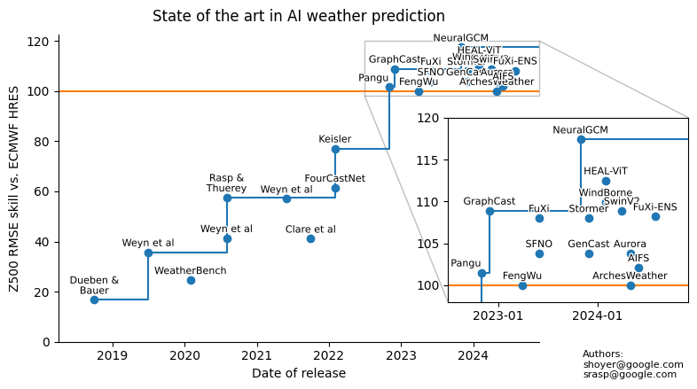
Evolution of ML Weather Prediction (MLWP) Models
Please also note that this is just a single metric, specifically the geopotential height at 500 hPa, and it represents a global average. It does not show the overall performance of the listed ML models
courtesy of Stephan Rasp

Slide 3
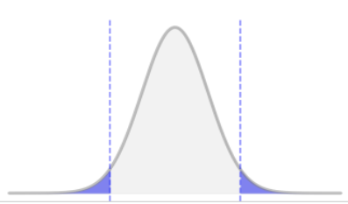
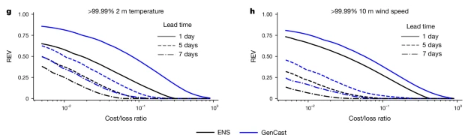
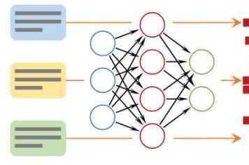
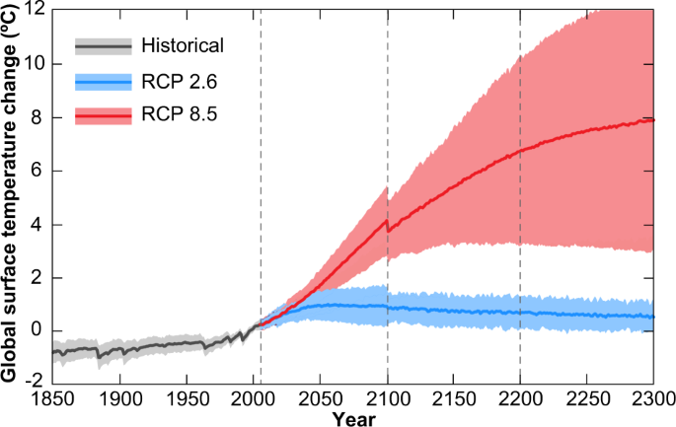
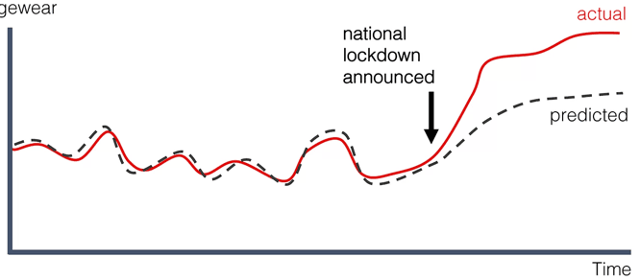

Emerging Challenges in ML-based models
It is good in tracks, but not wind and pressure extremes and smoother precipitation (negative bias) Price et al., 2024
Unable to represent rare extreme events accurately
Introducing additional components of the Earth System could help constrain AI/ML-based models and produce more physically realistic predictions.
Numerical instabilities especially for longer time scales, higher temporal resolutions
Insufficient or lack of physical constraints
Difficulties with extrapolating to new climate conditions

Slide 4
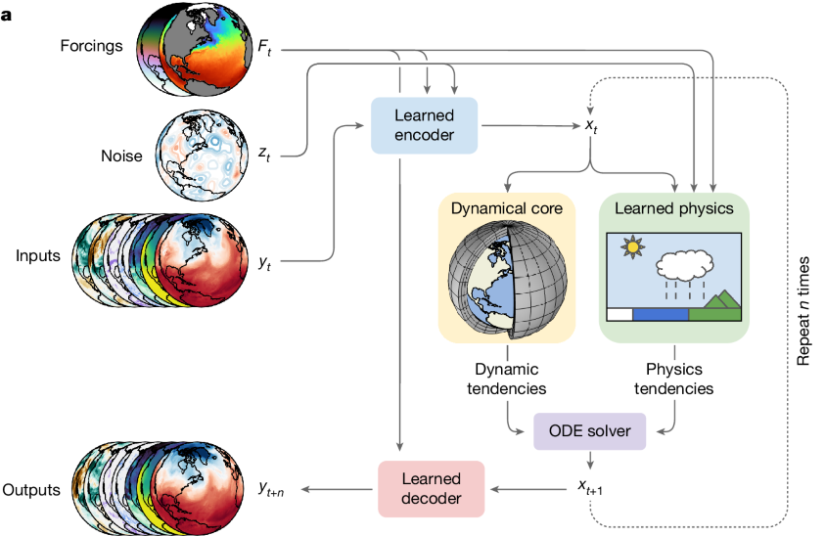
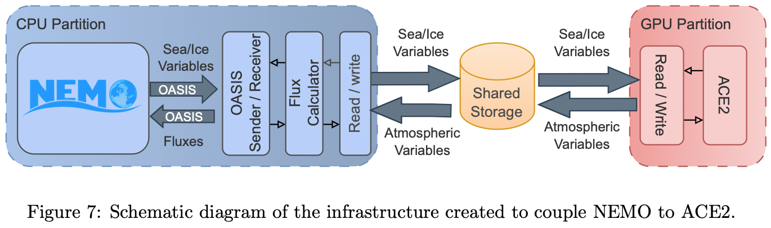
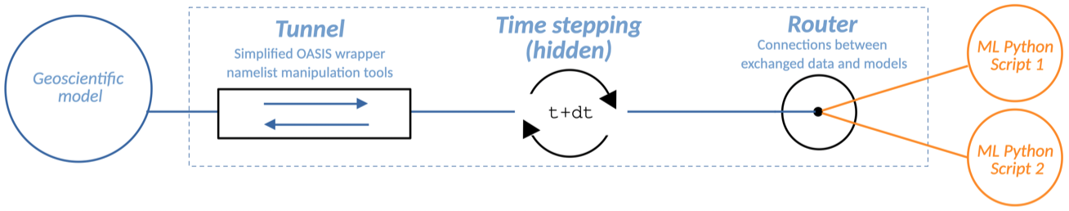
Hybrid Physics-ML Models?
Antonio et al., 2026: ACE2-NEMO: Coupling an ML atmospheric emulator to a full-depth dynamical ocean model
Kochkov et al., 2024: NeuralGCM
Traditional DYCORE coupled with AI/ML based physics
Barge et al., 2026: Deploying Machine Learning components coupled to Earth System Models with OASIS3-MCT (v6) and Eophis (v1.1)
Spencer et al., 2025: The Ai2 Climate Emulator coupled to a slab ocean accurately emulates temperature and precipitation sensitivity in a physics-based model
* Mainly designed for interfacing parameterization modules with GCMs

Slide 5
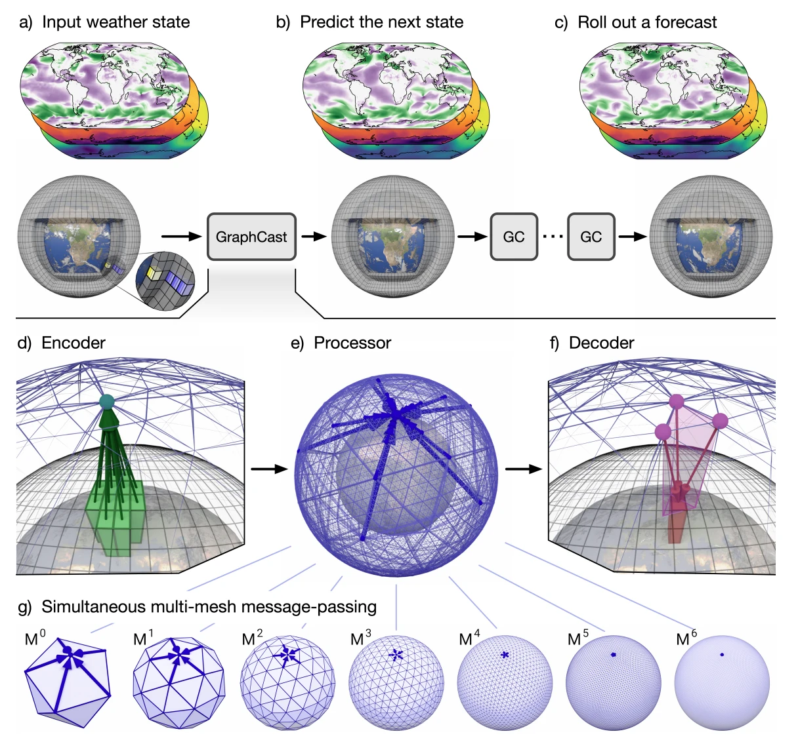

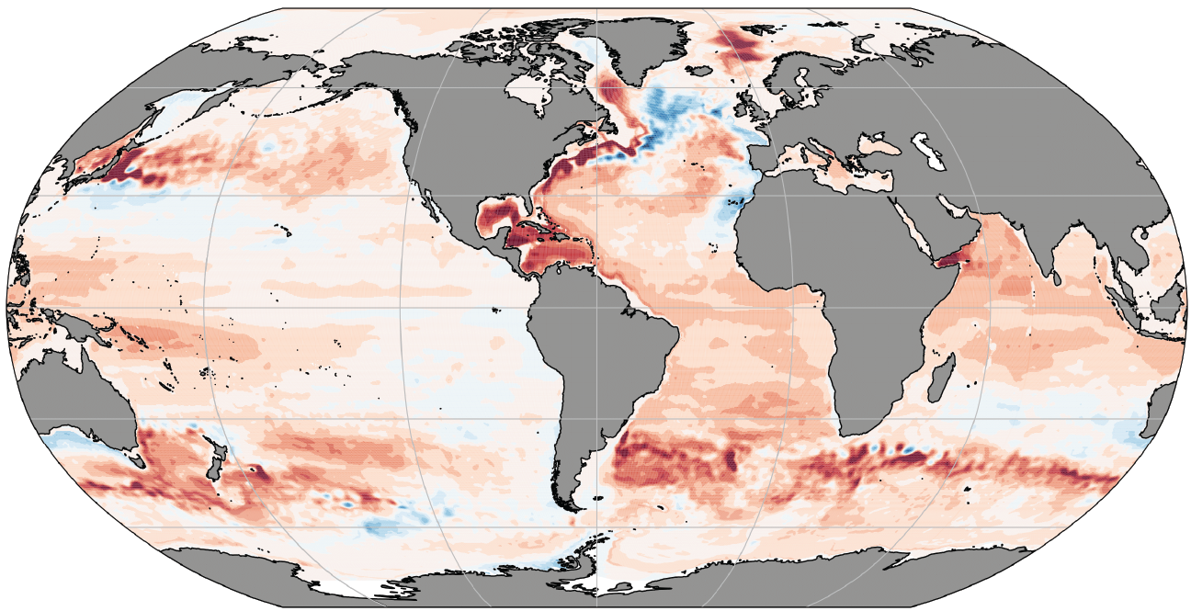
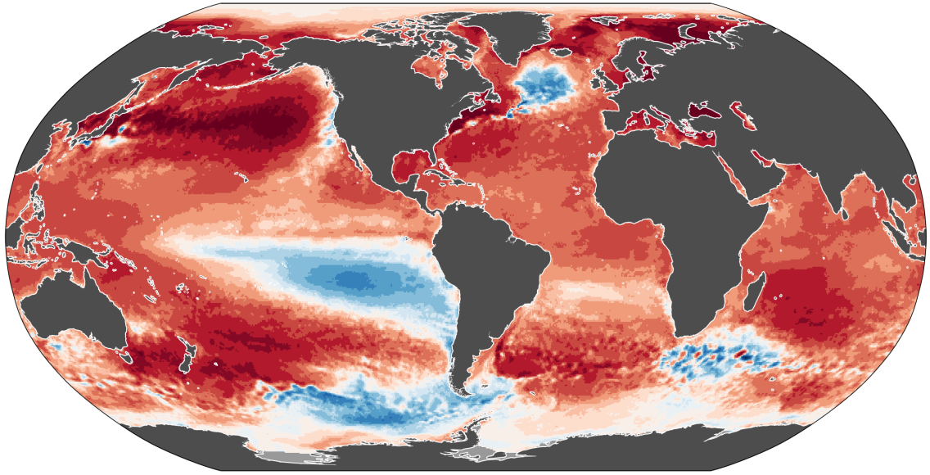
Hybrid Physics-ML Coupled Modeling System
ML Weather Prediction Model (MLWP; Aurora, GraphCast etc.)
Python
(PyTorch, …)
GPU enabled
ML-based model component/s
Input:
Time / Date
Initial Condition
(ERA5, GFS, …)
AI/ML
Model
Python
Generic, flexible, and efficient way to bridge the gap?
Fortran/C/C++
(ESMF/NUOPC)
Any ESMF/NUOPC based physical model component
(MOM6, SCHISM, CICE6, …)
Physical Model
Physics-based model component/s
Heat Content
SST
Example products from physical model (i.e ocean)
* It is application agnostic solution since other component/s will only see the generic ESMF/NUOPC component (GeoGate).

Slide 6

Bridging two worlds: GeoGate
ML Weather Prediction Model (MLWP; Aurora, GraphCast etc.)
Running ML-based model
single forecast
or
ensemble
Input:
Time / Date
Initial Condition
(ERA5, GFS, …)
ML
Model
Python
Two-way interaction:
The ML model might
have feedback from
active model component
such as surface flux components or SST
If it is ensemble run, the results can be aggregated to drive physical component such as ocean or multiple-instances can be triggered
Any ESMF/NUOPC based physical model component can be used
(MOM6, SCHISM, CICE6, …)
Physical Model
Heat Content
SST
Example products from physical model (i.e ocean)
* It is application agnostic solution since other component/s will only see the generic ESMF/NUOPC component (GeoGate).

Slide 7
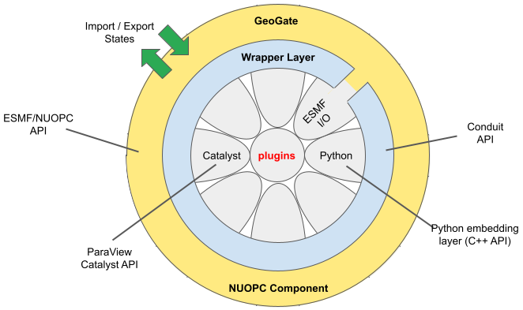
GeoGate: Generic ESMF/NUOPC Component
Interact with other
components through
its import/export states
NUOPC “cap”
Fortran
(mesh based)
Wrapper
leverages from Conduit to interact with Fortran, C, C++ and Python
Plugin for Python interaction
In situ visualization and co-processing plugin
Conduit library passes data among layers in different programming languages (Fortran, C/C++, Python)
Zero copy between NUOPC “cap” and wrapper layer - no additional memory pressure

Slide 8
Hybrid S2S Configuration
Based on UFS WM regression test (RT): datm_cdeps_mx025_cfsr
  Four component coupled system
    CDEPS [DATM] + MOM6 + CICE6 + CMEPS
    GeoGate [fine tuned Microsoft’s Aurora] + MOM6 + CICE6 + CMEPS
  The initial conditions for MOM6 and CICE6 are updated for Jan, Apr, Jul, Oct 2021 (to cover all seasons)
    Thanks to Denise Worthen and Nick Szapiro (NOAA/EMC)
  35-days long S2S timescale runs
    Two-way feedback is achieved by providing MOM6 SST to Aurora model
    Testing different inference strategies
      One-way vs. two-way, free prediction vs. constrained

Slide 9
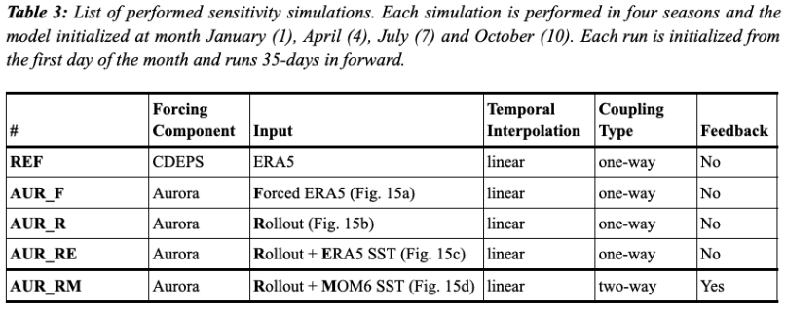
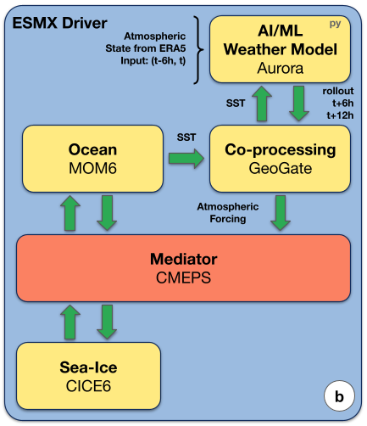
Experiments
A set of experiments are conducted with HESM-S2S to measure performance of the Aurora coupled configurations
The initial paper is submitted to JAMES and
it is under review: https://essopenarchive.org/doi/full/10.22541/essoar.15002925/v1

Slide 10
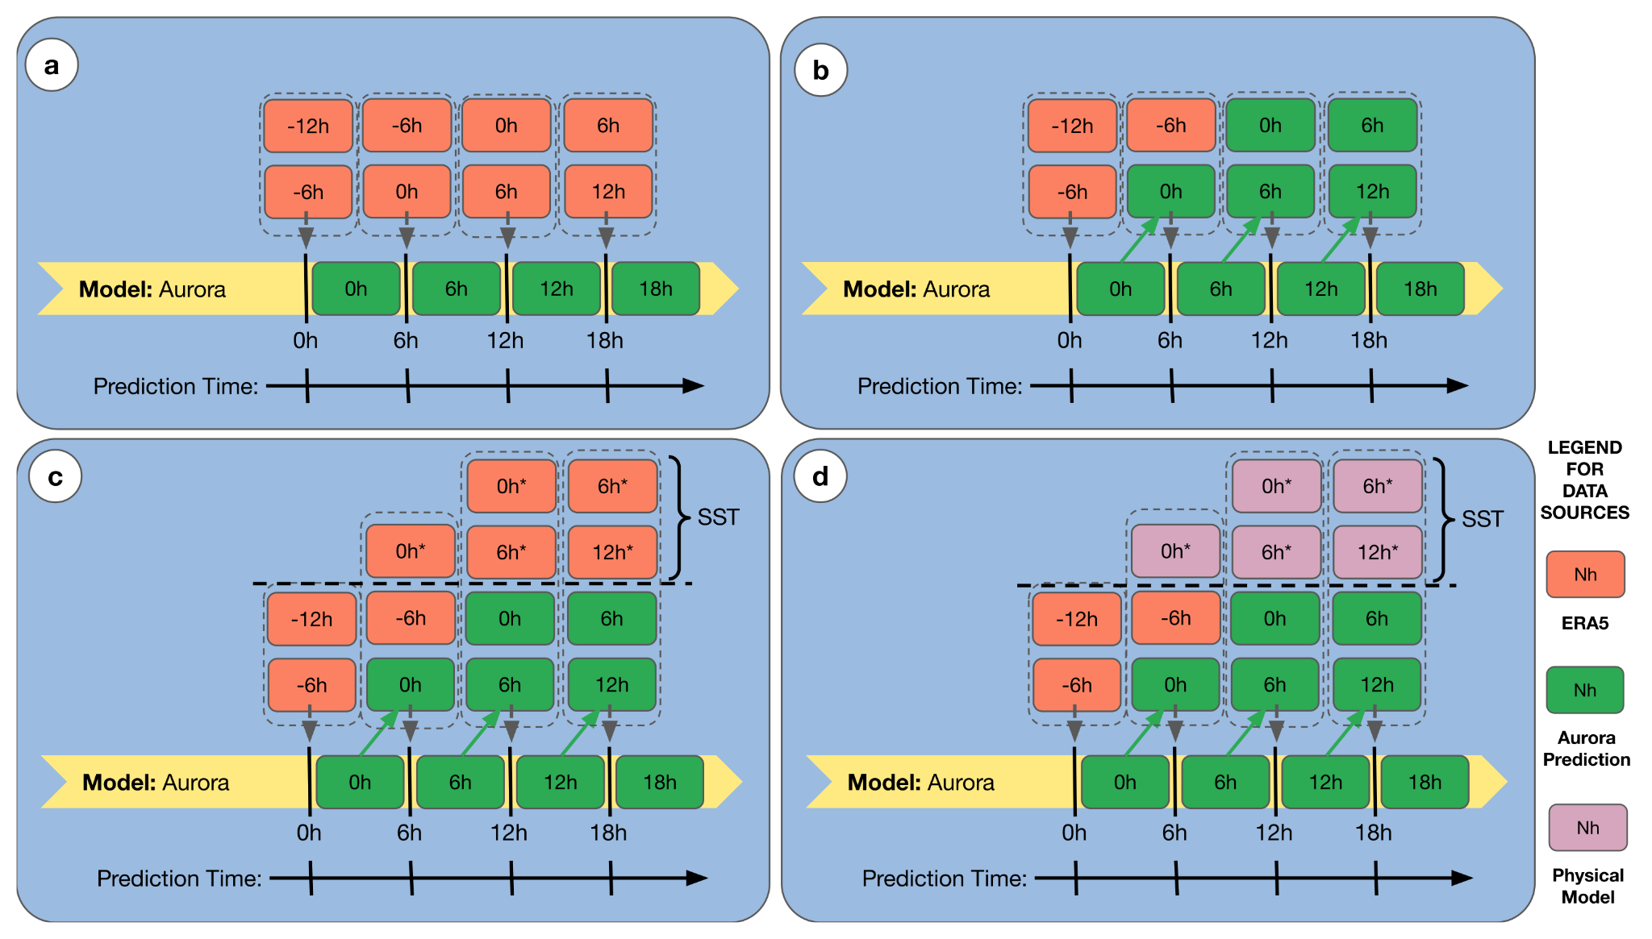
Inference Strategies
Forced prediction
ERA5
AUR_F
Perfect prediction
AUR_R
Perfect prediction constrained with ERA5 SST
AUR_RE
Perfect prediction constrained with MOM6 SST
AUR_RM

Slide 11
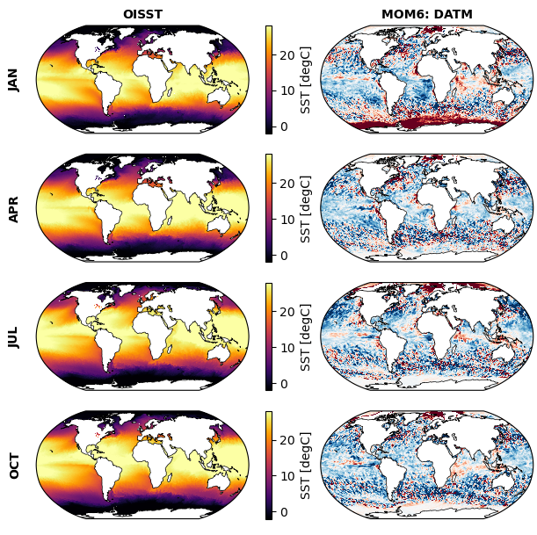
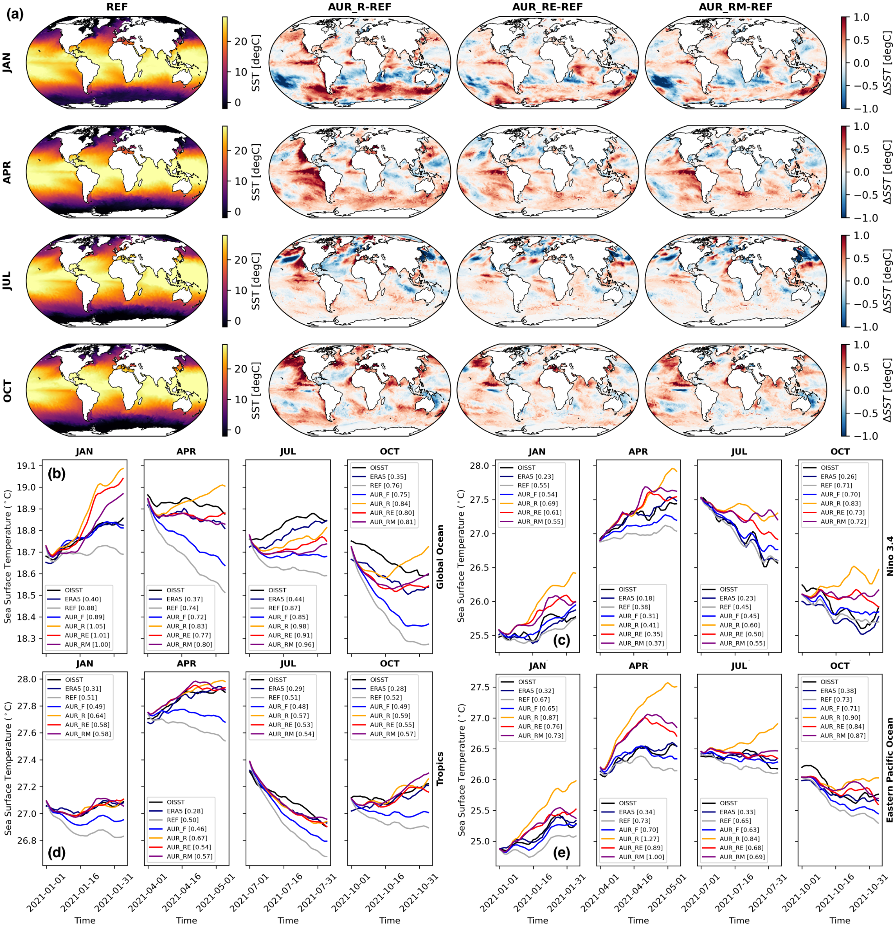
Sea Surface Temperature from MOM6
SST feedback is reducing bias
respect to AUR_R
Comparison against REF and OISST
Large warm bias
In general the performance of the Aurora coupled configurations are comparable with the REF simulation.
Some issues are found in MOM6 and CICE model configurations and ICs.

Slide 12
Sea Surface Temperature from MOM6
The runs with SST feedback (AUR_RE and AUR_RM) is helping to reduce bias and have smaller RMSE respect to AUR_F.

Slide 13
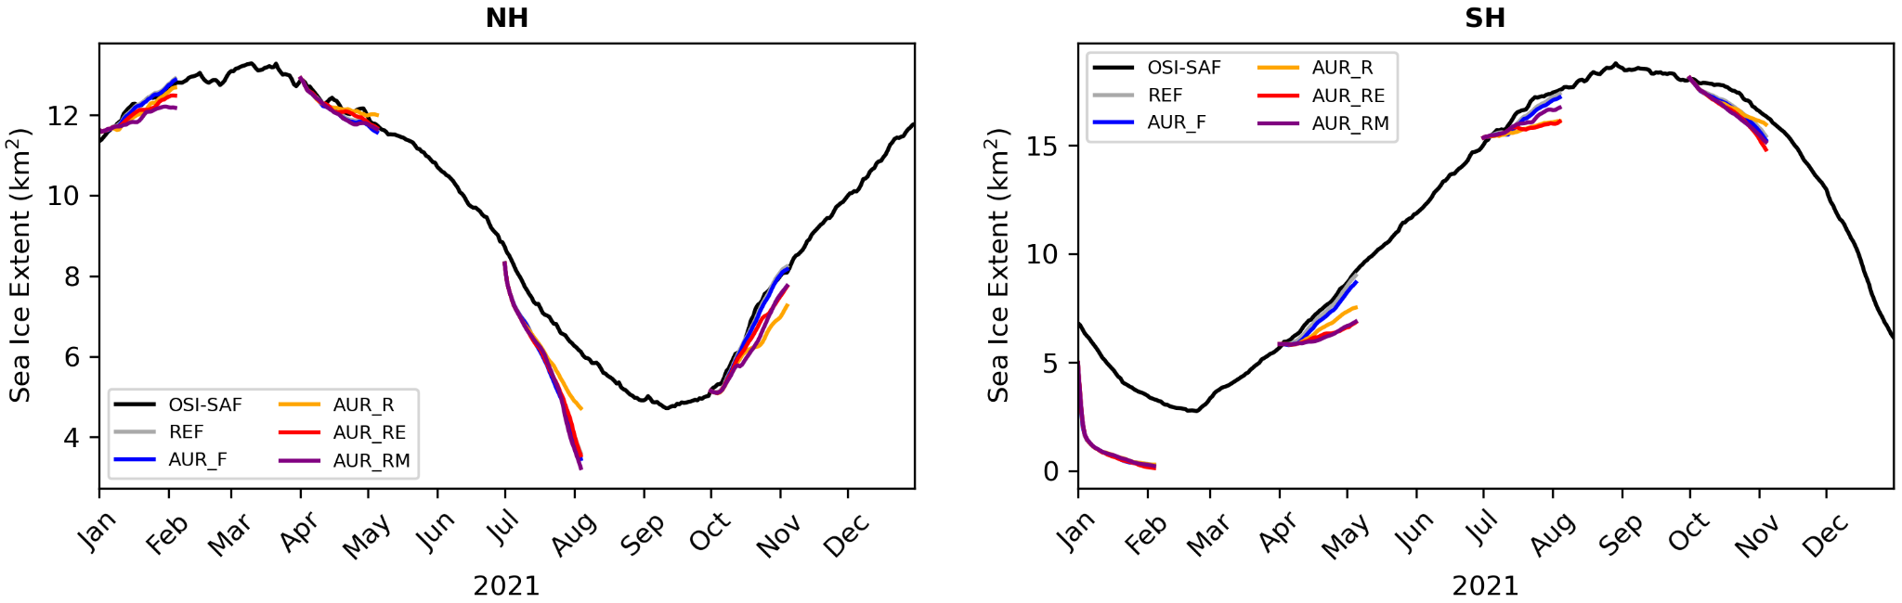
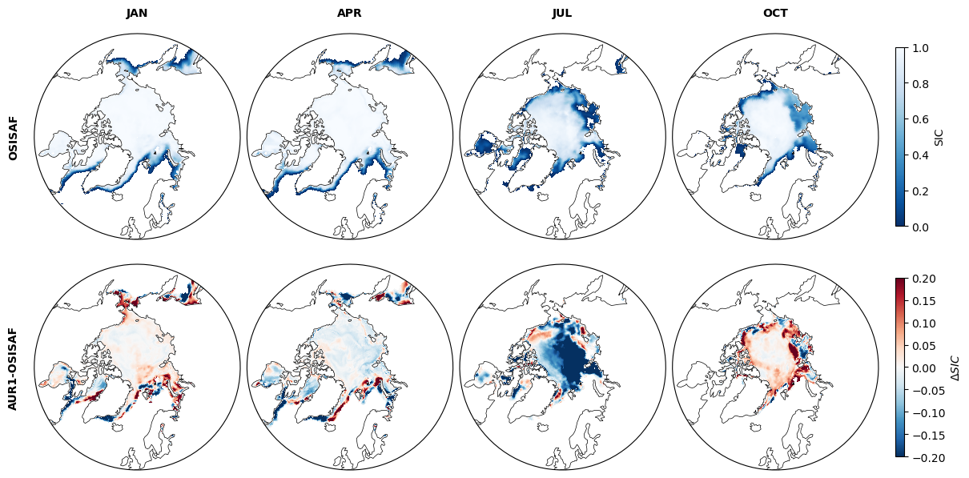
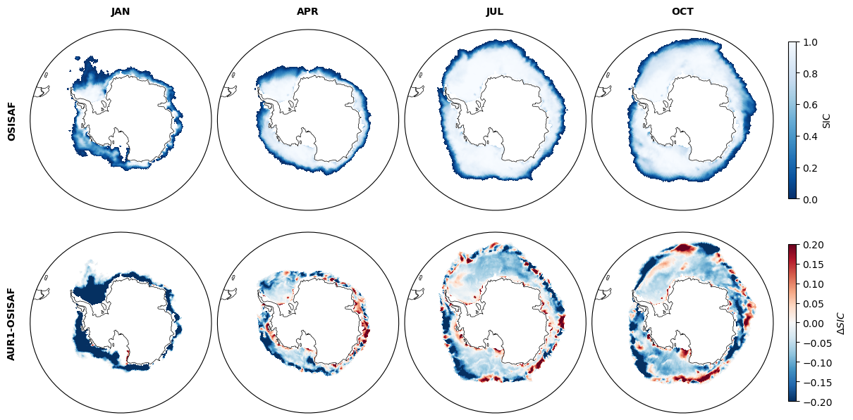
Sea Ice Extent and Coverage from CICE6
Very similar large bias in each hemisphere summer is appeared in all simulations incl. CDEPS DATM
It is related with model configuration!!!
ERA5 has also issues in the polar regions with large bias in surface temperature
Batrak and Müller, 2019 and Michalezyk et al., 2026
NH
SH

Slide 14
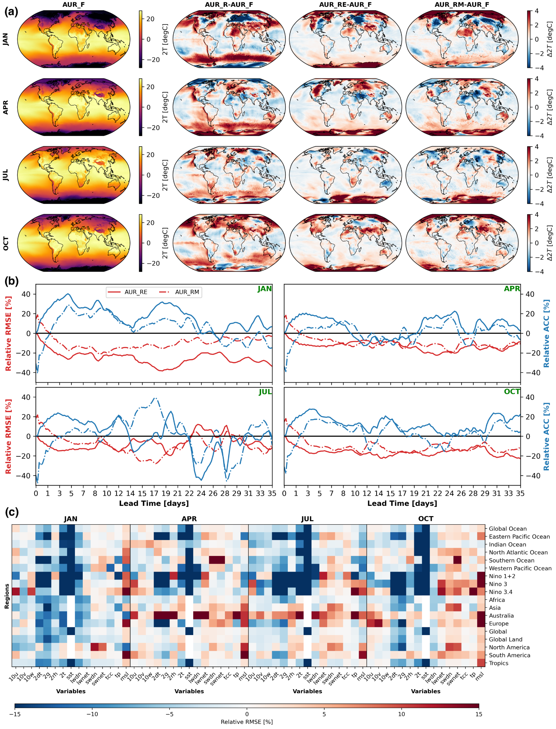
Added Value of Coupling
Figure: Globally averaged (over ocean) time series of relative RMSE and ACC scores with respect to AUR_R (free prediction mode) for 2-meter air temperature for different seasons
SST coupled configurations have smaller RMSE and higher ACC in general
Figure: Relative RMSE of the AUR_RM simulation with respect to AUR_R for different seasons, variables, and regions.
Set of surface variables such as humidity, surface temperature, longwave radiation are more responsive to the corrected SST

Slide 15
Conclusion
Application agnostic implementation (ESMF/NUOPC based)
Generic, flexible and efficient generic component (GeoGate)
  Enables coupling with any ML-based models/emulators with minimal effort
  It might be used to test ideas like online bias correction, data assimilation etc.
    model/s → AI/ML (bias correction or DA) → model/s
  Plugin based design that can be extended easily
The fine tuned version of the Aurora model
  New Aurora model (v1.5) is available → ensemble support, higher temporal frequency (hourly)
  It can be further improved by adding physical constraints (via loss function etc.), longer training, more variable for coupling (flux components)

Slide 16

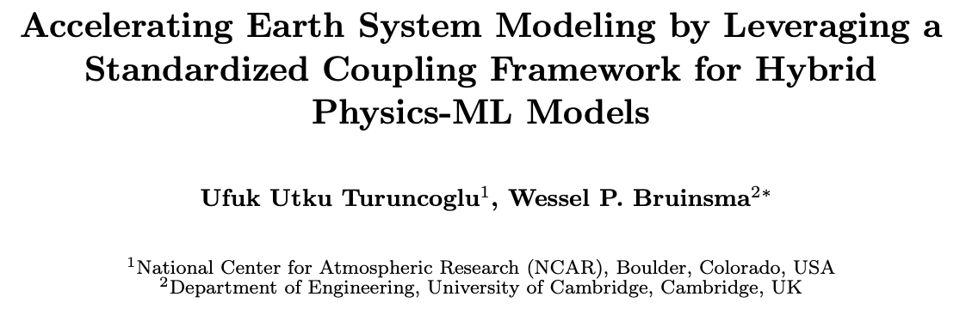
Questions?
Collaborators:
Wessel P. Bruinsma (co-author) | Department of Engineering, University of Cambridge, Cambridge, UK | Robert Oehmke, Daniel Rosen, Gerhard Theurich, and Ann Tsay | ESMF Team
Brian Dobbins, Gustavo Marques and David Bailey | NCAR/CGD | Saeed Moghimi | NOAA/NOS
Brian Vanderwende and Negin Sobhani | NCAR/CISL | Denise Worthen and Nick Szapiro | NOAA/EMC
geogate.io
Preprint

Slide 17
Additional Slides

Slide 18
Inference Optimization
Performance of inference → Python script is triggered every coupling time step
  Overhead of preparing AI model in each iteration
    Solutions: Caching and preserving Python environment
  Overhead of loading Python modules
    Python's import mechanism makes many small metadata calls like stat(), open(), and access()
    Lustre file system is not designed for metadata-heavy workloads (Derecho)
    Solutions:
      Flattening, packing the environment
      Caching, persistent inference environment, containers

Slide 19
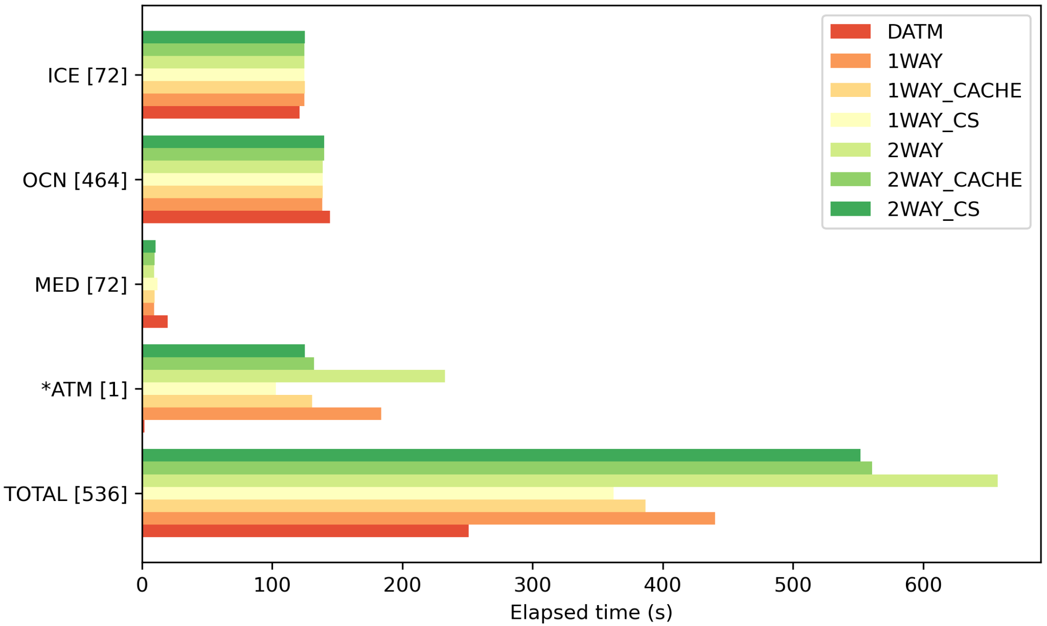
Inference Optimization - Components
Benchmark based on 1-day fully coupled S2S configuration based on datm_cdeps_mx025_cfsr
~%50 improvement
Runs on single CPU but offloads AI model to GPU
We have also multi-core GeoGate example for Aurora inference
GeoGate

Slide 20
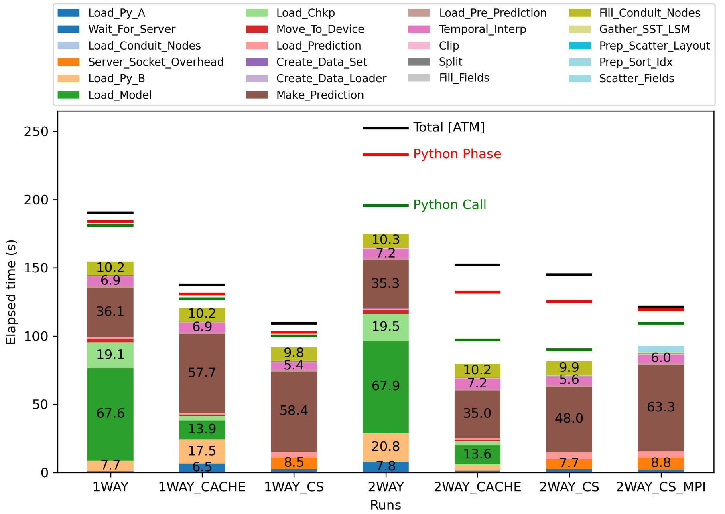
Inference Optimization - Python
Component overhead like interaction with other components, direct connection with OCN, preparing data that are used by the plugin
Interpolation (MOM6->Aurora),
move data to conduit
back and forth,
and other Python related code
MPI also helps further improvement
*_Cache: Preserved python environment
*_CS: Client/Server approach
Large variation among inference, probably due to system overhead
GeoGate / 1 Core + GPU
GeoGate / 72 Core + GPU

Slide 21
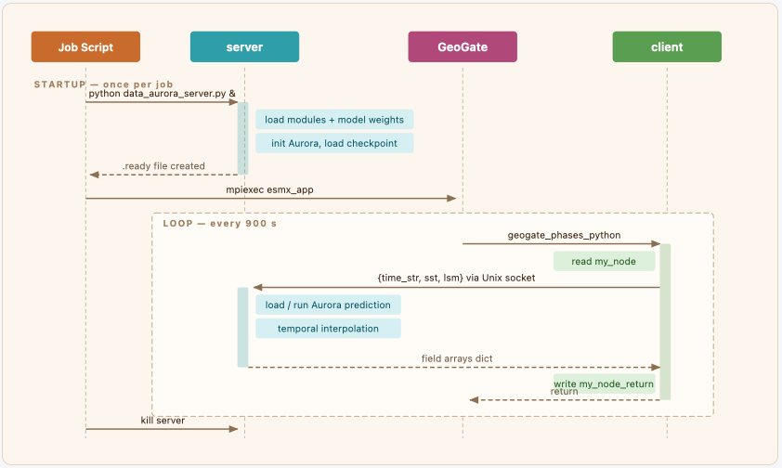
Inference Optimization: Client/Server
Client/Server approach (uses Linux sockets)
Server is started before running MPI executable
SERVER
listens CLIENT and make new predication
Get new data in every coupling interval and passes to the server
CLIENT
Interacts with GeoGate
Return new prediction to GeoGate

Slide 22
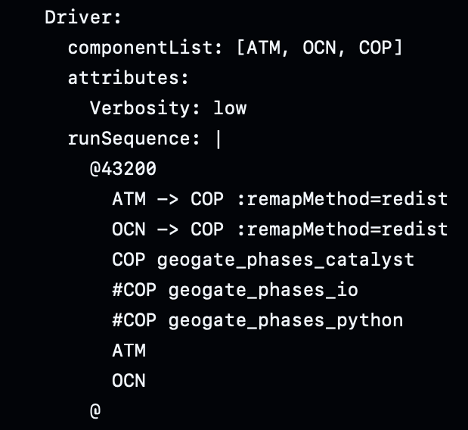
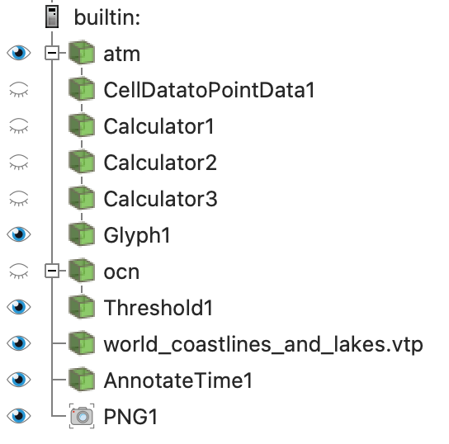
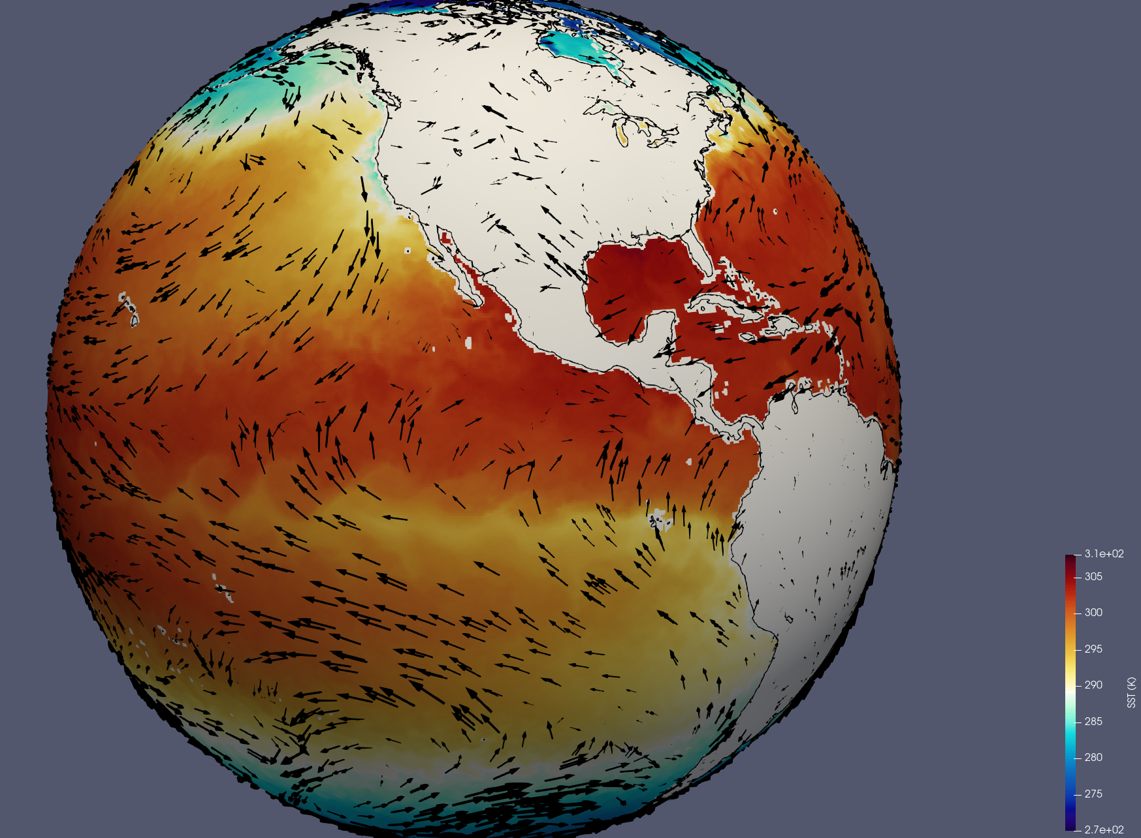
ParaView Catalyst Plugin
It is not just for Python interaction - two channel (atmosphere, ocean) pipeline:
maps vector from lat-lon to cartesian
Connect to components
Call desired
plug-in (multiple-
phase
can be called)
Simple Run Sequence
CDEPS +
GeoGate + ESMX
Catalyst pipeline
(exported as Python)
Simple output

Slide 23
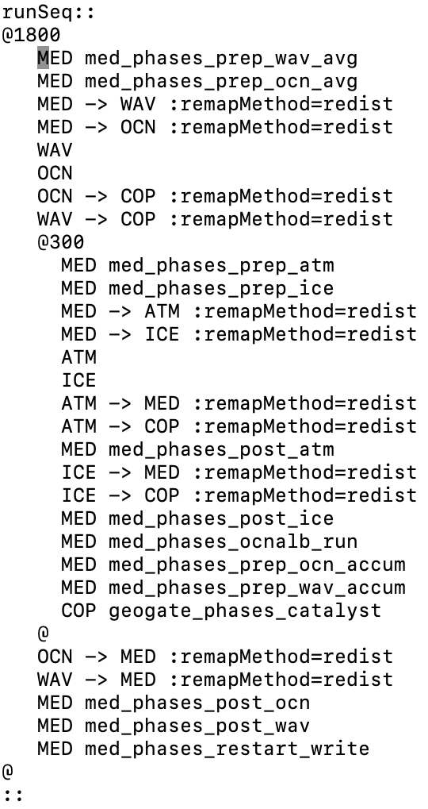
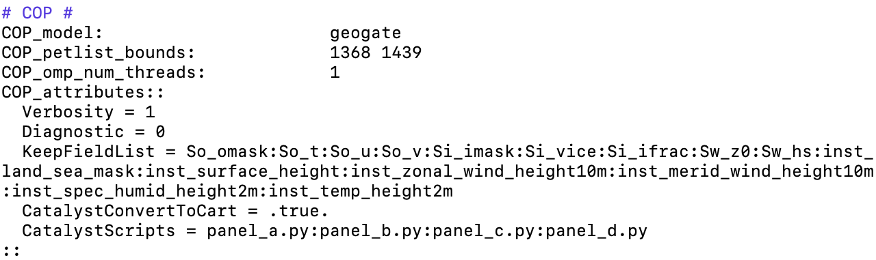
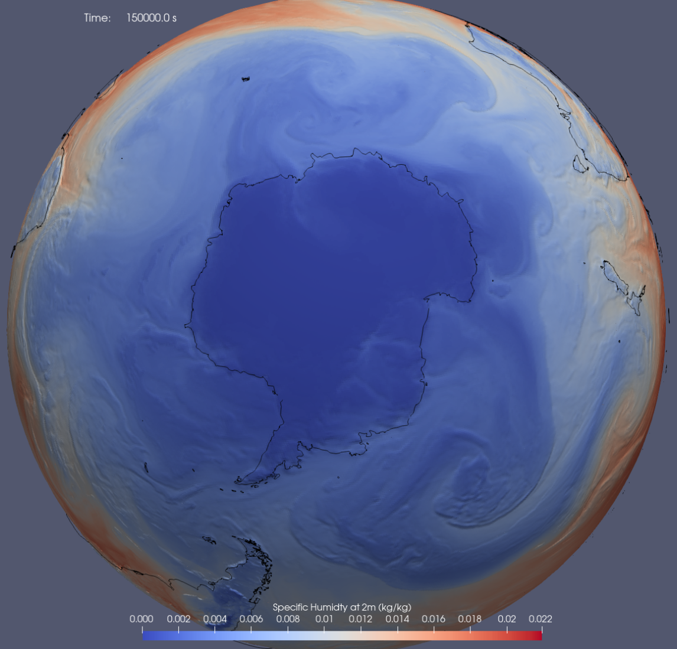
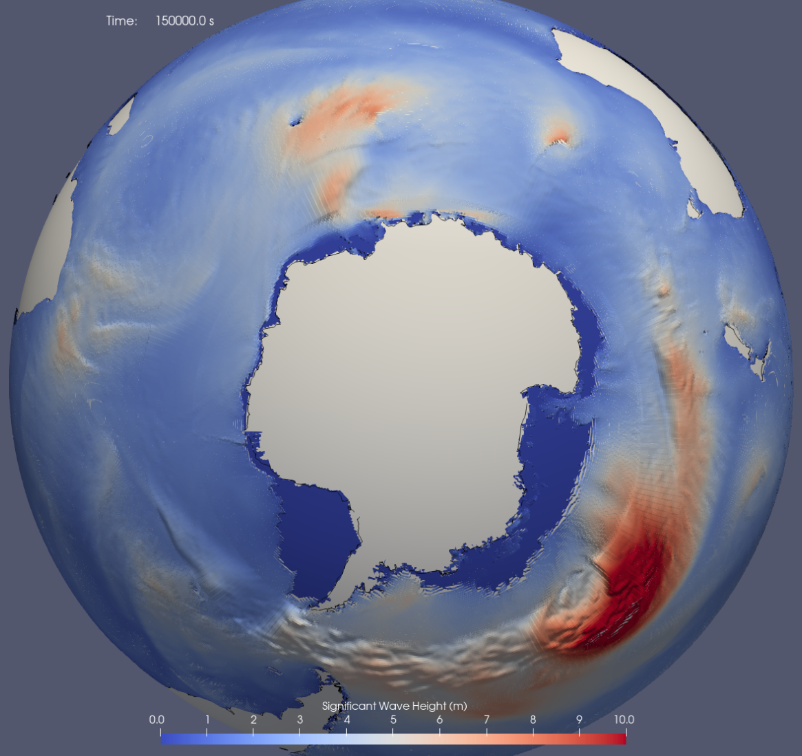
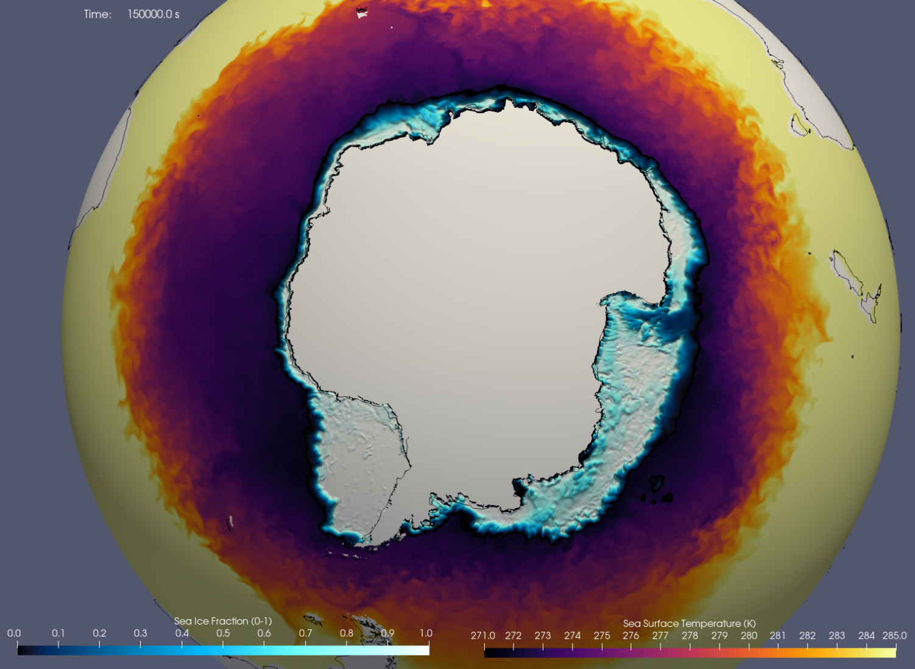
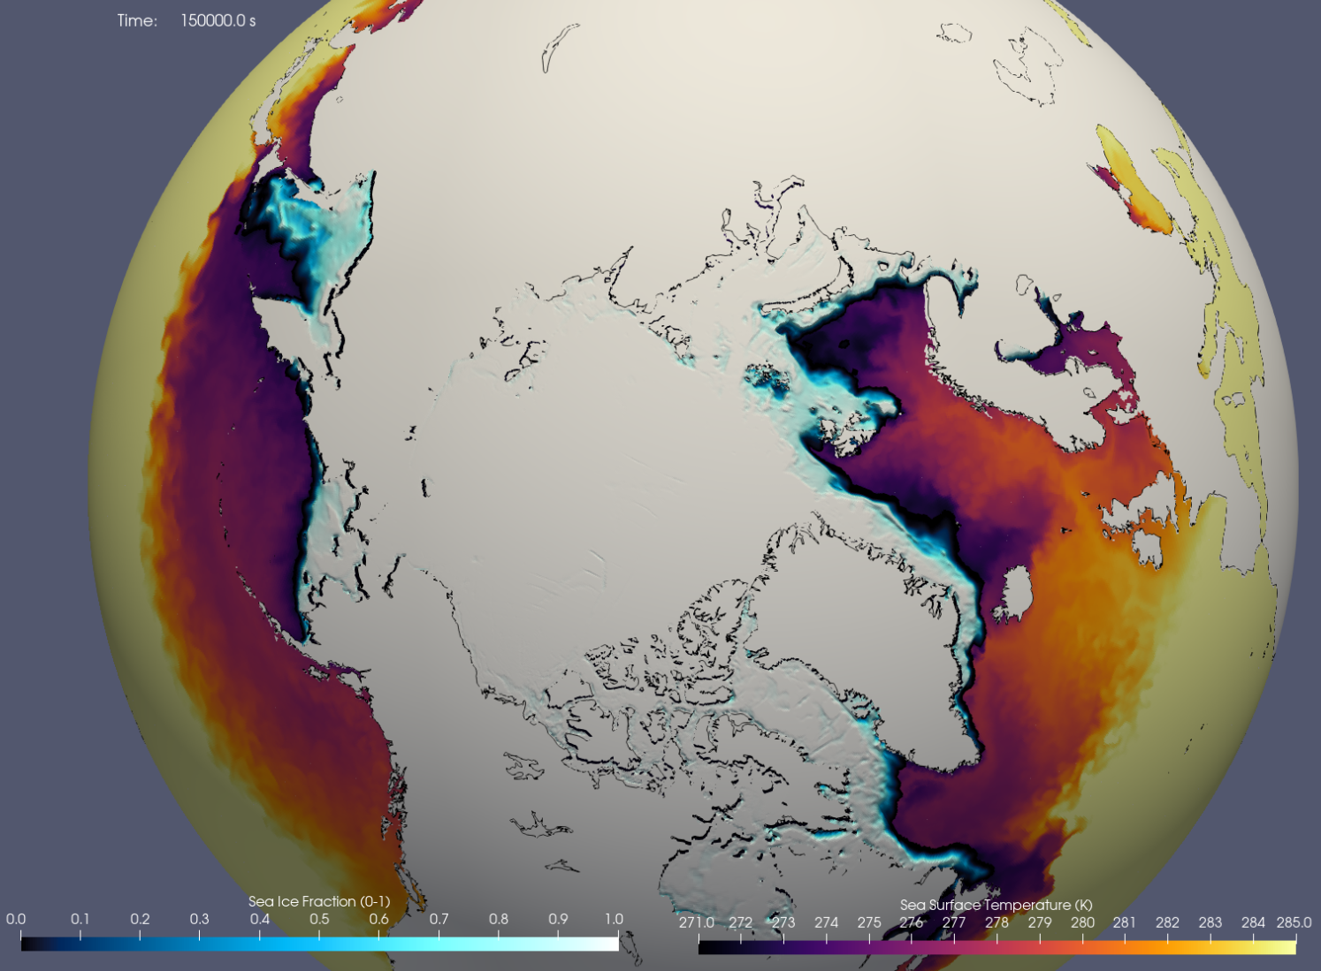
In Situ Analysis with UFS WM
cpld_control_gefs → the GeoGate ESMF/NUOPC component creates a different channel for each connected component, such as atm, ocn, ice, and wav
SSH
SWH
Sea Ice + SST (SH; NH)

Slide 24
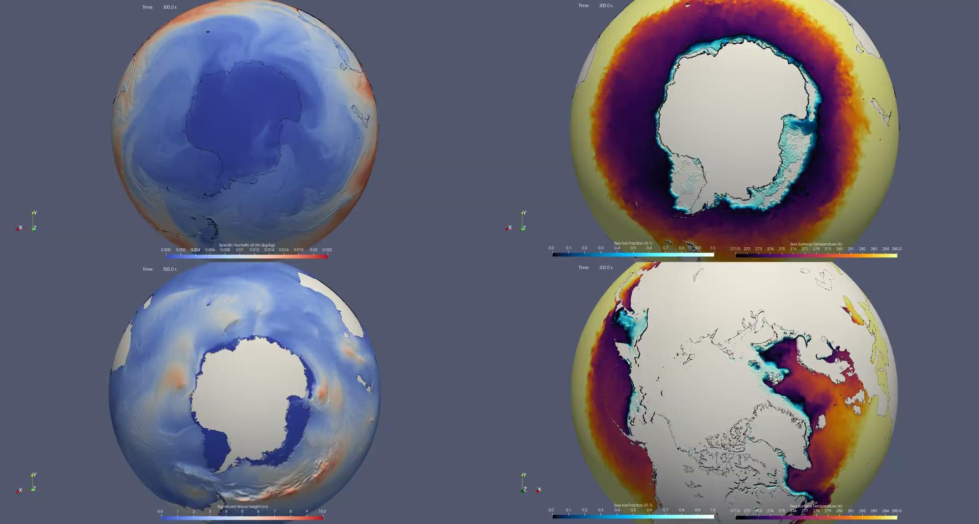
In Situ Analysis with UFS WM
Link

