Slide 1



Improving Tropical Cyclone Track and Intensity Forecasts via Integrated AI
Lin Zhu¹, Xu Lu², Zhan Zhang³, Bin Liu², Yonghui Weng², Biju Thomas², Linlin Cui², Jun Wang³, Vijay Tallapragada³, Fanglin Yang³
¹SAIC at NOAA/NWS/OMD;
²Lynker at NOAA/NWS/OMD;
³NOAA/NWS/OMD
U.S. Department of Commerce
National Oceanic and Atmospheric Administration
National Weather Service

Slide 2
Overview
Improve Hurricane track via Spectral Nudging
Hurricane intensity bias correct via XGBoost
AI-HAFS in Anemoi Framework

Slide 3
Overview
Improve Hurricane track via Spectral Nudging
Hurricane intensity bias correct via XGBoost
AI-HAFS in Anemoi Framework

Slide 4
Spectral Nudging Introduction
Use model–target differences as an additional forcing term to gradually relax the evolving model state toward the target.
Apply the forcing during integration to reduce imbalances and better maintain model balance.
Target
Nudged Model
Nudging Tendency
……
Free Model
T+0h
T+120h

Slide 5
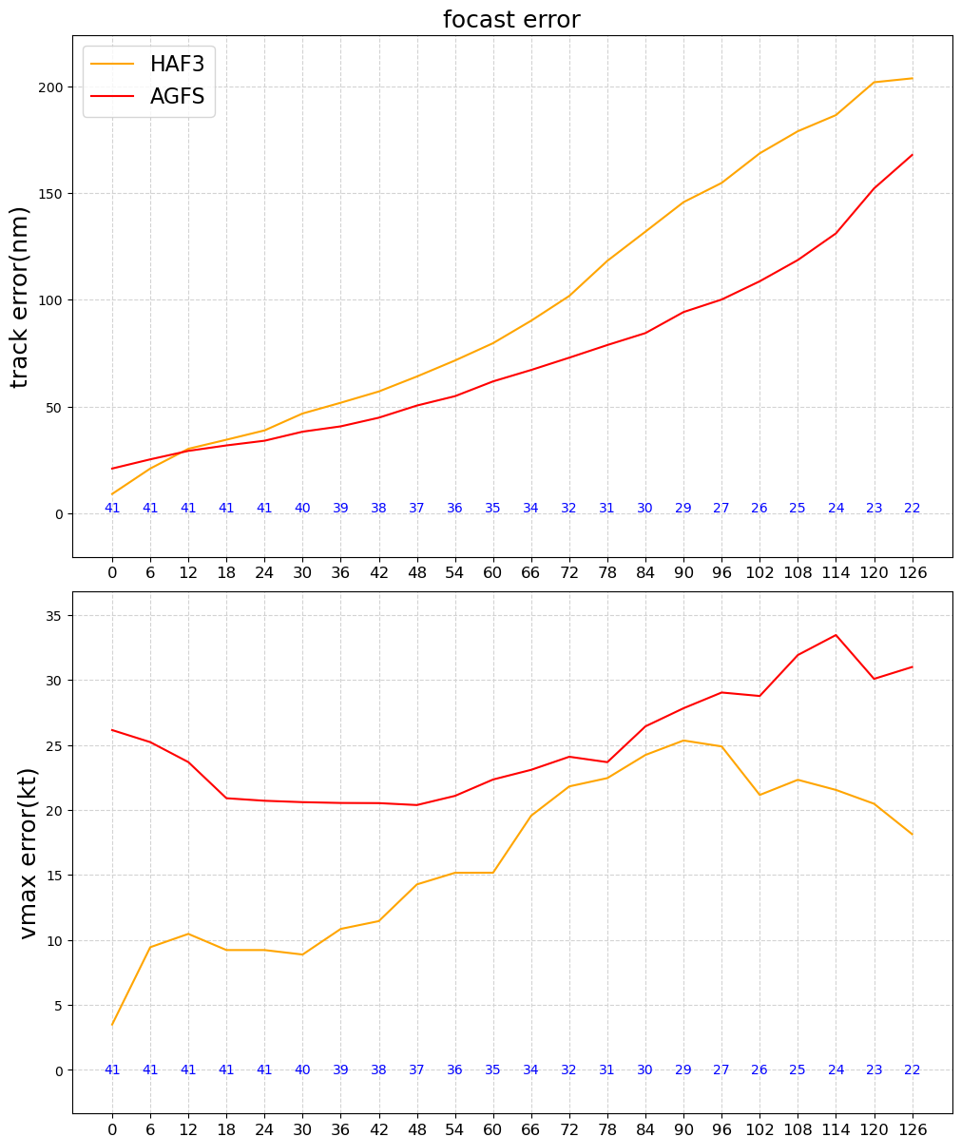
Why Spectral Nudging Towards AIGFS?
Hurricane Melissa (2025)
AIGFS produces overall better track
  Better Large-Scale Environmental Flow
HAFS produces overall better intensity
  Better Small-Scale Inner-core Evolution
Track Error
Vmax Error
Can we utilize the better large scale environment from AIGFS forecast in real-time?
  Spectral nudging towards the AIGFS large-scale
HAF3: HAFSv2.2 Final
AGFS:Operational AIGFS

Slide 6
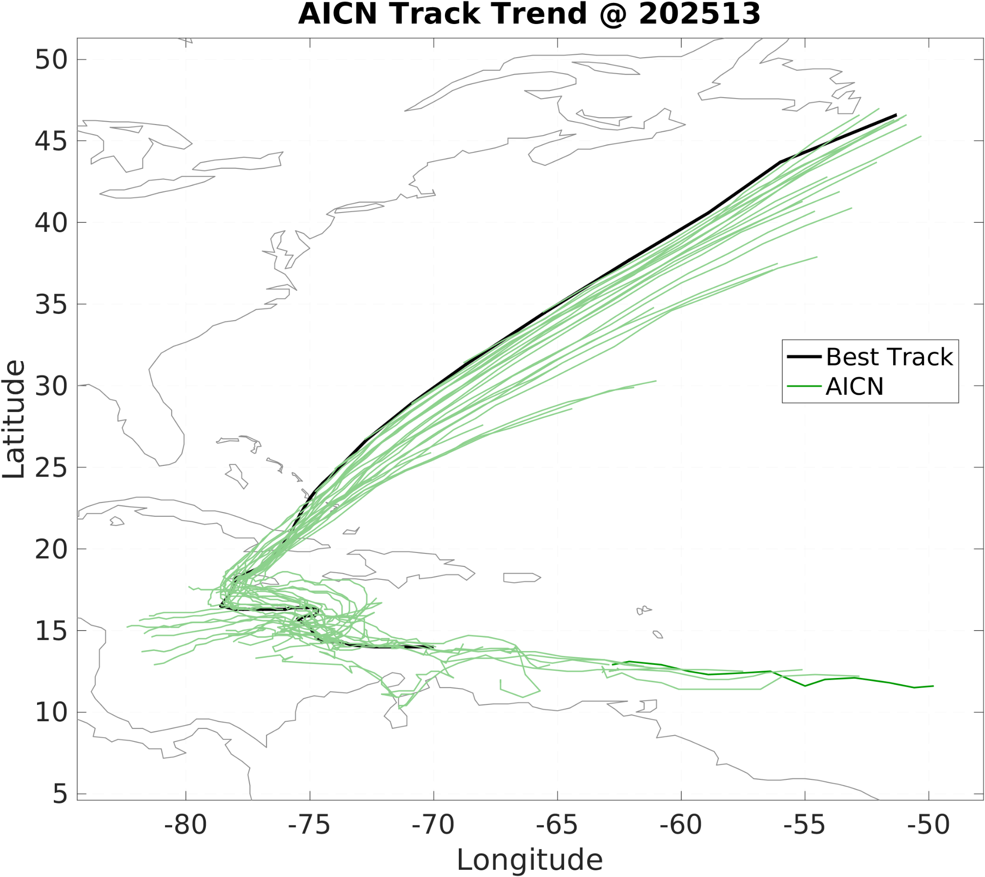
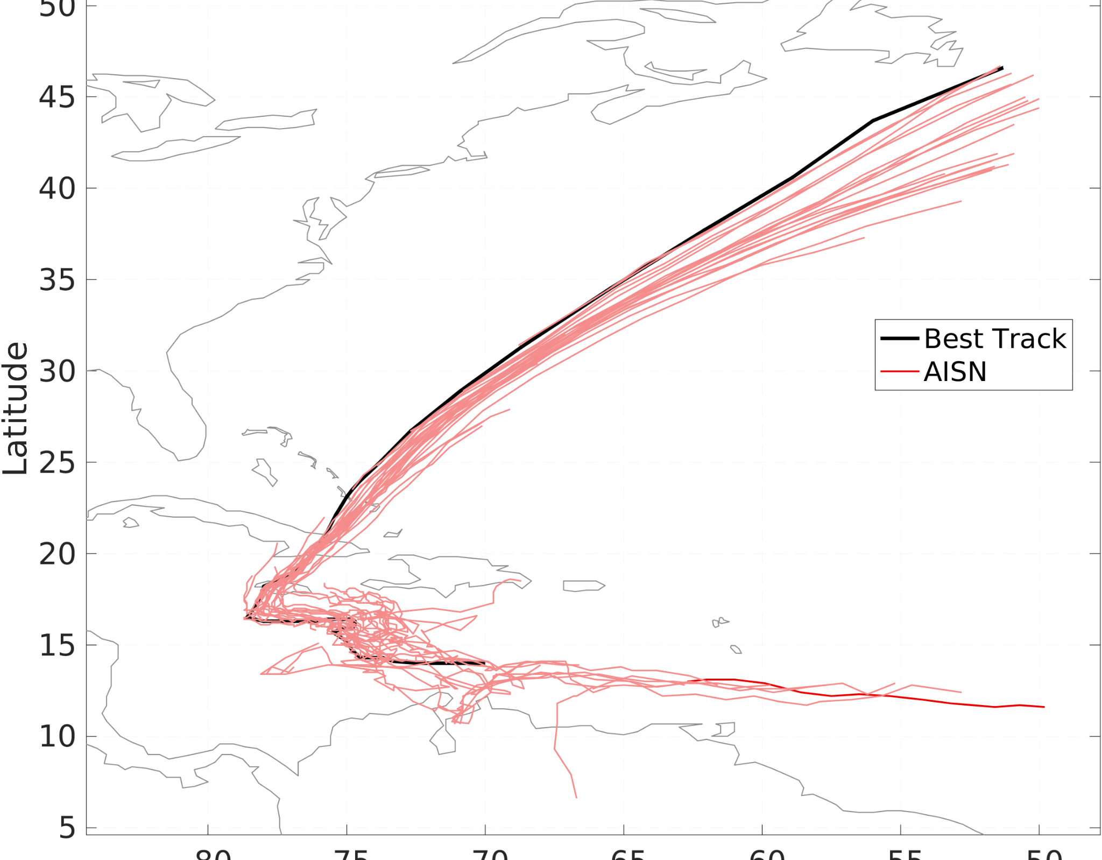
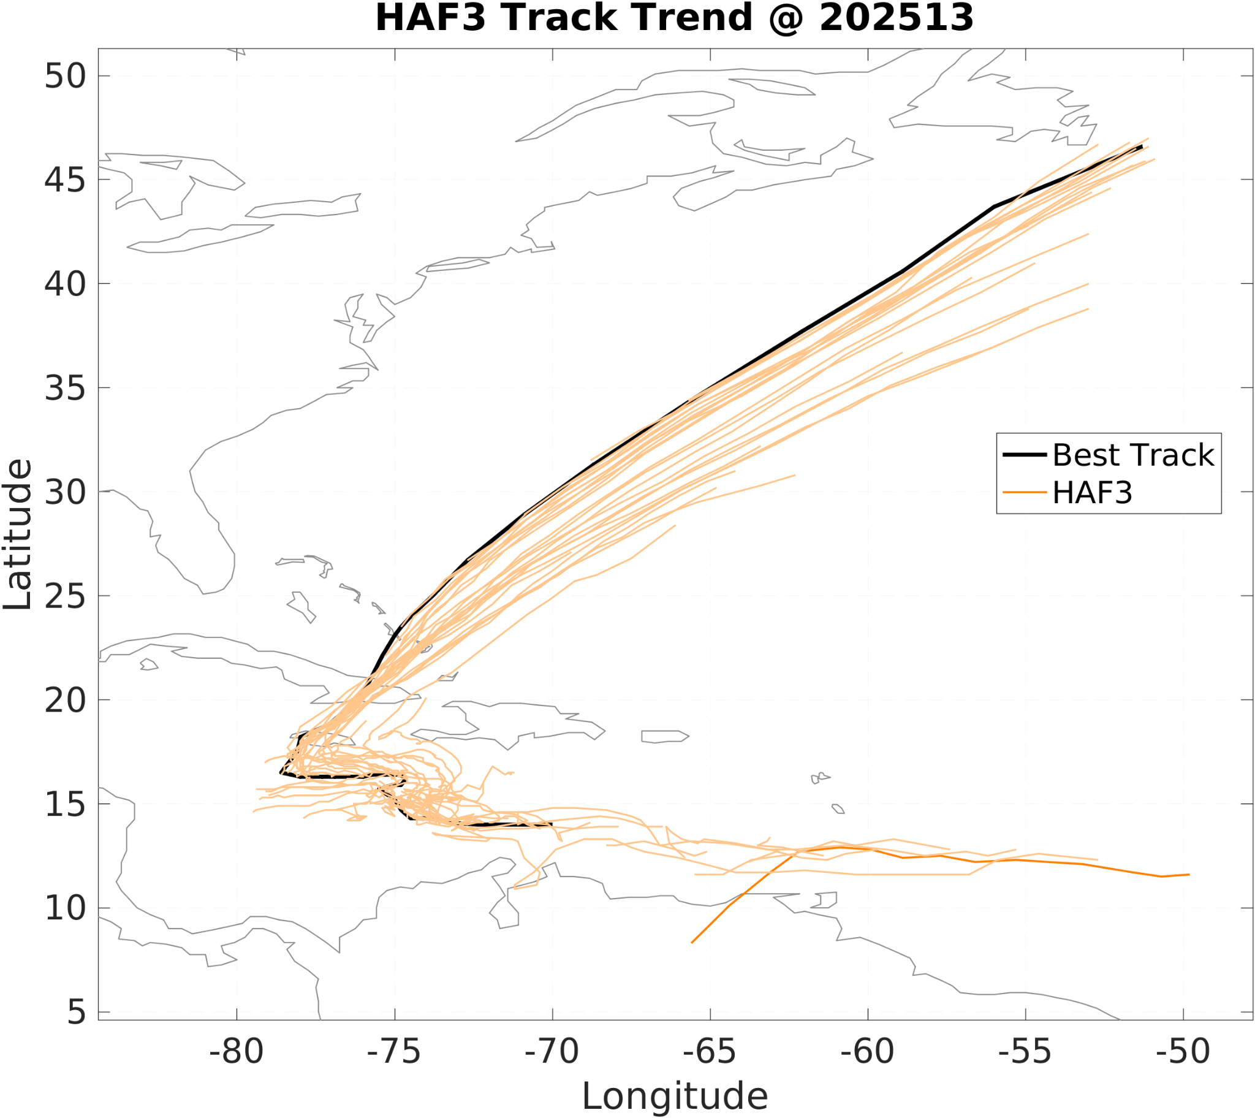
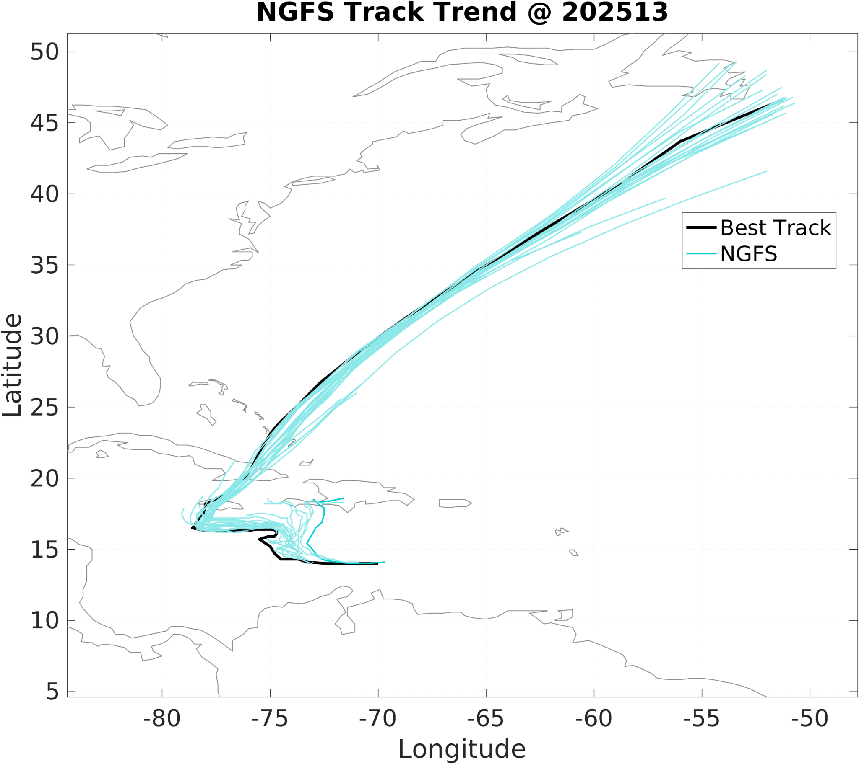
AIGFS Spectral Nudging in HAFS (Melissa)
AISN did well in the turning, but produces slightly larger right bias at higher latitudes even though the AIGFS leans to the left of track.
HAF3: HAFSv2.2 Final
AICN: HAF3 + AIGFS LBC
AISN: AICN + SN
NGFS: AIGFS

Slide 7
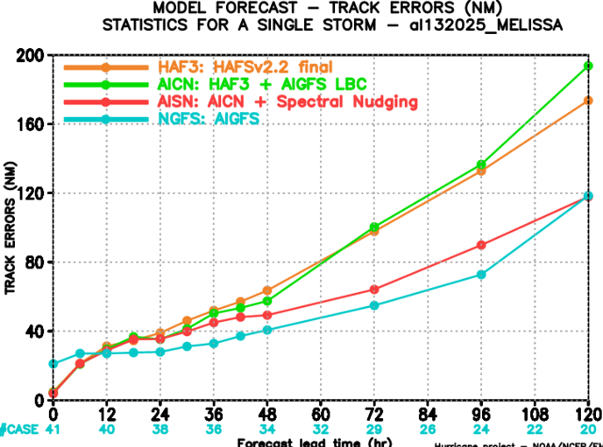
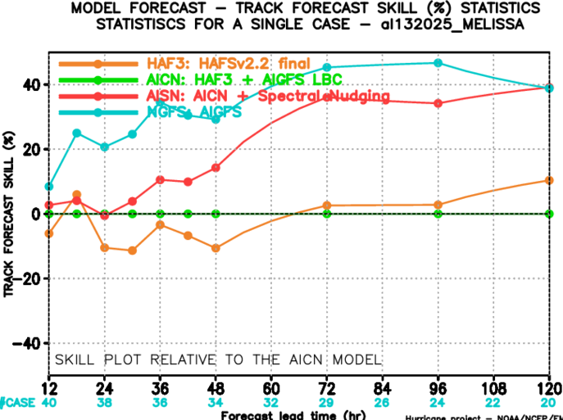
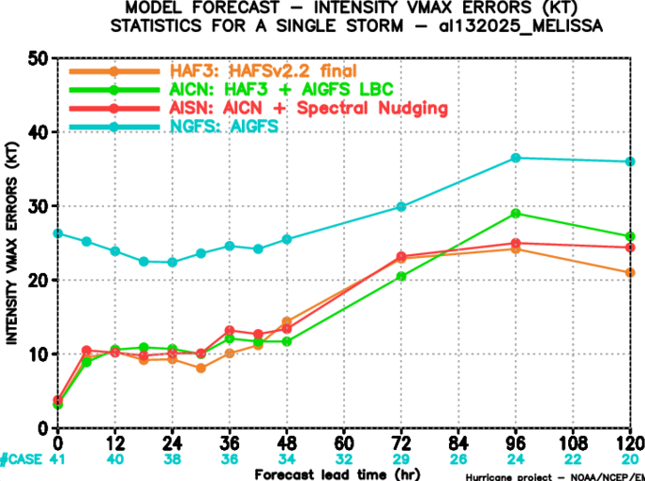
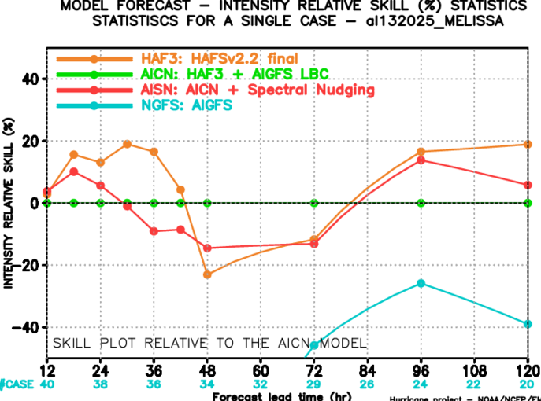
AIGFS Spectral Nudging in HAFS (Melissa)
~30%
Compared with AICN, AISN improves track prediction up to 40%, averaged ~30%. Intensity is average comparable.
Track Error
Track Skill
HAF3: HAFSv2.2 Final
AICN: HAF3 + AIGFS LBC
AISN: AICN + SN
NGFS: AIGFS
Vmax Error
Vmax Skill

Slide 8
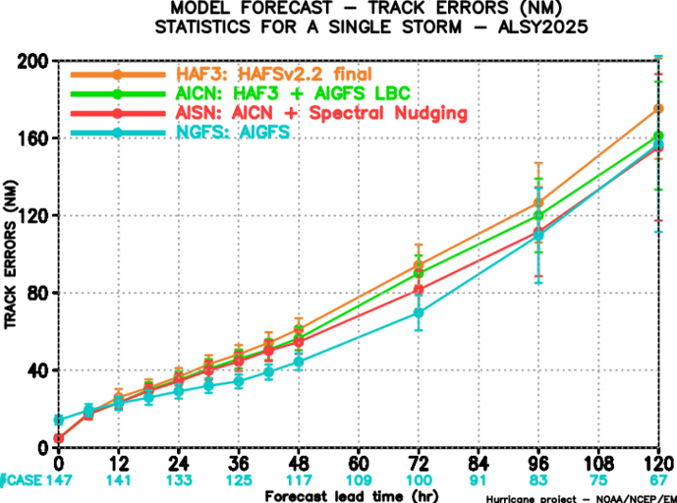
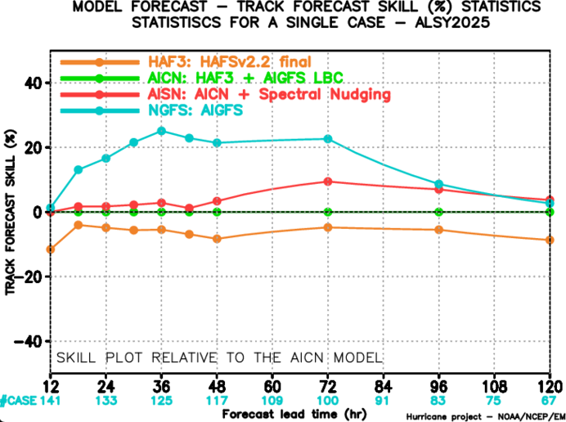
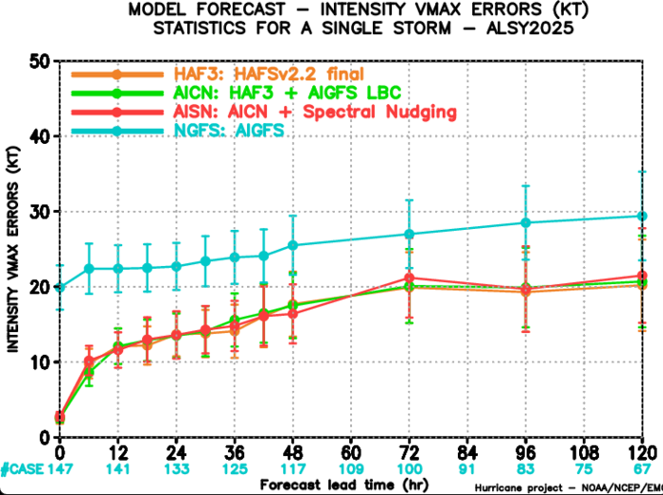
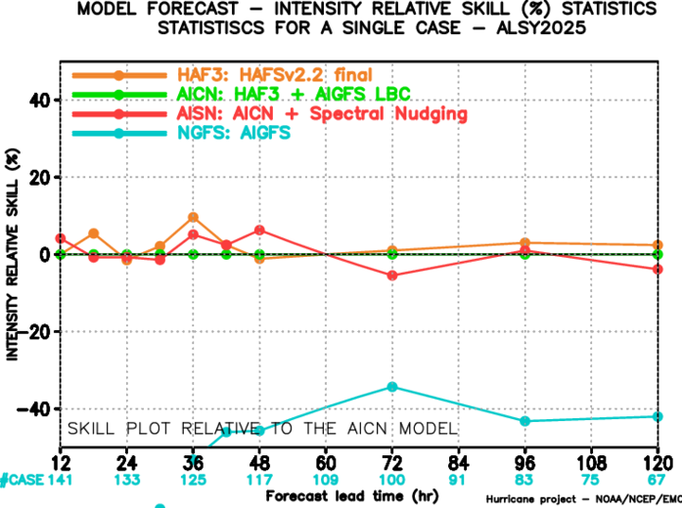
AIGFS Spectral Nudging in HAFS (2025 Major AL Storms)
Compared with AICN, AISN improves track prediction almost through all forecast lead times and comparable intensity.
Track Error
Track Skill
HAF3: HAFSv2.2 Final
AICN: HAF3 + AIGFS LBC
AISN: AICN + SN
NGFS: AIGFS
Vmax Error
Vmax Skill

Slide 9
Overview
Improve Hurricane track via Spectral Nudging
Hurricane intensity bias correct via XGBoost
AI-HAFS in Anemoi Framework

Slide 10
Objectives for bias correction via XGBoost
Improve HAFS tropical cyclone intensity forecasts through post-processing
Machine learning can capture nonlinear relationships
use XGBoost to learn forecast biases
Apply correction after HAFS completes its forecast
Low computational cost and easy to implement

Slide 11
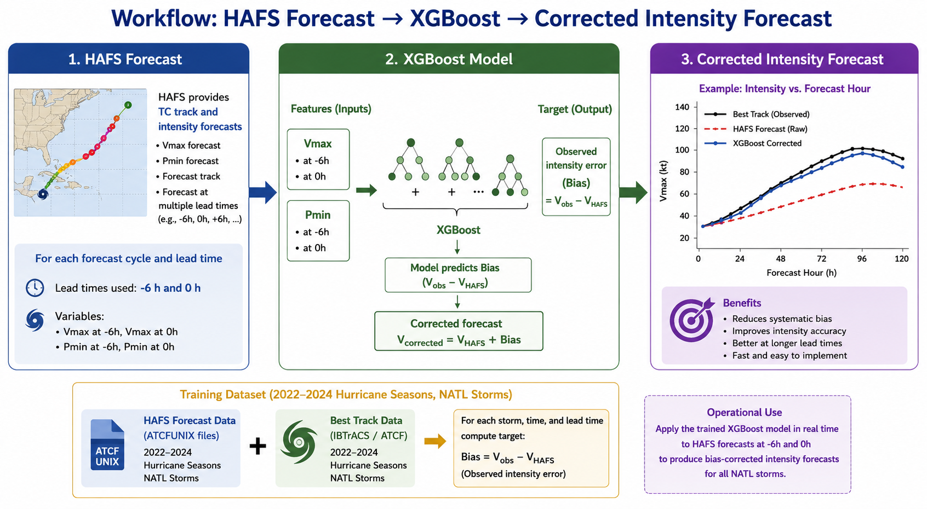
XGBoost for HAFS Bias Correction

Slide 12
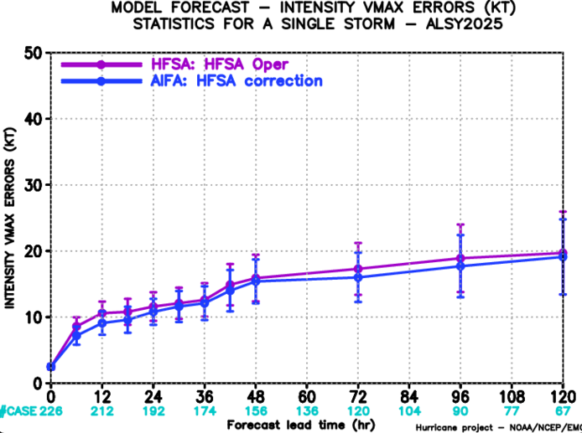
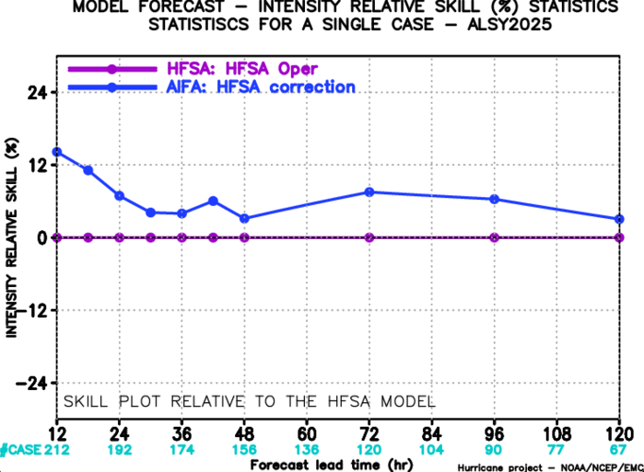
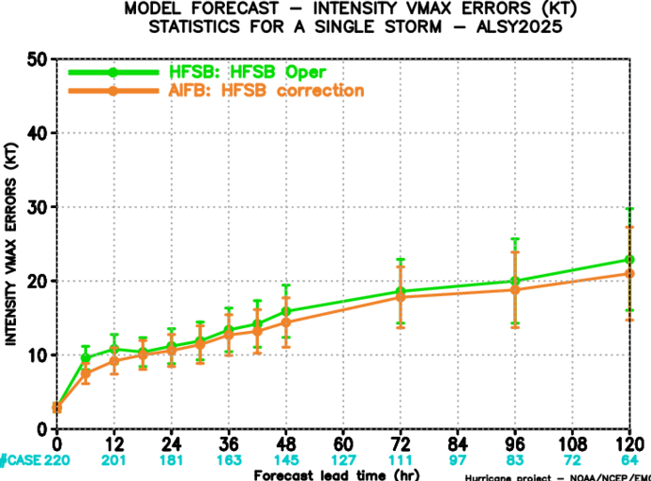
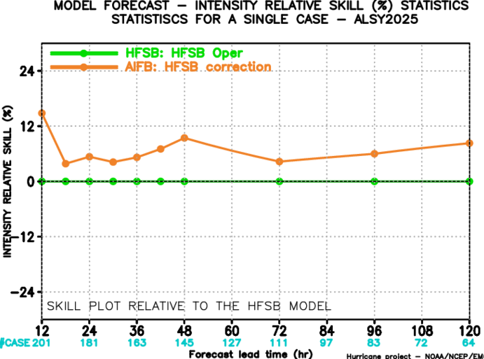
Preliminary Results of XGBoost bias correction
Vmax Error
Vmax Skill
XGBoost improves storm intensity for both HAFS-A and HAFS-B, the errors are reduced across all forecast lead times. Overall, the improvement is 5-10%.
Vmax Error
Vmax Skill

Slide 13
Overview
Improve Hurricane track via Spectral Nudging
Hurricane intensity bias correct via XGBoost
AI-HAFS in Anemoi Framework

Slide 14
Motivation & Objectives
Most existing data-driven AI weather models primarily target global weather prediction, and are not optimized for tropical cyclones
Develop an AI-based tropical cyclone forecasting system using Anemoi Framework.
Build a high-resolution over storm region AI model for tropical cyclone prediction.

Slide 15
AI-HAFS Experiments Design
Trimmed-down state space:
  Prognostic: z, u, v, w, t, q at 13 pressure levels and mslp, t2m, u10m, v10m
Graph Encoder, Processor & Decoder + Graph Transformer Processor
  Latent space = coarsed data space + cutout fine NATL region
Training dataset:
  Forcing dataset: Global dataset at 0.25° resolution
  Regional dataset: North Atlantic region at 12 km resolution

Slide 16
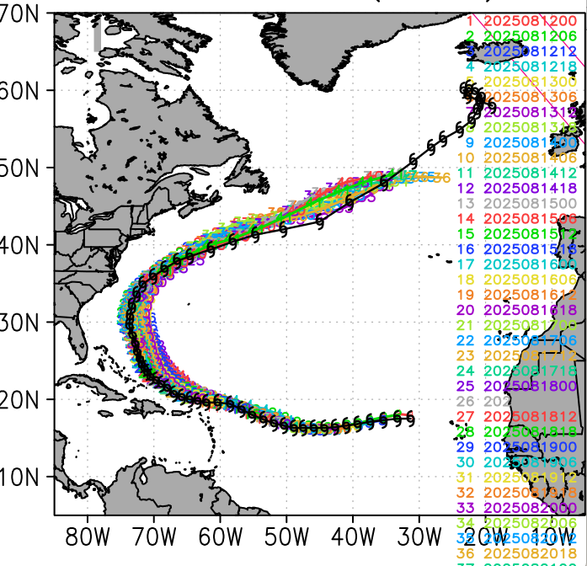
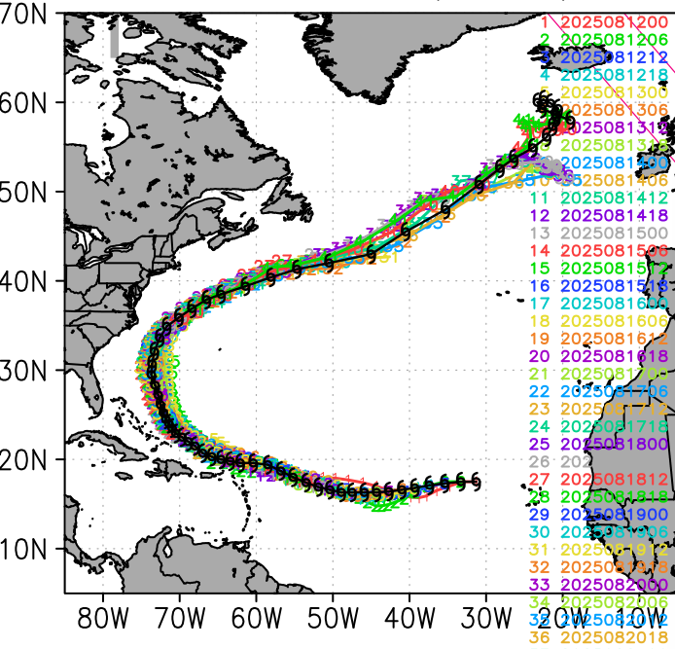
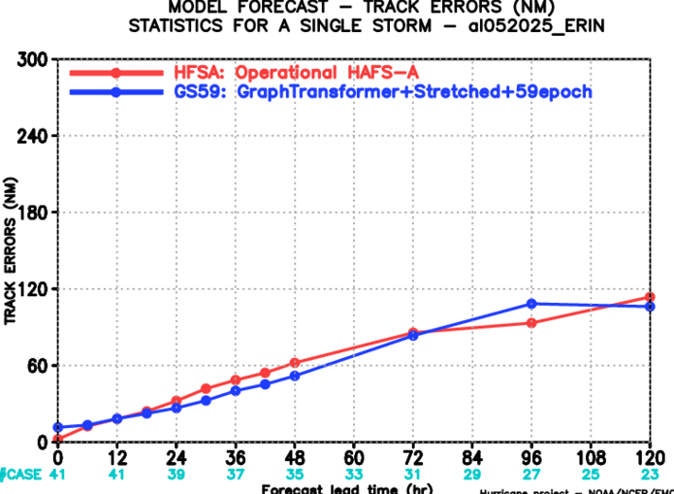
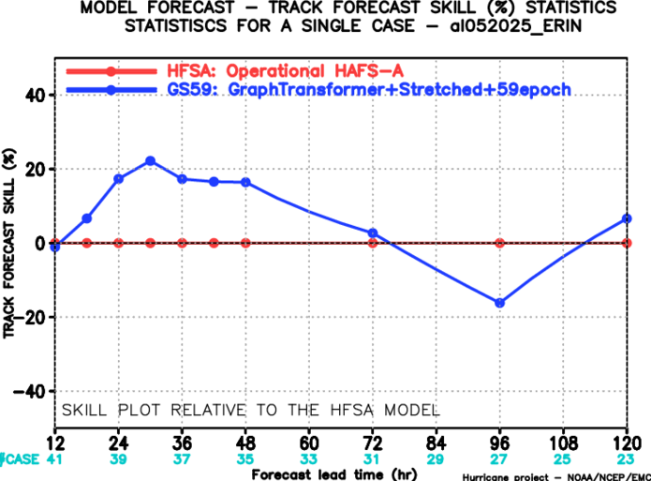
AI-HAFS Preliminary Results
Top Row: Track Composite
Hurricane Erin 05L 2025
Compared with operational HAFS-A, AI-HAFS experiment also captures the overall track, differences most evident at longer forecast lead times
AITC
HFSA
HFSA: Operational HAFS-A
AITC: AI-HAFS experiment
HFSA: Operational HAFS-A
AITC: AI-HAFS experiment
Bottom Row: Summary Statistics
AI-HAFS experiment has smaller track error at early forecast lead times. It provides positive skill overall ~10% through 72h.

Slide 17
Summary
A Recursive Filter capability has been successfully implemented in the HAFS to perform scale-separation for Spectral Nudging.
Spectral Nudging towards the AI-GFS forecasts large-scale T & wind fields showed promising improvements in the TC track predictions.
XGBoost can effectively learns HAFS intensity forecast errors, provides efficient statistical post-processing and improves intensity accuracy.
Early AI-HAFS experiment demonstrate AI-based hurricane prediction capability with encouraging track performance.

Slide 18
Future Work
Spectral nudging: evaluate more TC cases and investigate the impact of different spectral nudging separation scales, explore alternative scale-separation methods (eg. FFT-based approaches).
Intensity correction: explore more advanced AI methods and extend framework to jointly correct both track and intensity.
AI-HAFS in Anemoi: continue developing the model for Hurricane prediction, optimize configuration and training strategy, train with higher-resolution dataset to improve hurricane structure and intensity.

Slide 19

Thank you!

