Slide 1
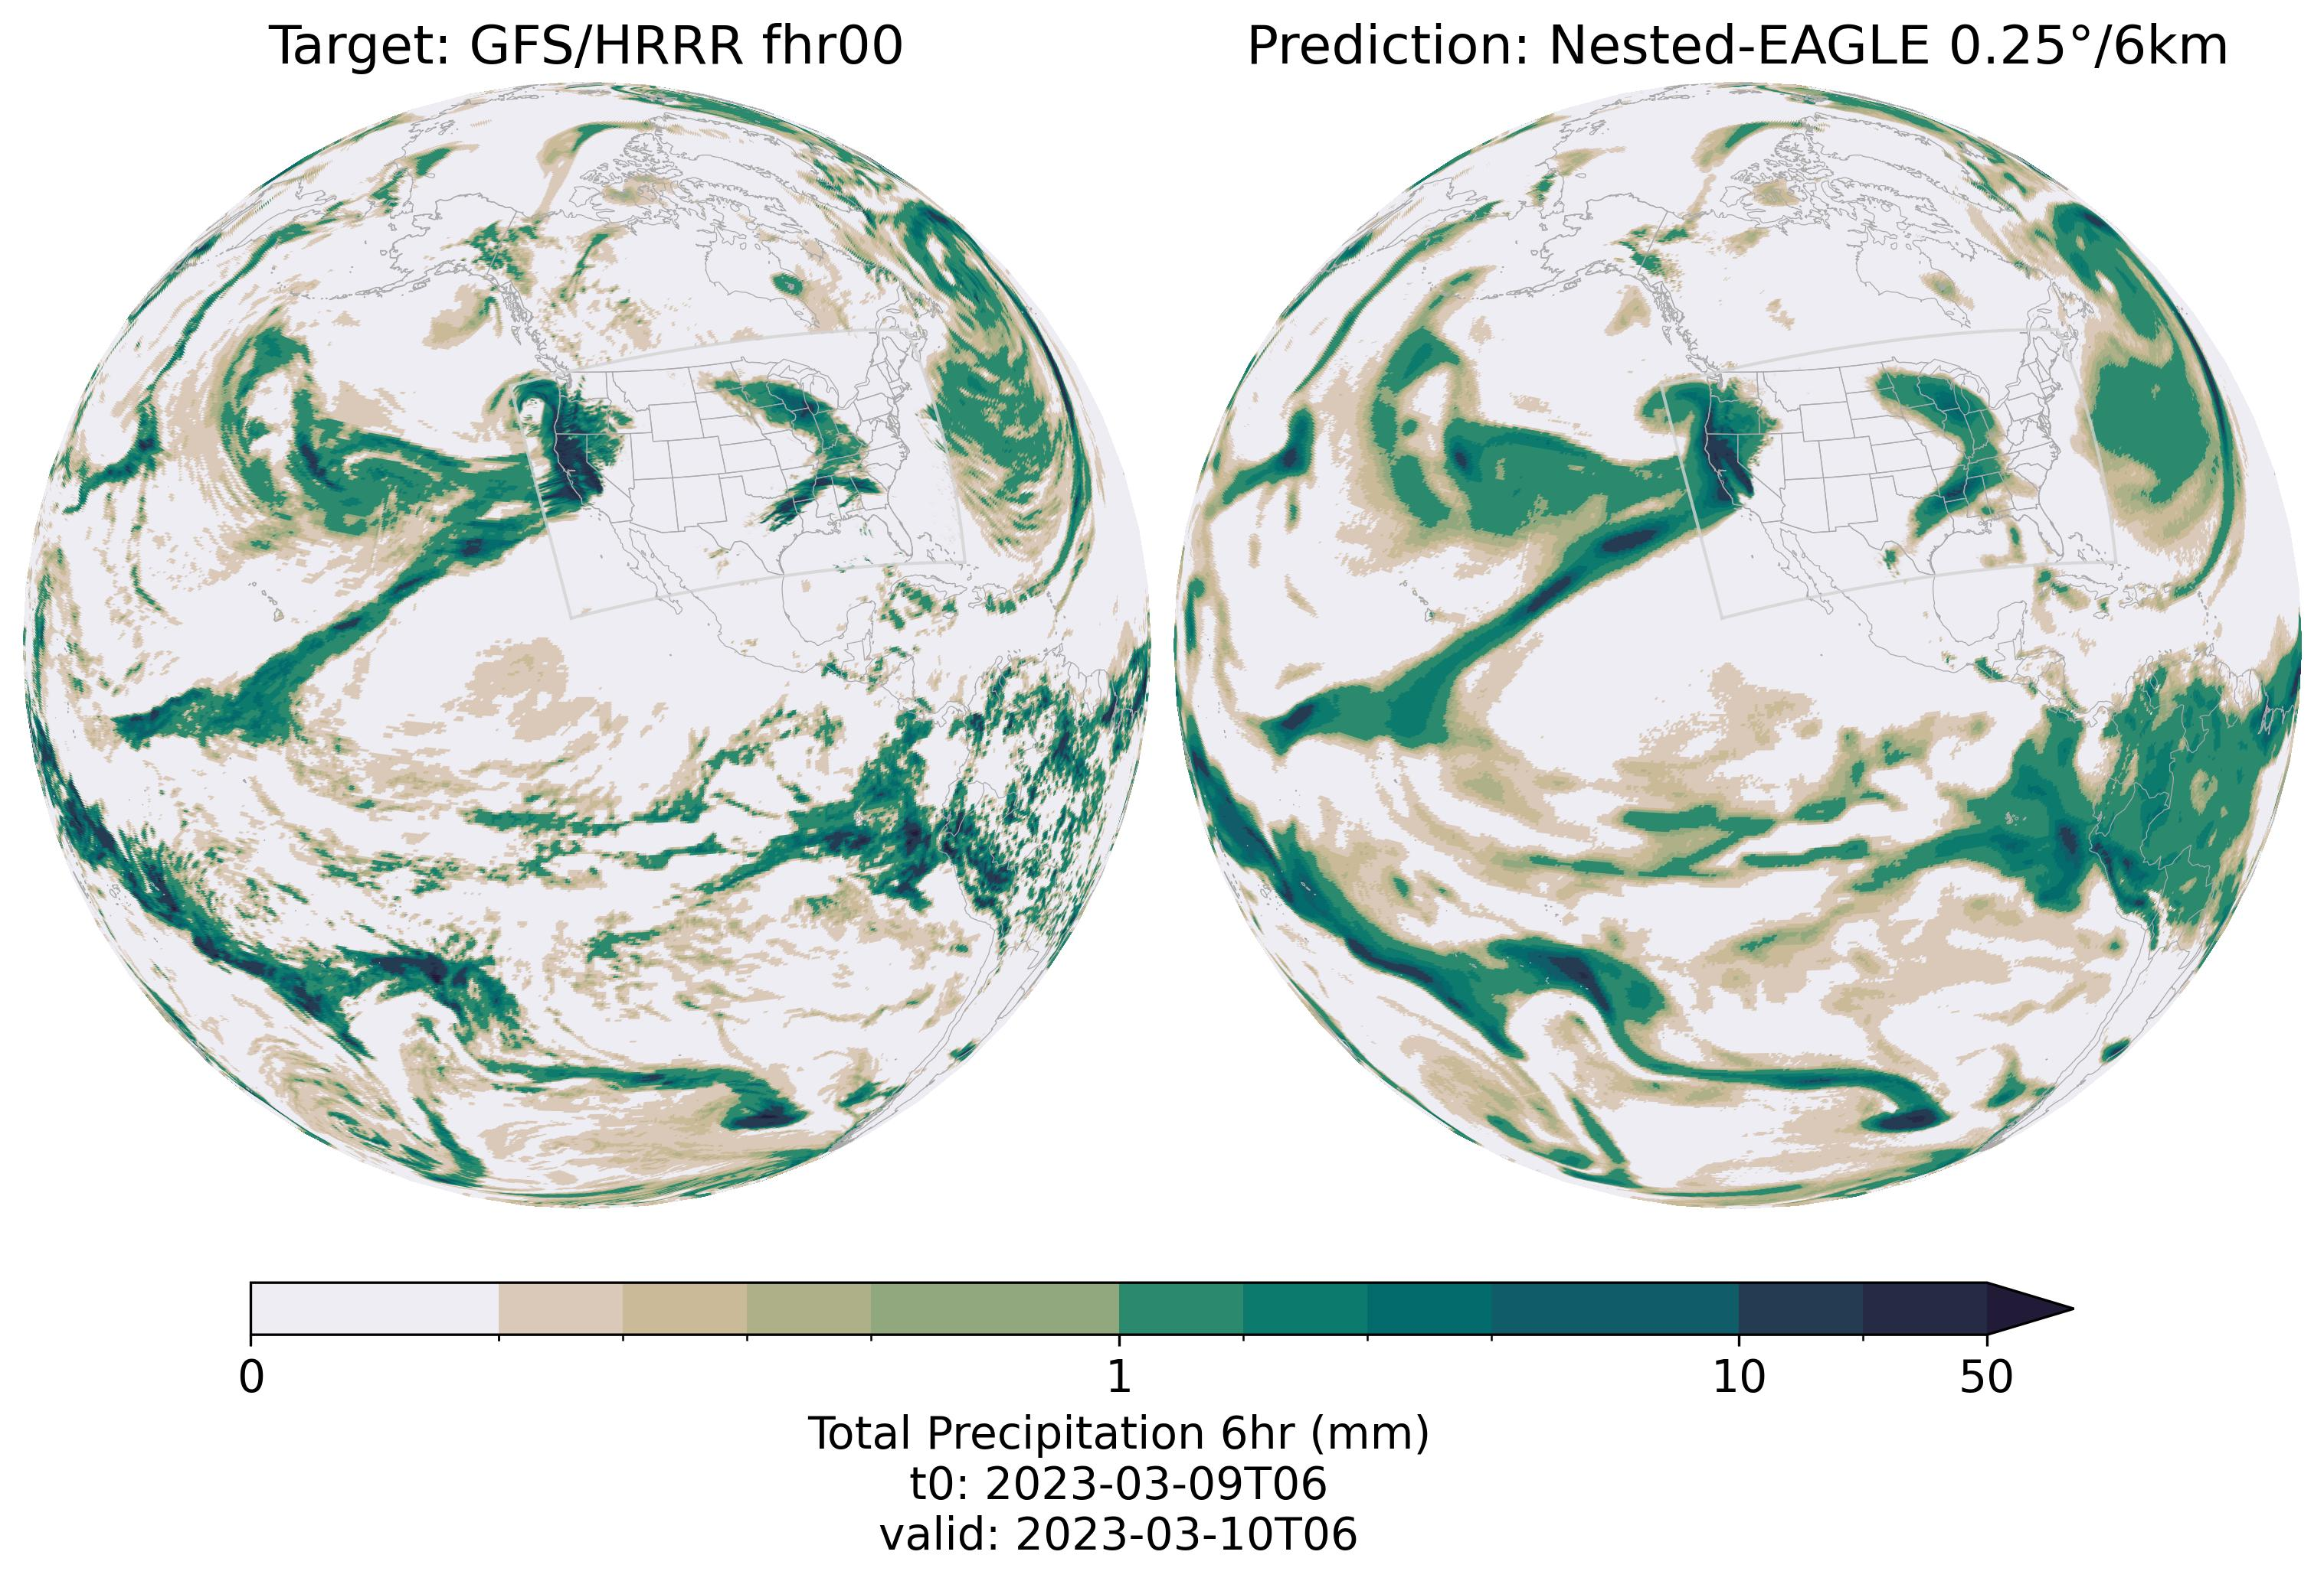

Nested-EAGLE:
A Data Driven, Global Weather Model with High Resolution over the Contiguous US
Timothy Smith
previously NOAA PSL, now at the Nansen Center
Mariah Pope, EPIC
Sergey Frolov, NOAA PSL
Brett Basarab, CIRES/NOAA PSL
Paul Madden, CIRES/NOAA GSL
Bo Huang, CIRES/NOAA PSL
Daniel Abdi, CIRES/NOAA GSL
Isidora Jankov, NOAA GSL

Slide 2
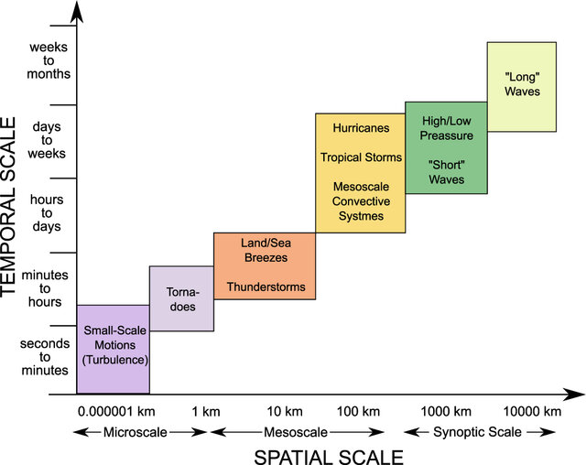
Motivation: Seamless Prediction Across Scales
Weather and climate phenomena can be broadly categorized by their spatiotemporal scales
NOAA’s Numerical Weather Prediction suite consists of individual forecast systems, each of which is uniquely tuned to its target application and scales of motion
SPEAR
SFS
GFS
HRRR
HAFS
WoFS
Can we unify some of these applications into a single model?
Figure from Brisch & Kantz (2019)

Slide 3
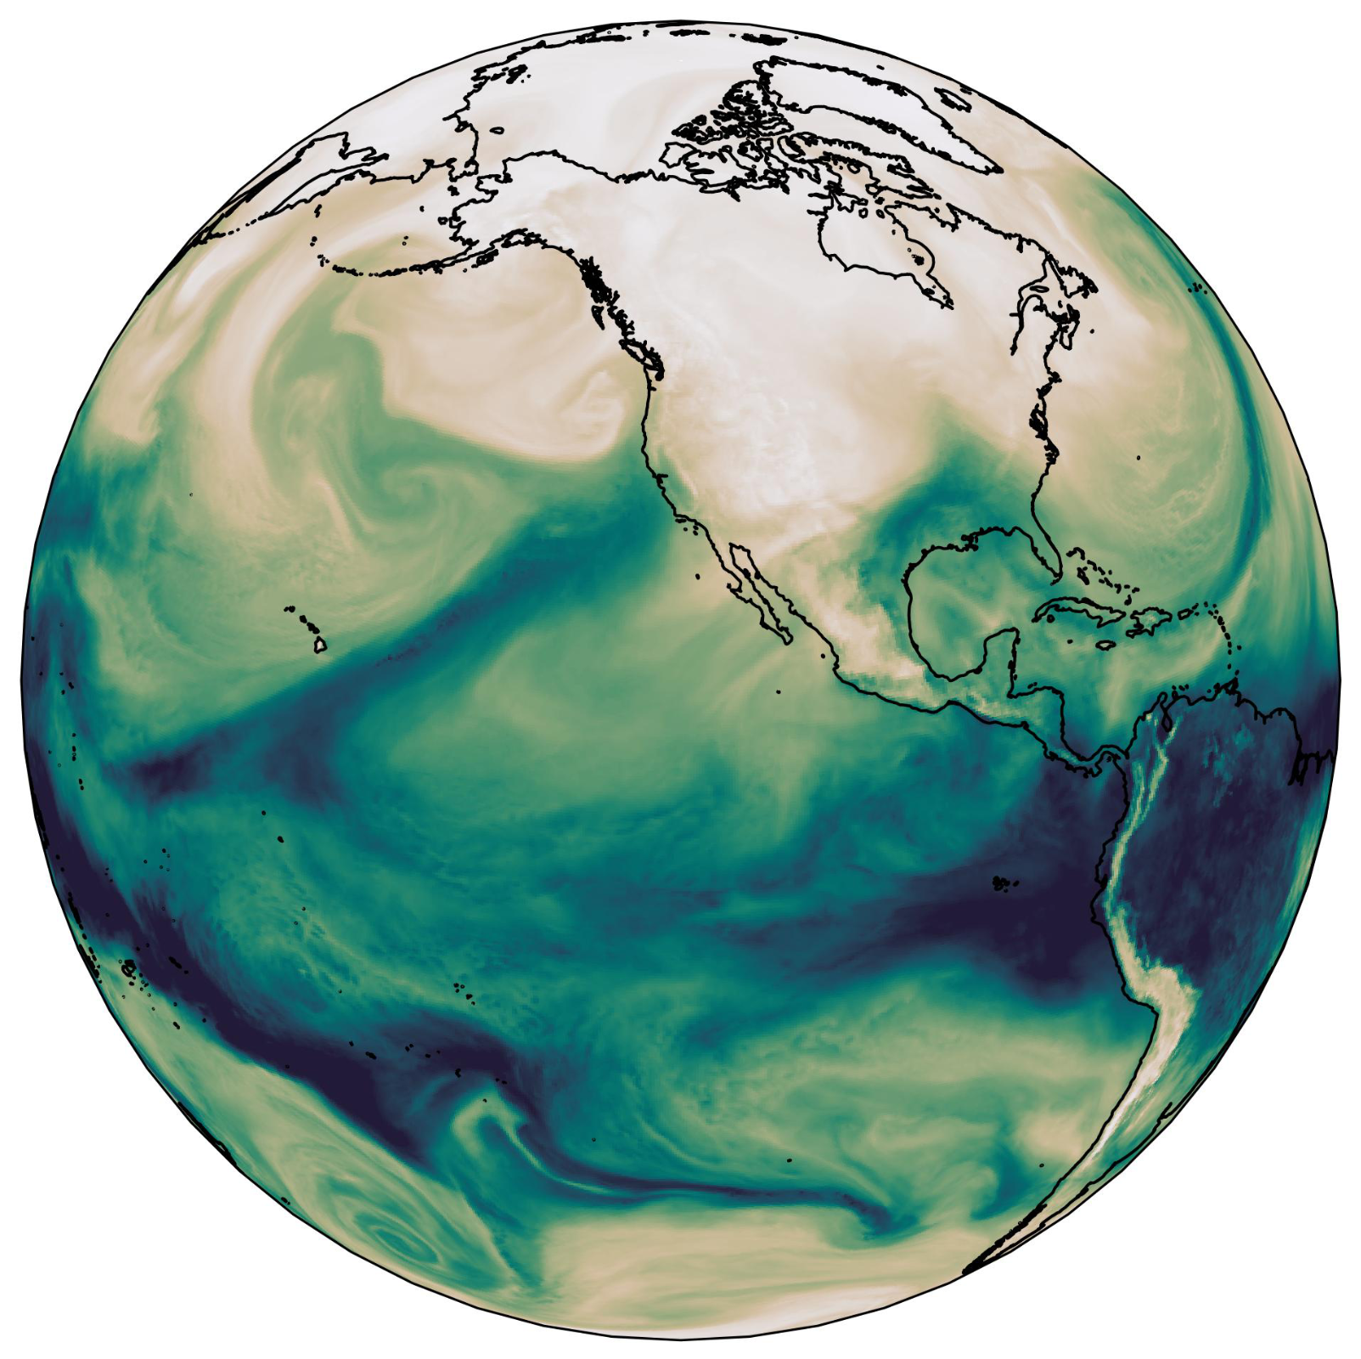
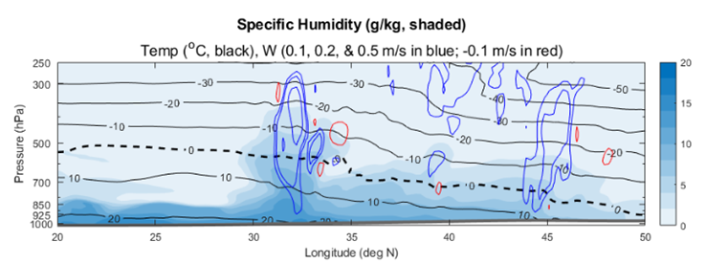
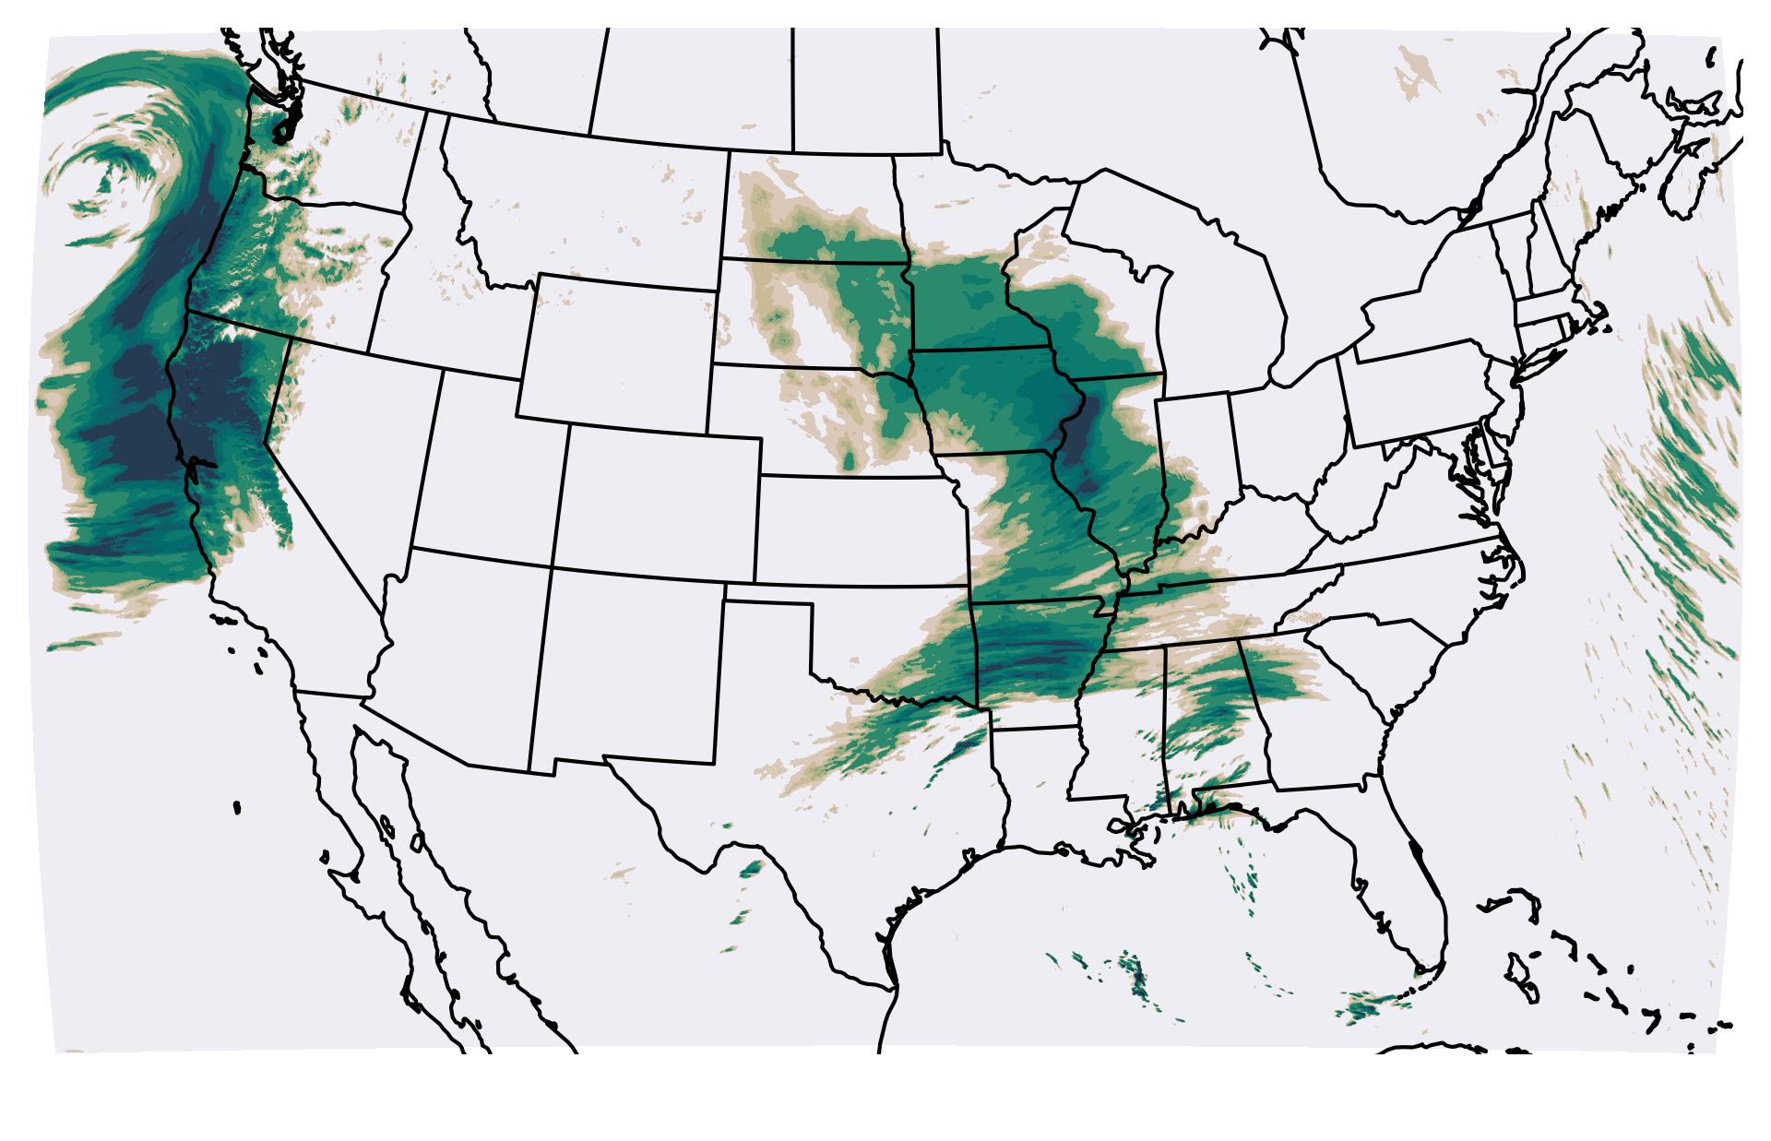
Atmospheric River as an example of cross-scale forecast problem
3850 km
Transport of tropical moisture to the West coast is modulated by the ocean surface (100-1,000 km).
AR precipitation over the West coast is terrain driven (~10 km).
Data driven approach: use ML to compress ~1 decade of GFS & HRRR + 4 decades of UFS-Replay knowledge into a single prediction system
Steering of the AR is driven by large-scale pressure gradients
(5,000-10,000 km).

Slide 4
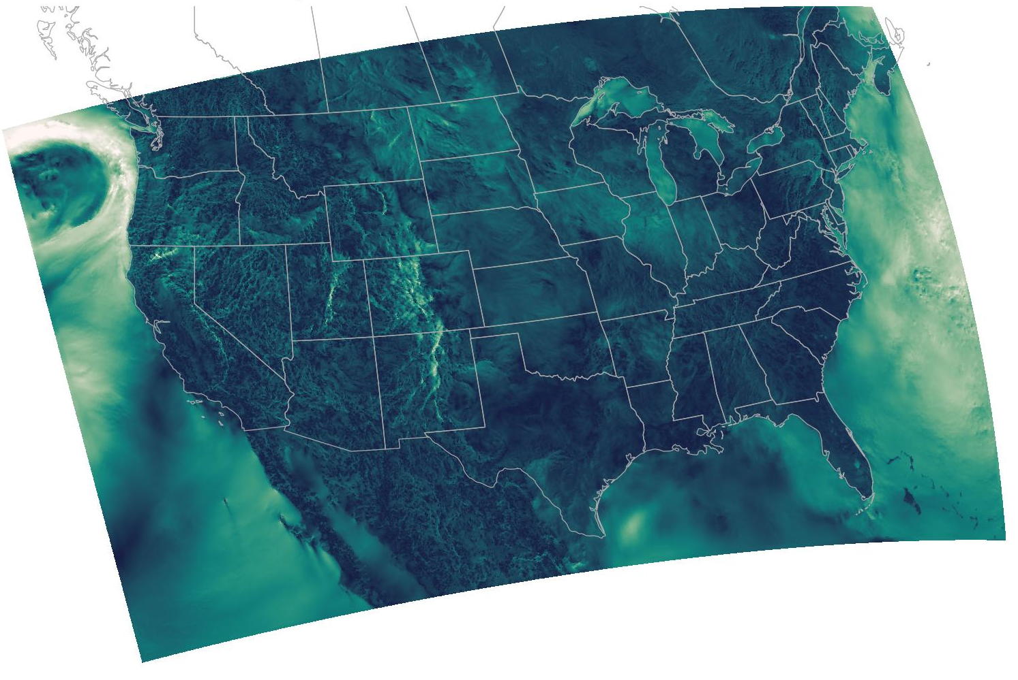
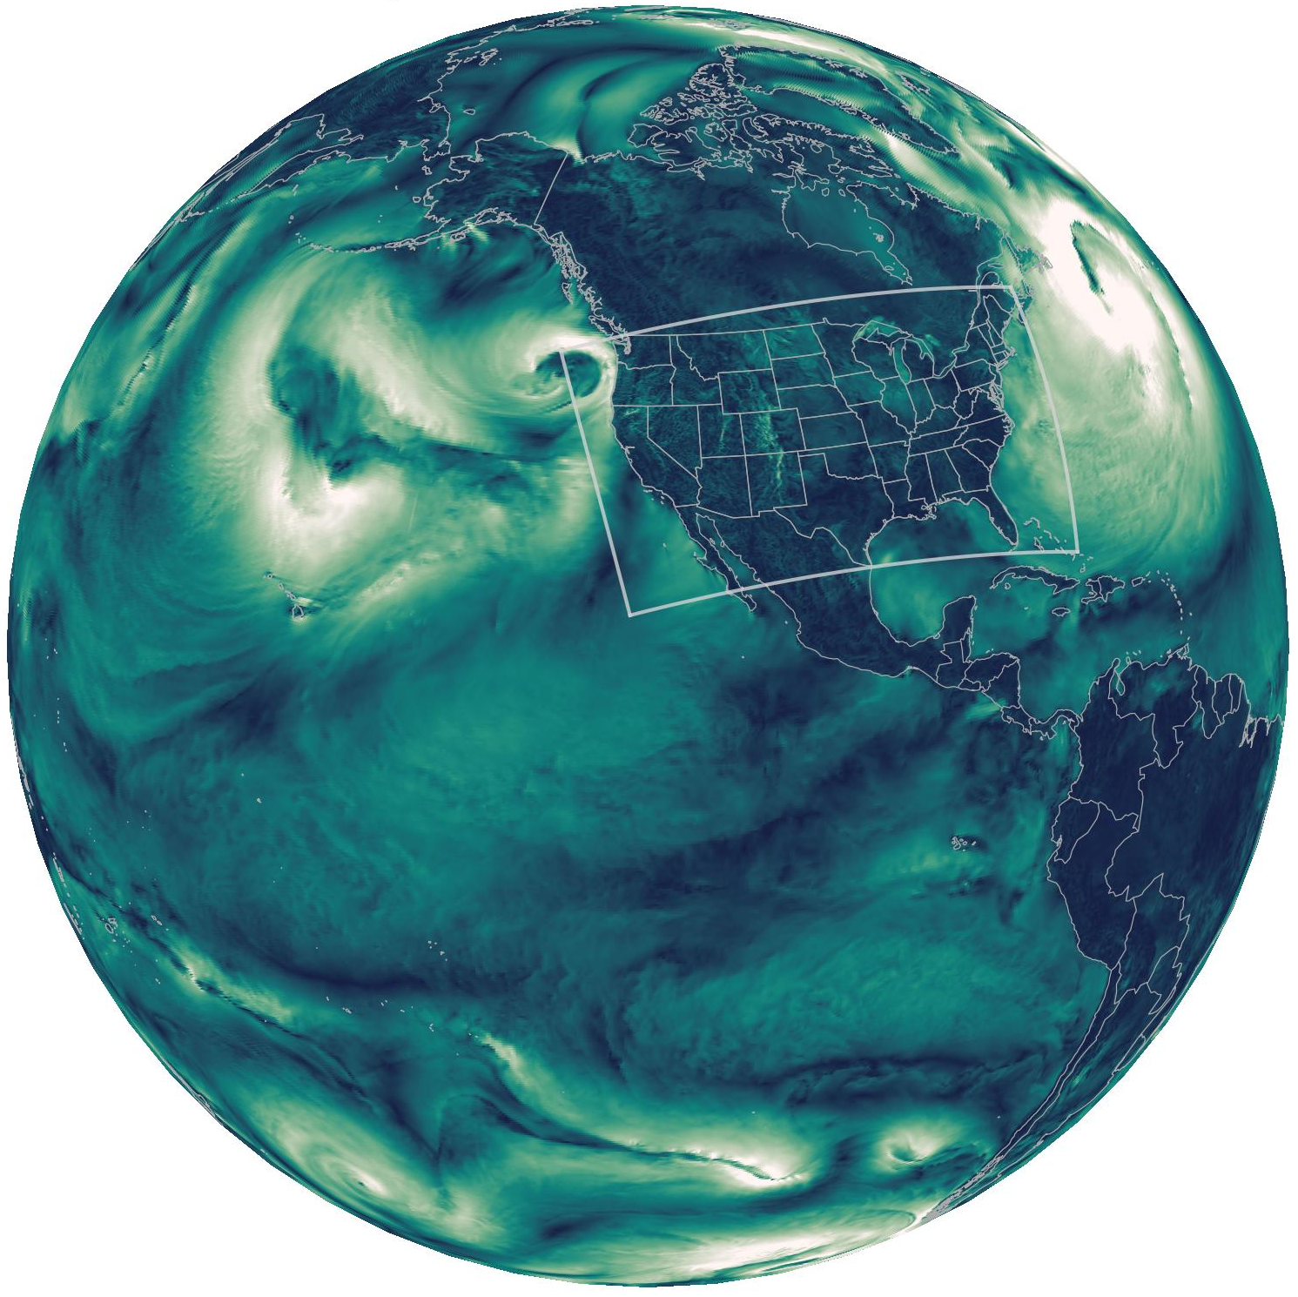

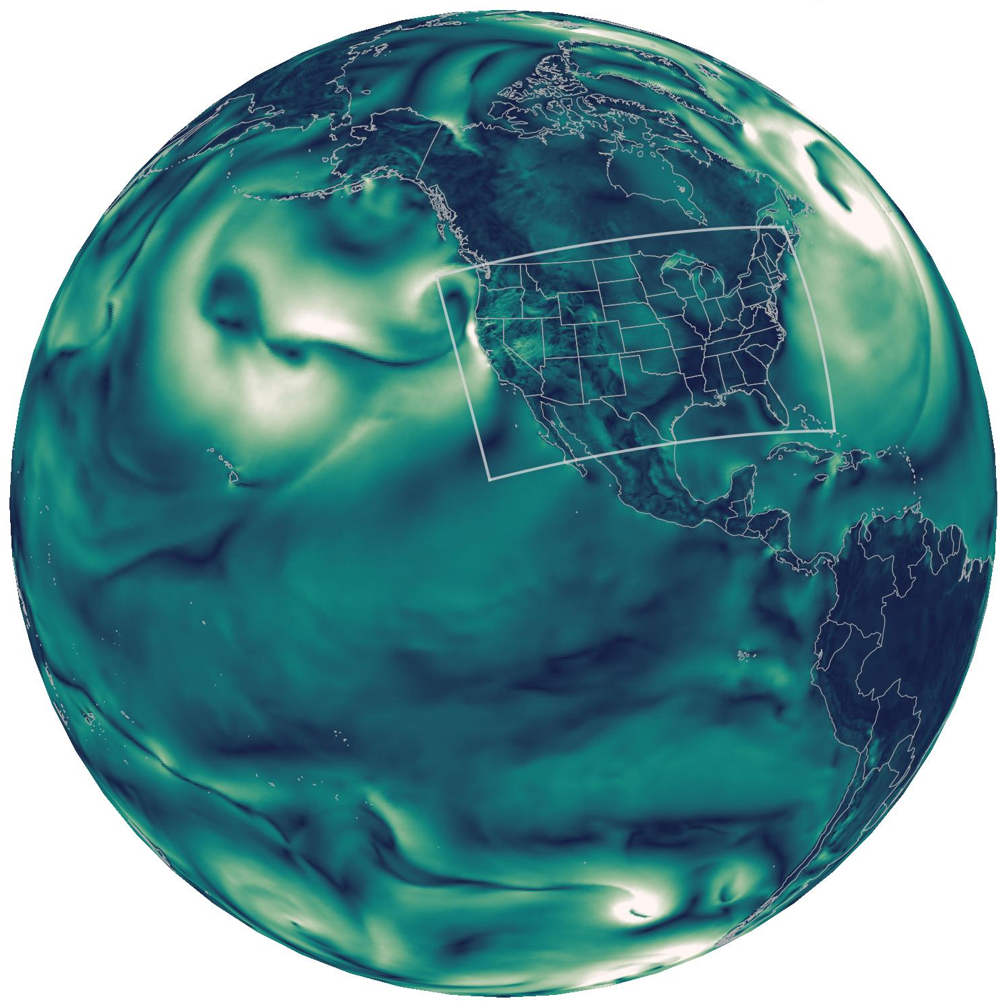
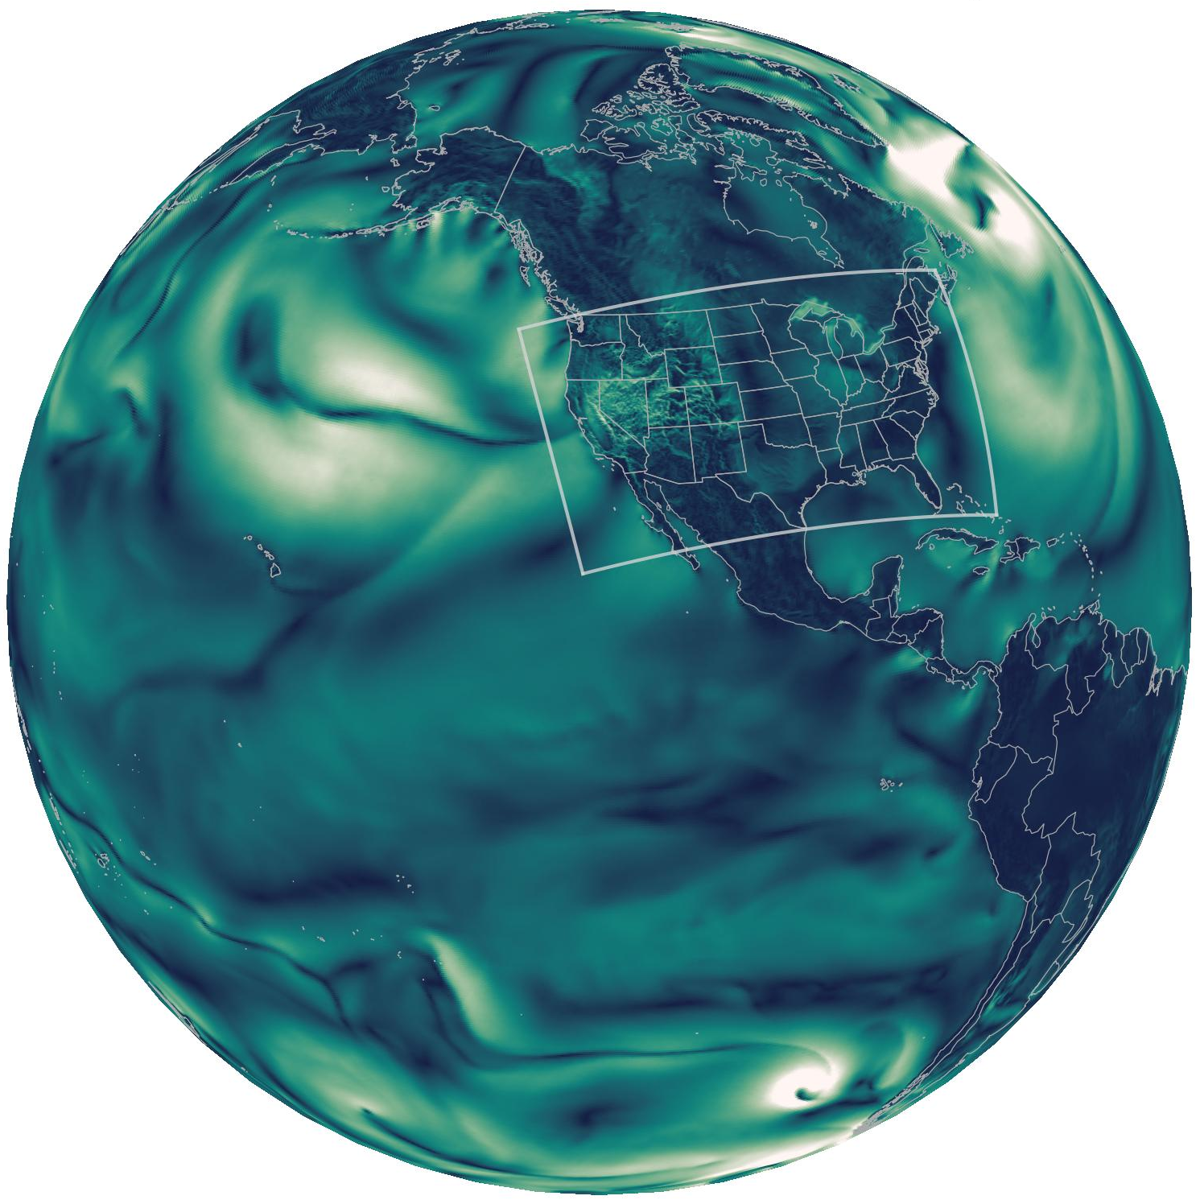

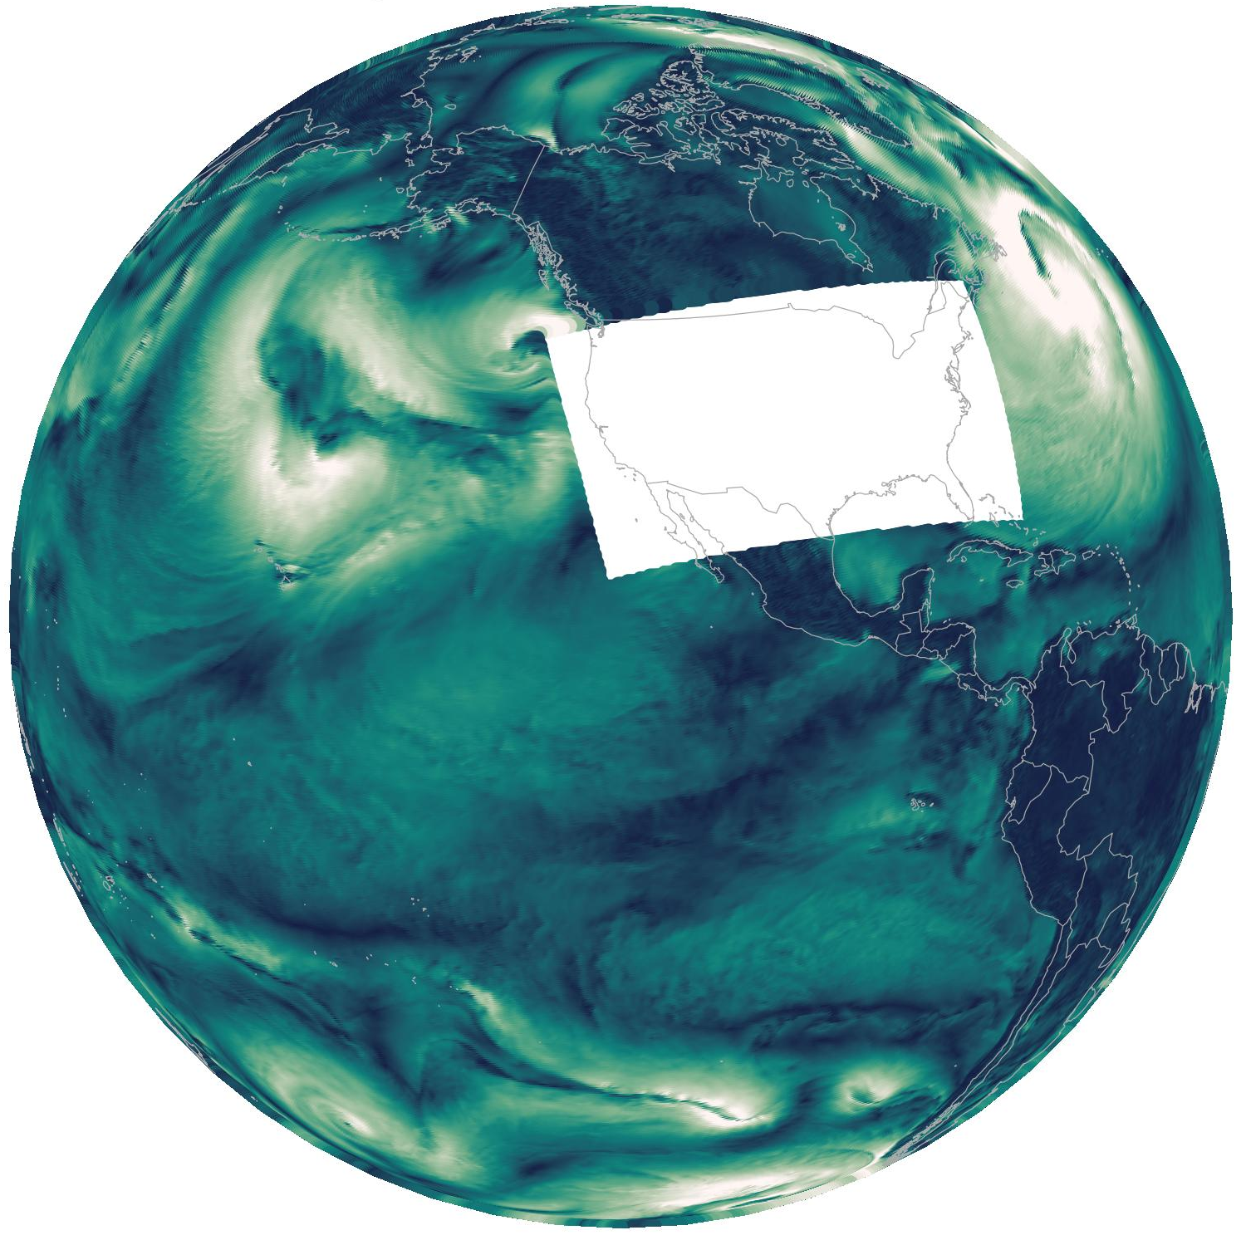




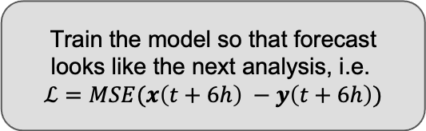
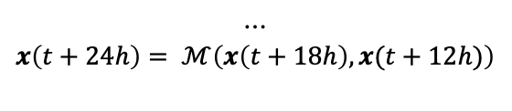
GFS + HRRR = Nested-EAGLE
Train the model so that forecast looks like the next analysis, i.e.
$$ℒ=MSE(x\left(t+6h\right) −y\left(t+6h\right))$$
HRRR fhr = 0
Nested-EAGLE
$$ℳ\left(x\left(t\right), x(t−6h)\right)$$
$$x\left(t+6h\right)= ℳ\left(x\left(t\right), x(t−6h)\right)$$
Nested-EAGLE
Initial Conditions
$$x\left(t\right)$$
$$x\left(t+12h\right)= ℳ\left(x\left(t\right)+6h, x(t)\right)$$
$$⋯$$
$$x\left(t+24h\right)= ℳ\left(x\left(t+18h\right), x(t+12h)\right)$$
Follows approach pioneered by Nipen et al., (2026) at Met Norway, and directly benefits from open-source contributions by the Anemoi team.
GFS fhr = 0
(HRRR Cutout)

Slide 5

Evaluation

Slide 6
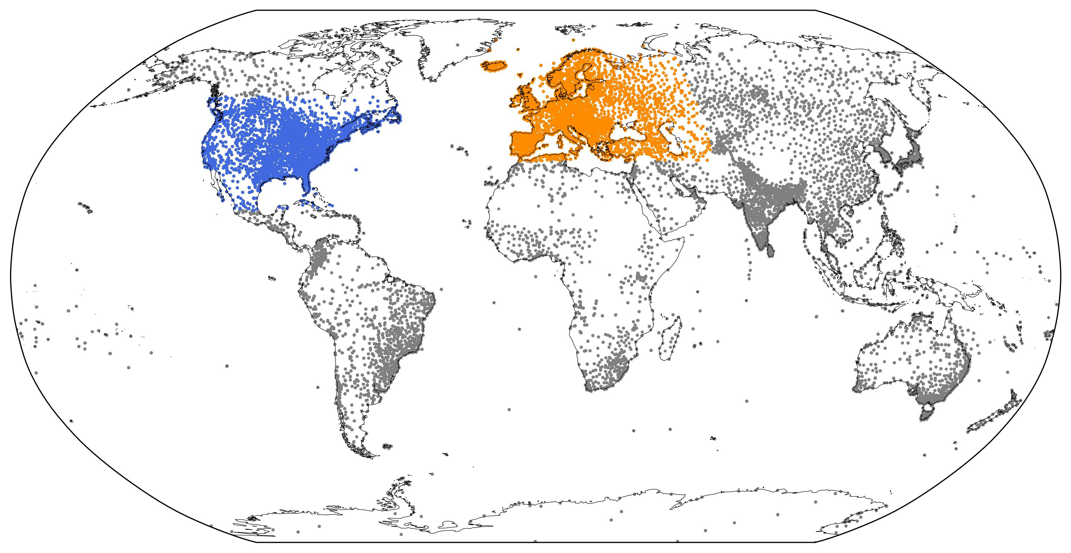
Prognostic Skill Over US & Europe
293 forecasts initialized during Feb 2024 - Jan 2025
Conservatively regridded to 6km (US) and 0.25° grid (Europe/Globe)
  Processing with ufs2arco
Bilinearly interpolate to conventional observations from NOAA/Brightband NNJA-AI dataset
  Includes e.g. dropsondes, rawinsondes, aircraft, SYNOP/METAR station data
  Data ingest via nnja-ai and comparison via eagle-tools
Example of evaluation coverage on 7 Dec 2024

Slide 7
Prognostic Skill Over CONUS vs Conventional Observations
~2 day skill gain to 5 days in
2m Temperature, 10m Winds
Slight advantage to ~5 day
850 hPa Temperature
Competitive Z500 and upper air winds
Notes:
Assign colors, near surface variables along the top, and upper atmosphere variables along the bottom
First, the near surface variables are where we see the most positive results. Here Nested-EAGLE outperforms the two operational baselines out to at least 5 days or so.
Near surface improved initial conditions are from...
HRRR’s hourly assimilation cycle and higher spatial resolution
Better land model, can make better use of near surface observations
Better observational coverage, uses more station data than GFS
For near surface winds, it leads HRRR and GFS by a sizable margine, with approximately a 2 day lead in skill gain over looking at the near surface variables,
In the upper atmosphere, the skill gain is much more muted

Slide 8
Prognostic Skill Over Europe vs Conventional Observations
Outside of the US, Nested-EAGLE tracks a model trained only on GFS analysis
Unfortunate US benefits don’t carry over due to supervised learning task
At least not overtrained to US - still a good global MRW model!
Notes:
Note that we had to play with the loss function a bit, so this was a good check that we were not over prioritizing the US

Slide 9
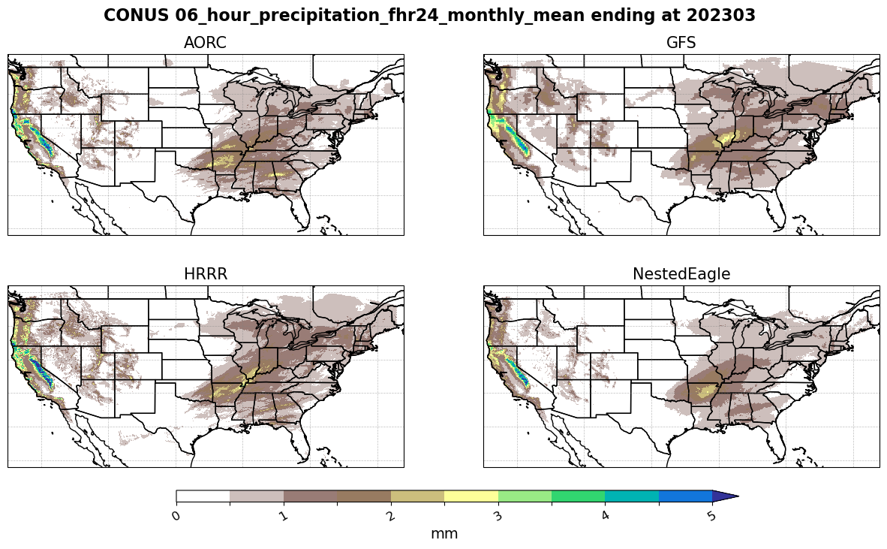
Preliminary evaluation for precipitation
Precipitation in the nested model is biased low (see AIGFS v1.1. for potential fix). But placement of precipitation is better than in GFS or HRRR.

Slide 10
Skill Gain from Errors of the Day, or Learned Constraints?
The models relax to the errors corresponding to their training
In this framework, improved initial conditions must be incorporated into training
Notes:
The ML models still rely on GFS and HRRR initial conditions to run a forecast
Here we use these two models to understand how much of the skill in their forecasts are coming from the initial conditions, and how much is baked into the model at training time.
Nested-EAGLE is robust to degraded (relatively speaking) ICs, and it is clear that the nested training was beneficial in order to capture gains from HRRR analysis.
Improvements presumably from:

Slide 11
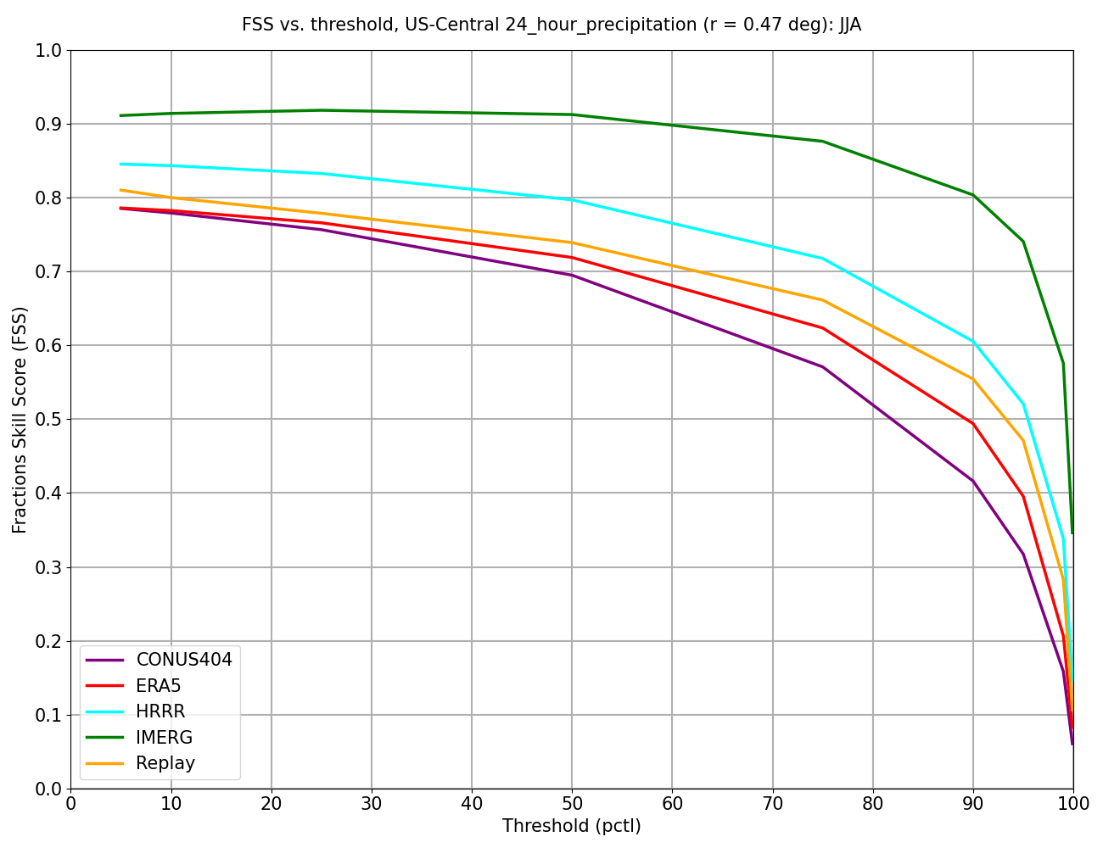
Should we abandon variable resolution and switch to global km-scale?
The AI models relax to the errors corresponding to their training
With present technology, we can either generate training dataset using a free-running model at 3 km over the entire globe or with regional refinement
Free-running models (e.g. CONUS404) are scientifically less skillful compared to data-constrained models (e.g. HRRR).

Slide 12
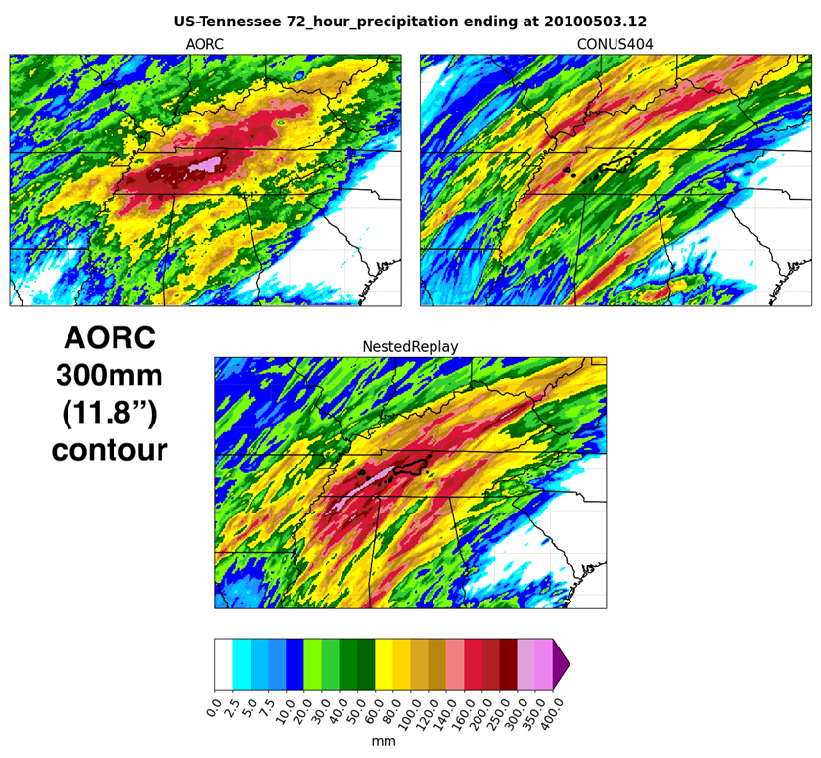
Nested Replay: training data for the next version of Nested-EAGLE
NOAA PSL aims to generate new training data for Nested-EAGLE models
(potential new collaboration with AOML)
Nested UFS configuration:
Atm-only UFS 12 km global, 3 km CONUS replayed to ERA5.
Production starting later this summer (length ~10 years).
Early results show promising skill for improved representation of precipitation extremes.

Slide 13
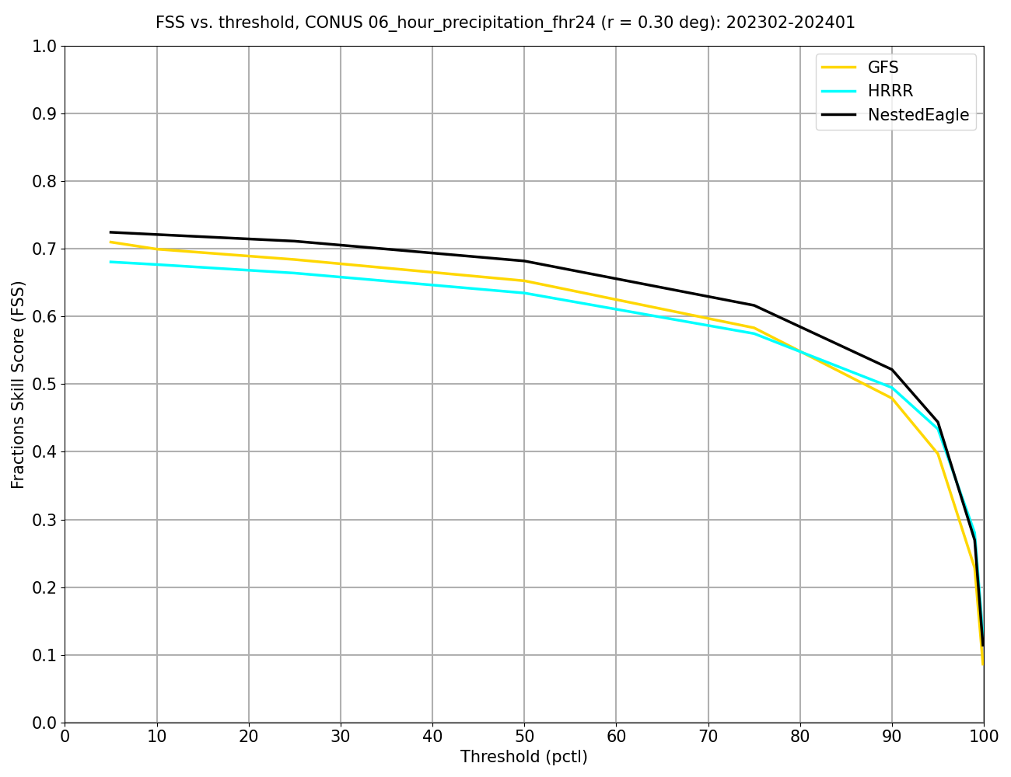

Summary
Nested-EAGLE outperforms NOAA’s current NWP suite for near surface quantities, providing short to medium forecasts all-in-one
  These improvements are due to using better NOAA data in training (HRRR)
  Precipitation shows blurred features: Good location, bad amplitudes
Open, reproducible, and accessible. The pipeline consists of pip & conda installable packages and yaml files
ufs2arco
wxvx

Slide 14

Next Steps
MITRE/PSL: Higher temporal resolution and ensemble development (See poster by Josh de Rosa)
Staged pre-training to further improve skill
(similar to Nipen et al., (2026))
Learn from observations directly
Add coupled ocean.
The model has been running in a Near Real Time, quasi operational setting since April.

Slide 15
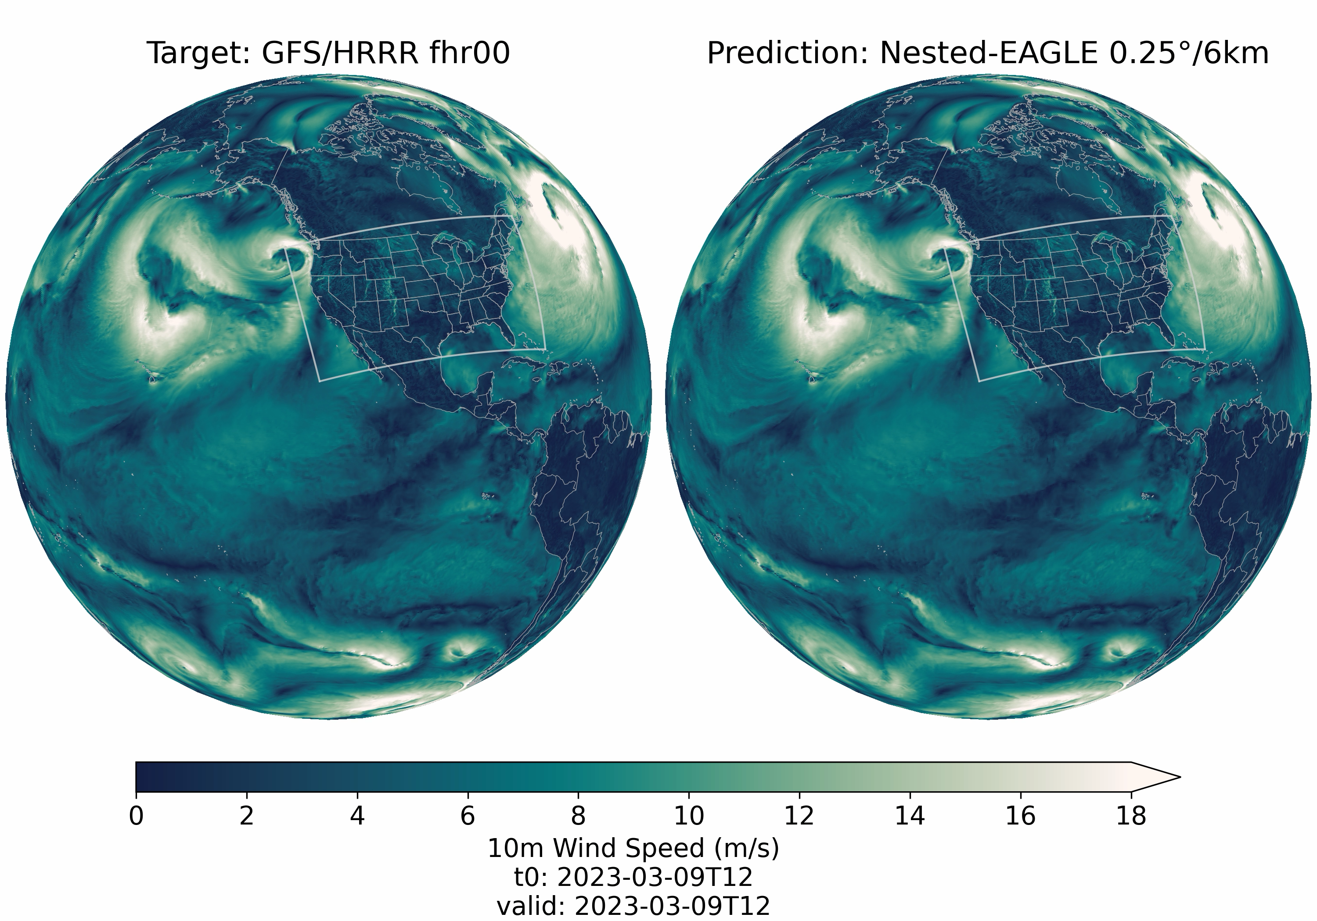
Qualitative 10 Day Forecasts
Notes:
Can visually see features look good in the predictions.
Can follow individual synoptic scale storms in the target and predictions out to ~5 days, about what we see in the RMSE analysis
See some relatively sharp features in the predictions, at least over the mountainous regions and e.g. over the great lakes
Definitely smooth otherwise, especially over the Pacific ocean and over the US plains
After 5 days though, encouraged to see that the fields don’t lose all resemblance to reality, we just don’t see a 1:1 match like we were seeing in the first 5 days.
Also encouraged to see seamless behavior at the boundary, as this is not always the case in the data. The model is learning a dynamical representation that is stitching these two subdomains together.
Have not evaluated stability, but simply good to see visual lineup with the objective reality shown before

