Slide 1

UFS-DeepAQM:
A deep learning extension of the Unified Forecast System Air Quality Model
Wei-Ting Hung¹, Jia Xing², Youhua Tang^{1,3}, Barry Baker⁴,
Patrick C. Campbell^{1,3}, Zachary Moon³
¹Center for Satellite and Earth Science Research, George Mason University, Fairfax, VA
²Department of Civil and Environmental Engineering, the University of Tennessee, Knoxville, TN
³Air Resources Laboratory, NOAA, College Park, MD
⁴National Centers for Environmental Prediction, NOAA, College Park, MD

Slide 2
Background
Air quality forecasting (AQF) is important for foreseeing and protecting the public from potential hazardous air pollutants from nature and/or anthropogenic sources.
AQF models simulate various atmospheric physical (e.g. transport and dispersion) and chemical processes of air compositions, which often require substantial time and computational resources and limit the capabilities of AQF models for near-real-time applications.
Recently, deep learning (DL) algorithms show good performance in capturing the spatiotemporal variation of key air compositions (e.g. O₃ and PM_{2.5}) driven by meteorological and geographic features, providing reliable forecasts with improved computational efficiency.
This study aims to develop a DL-based model to support the operational application of Unified Forecast System Air Quality Model (UFS-AQM), a UFS-CMAQ-coupled Earth system model developed at NOAA, by extending UFS-AQM’s predictive capabilities:
  Deliver faster performance and support higher resolution simulation
  Serve as ensemble members
  Improve the performance with assimilated/fused observations (ongoing)
Notes:
Emulator, reproduce the physical/chemical mechanisms in UFS-AQM

Slide 3
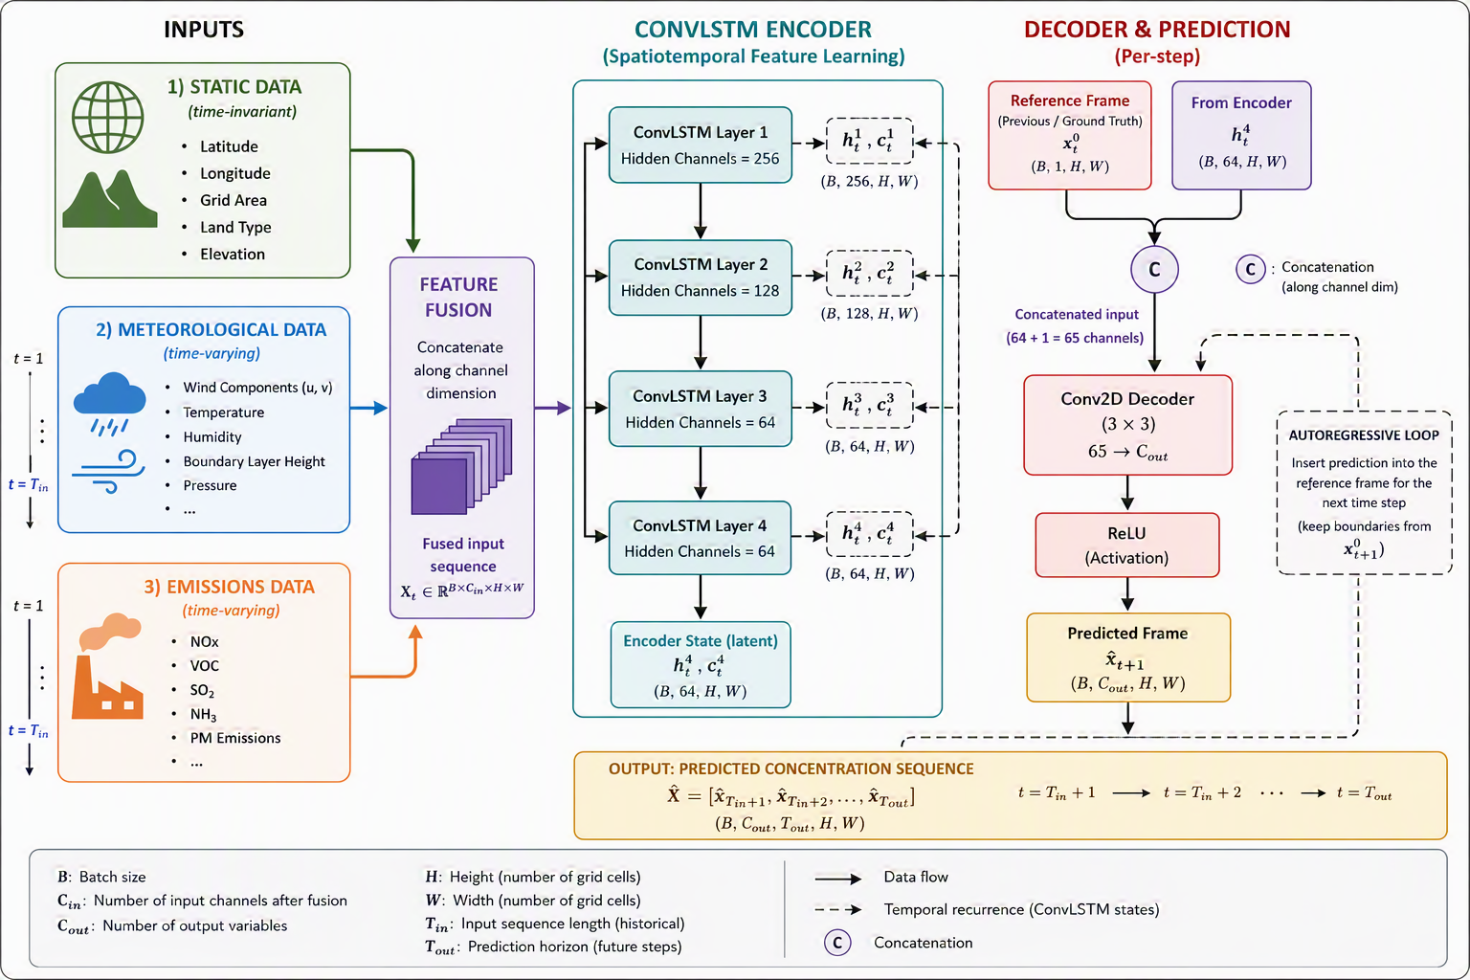
UFS-DeepAQM – 2D ConvLSTM
All inputs come from UFS-AQM
Training period: May 2023 - April 2024
 | Variable
Geography | lat, lon, area, zsurf, land
Meteorology | u10, v10, hpbl, spfh2m, tmp2, veg, dswef_ave, tcdc_aveclm, tprcp, lhtfl_ave, fricv, pressfc, cnwat, snowc_ave
Emission (point, area, fire) | NOx, SO₂, NH₃, VOC, PM_{2.5}
Target | O₃, PM_{2.5}
Notes:
72h input

Slide 4
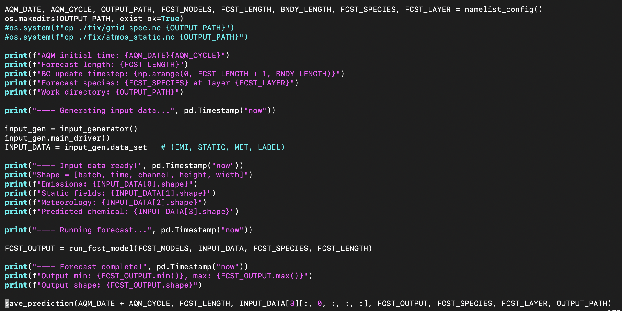
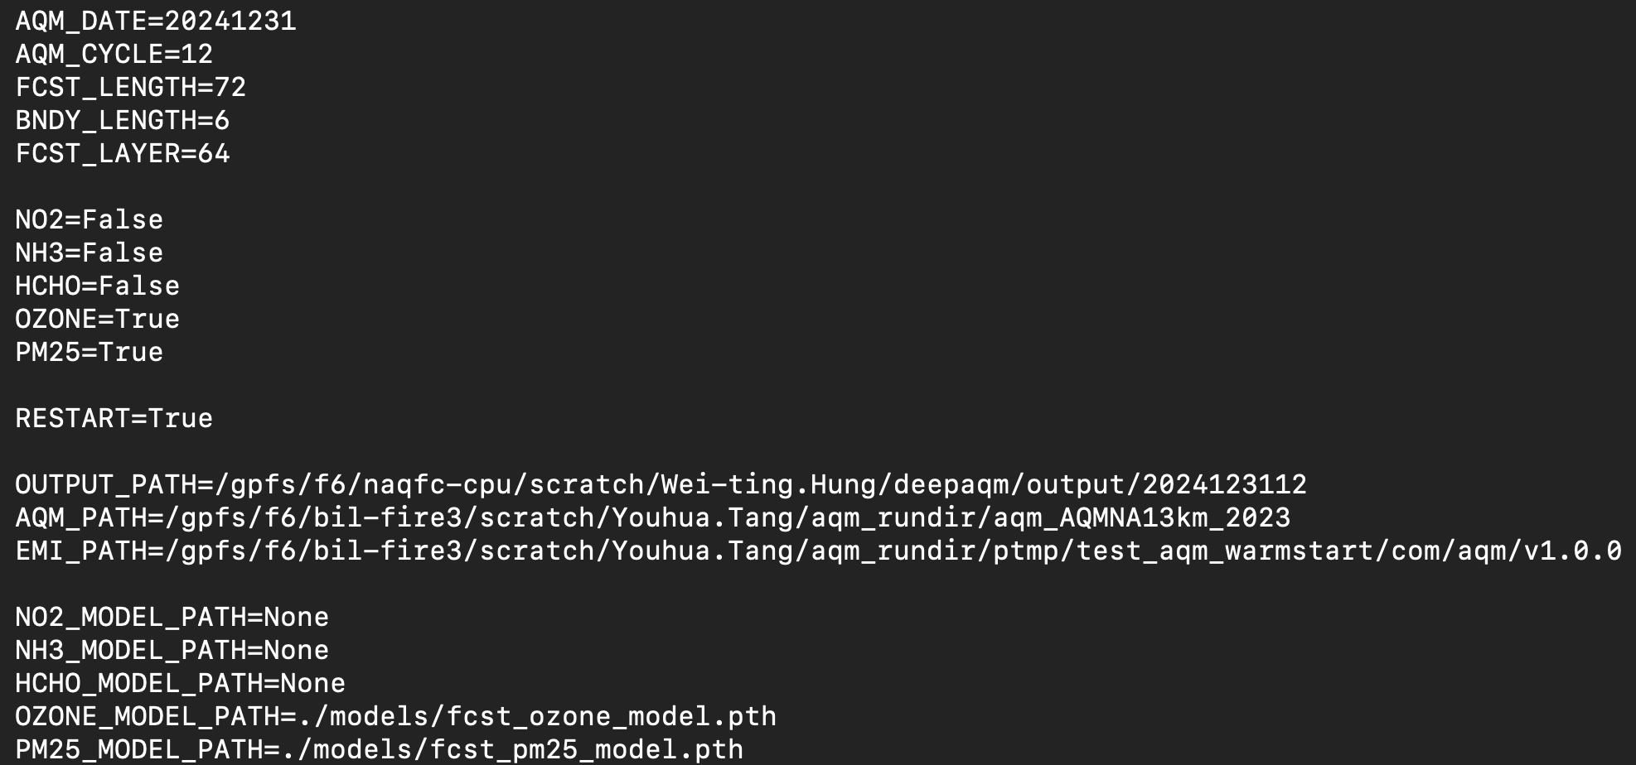
Forecast workflow
Rolling forecast up to 72 h is capable.
72-h forecast takes ~ 12 min (1 core + 2 node on Gaea C6)
namelist

Slide 5
Preliminary results
Evaluation with UFS-AQM and AirNow
Evaluation period: Jan, Apr, Jul, Oct 2024
UFS-DeepAQM can produces forecasts up to 72 h but only the first 24 h is evaluated here corresponding to AQM time.
Key points: 1) how well does UFS-DeepAQM emulate UFS-AQM, 2) performance when comparing with observations
Evaluation tool: MELODIES MONET

Slide 6
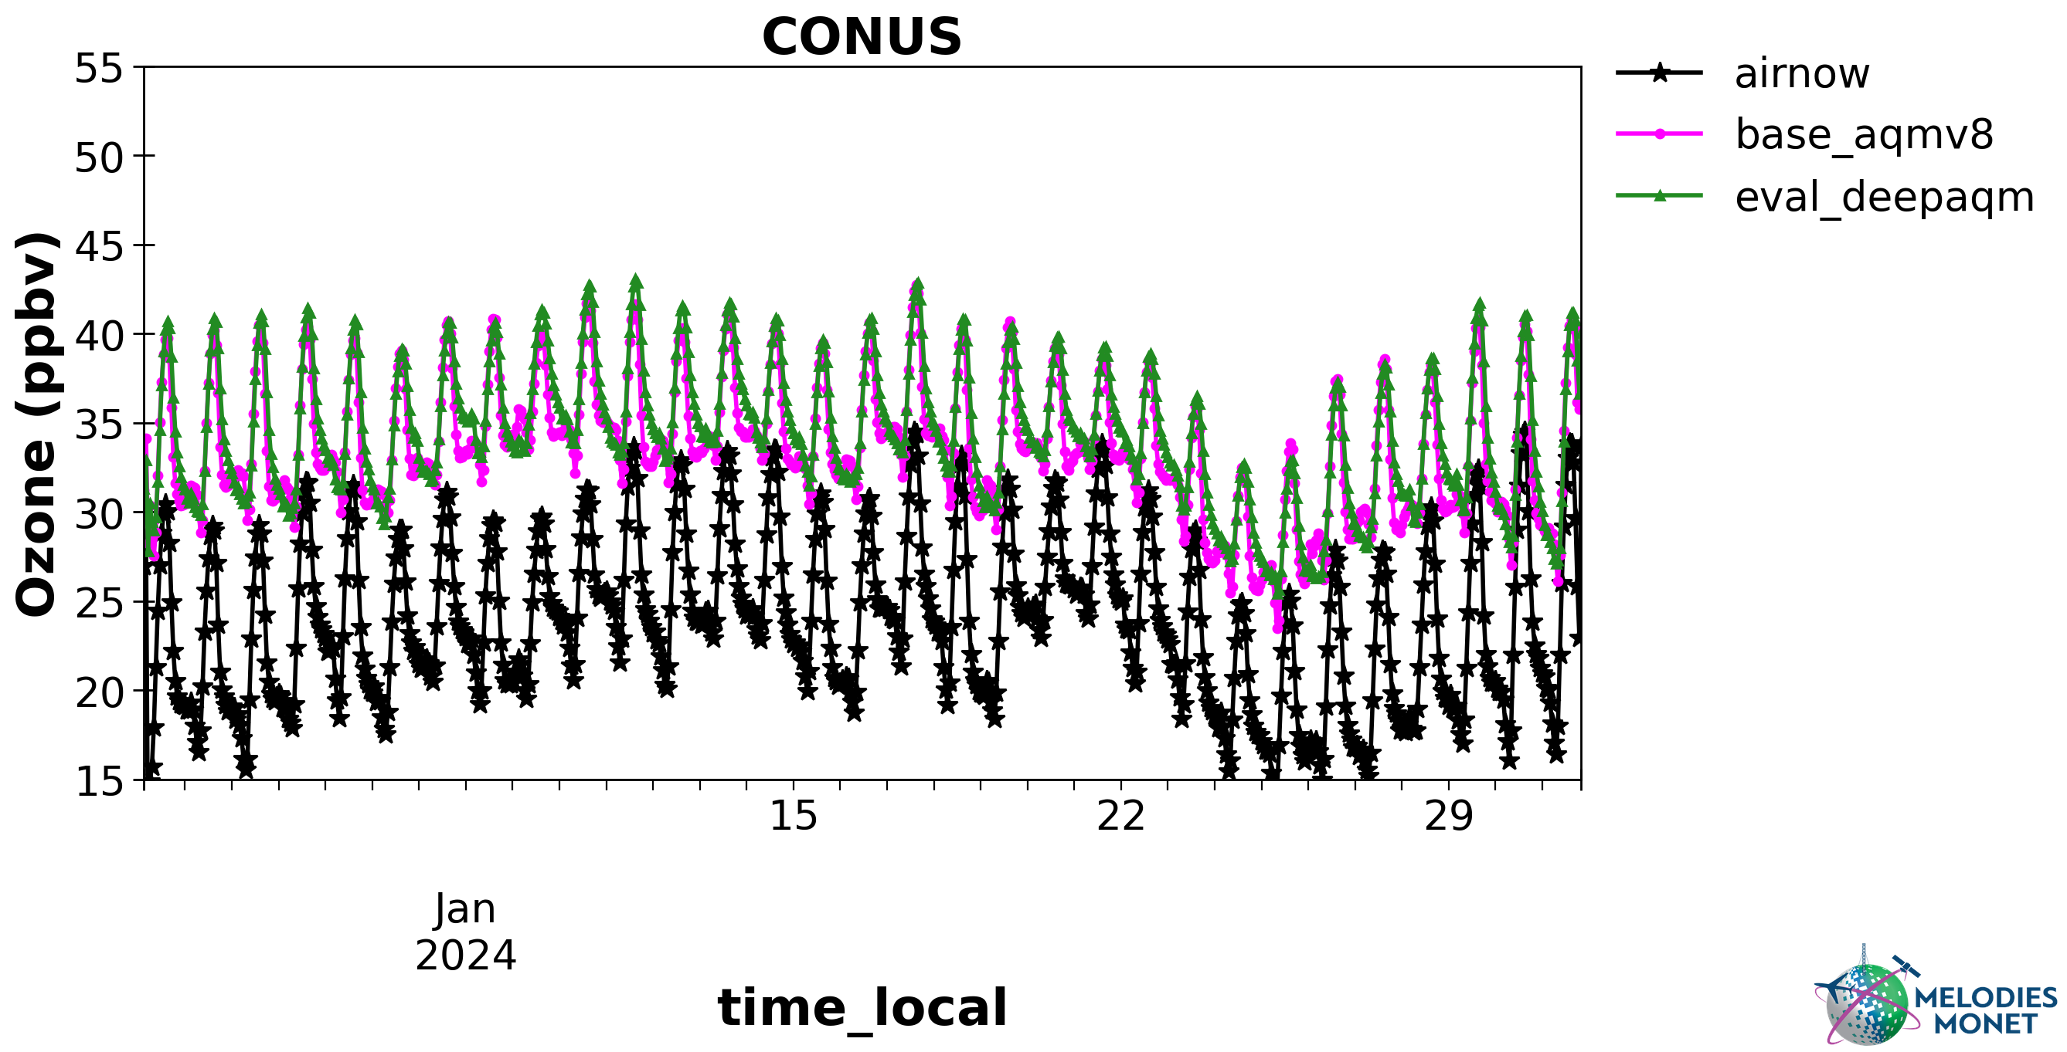
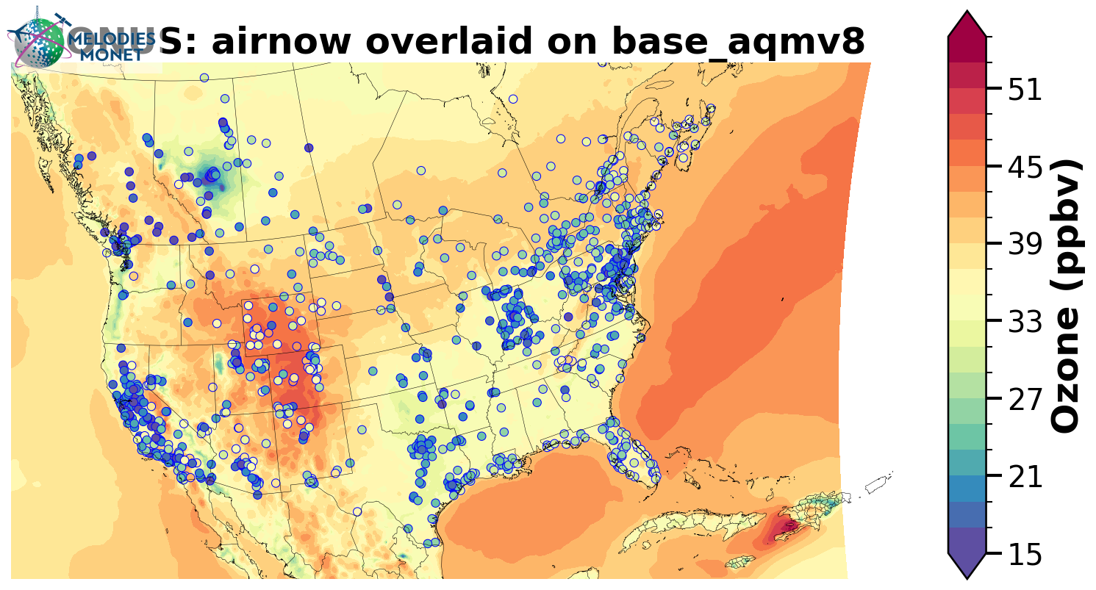
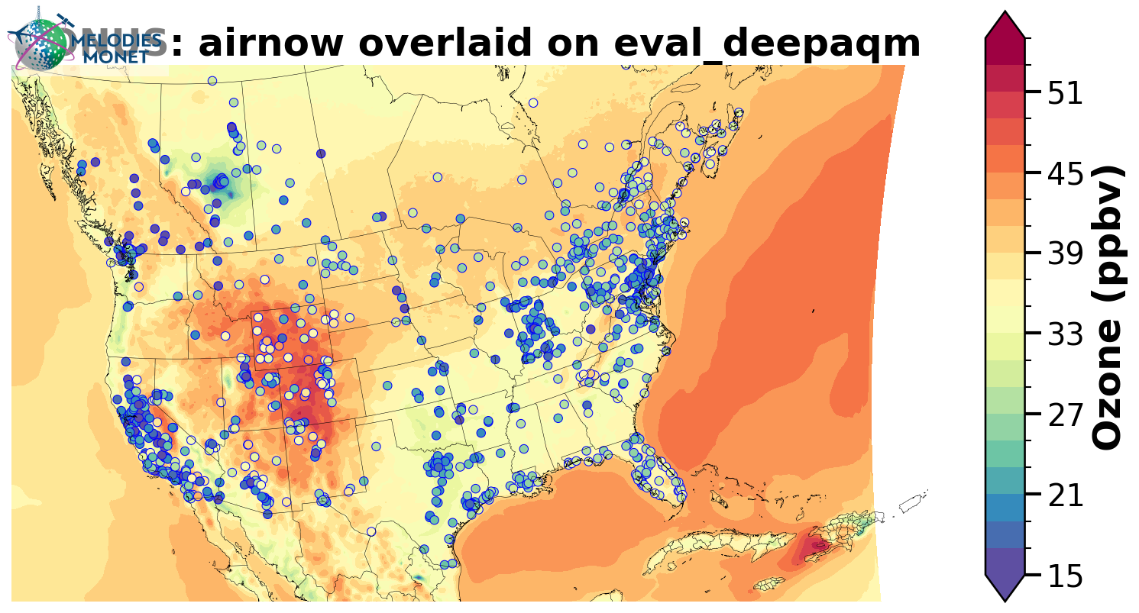
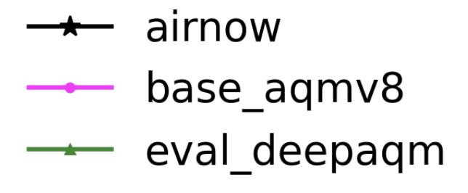
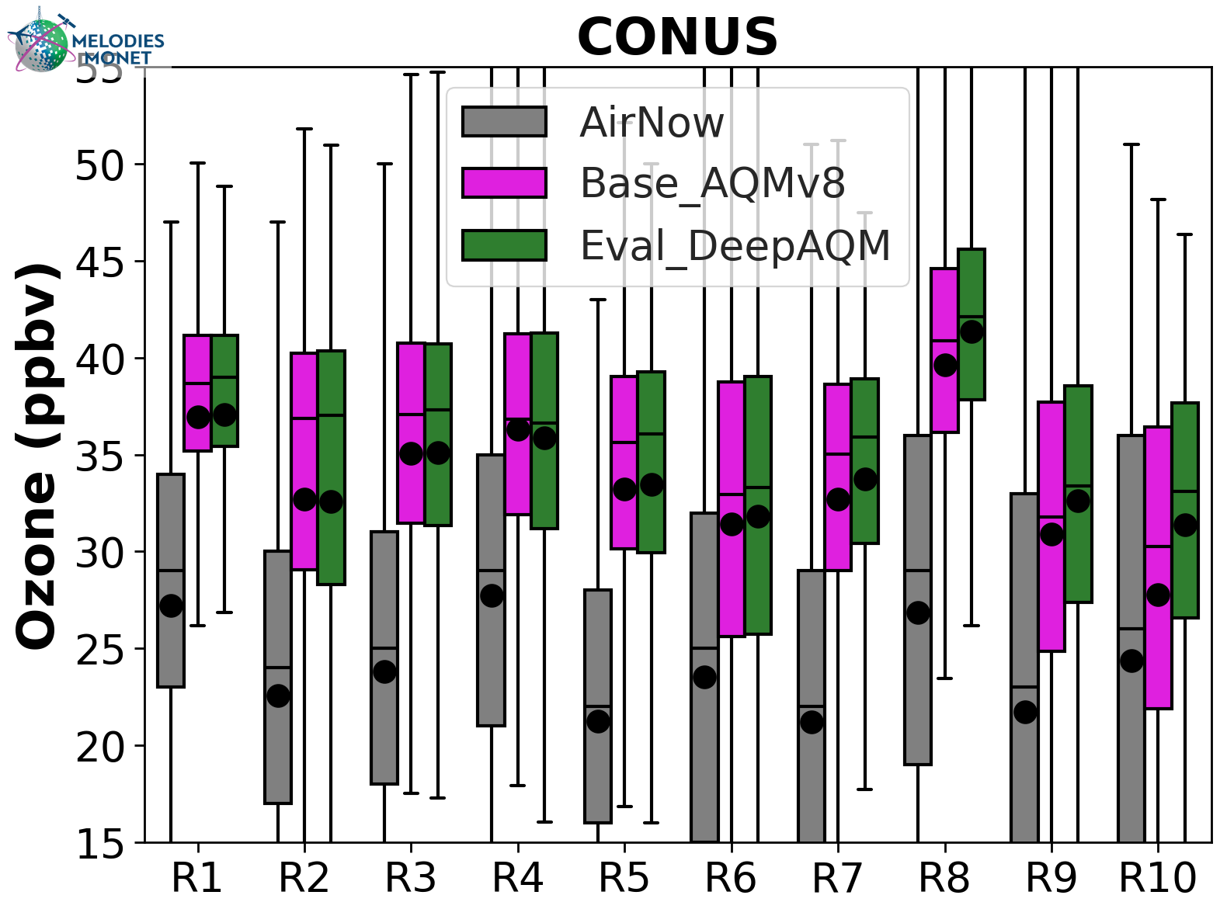
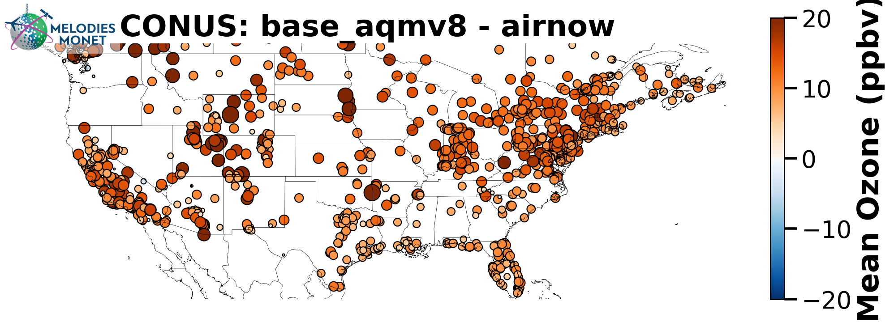
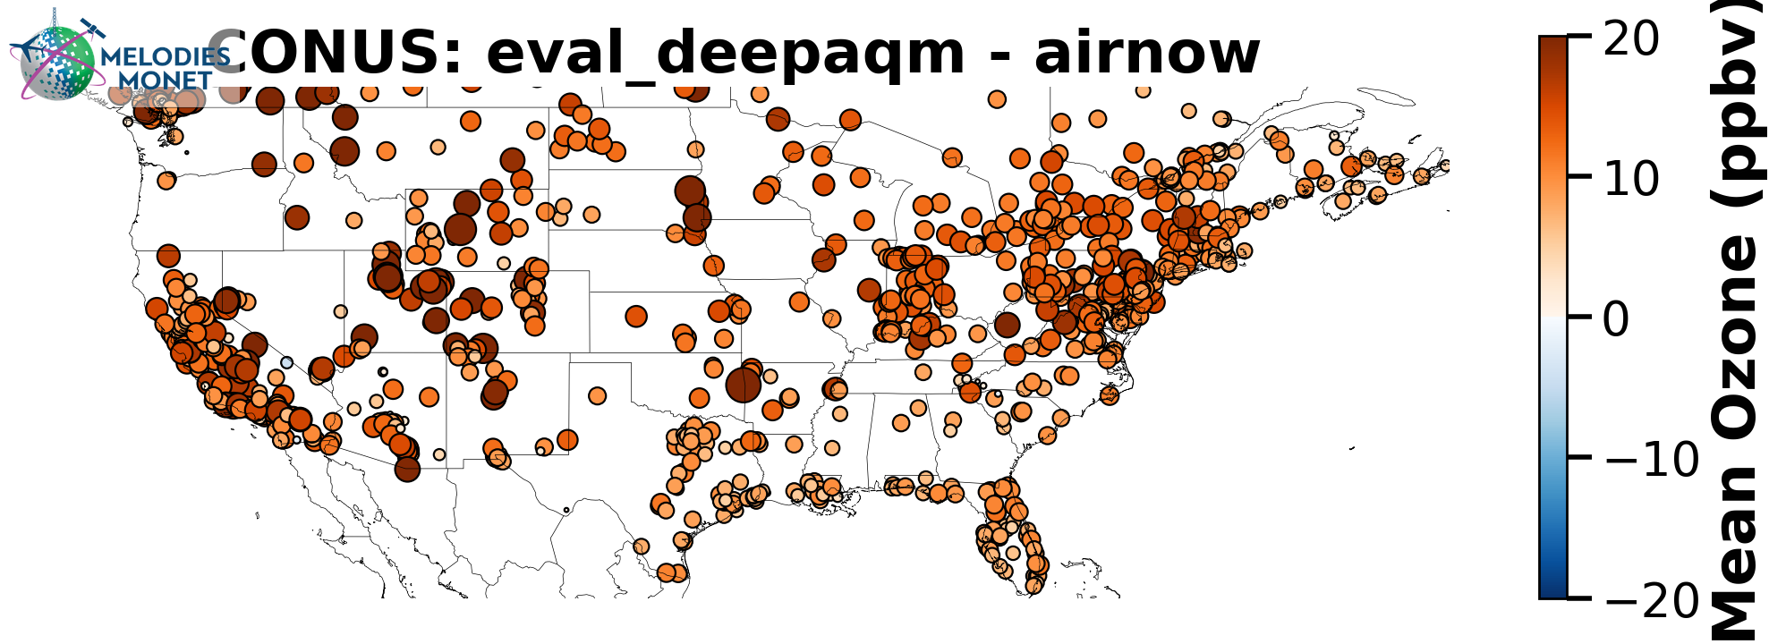
January 2024 (O₃)
UFS-AQM
UFS-DeepAQM

Slide 7
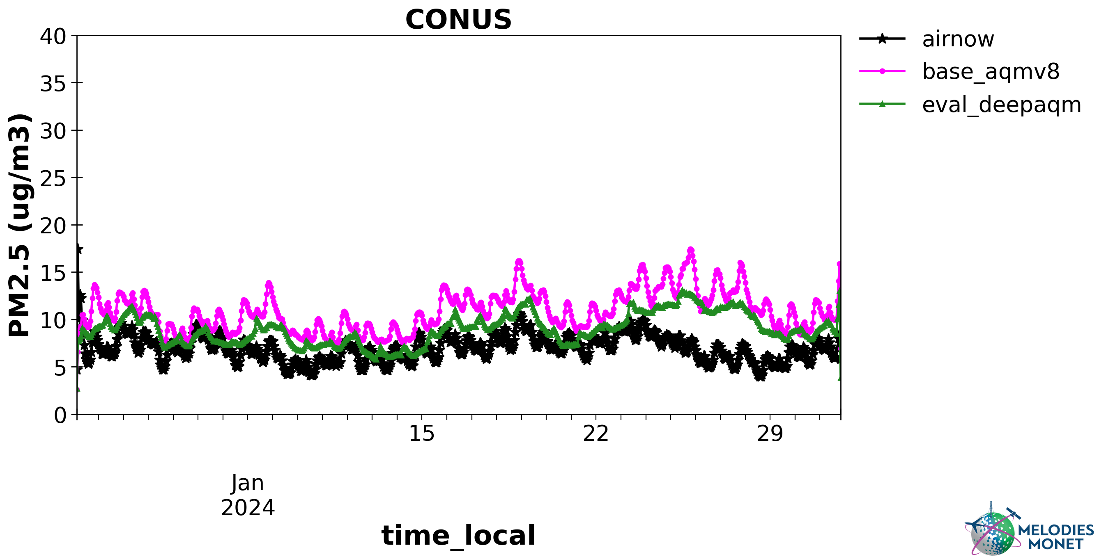
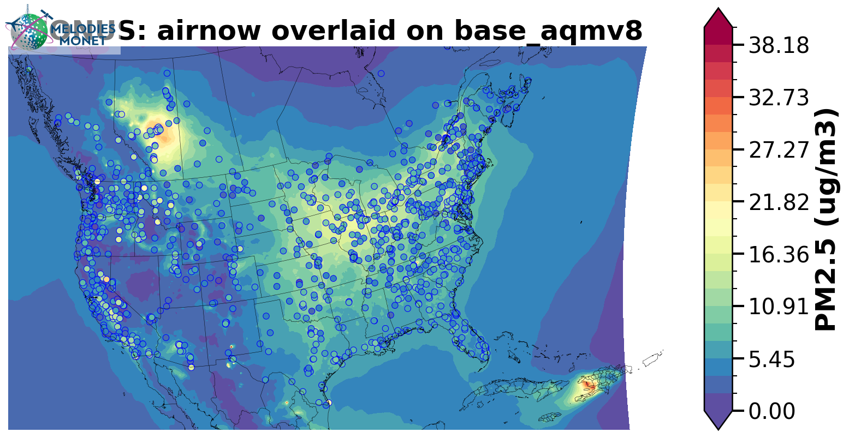
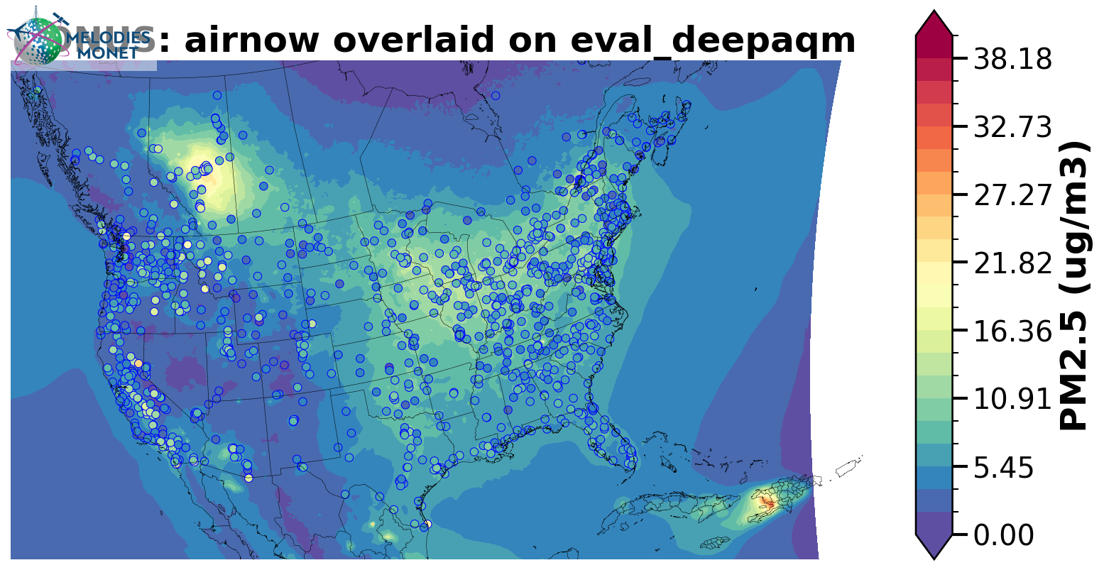
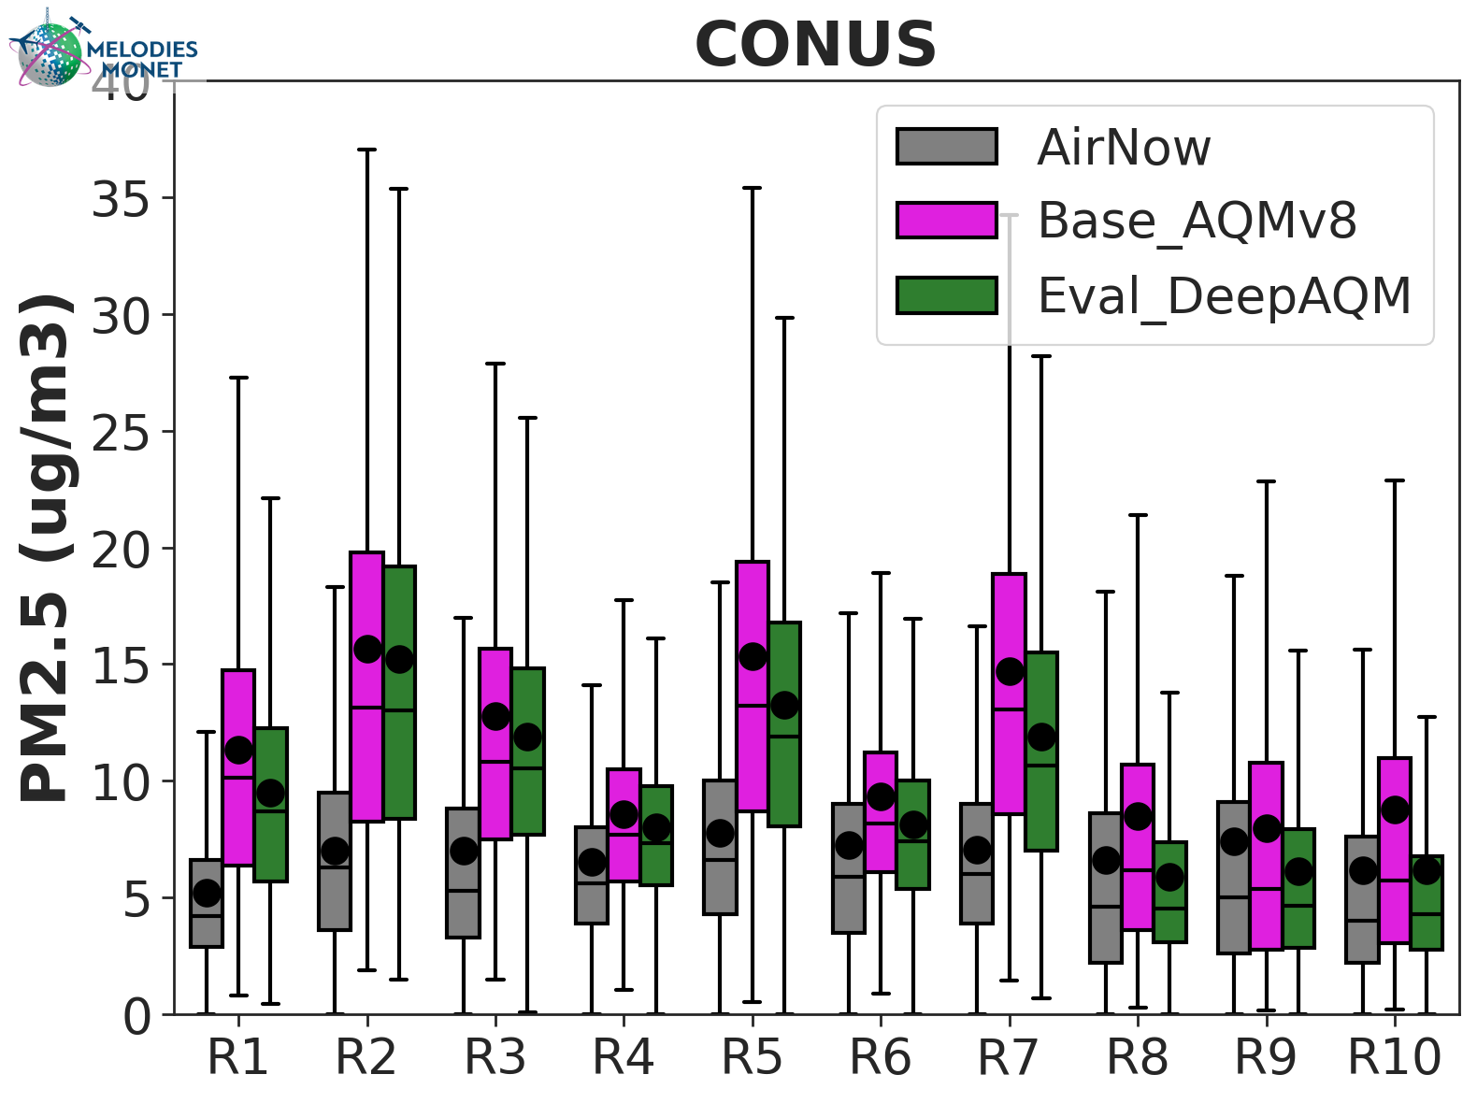
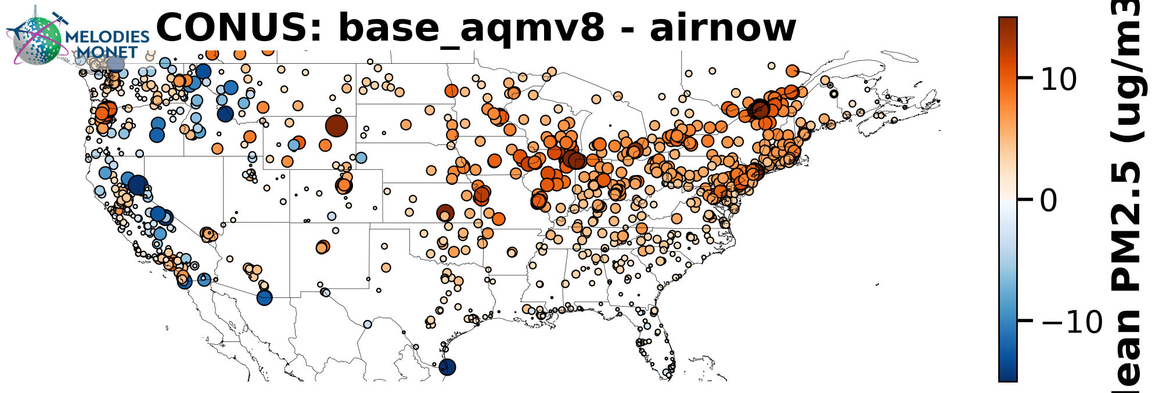
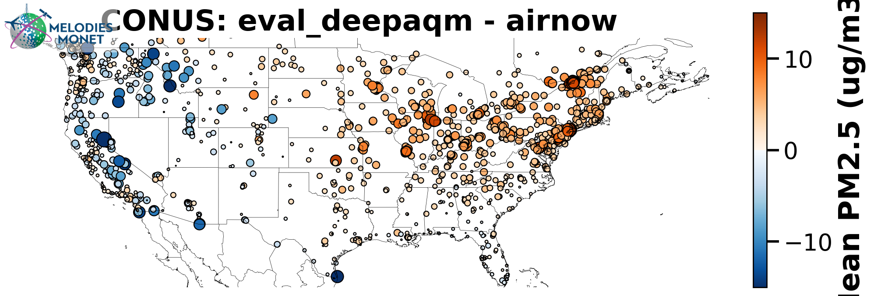
January 2024 (PM_{2.5})
UFS-AQM
UFS-DeepAQM

Slide 8
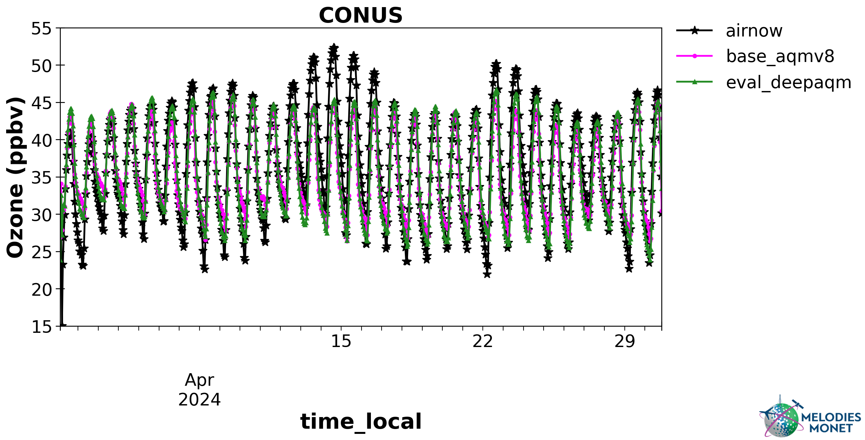
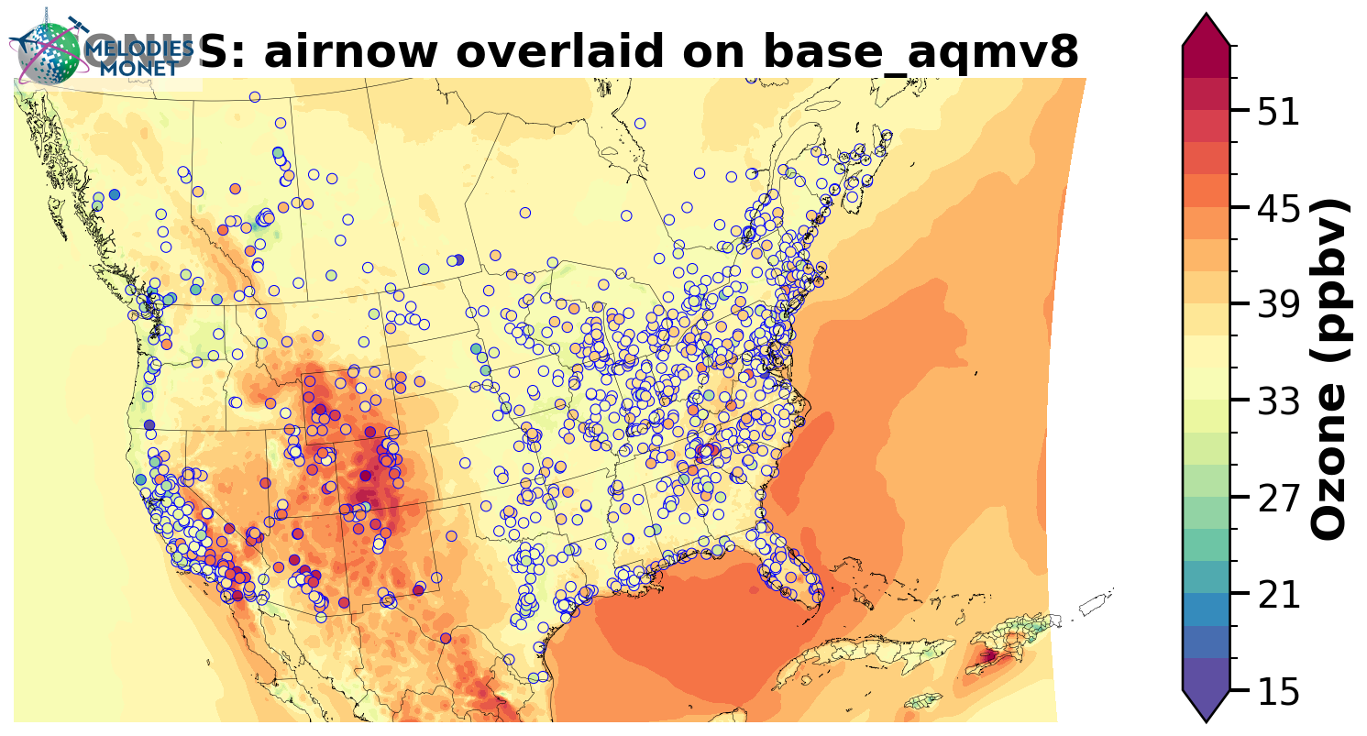
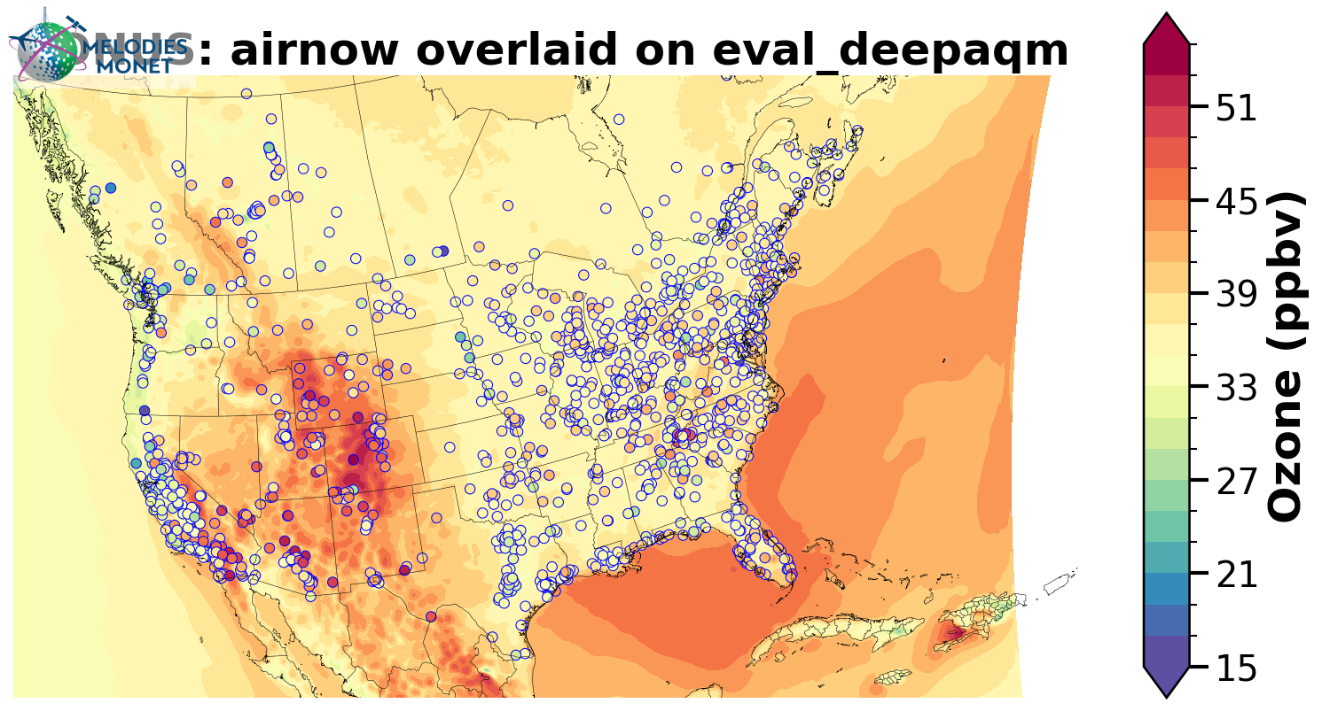
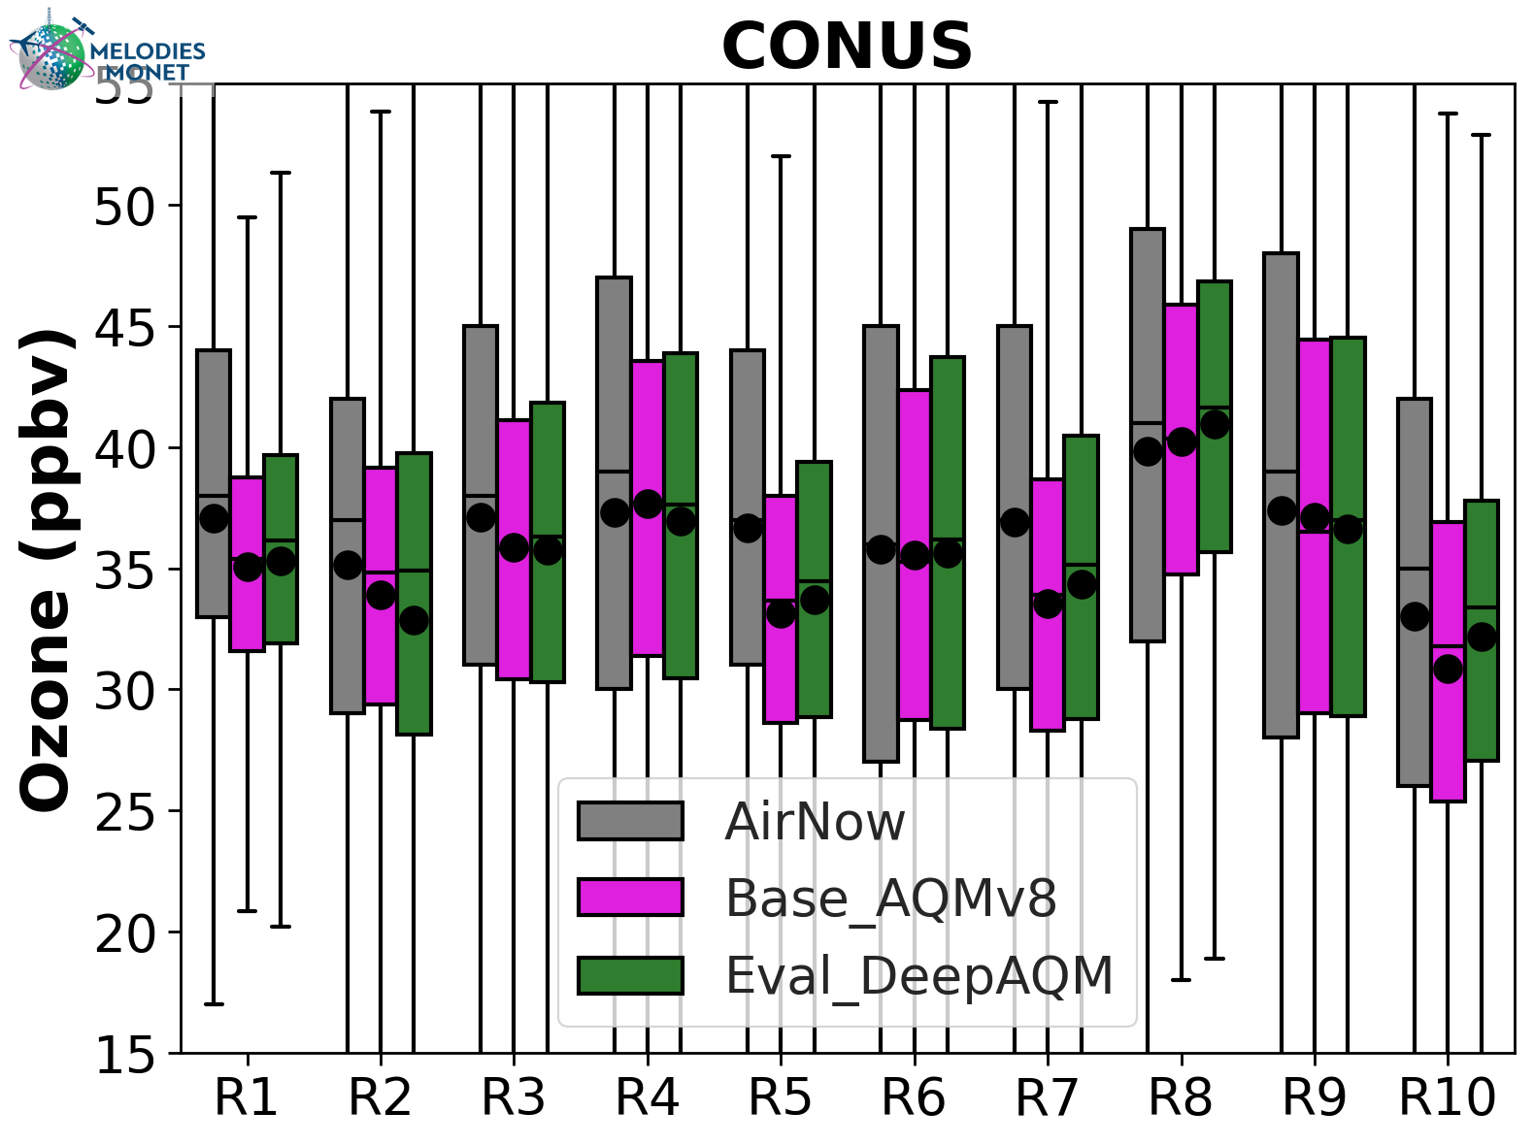
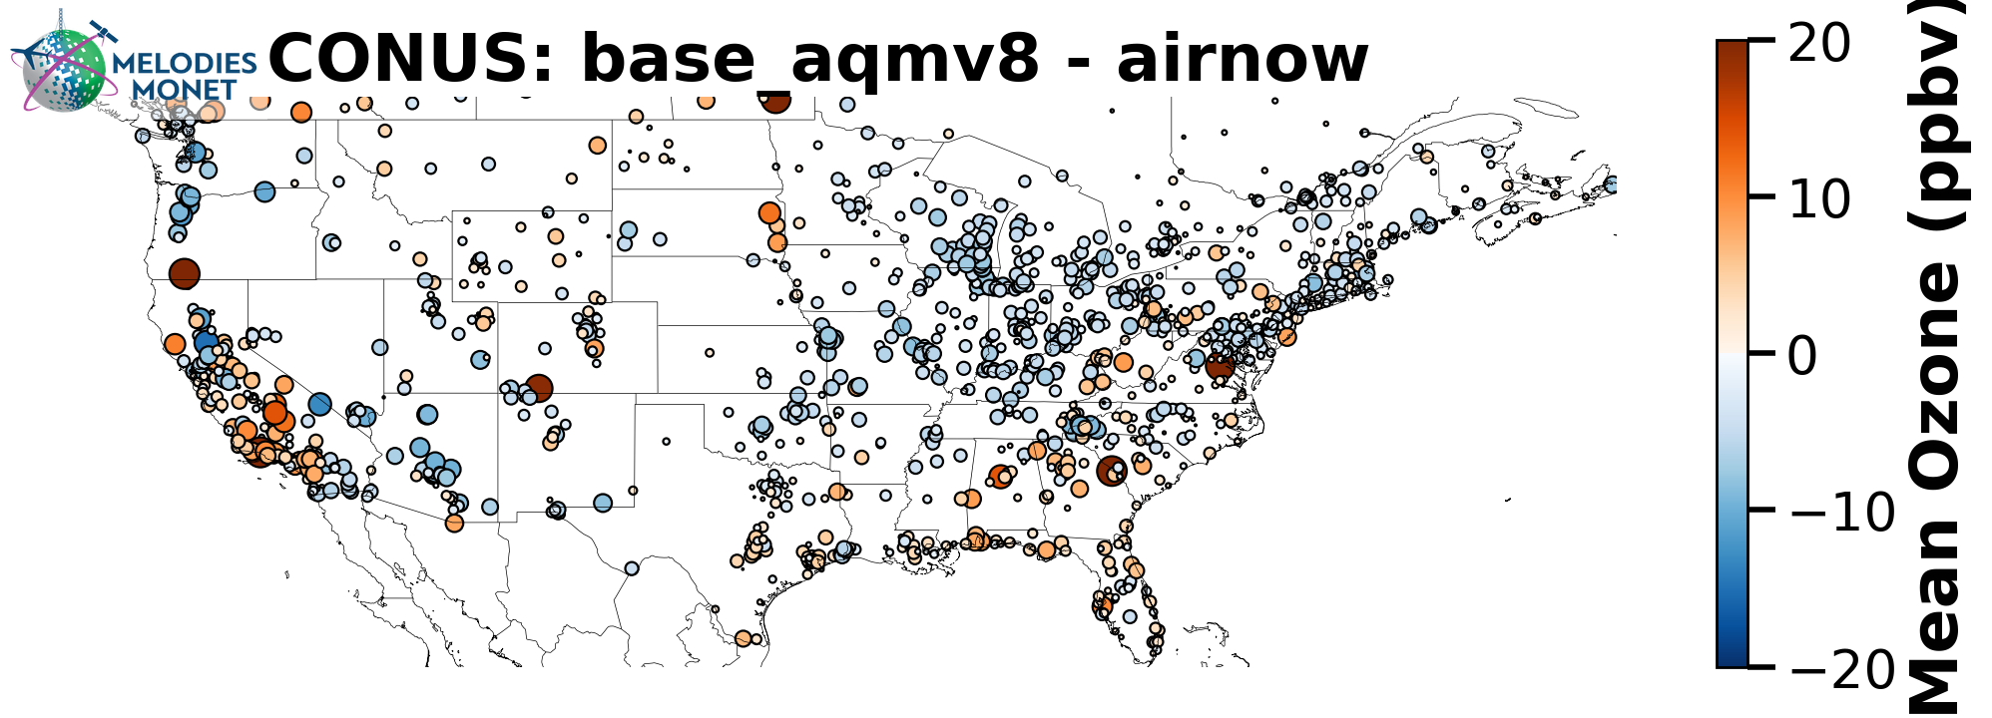
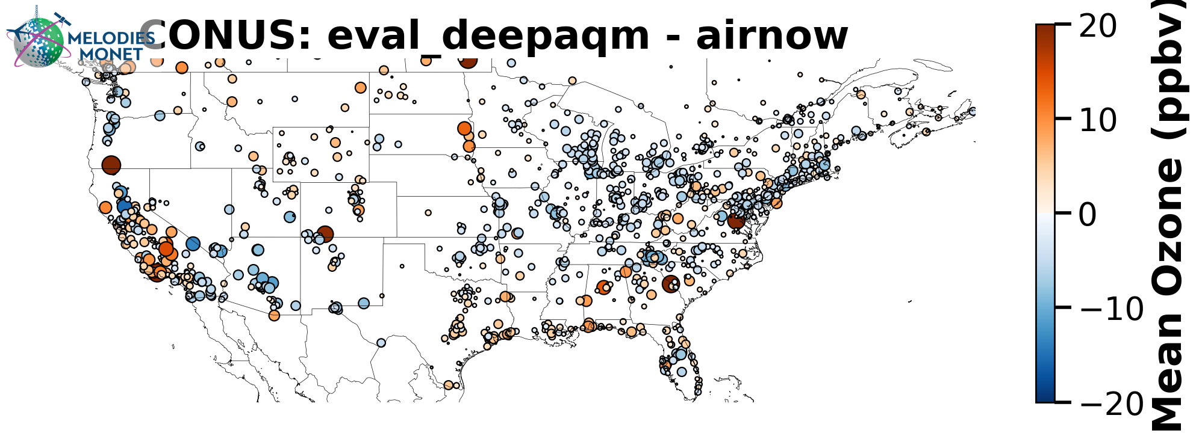
April 2024 (O₃)
UFS-AQM
UFS-DeepAQM

Slide 9
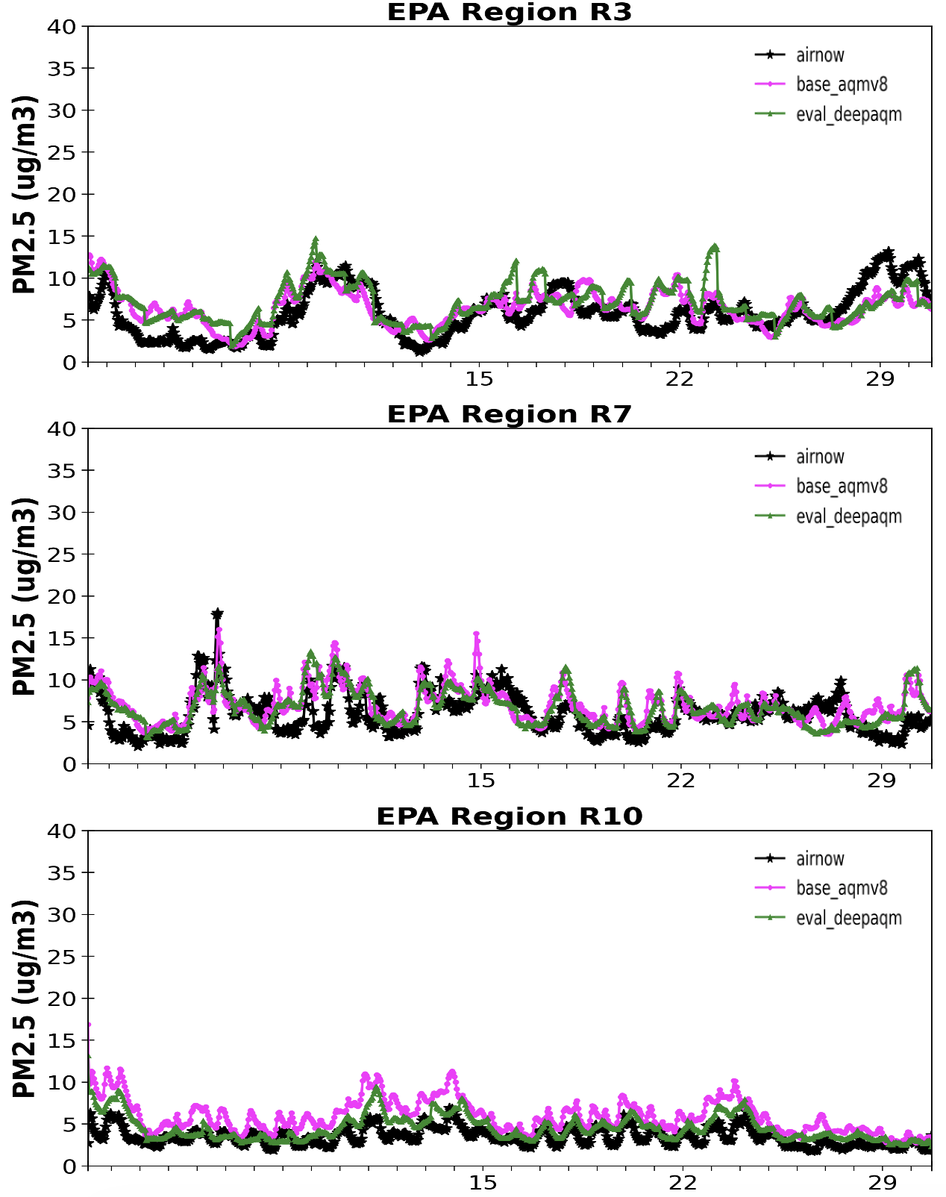
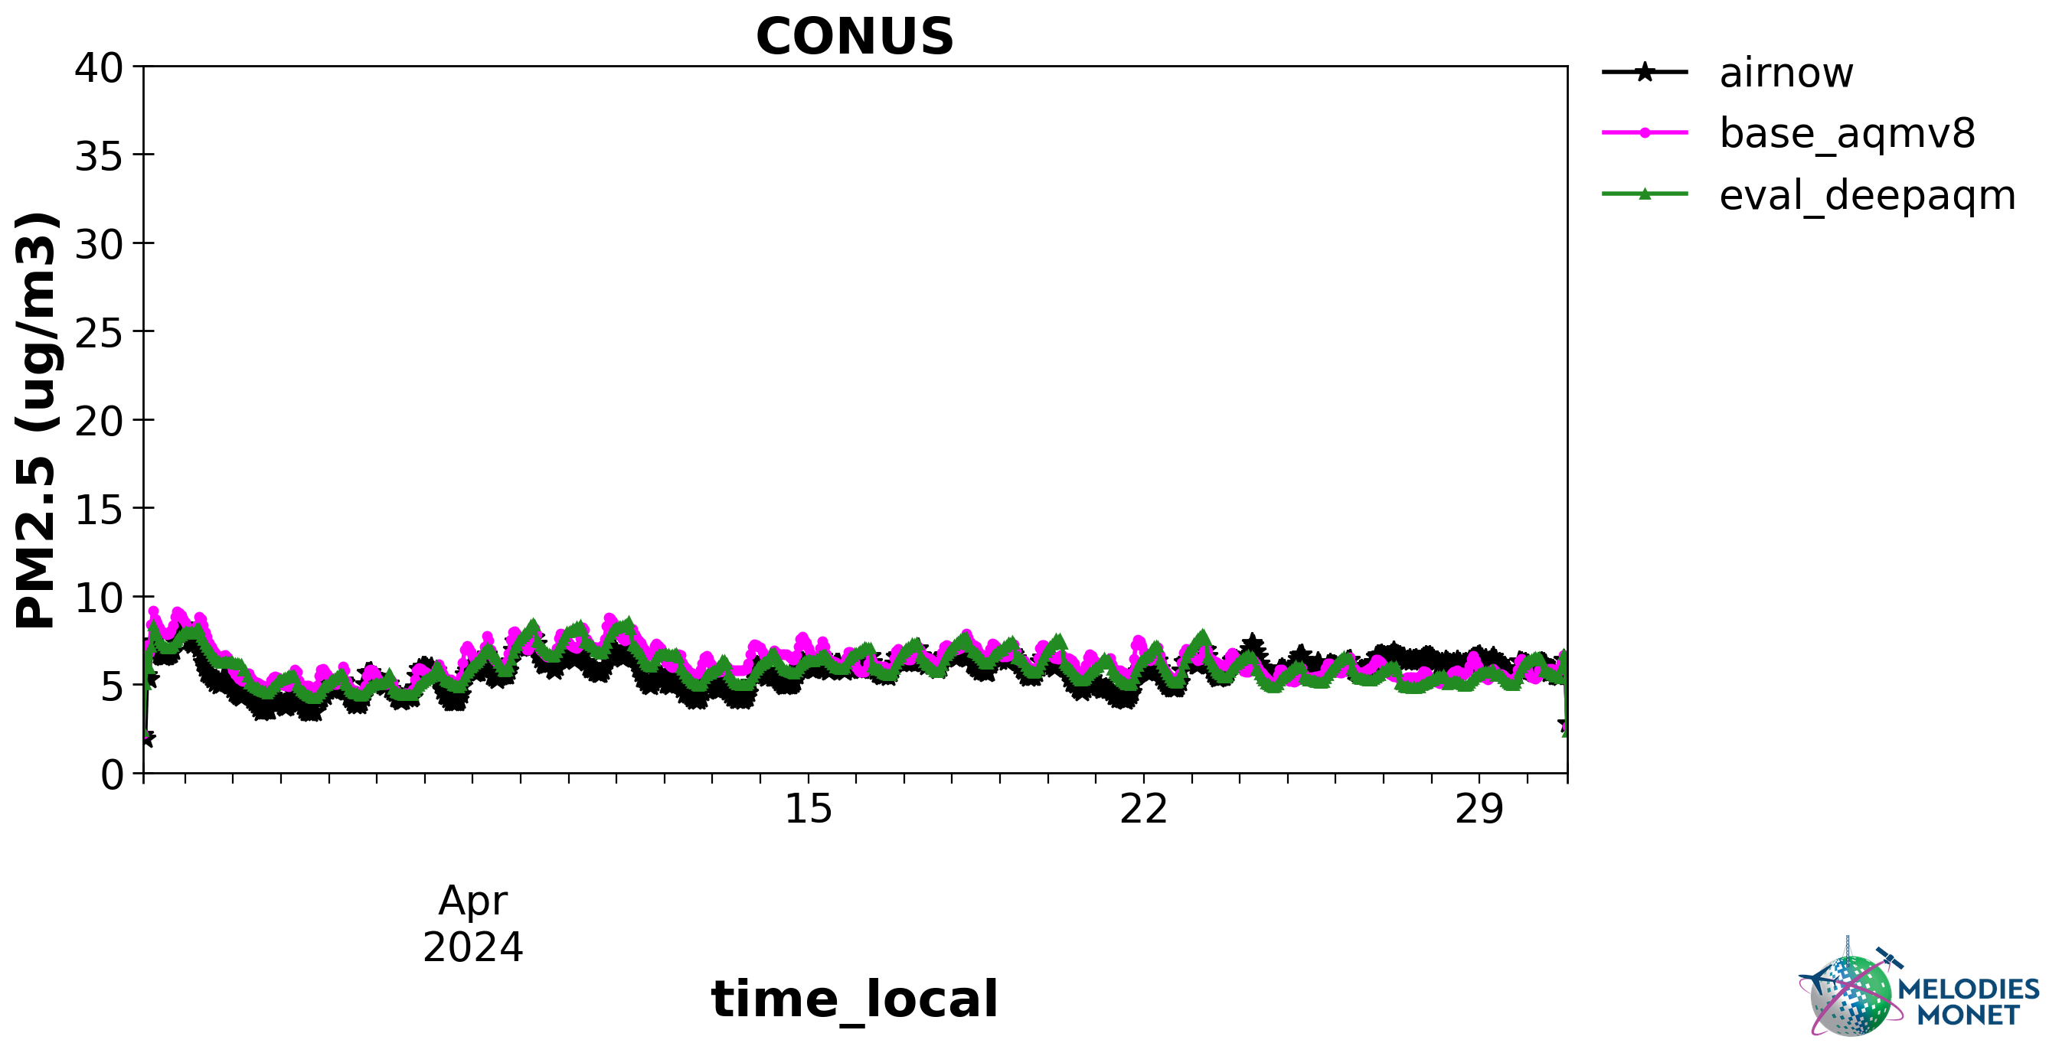
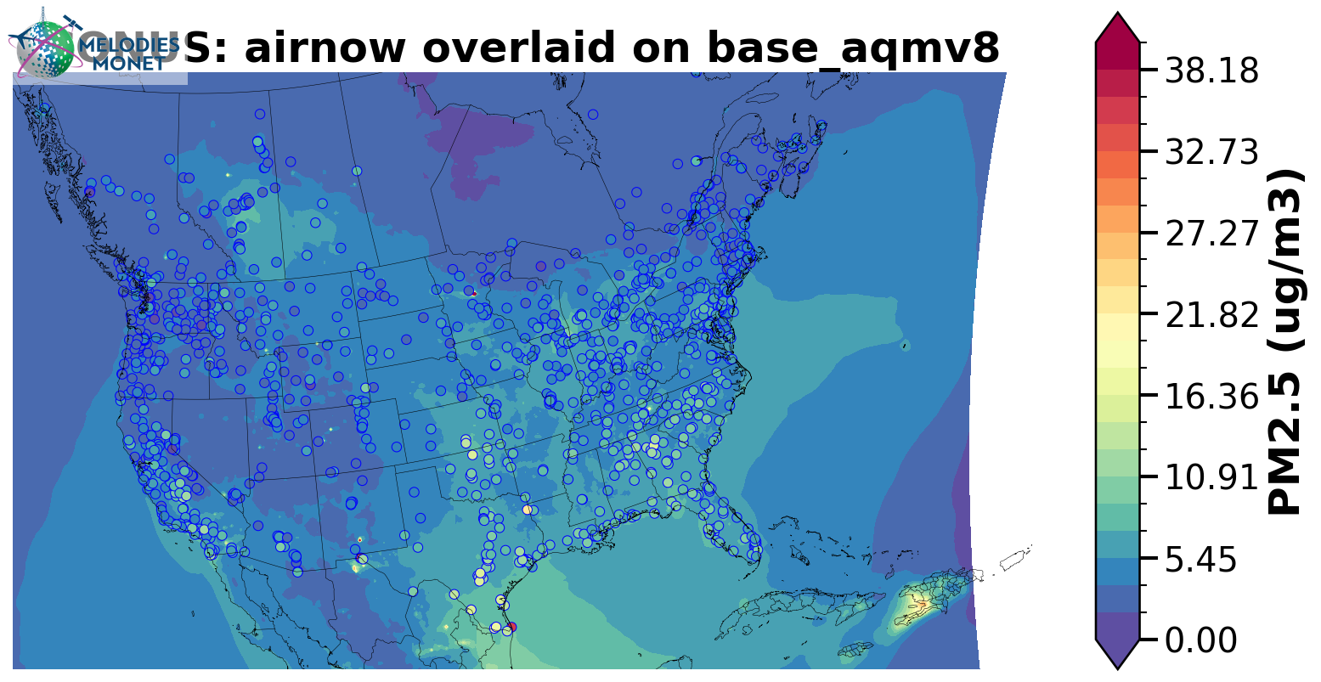
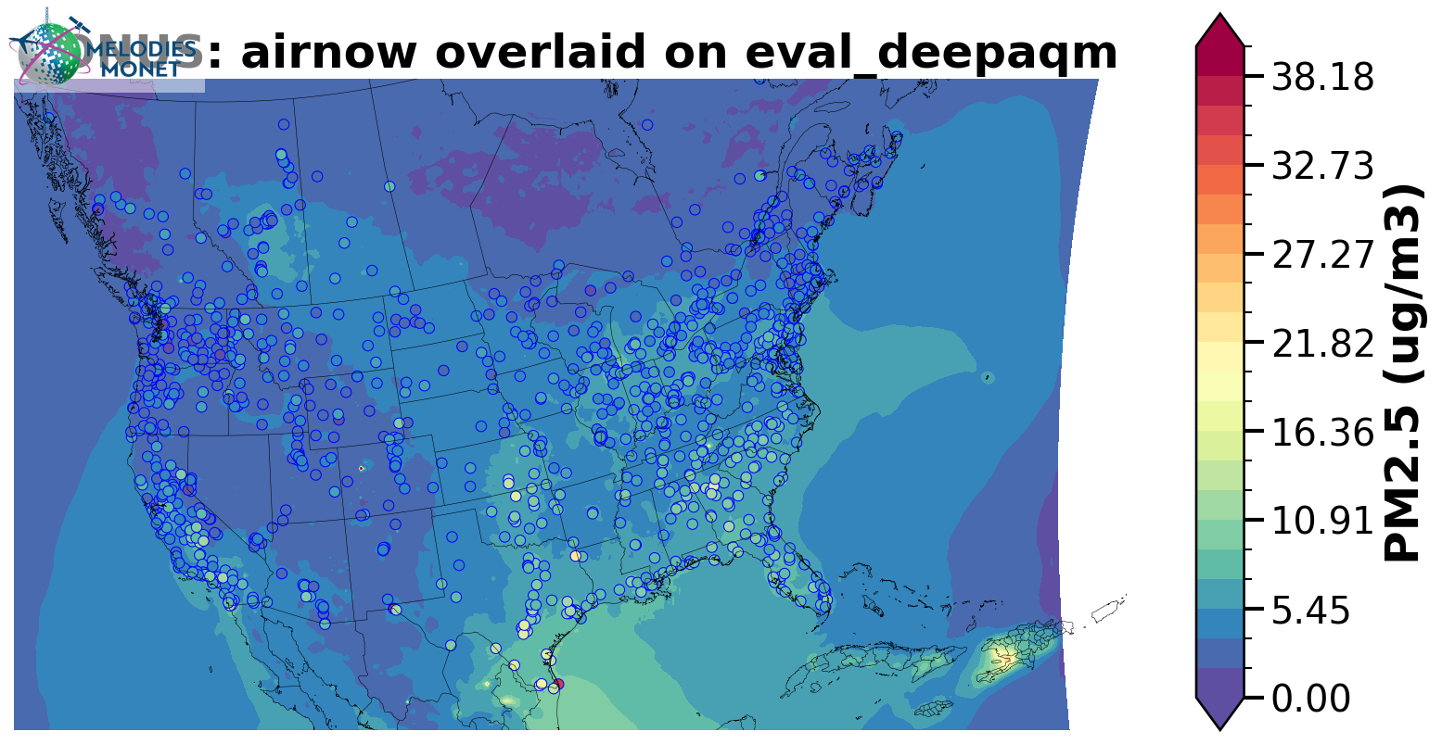
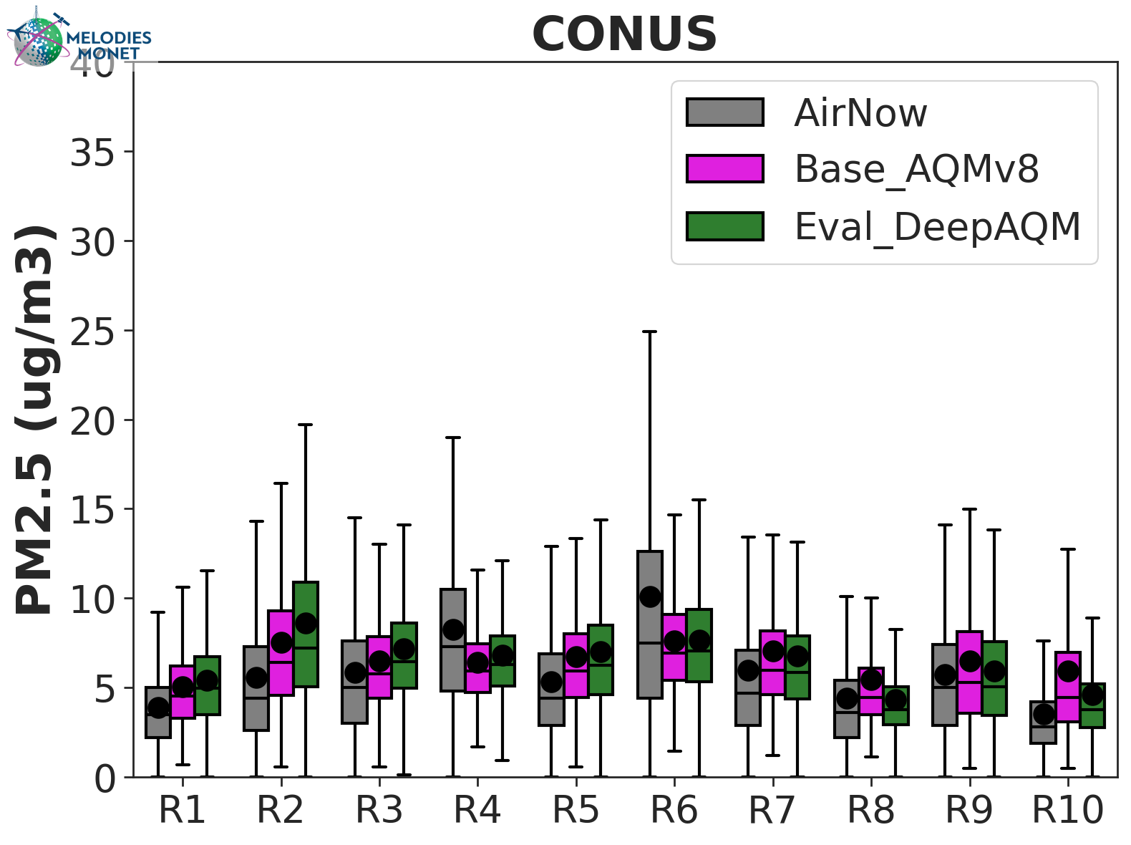
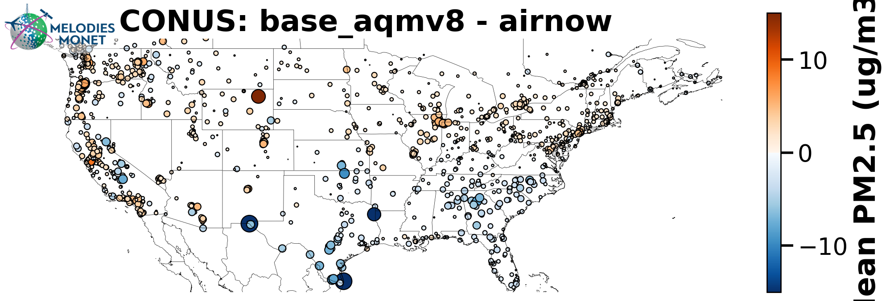
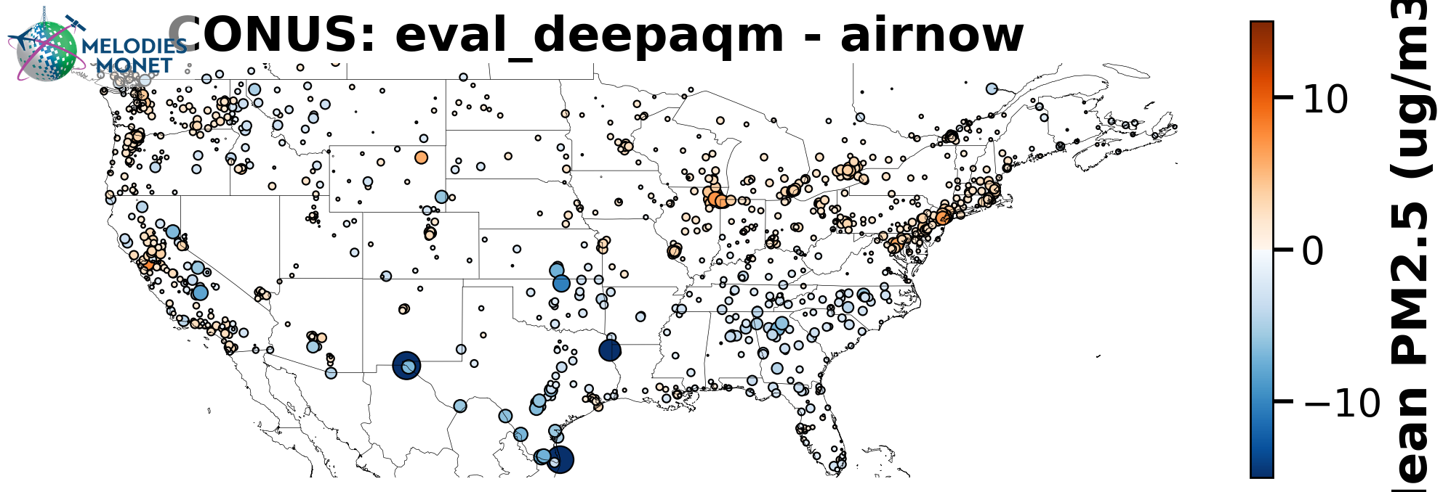
April 2024 (PM_{2.5})
UFS-AQM
UFS-DeepAQM

Slide 10
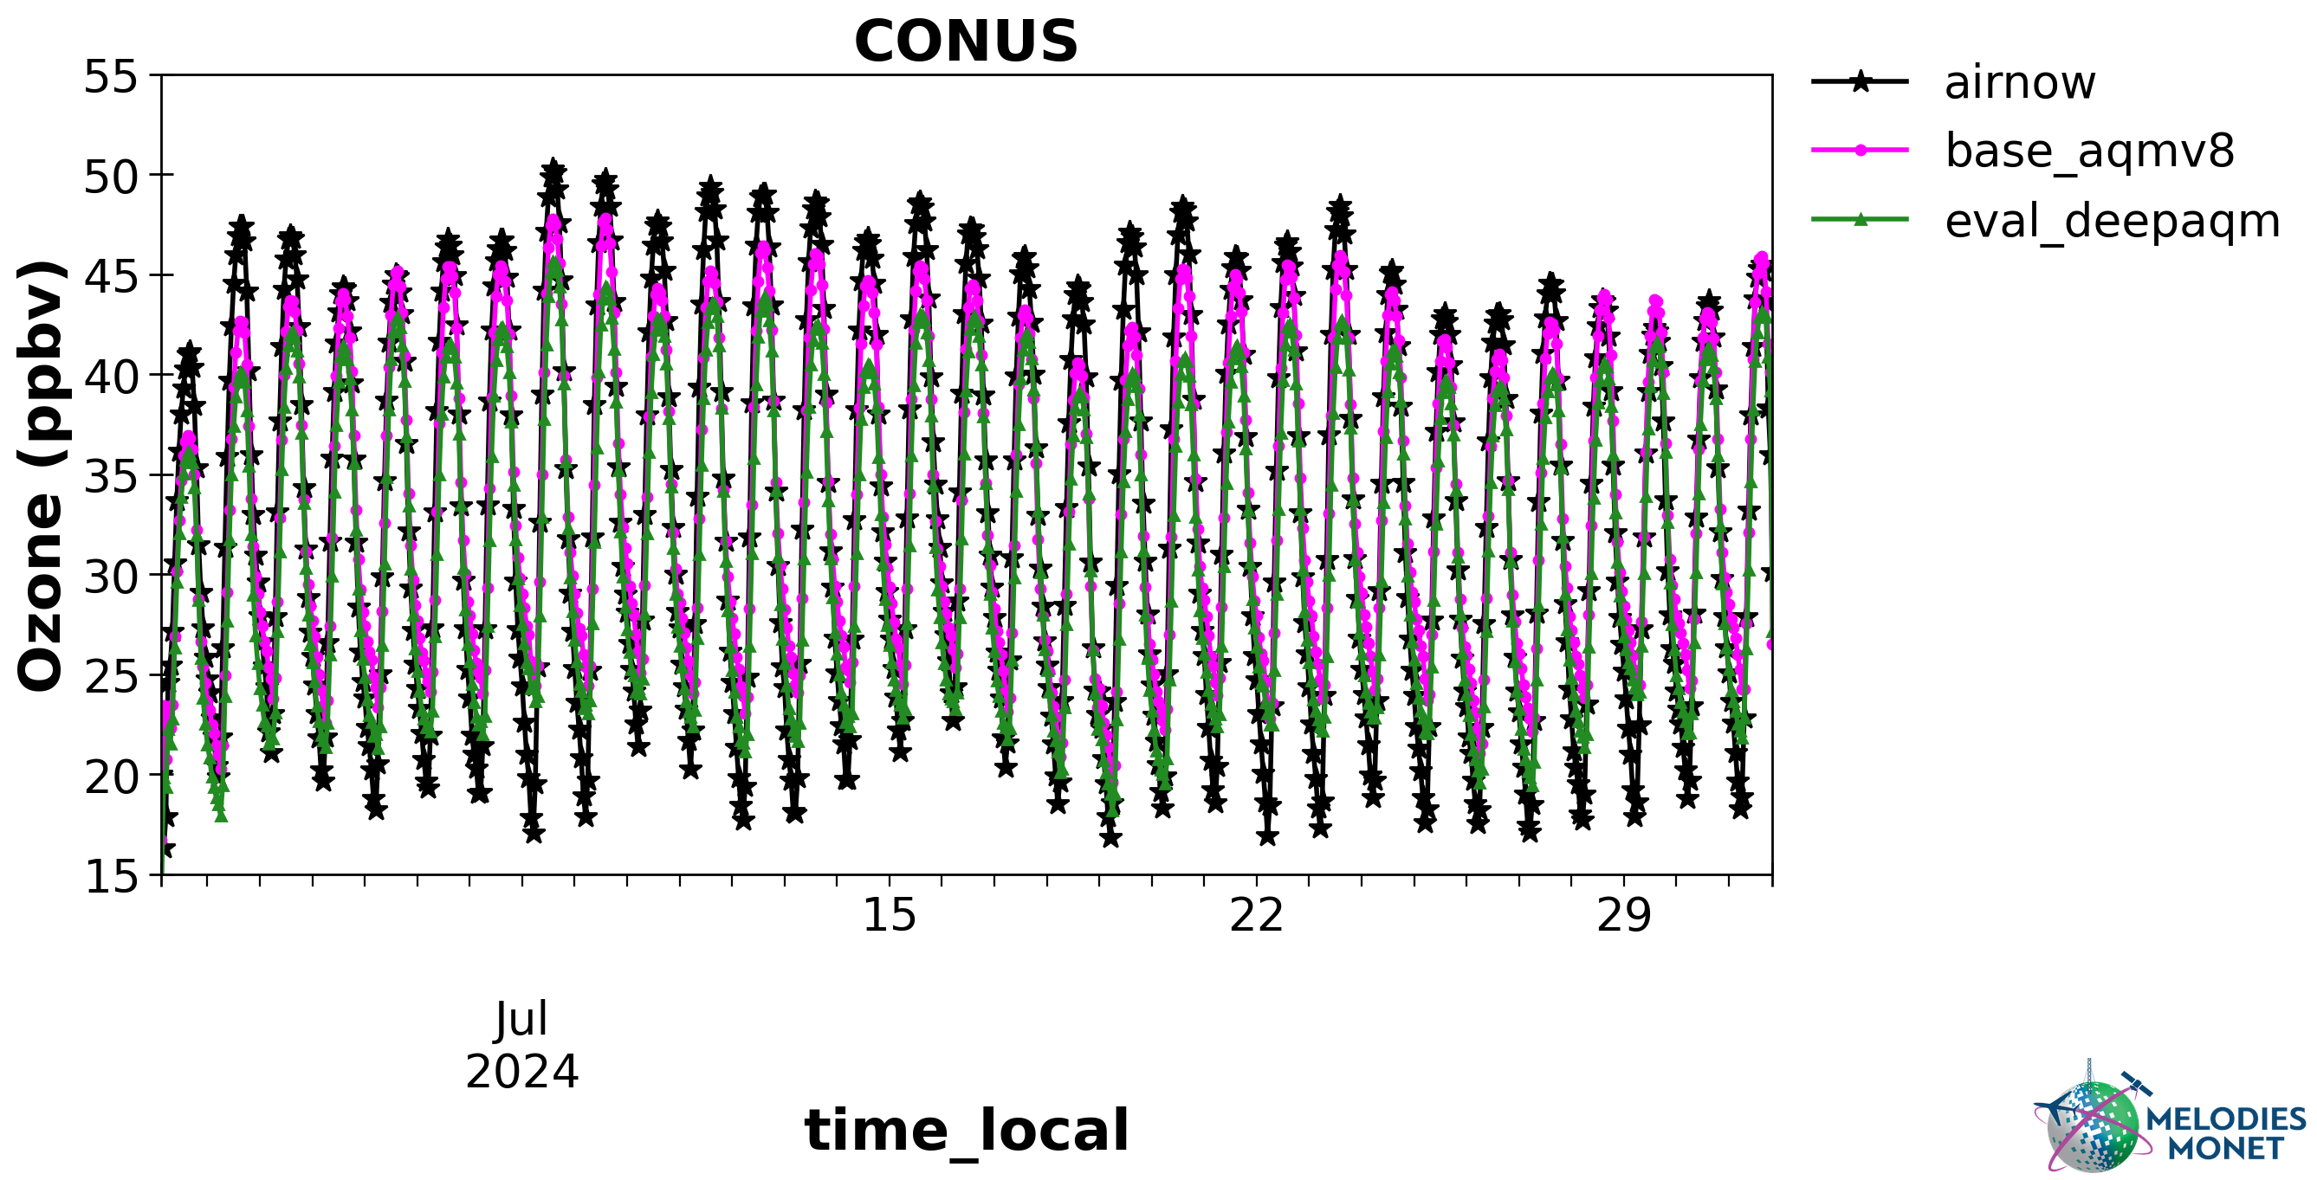
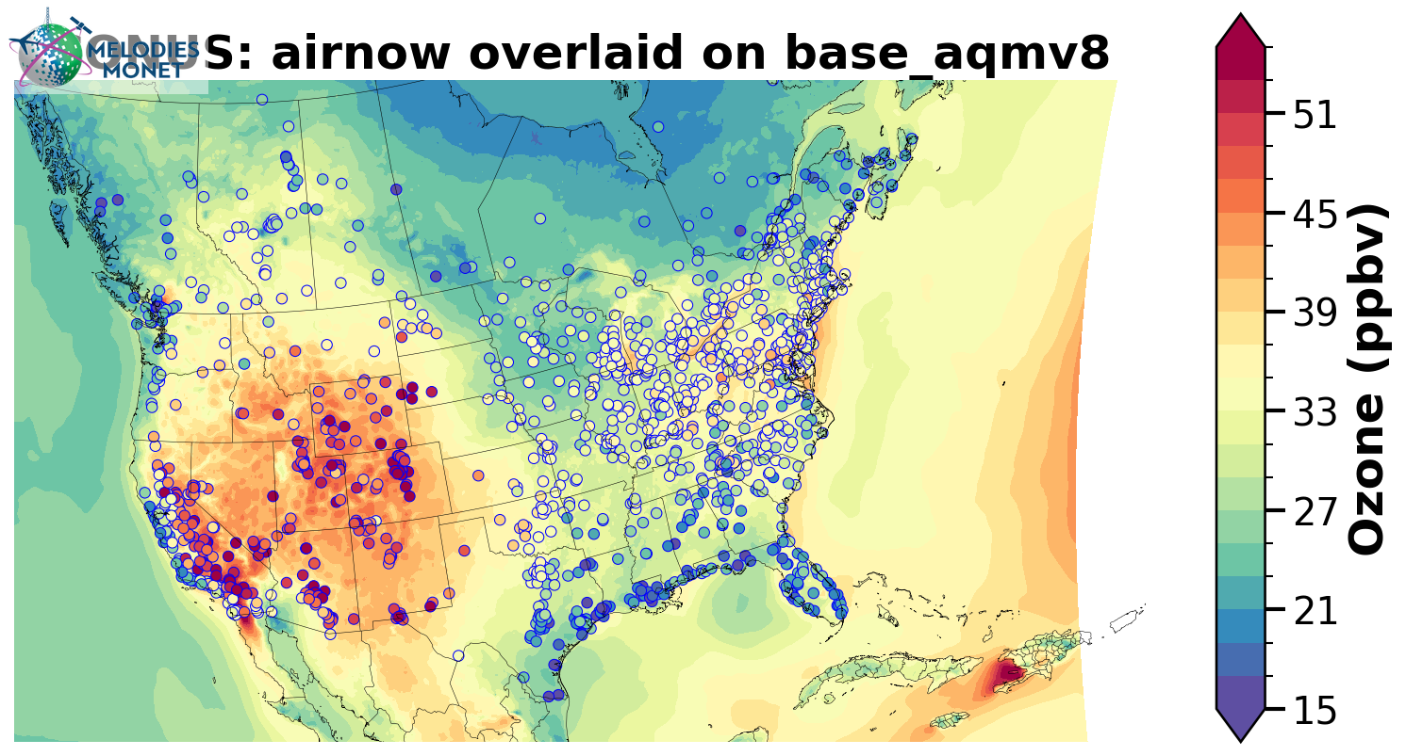
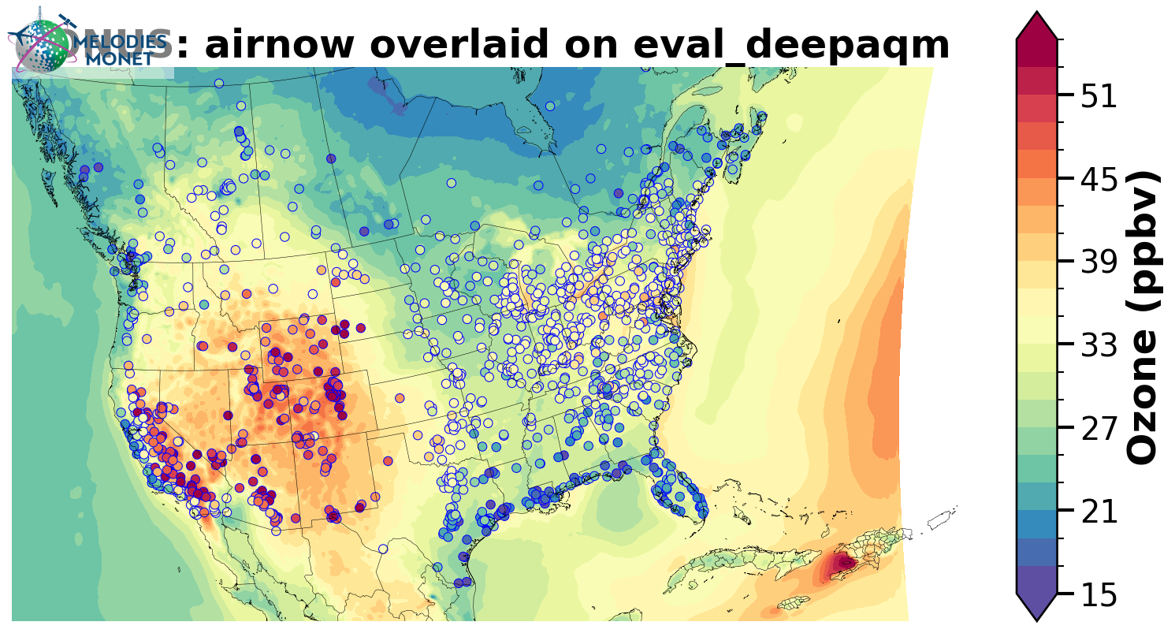
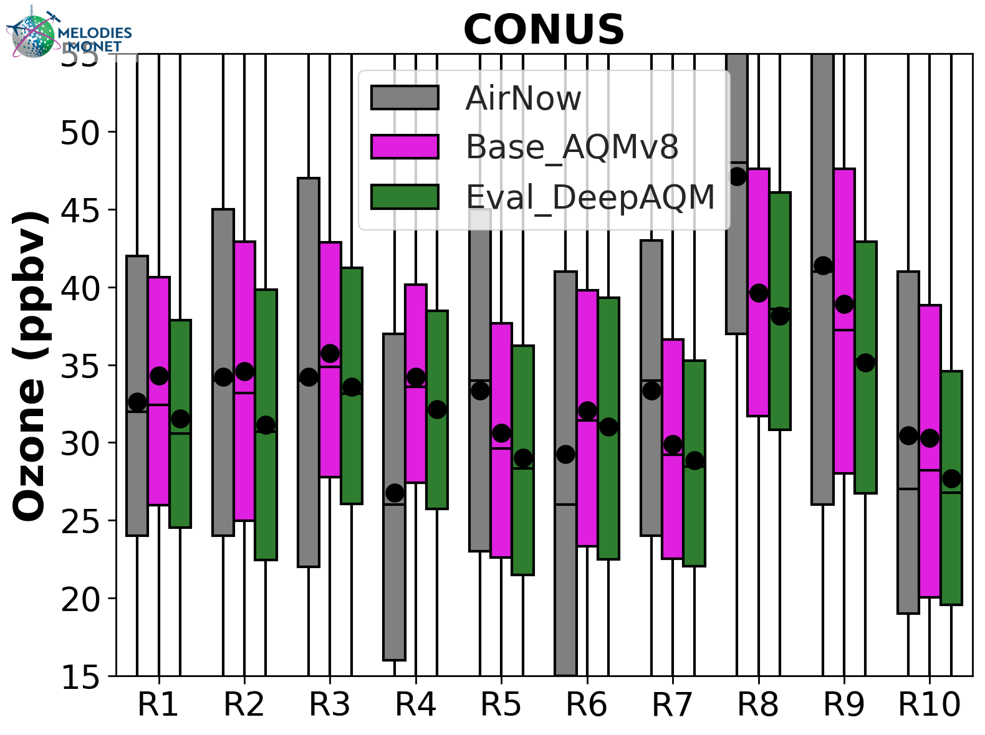
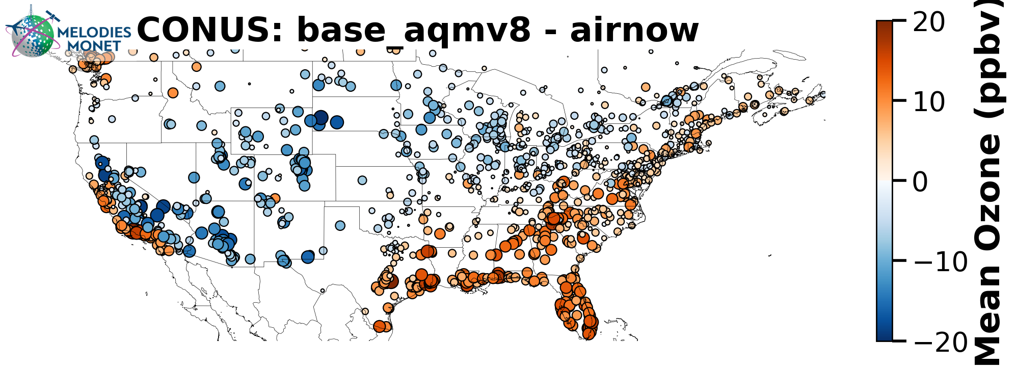
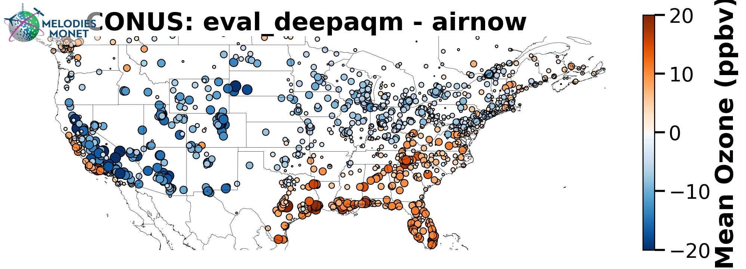
July 2024 (O₃)
UFS-AQM
UFS-DeepAQM

Slide 11
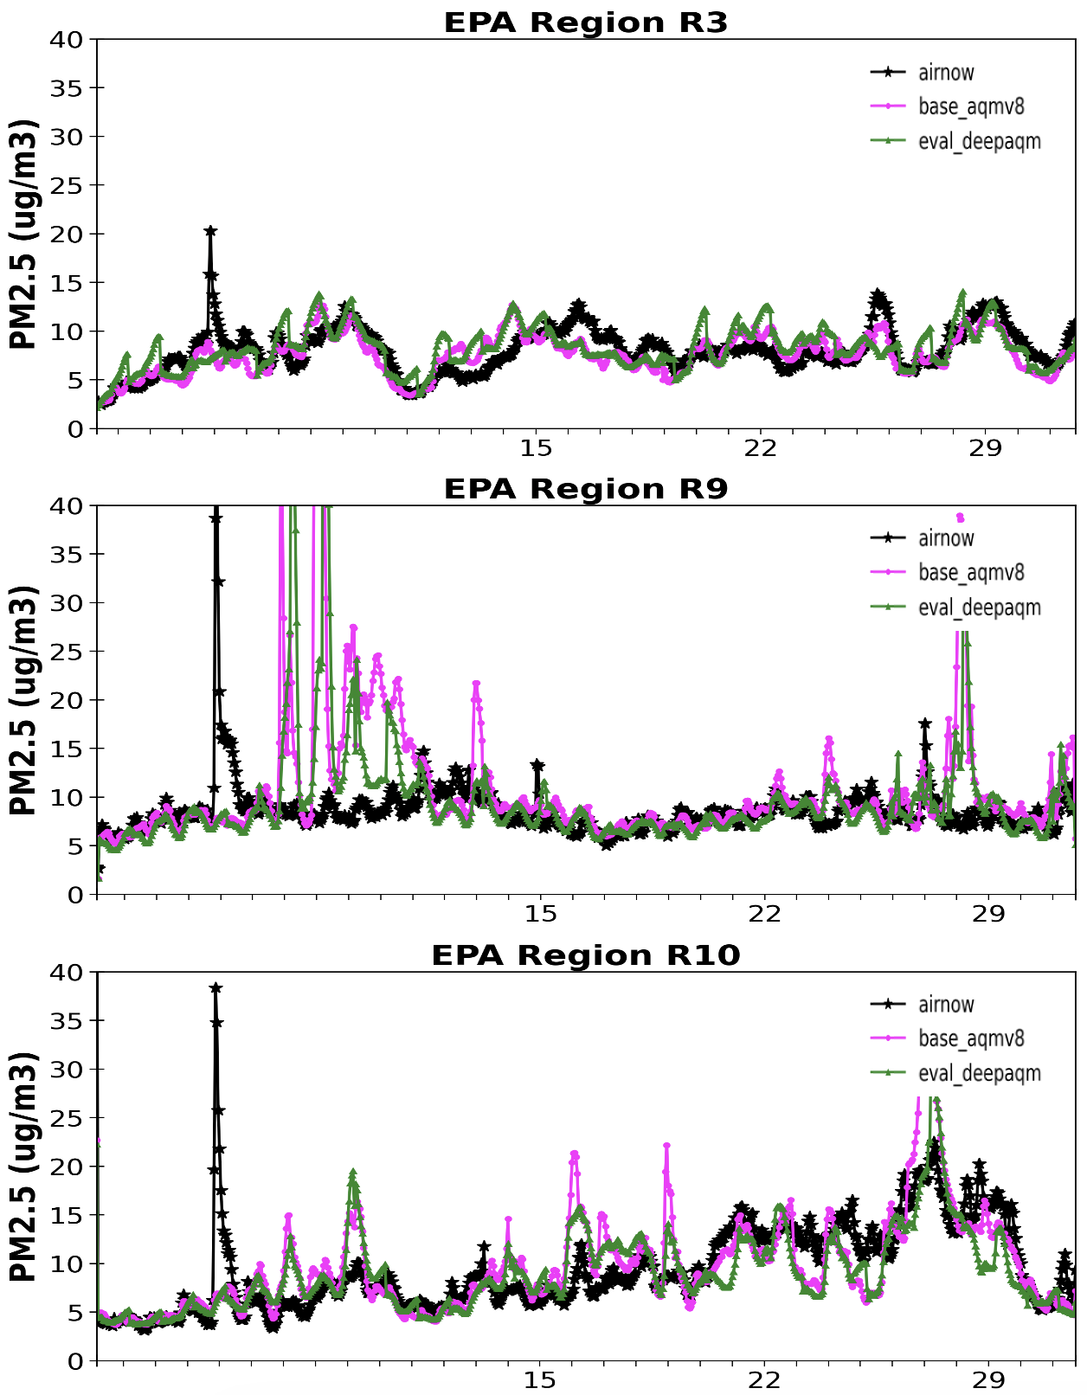
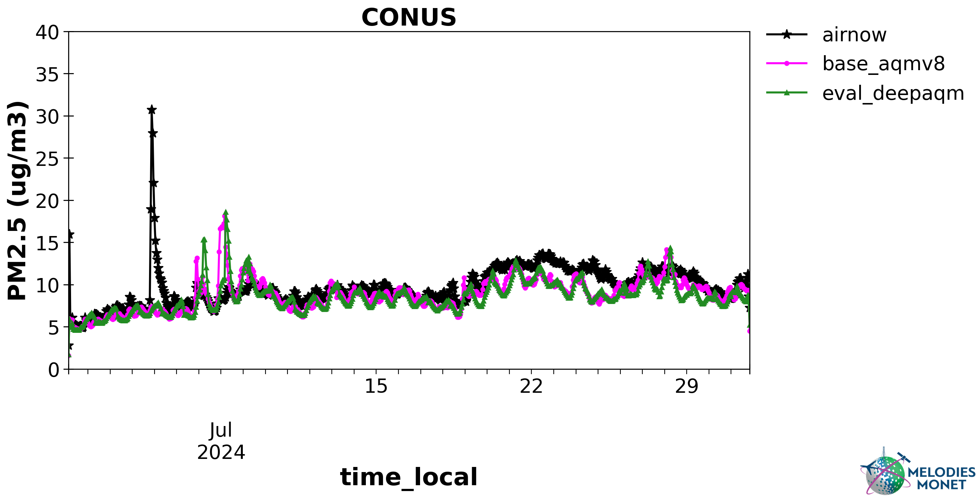
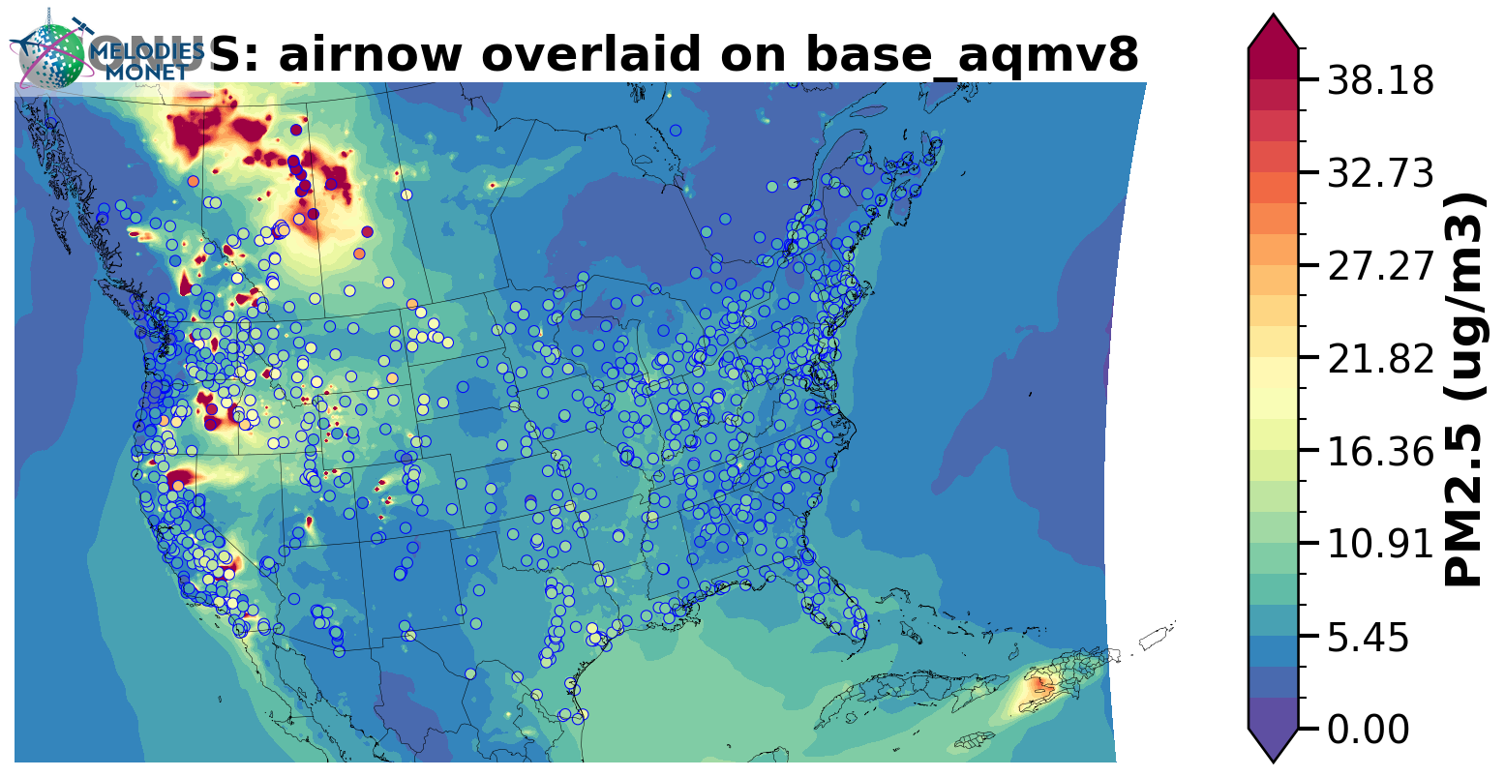
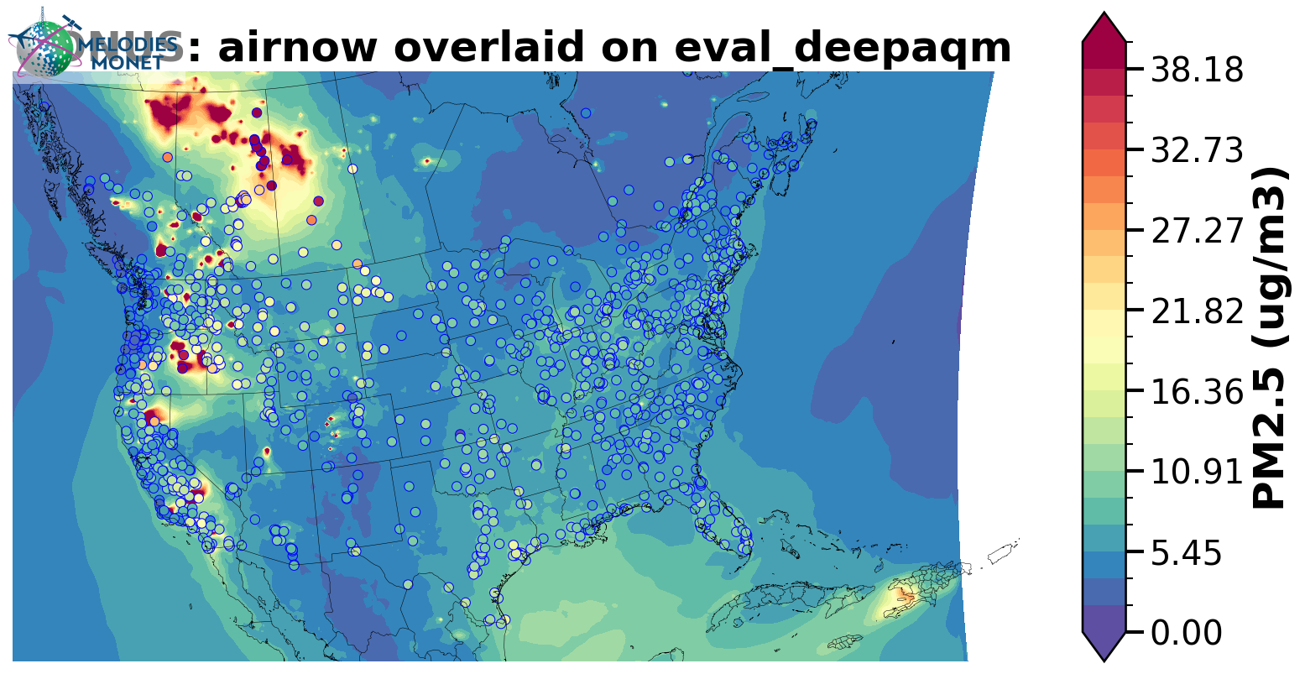
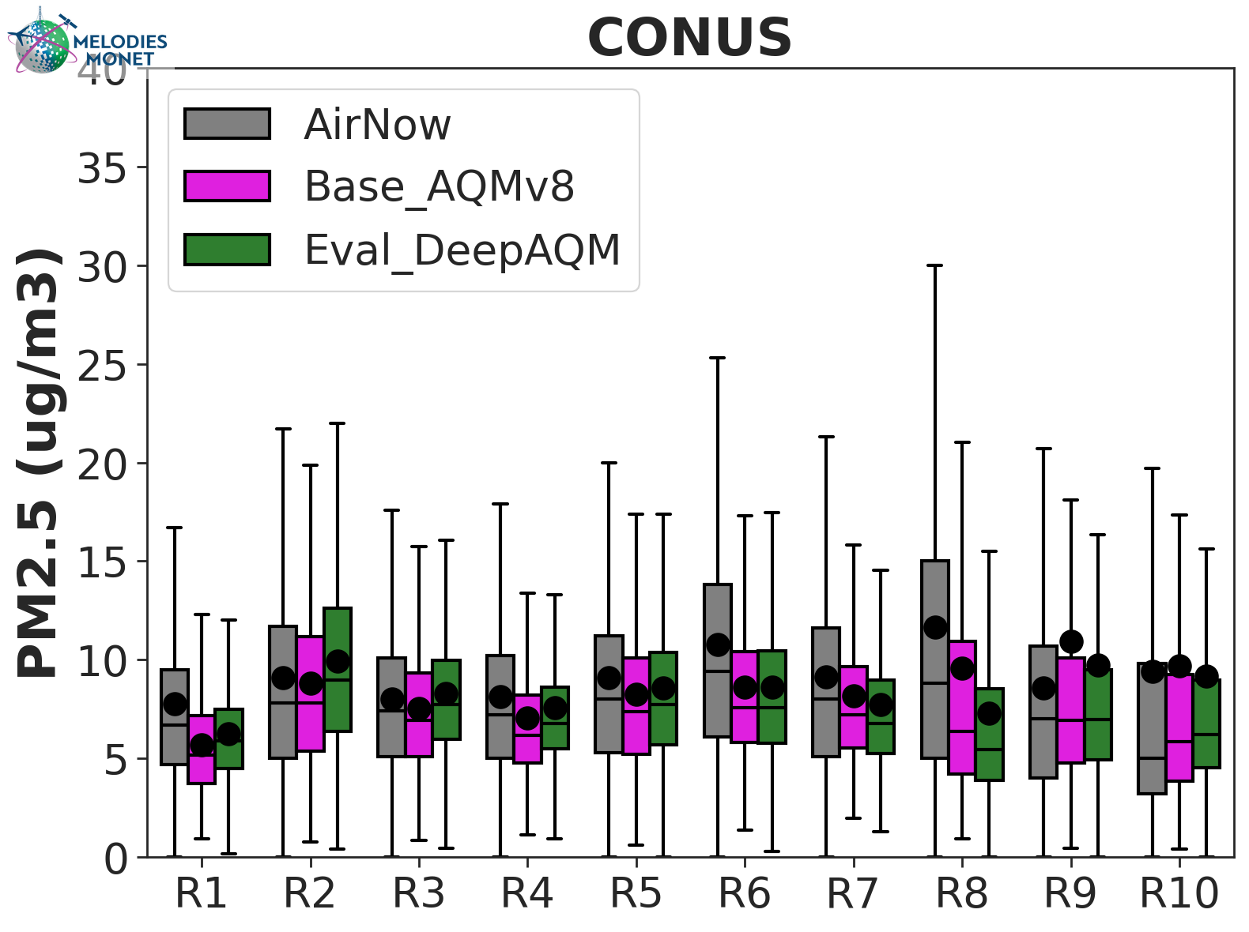
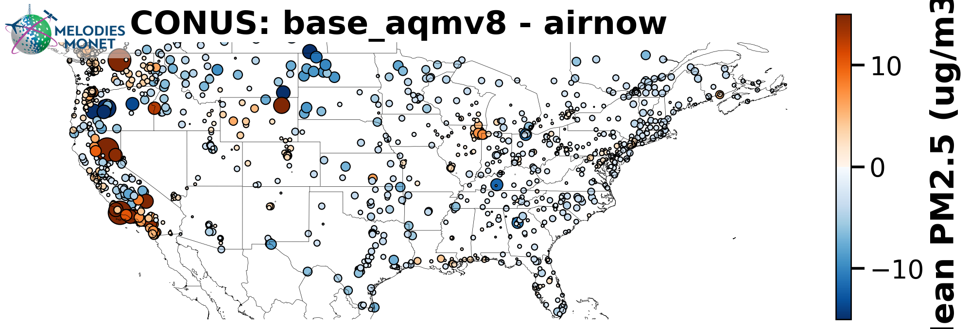
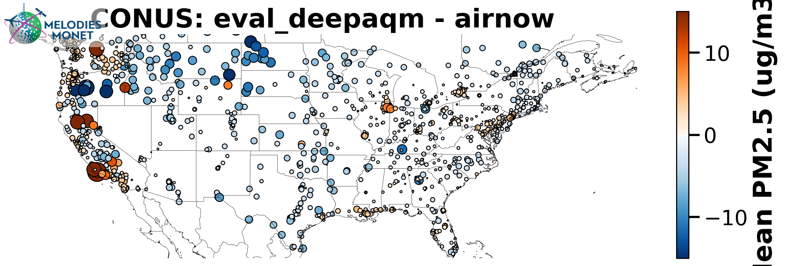
July 2024 (PM_{2.5})
UFS-AQM
UFS-DeepAQM
Notes:
Capture wildfire events but fail to get the right values -> 2D model without vertical trainsport and mixing

Slide 12
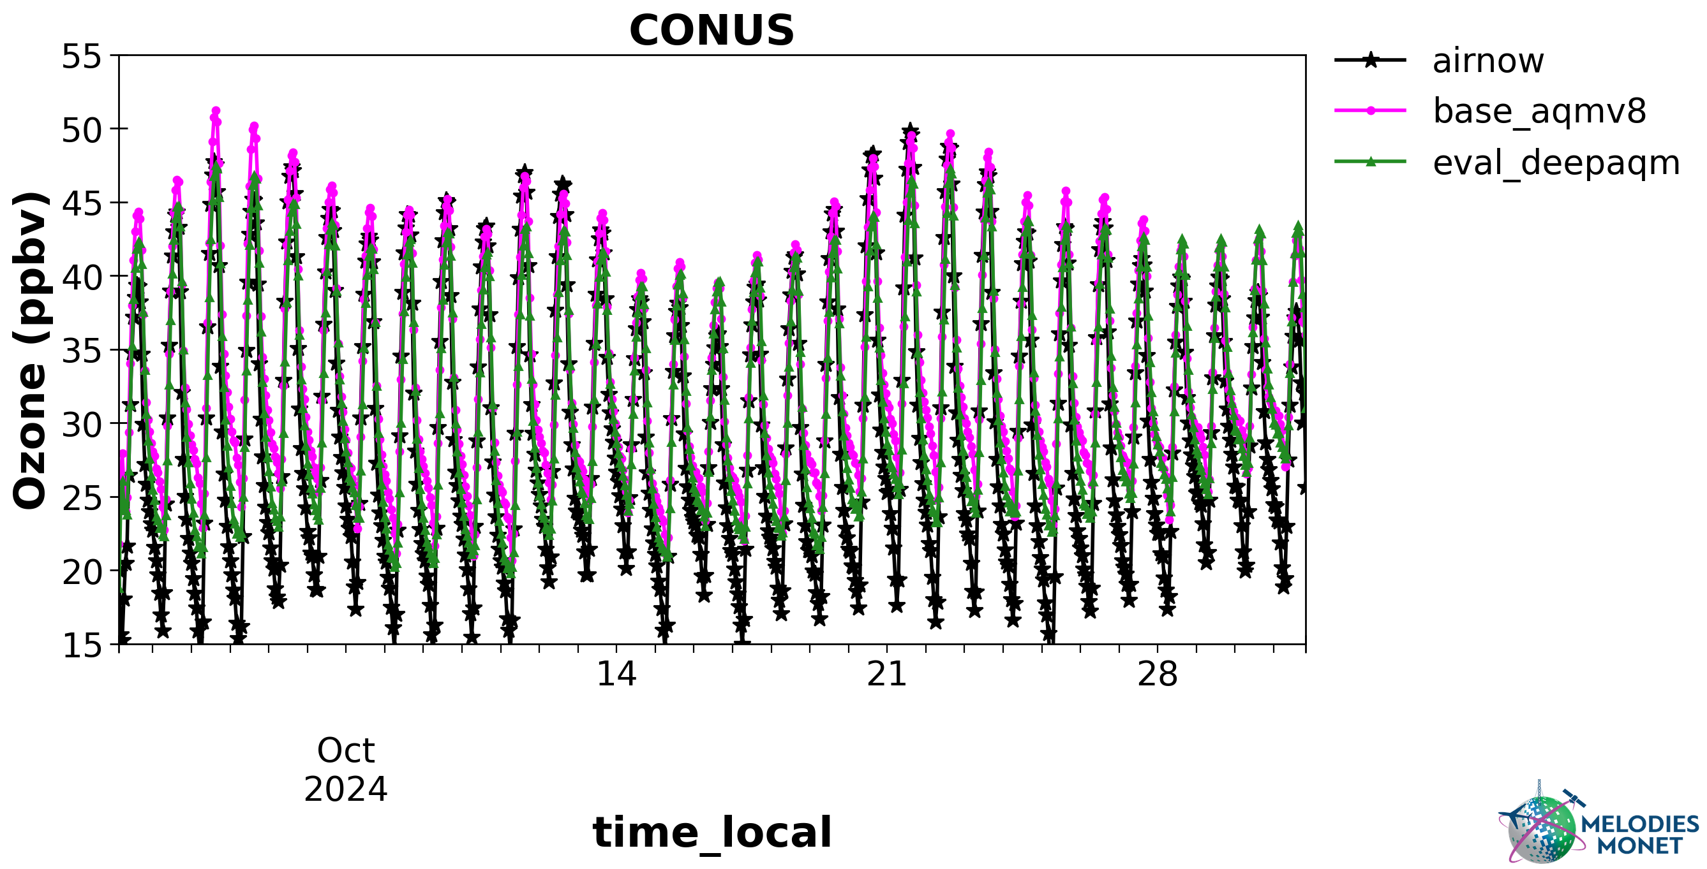
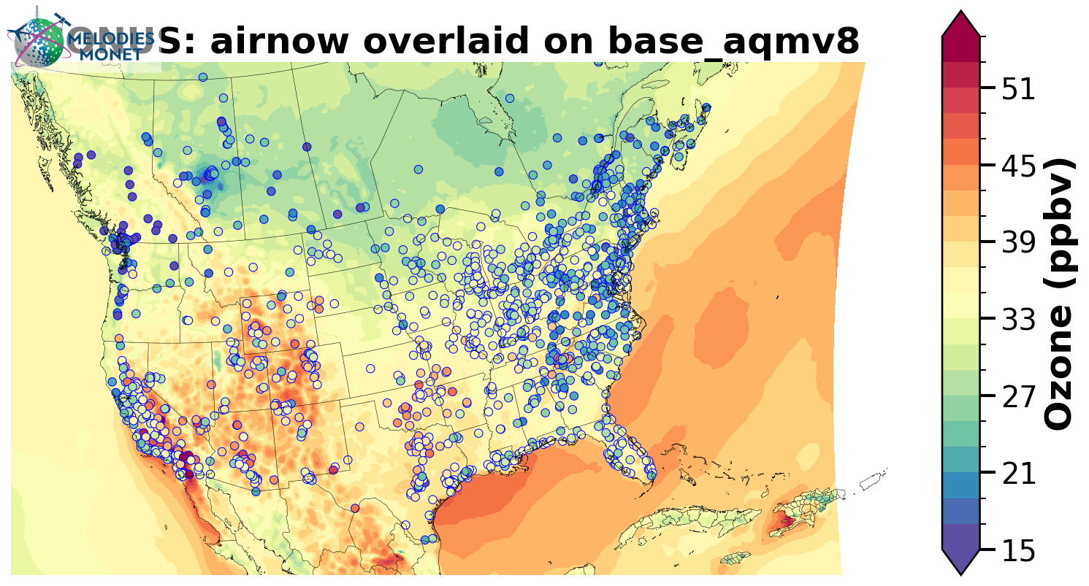

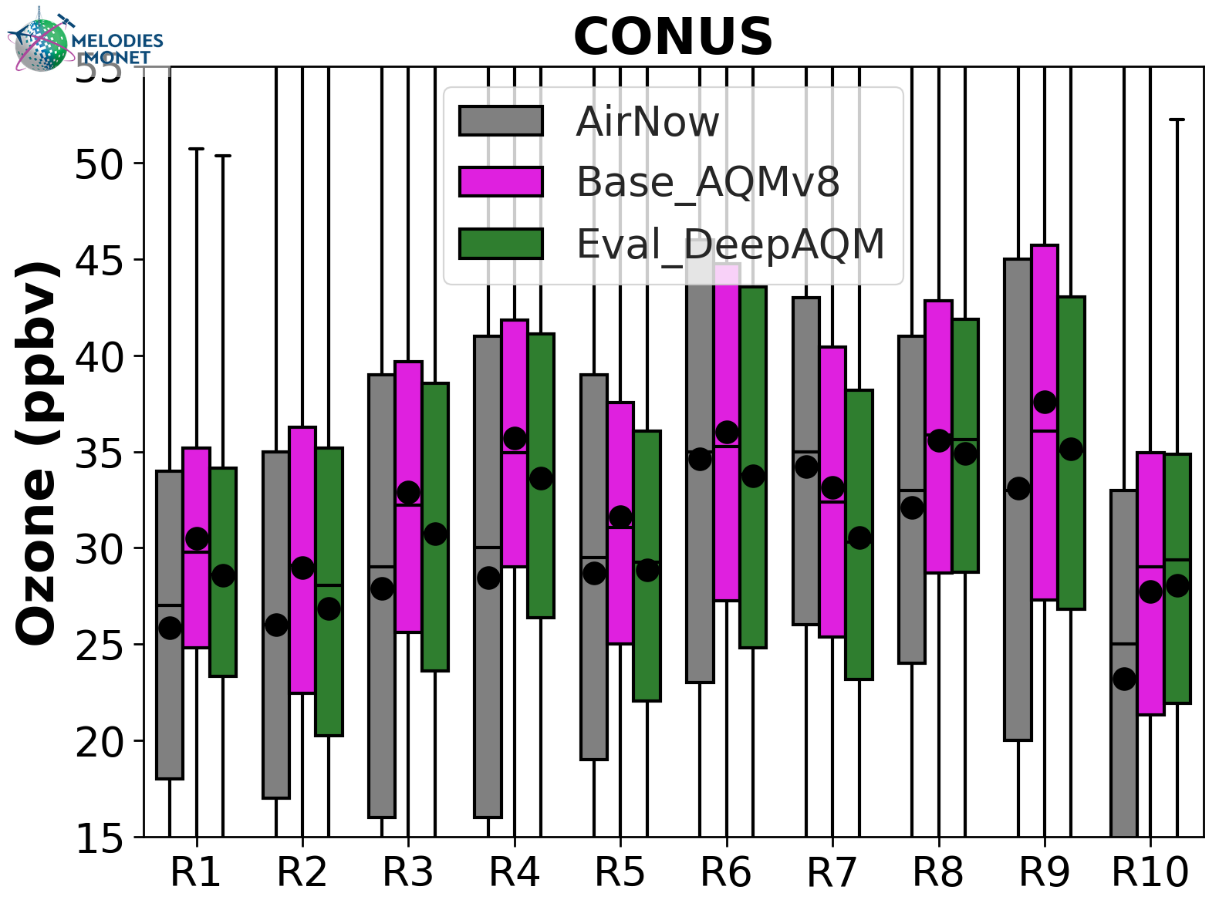
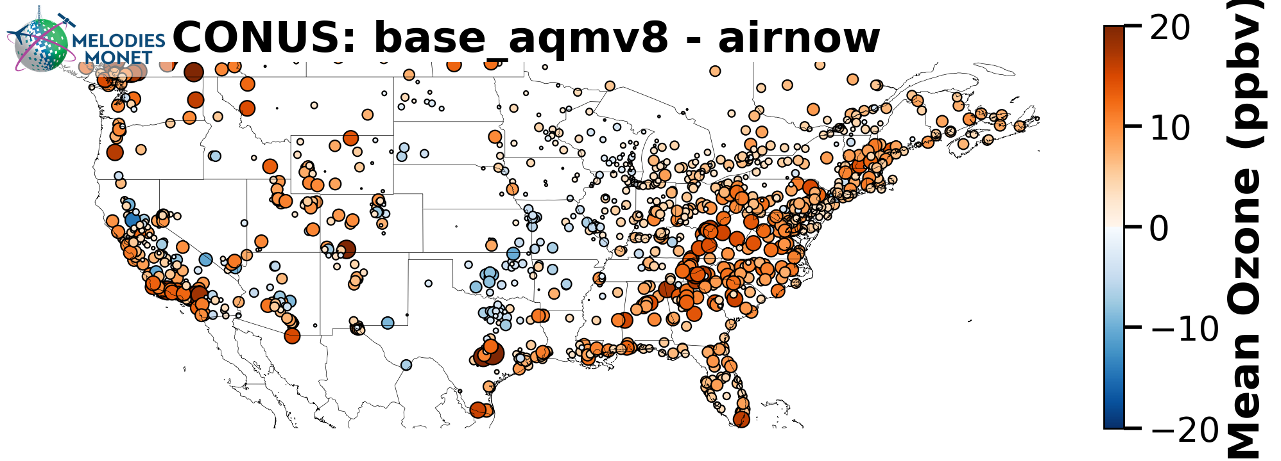
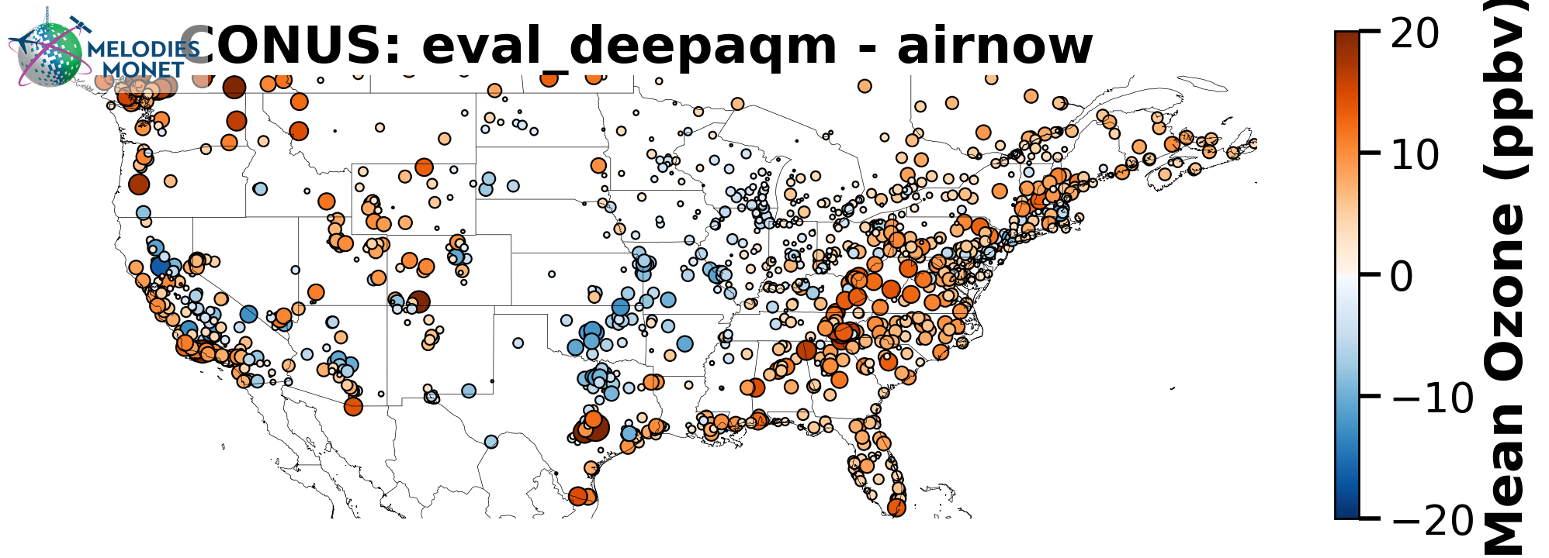
October 2024 (O₃)
UFS-AQM
UFS-DeepAQM
Notes:
The lower values may offset UFS-AQM’s nighttime overestimation against observation.

Slide 13
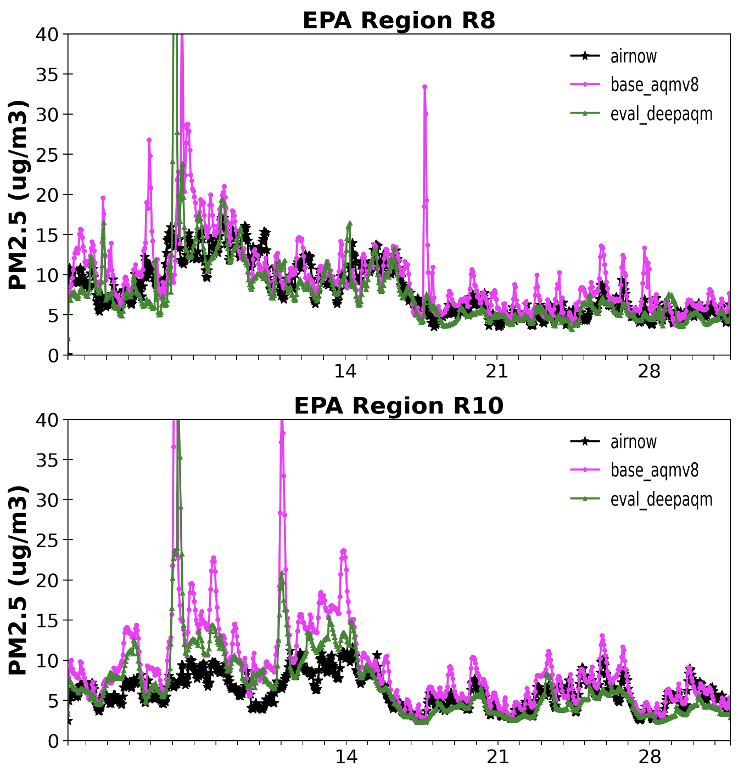
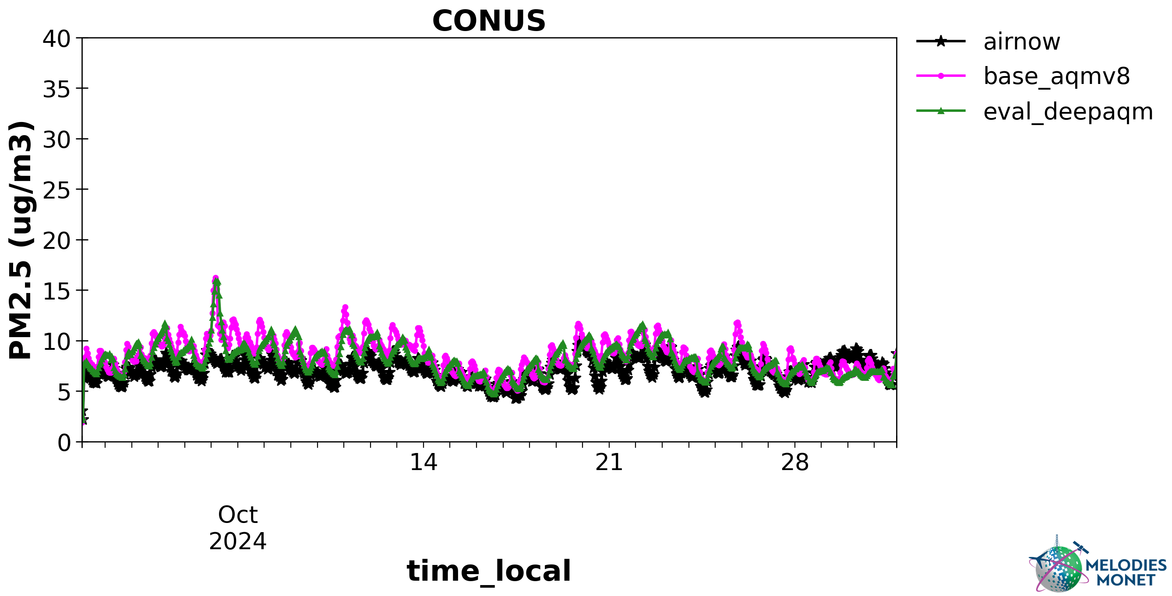
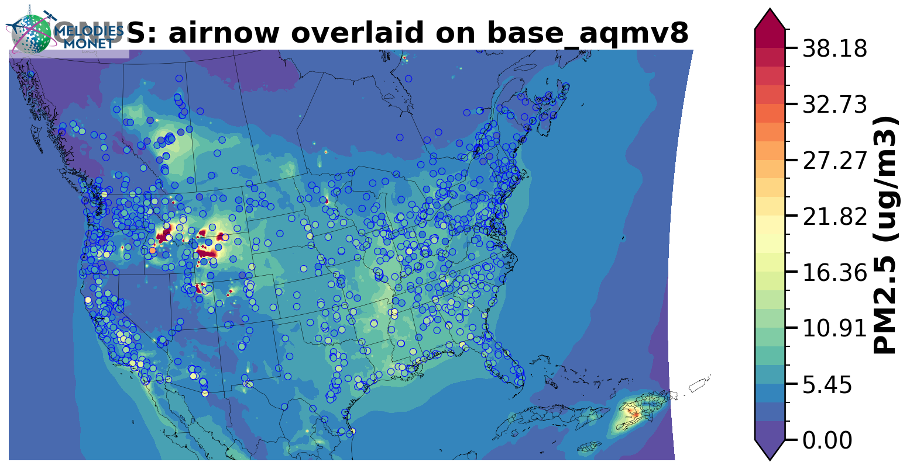




October 2024 (PM_{2.5})
UFS-AQM
UFS-DeepAQM

Slide 14
Pros:
UFS-DeepAQM can properly emulate the behavior of the current UFS-AQM and produce reasonable predictions. The substantially faster predictions enable large ensemble forecasts.
UFS-DeepAQM can efficiently derive source–receptor relationships and support rapid emission inversion and sensitivity analyses.
When trained using assimilated or fused observational datasets as targets, UFS-DeepAQM generally achieve better agreement (not shown).
Cons:
UFS-DeepAQM may have reduced skills for complicated physical/chemical processes with various emission sources and chemical components included.
Current 2D ConvLSTM architecture primarily propagates information between neighboring grid cells over time, and may not adequately capture long-range transport processes, such as wildfire plumes.
Since current UFS-DeepAQM is designed to emulate UFS-AQM, biases present in UFS-AQM relative to observations will also be inherited by UFS-DeepAQM.
Notes:
Dominant contribution from wildfire emissions -> simplifying emission condition may help the model
Bias inherit -> incorporating observational data (e.g., surface and satellite observations) during training may allow the development of a fused DeepAQM model with improved forecasting performance.

Slide 15
Conclusions
UFS-DeepAQM can emulate the behavior of the current UFS-AQM by capturing O₃ diurnal variation while systematical biases are found, especially for daytime peaks.
UFS-DeepAQM generates reasonable PM_{2.5} predictions that are comparable to both UFS-AQM simulations and observations but shows reduced skills for complicated physical/chemical processes and long-range transport events.
Current two-dimensional framework may not fully capture vertical transport, mixing, and interactions between atmospheric layers.
Future plans:
  Simplify PM_{2.5} processes: train different PM_{2.5} species (e.g. SO₄ and OC) and sources (e.g. dust and wildfire) separately
  Include real-time observations in training targets and IC
  Add fields at representative pressure levels (e.g. 850 hPa and 500 hPa)
  Adopt new DL algorithms (e.g. Fourier Neural Operator)
Notes:
Dominant contribution from wildfire emissions -> simplifying emission condition may help the model

Slide 16
Thank you for listening!
Wei-Ting Hung, wei-ting.hung@noaa.gov
Xing, J. et al. (2026) UFS-DeepAQM: A Deep-Learning Extension of the Unified Forecast System for Air Quality Forecasting (Submitted to JGR-Atmosphere).

Slide 17
Region | Ozone (ppb) |  |  | PM2.5 (ug/m3)
 | Bias | R2 | RMSE | Bias | R2 | RMSE
January 2024
Full NA | 0.000 | 0.337 | 1.454 | -0.295 | 0.302 | 1.500
1 | -0.159 | 0.268 | 0.929 | -0.621 | 0.166 | 1.489
2 | -0.264 | 0.247 | 1.447 | -0.874 | 0.170 | 1.188
3 | -0.328 | 0.229 | 1.727 | -0.354 | 0.183 | 1.765
4 | -0.278 | 0.229 | 1.539 | -0.332 | 0.170 | 1.028
5 | -0.178 | 0.255 | 1.120 | -1.126 | 0.228 | 2.196
6 | -0.057 | 0.313 | 1.352 | -0.388 | 0.227 | 1.204
7 | -0.015 | 0.275 | 1.493 | -1.223 | 0.166 | 2.044
8 | 0.273 | 0.291 | 1.580 | -0.276 | 0.292 | 1.118
9 | 0.192 | 0.286 | 1.521 | -0.073 | 0.228 | 0.948
10 | 0.150 | 0.328 | 0.866 | -0.069 | 0.222 | 1.147
Canada | 0.050 | 0.373 | 0.855 | -0.119 | 0.344 | 0.893
Mexico | -0.270 | 0.330 | 1.759 | -0.610 | 0.275 | 2.499
April 2024
Full NA | 0.050 | 0.294 | 1.502 | -0.132 | 0.258 | 0.520
1 | 0.115 | 0.233 | 1.398 | 0.007 | 0.220 | 0.695
2 | -0.048 | 0.237 | 1.019 | 0.022 | 0.196 | 0.857
3 | -0.274 | 0.232 | 1.539 | 0.047 | 0.153 | 0.810
4 | -0.242 | 0.252 | 1.595 | 0.033 | 0.219 | 0.817
5 | 0.057 | 0.235 | 1.620 | -0.029 | 0.186 | 1.531
6 | -0.100 | 0.281 | 1.674 | -0.131 | 0.186 | 0.759
7 | 0.023 | 0.241 | 1.516 | -0.176 | 0.161 | 0.867
8 | 0.234 | 0.278 | 1.517 | -0.337 | 0.069 | 0.969
9 | -0.018 | 0.326 | 1.740 | -0.210 | 0.244 | 0.758
10 | -0.061 | 0.268 | 1.290 | -0.184 | 0.164 | 0.757
Canada | 0.026 | 0.347 | 0.959 | -0.049 | 0.231 | 0.472
Mexico | -0.285 | 0.269 | 2.333 | -0.524 | 0.262 | 2.310
Region | Ozone (ppb) |  |  | PM2.5 (ug/m3)
 | Bias | R2 | RMSE | Bias | R2 | RMSE
July 2024
Full NA | -0.199 | 0.348 | 2.138 | -0.156 | 0.258 | 6.128
1 | -0.767 | 0.259 | 2.070 | 0.145 | 0.221 | 0.750
2 | -0.738 | 0.287 | 2.066 | 0.223 | 0.242 | 0.878
3 | -0.822 | 0.258 | 1.977 | 0.206 | 0.241 | 0.803
4 | -0.508 | 0.273 | 1.334 | 0.045 | 0.184 | 0.844
5 | -0.173 | 0.272 | 1.996 | -0.031 | 0.221 | 1.216
6 | -0.192 | 0.326 | 1.568 | -0.122 | 0.236 | 0.935
7 | -0.161 | 0.319 | 1.472 | -0.322 | 0.160 | 0.852
8 | -0.567 | 0.335 | 1.991 | -1.133 | 0.091 | 4.703
9 | -1.300 | 0.296 | 2.742 | -0.995 | 0.231 | 10.826
10 | -0.314 | 0.373 | 1.989 | -0.200 | 0.235 | 7.229
Canada | -0.038 | 0.297 | 1.698 | 0.023 | 0.258 | 7.285
Mexico | -0.193 | 0.285 | 2.141 | -0.381 | 0.242 | 0.998
October 2024
Full NA | -0.111 | 0.342 | 1.464 | -0.070 | 0.224 | 6.915
1 | -0.632 | 0.239 | 1.578 | 0.380 | 0.269 | 0.811
2 | -0.511 | 0.275 | 1.731 | 0.654 | 0.262 | 0.949
3 | -0.752 | 0.277 | 1.474 | 0.435 | 0.202 | 0.883
4 | -0.505 | 0.292 | 0.582 | 0.202 | 0.267 | 0.932
5 | -0.666 | 0.286 | 1.578 | -0.019 | 0.217 | 1.768
6 | -0.339 | 0.295 | 1.476 | -0.004 | 0.257 | 1.006
7 | -0.636 | 0.283 | 1.746 | -0.165 | 0.200 | 0.725
8 | -0.317 | 0.327 | 1.670 | -0.722 | 0.158 | 10.302
9 | -0.391 | 0.319 | 2.125 | -0.094 | 0.266 | 1.300
10 | -0.027 | 0.296 | 1.380 | -0.128 | 0.212 | 8.537
Canada | 0.007 | 0.336 | 0.857 | 0.013 | 0.241 | 0.984
Mexico | -0.246 | 0.314 | 1.940 | -0.394 | 0.243 | 1.517
Notes:
Bias: [dark]+-0.5 [light]+-0.1

Slide 18








O₃
PM_{2.5}
UFS-DeepAQM successfully emulate O₃ diurnal variation while systematically lower O₃ concentrations during warm months are found, especially daytime peaks.
UFS-DeepAQM generates reasonable PM_{2.5} predictions but fails in capturing diurnal variations.
UFS-DeepAQM can emulate extreme events from local sources (e.g. CA wildfire) but show reduced skills in capturing long-range transport processes.
Jan
Apr
Jul
Oct

