Slide 1


Physics-Based Machine Learning for Compound Flooding Forecast
Zhengui Wang¹, Joseph Zhang¹, Fei Ye¹, Dan Yu¹, Saeed Moghimi²
¹Virginia Institute of Marine Science
²National Oceanic and Atmospheric Administration
July 24, 2026

Slide 2
Outline
  STOFS3D-Atlanitc Total Water Level (TWL) prediction
  Data Reduction Using Machine Learning Based Empirical Orthogonal Function (MLEOF) method
  Development of ML Inundation Model Based on MLEOF
    Comparison of MLEOF mode amplitude
    Comparison of Tidal Signal
    Comparison of Sub-tidal Signal
    Comparison of TWL
      Summary

Slide 3
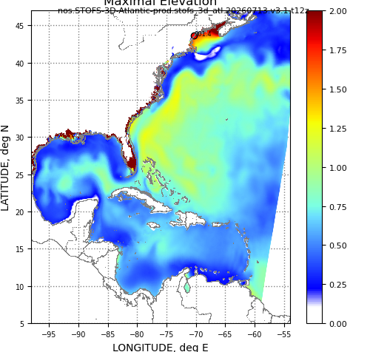
Background
Max. Elevation of STOFS3D @20260713
STOFS-3D-Atlantic (Surge and Tide Operational Forecast System – 3D Atlantic) is an advanced 3D coastal ocean forecasting system jointly developed by the Virginia Institute of Marine Science (VIMS) and NOAA.
Built on SCHISM, it predicts coastal water levels, flooding, and other ocean state (3D currents etc) across the northwestern Atlantic with very high spatial resolution in coastal transition zone (down to ~1m).
It incorporates the major physical drivers of coastal flooding, including river discharge, precipitation, tides, and storm surge. It has been in operation since Jan 2023 on NOAA’s WCOSS2 supercomputers.
The resource usage is intensive for this large forecast, with over 3 million nodes in the horizontal dimension and a vertically varying discretization ranging from 1 to 48 layers (mean ≈ 10).
https://polar.ncep.noaa.gov/estofs/autoval/stofs.3d.atl/index.htm
Database of Total Water Level (TWL)
  By incorporation Data Simulation into STOFS3D, VIMS constructed a 26-year database of TWL, which will be used to train our ML inundation model.
  Time Range: 2000 – 2025; File size (TWL): ~3 TB; Interval: 1 Hour; # of nodes: 3 M

Slide 4
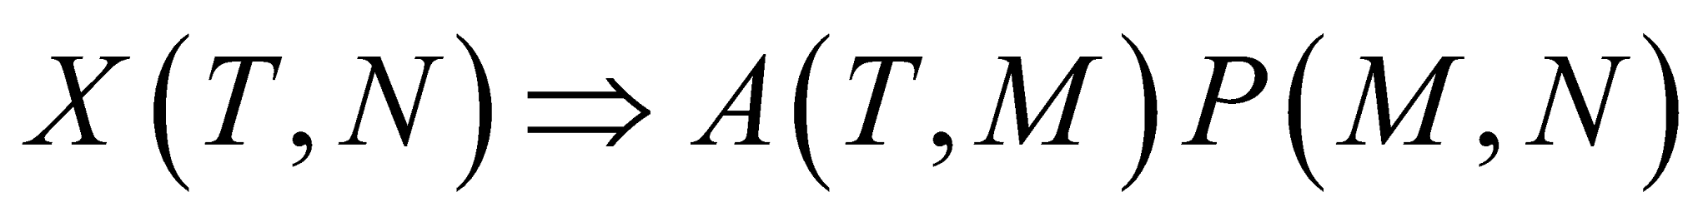
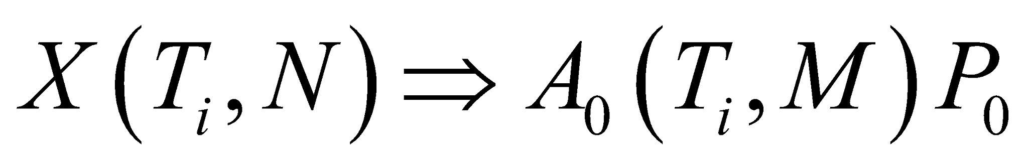
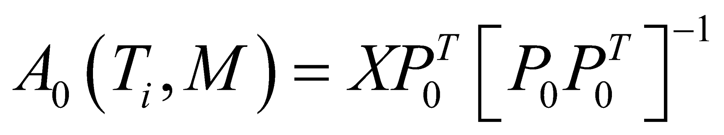
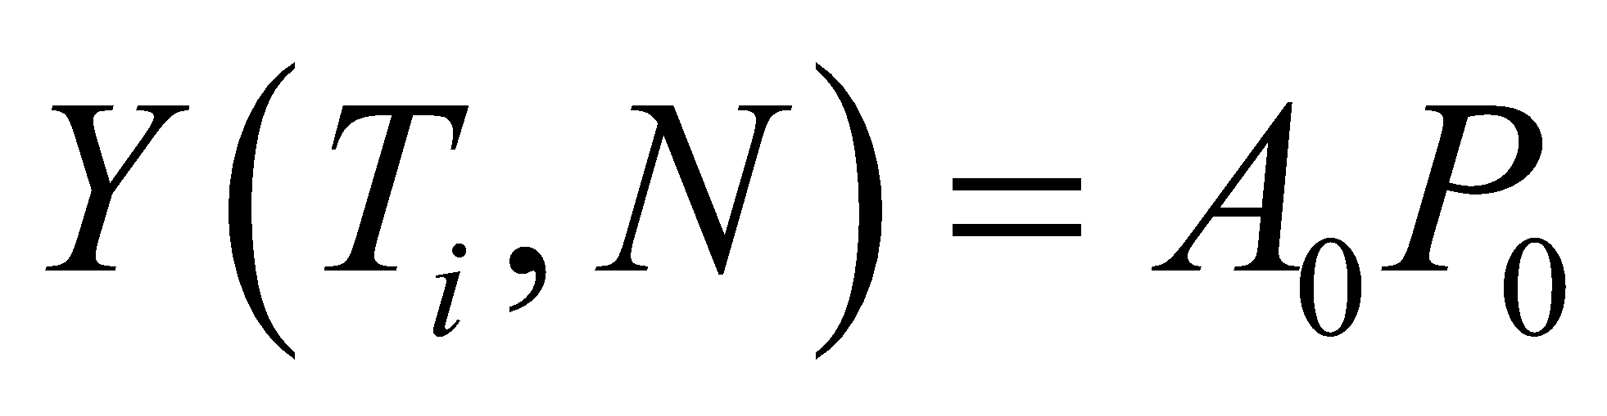
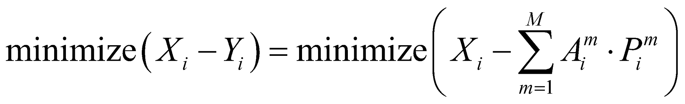
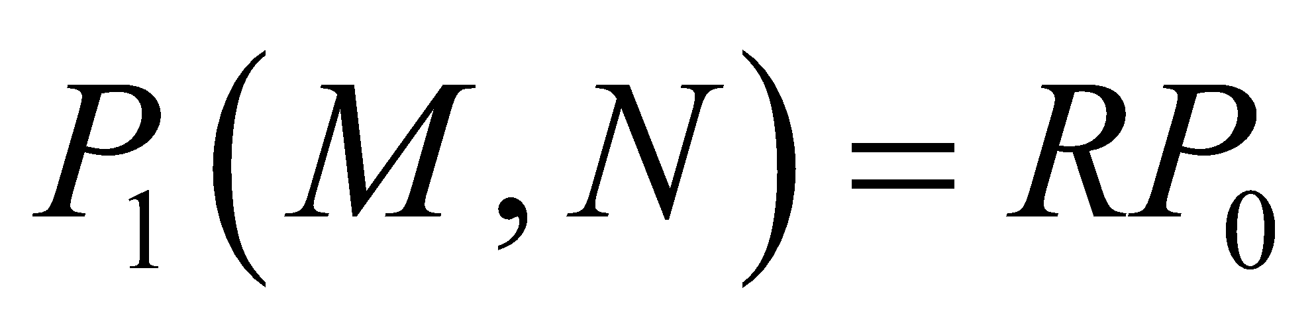
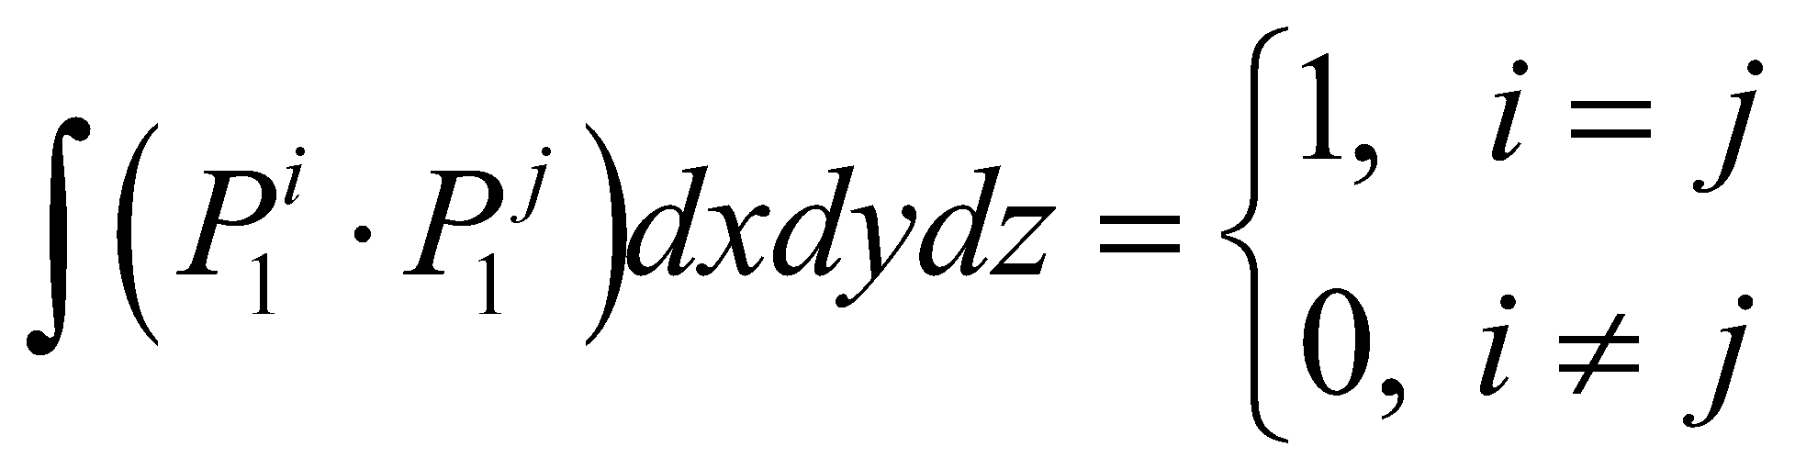
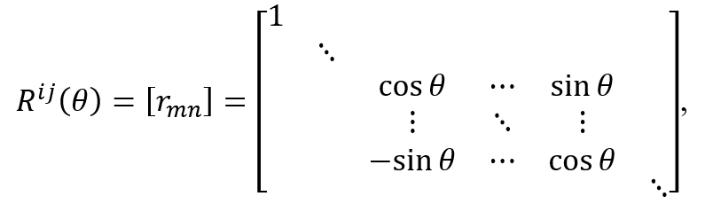
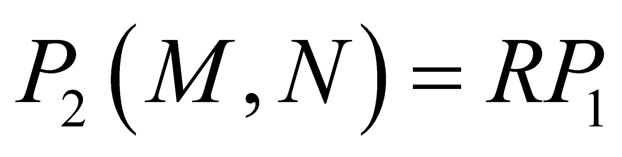
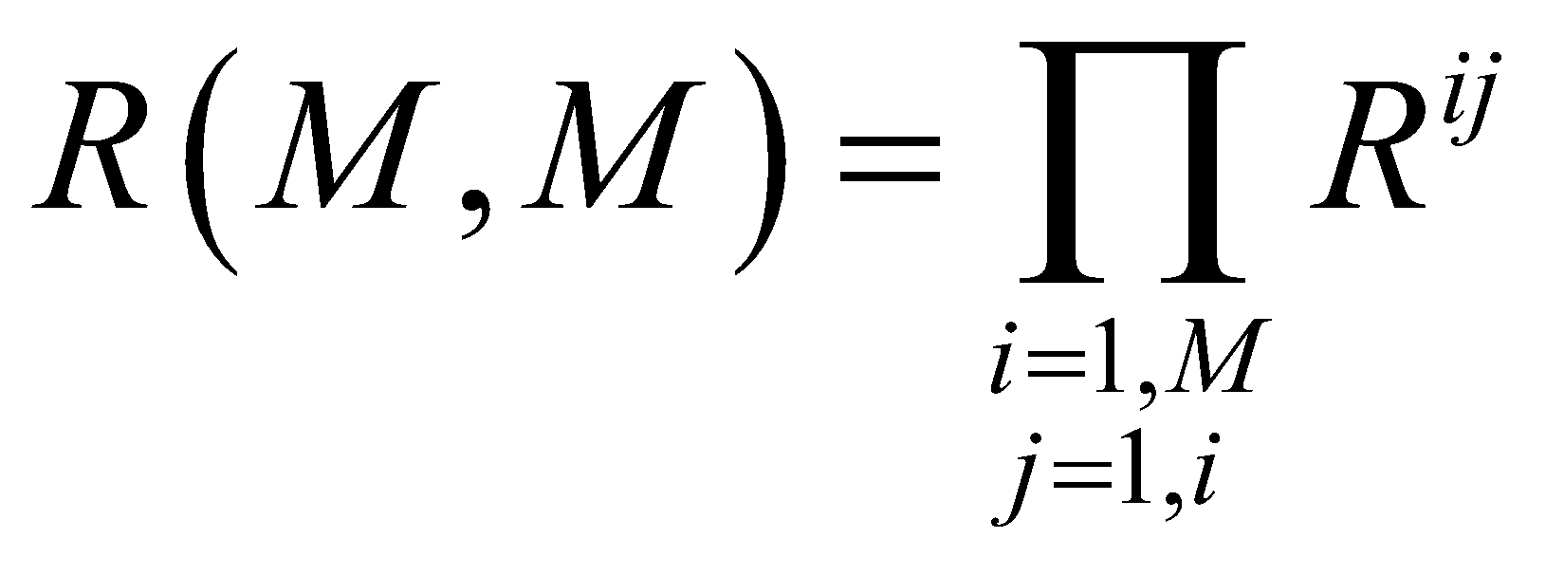
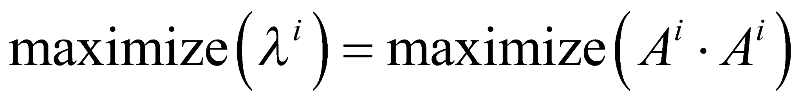
Machine Learning Based Empirical Orthogonal Function (MLEOF) method
MLEOF is a method we developed to extract the intrinsic oscillation modes of water level.
MLEOF not only compress the data, but also MLEOF modes are physically based.
Our experiments shows that MLEOF modes reproduce the classic EOF modes (Wang et al. in review).
T: time steps N: # of features M: # of modes A: amplitudes of modes P: MLEOF modes
Training:
Dimension Reduction
Loss Function:
Note: subscript i is batch #
Mode
Orthogonality
QR Decomposition
Rotation of modes:
Variance
Maximization
Loss Function:
Note: R is the rotation matrix

Slide 5
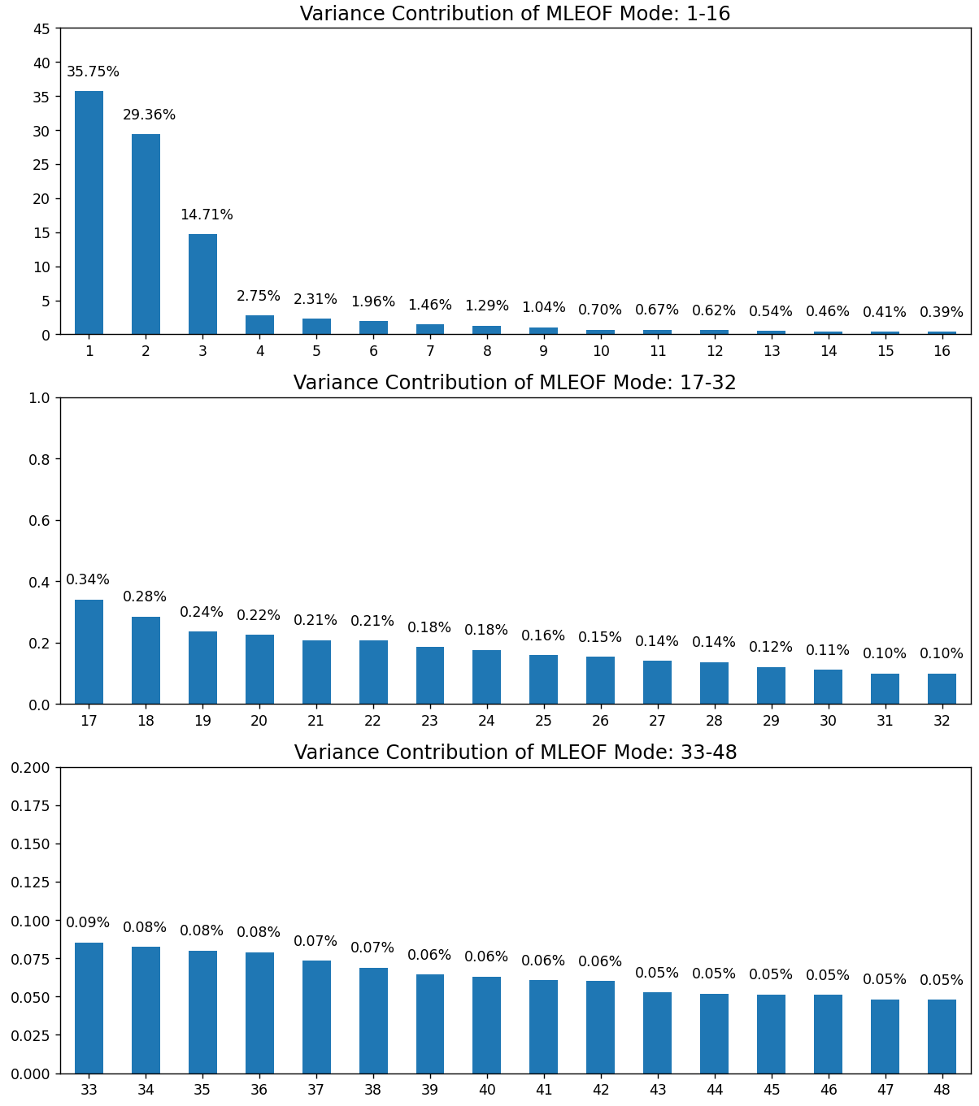
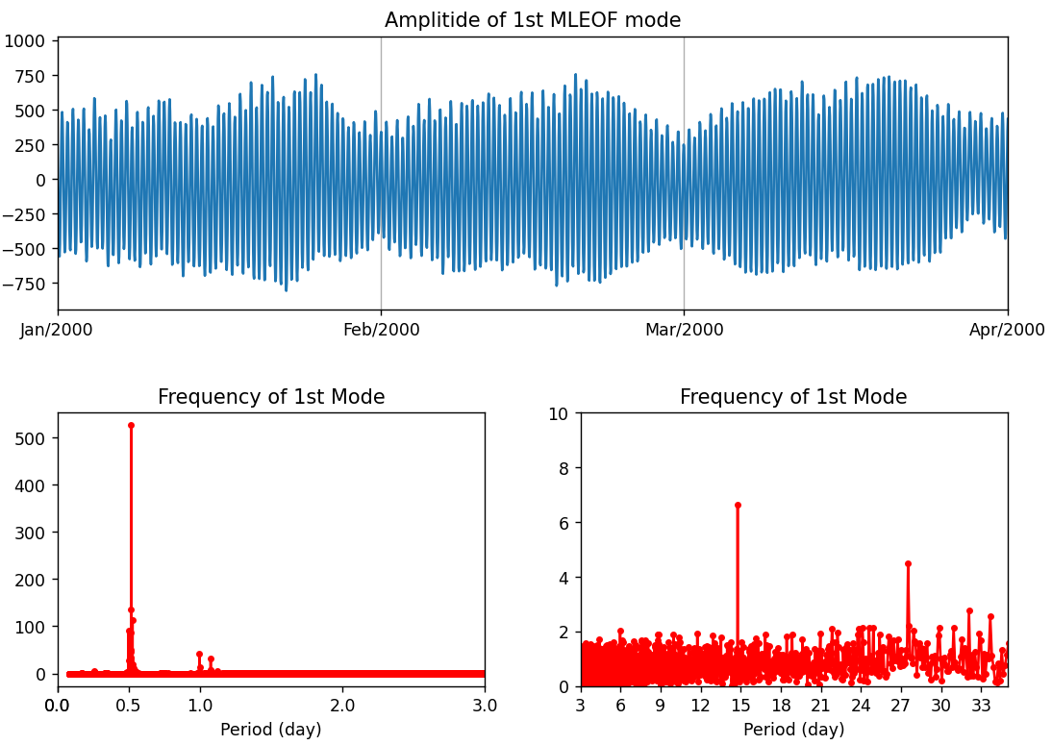
MLEOF modes
We used extracted 112 MLEOF modes from STOFS3D water level databases (3TB -> 1.2GB).
The leading modes contributes most of total variance
The 1st MLEOF mode mainly account for represents tidal variation
semidiurnal
spring-neap
lunar
diurnal

Slide 6
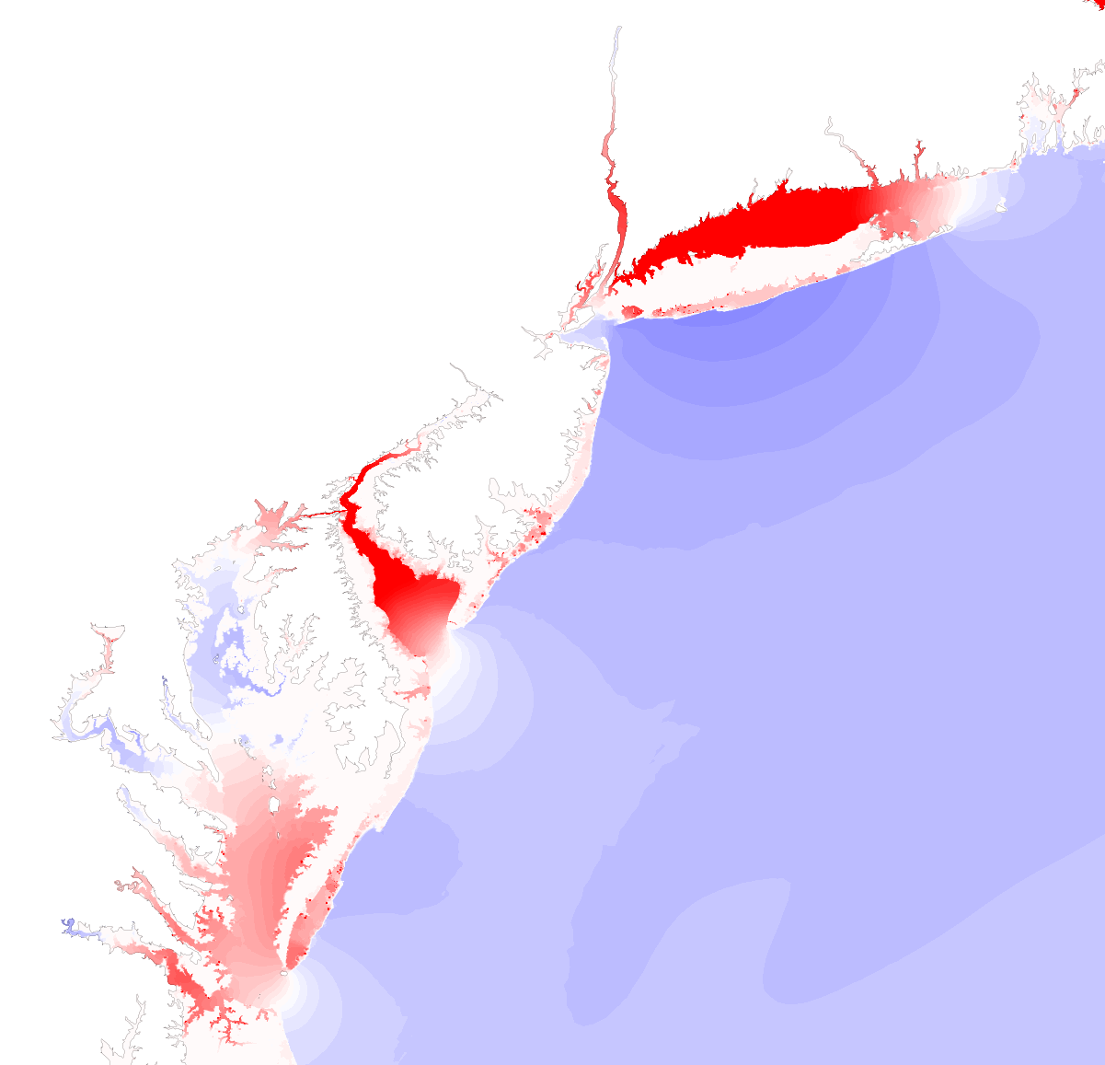
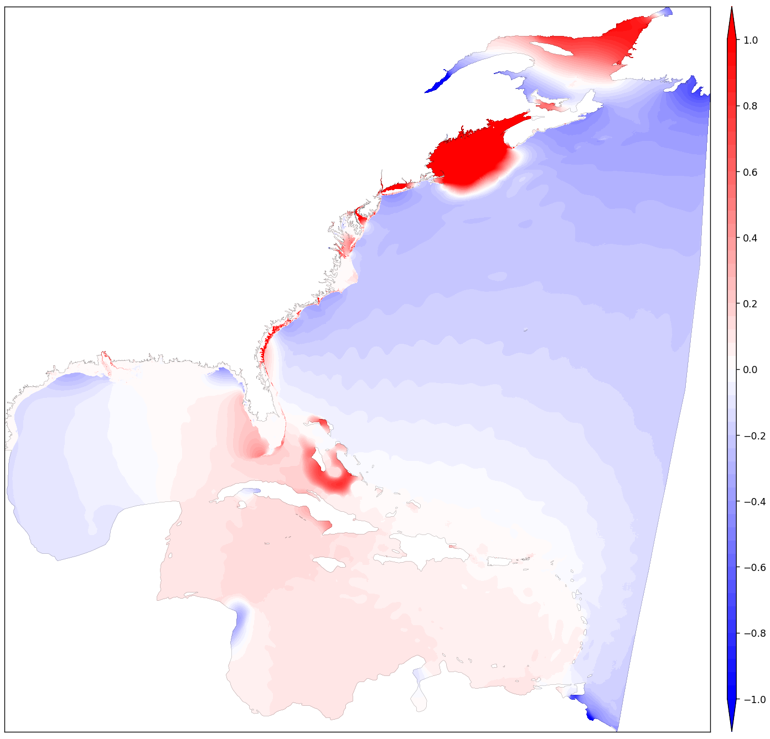
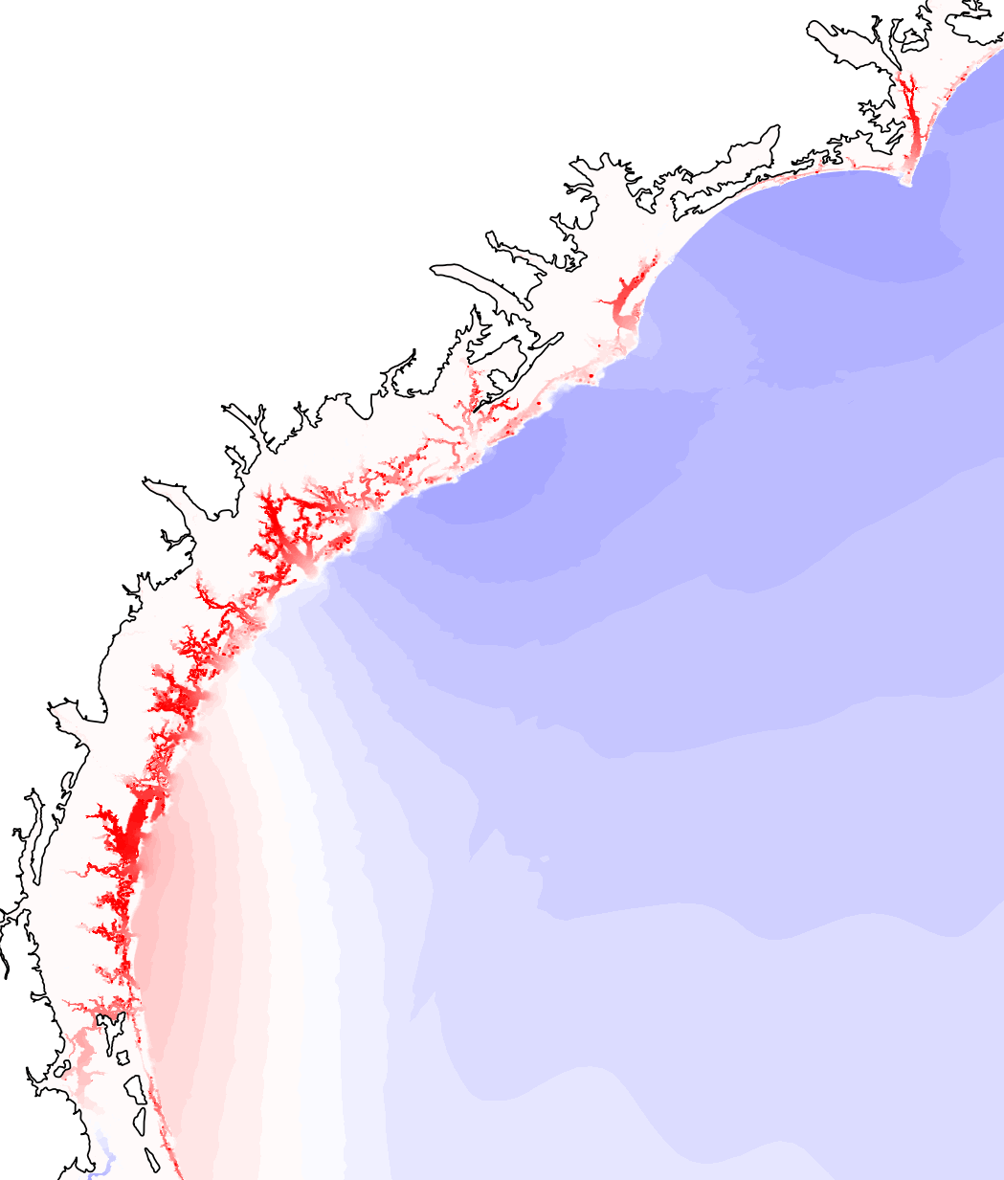
The 1st MLEOF Mode: Spatial Pattern
Total Variance Explained By the 1st MLEOF Mode: 35.75%
Tidal propagation in Chesapeake Bay
Grid Boundary
River Network

Slide 7
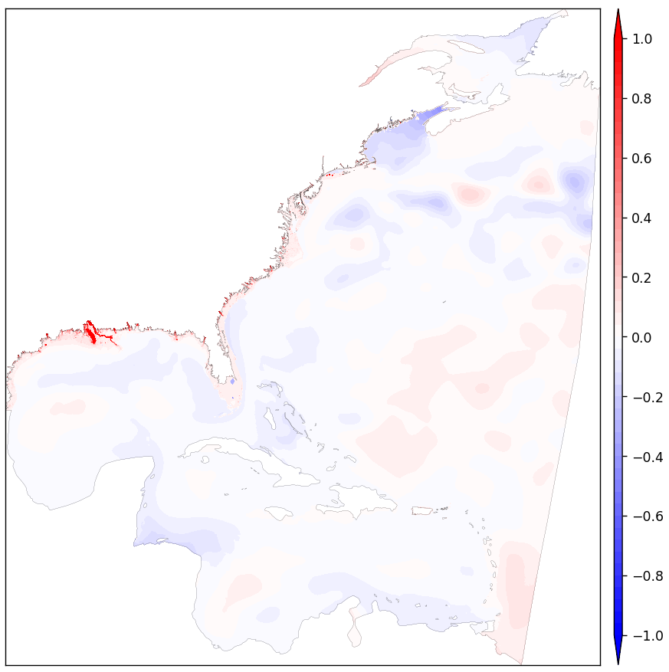
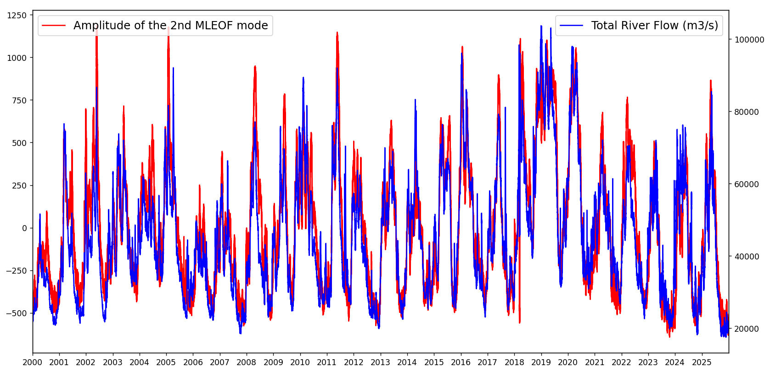
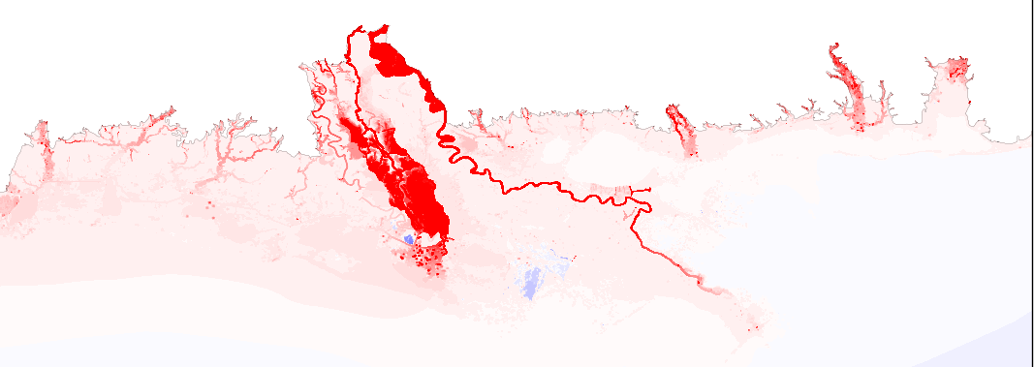
The 2nd MLEOF Mode
The 2nd MLEOF mode mainly account for river flow effect
Good Correlation: R(amplitude, flow)=0.907
Total Variance Explained By the 2nd MLEOF mode: 29.36%
river flow effect on water level

Slide 8
Development of ML model For STOFS3D-Atlantic
With MLEOF analysis, we only need to simulate the amplitude of MLEOF modes.
number of spatial points: N=3 million
number of MLEOF modes: M=112
X(T,N) => A(T,M) P(M,N)
ML model structure
Training: 2000 - 2019
Validation: 2020 – 2022
Testing: 2023-2025 (Forecast)
Forcing
(from STOF3D model)
cnn¹
cnn²
lstm
flatten
FC
River Flow
Elevation B.C.
lstm
FC
+
A(T,M)
Wind
Air Pressure

Slide 9
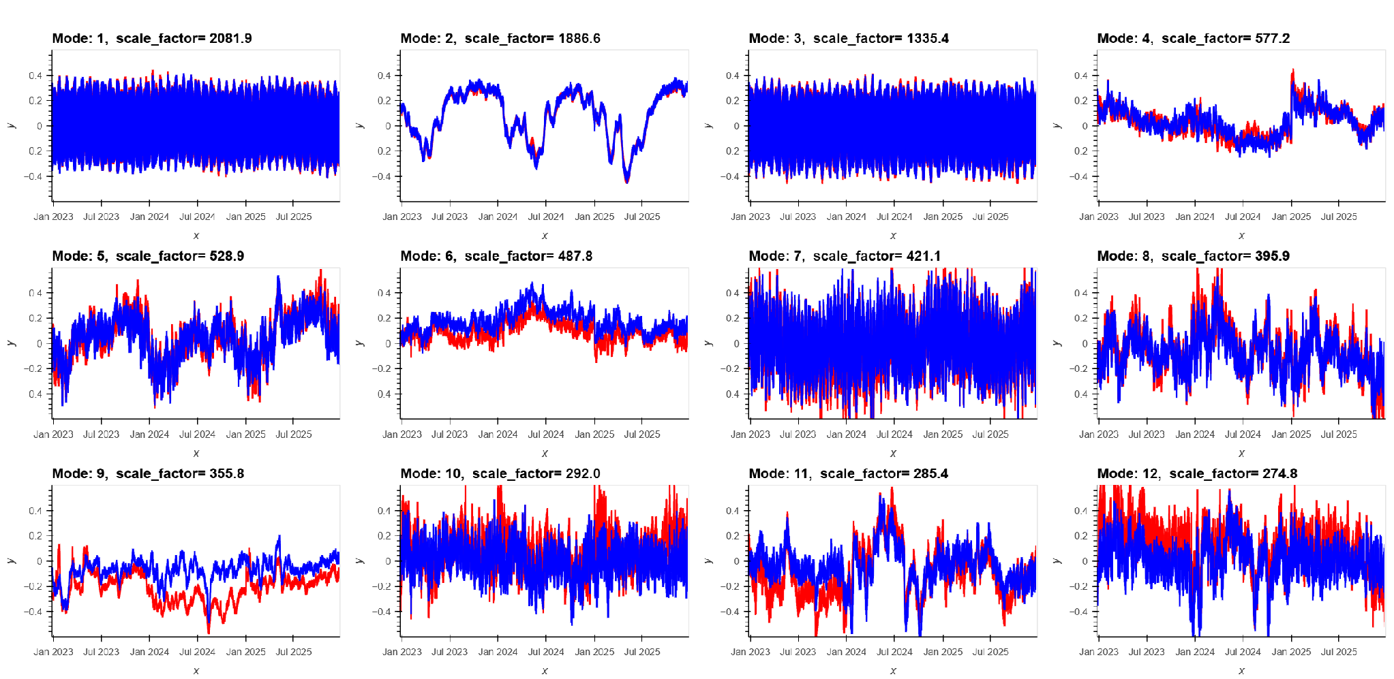
Comparison of Amplitudes of MLEOF Modes
STOFS3D
ML Forecast
ML model successfully simulate the leading MLEOF modes of water level

Slide 10
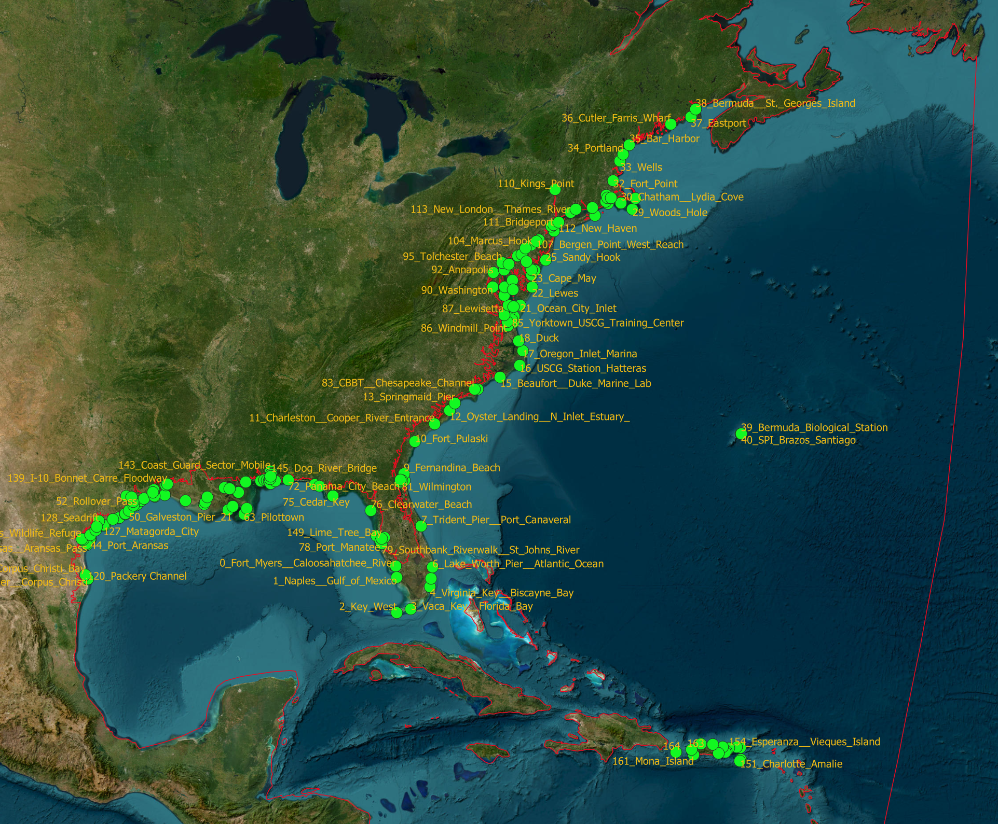
NOAA Water Level Stations: Comparison

Slide 11
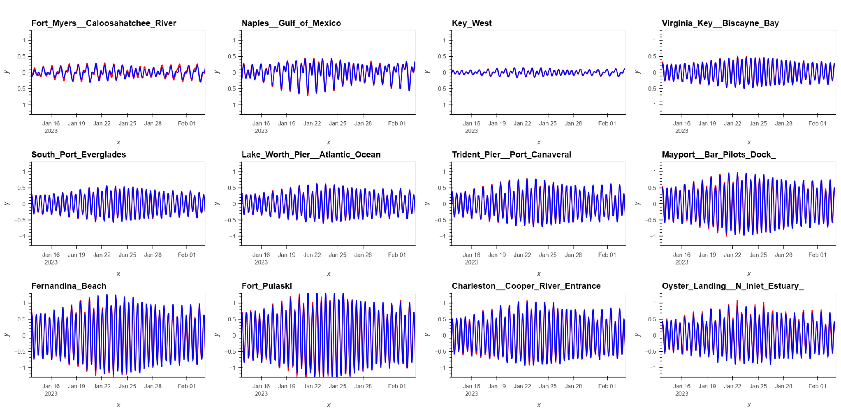
Comparison: Tides
STOFS3D
ML model well simulates the tides
ML Forecast

Slide 12
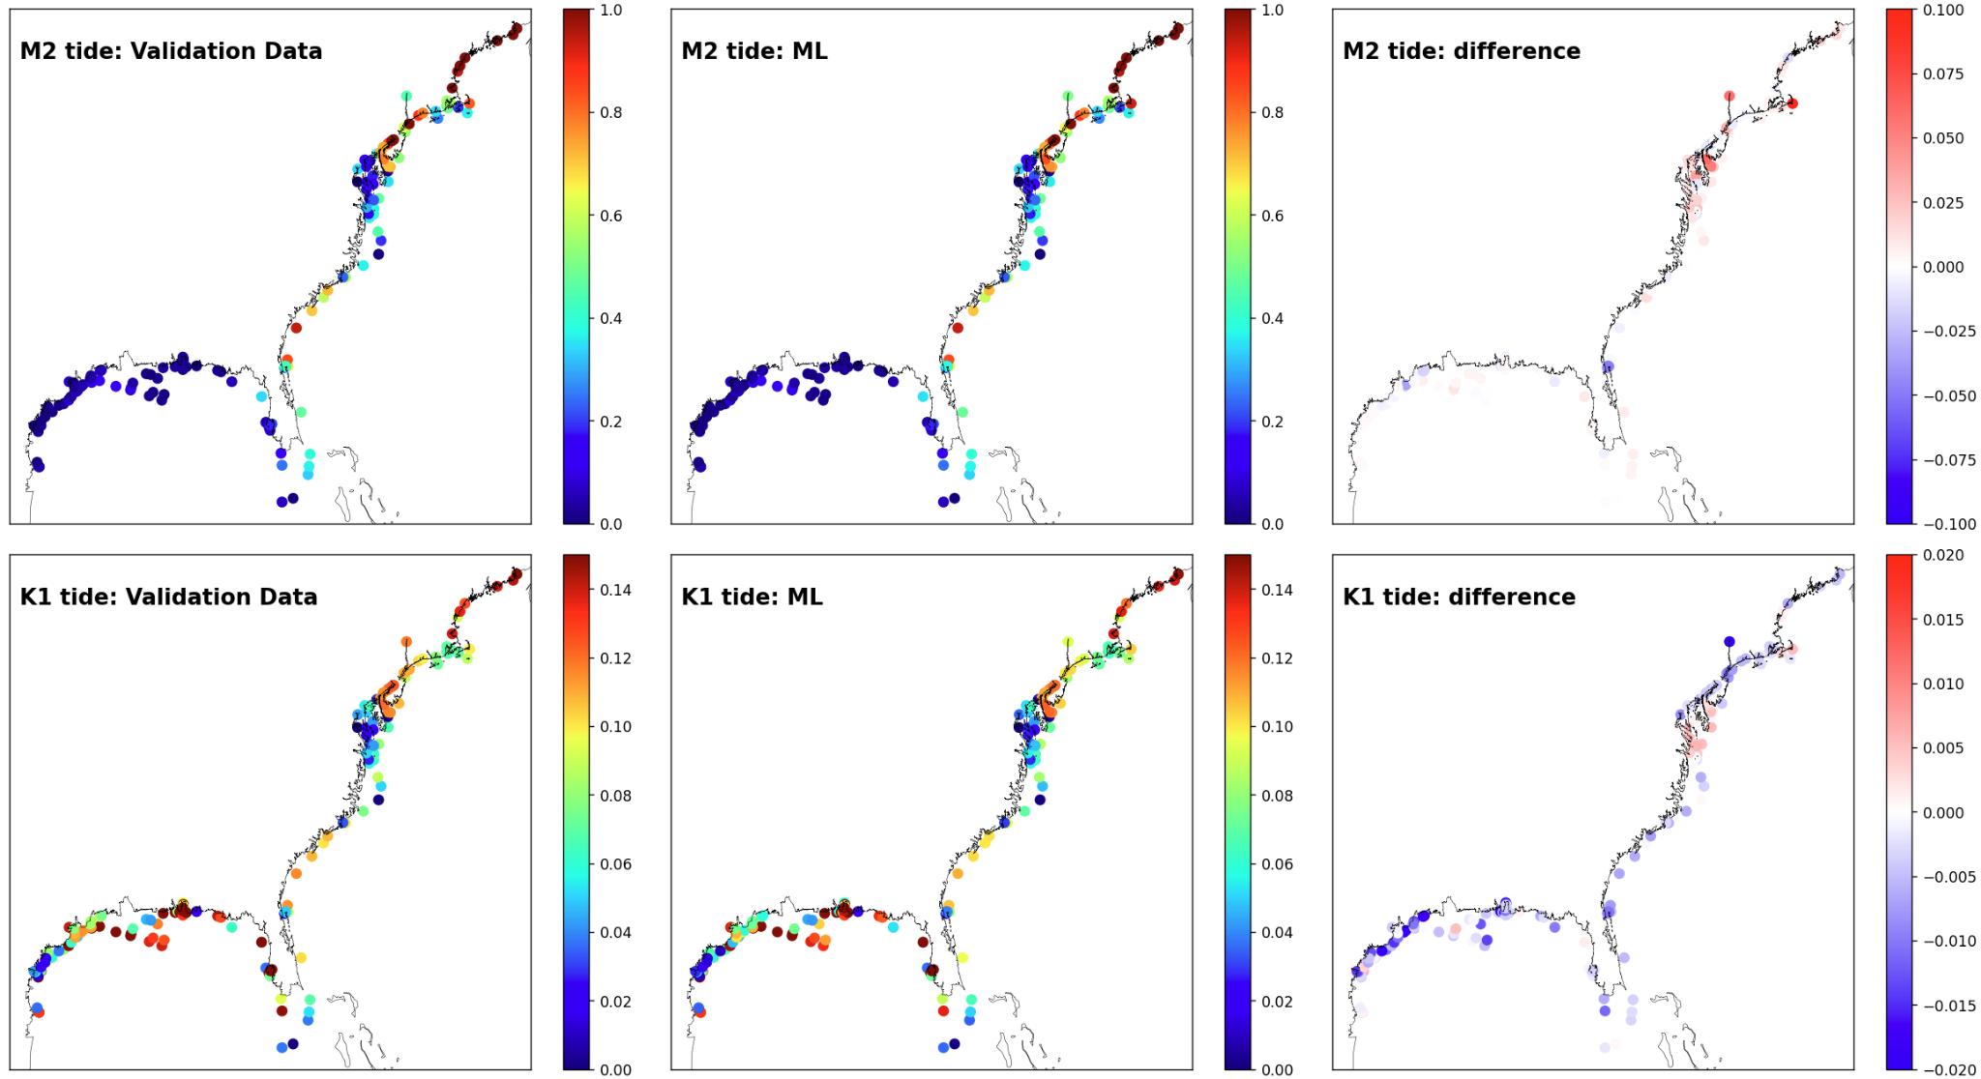
Comparison: Tidal Harmonics
ML model well simulates the tides regarding M2 and K1 tidal constituents.
M2: STOFS3D
M2: ML
M2: difference
Tidal Amplitudes (m)
K1: STOFS3D
K1: ML
K1: difference

Slide 13
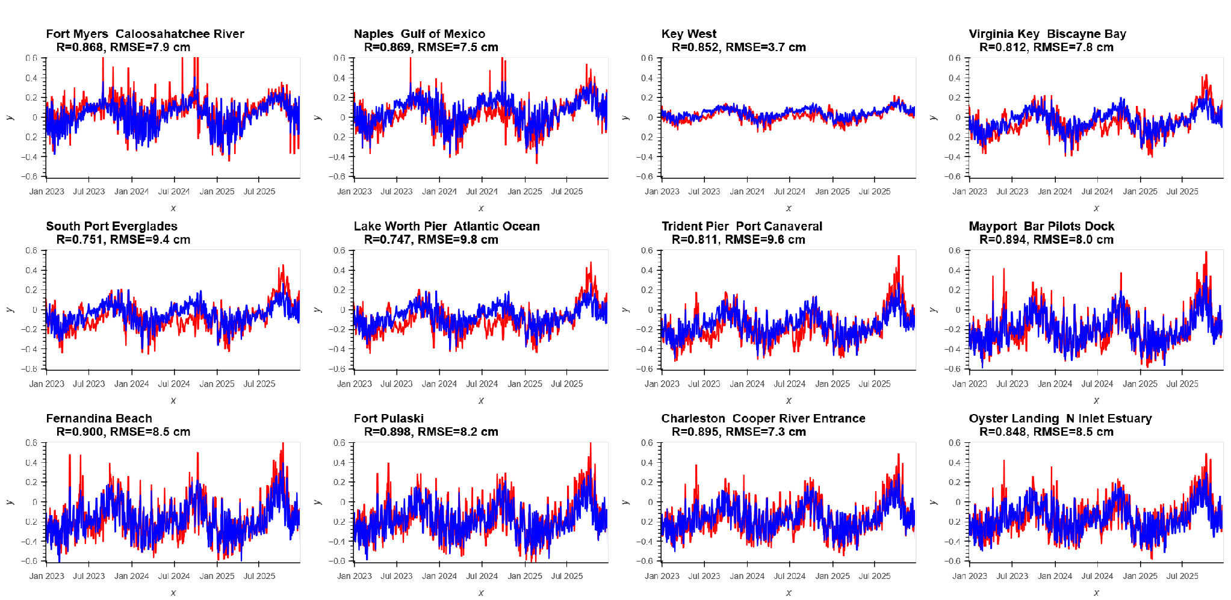
Comparison: Sub-tides
STOFS3D
ML model well simulates the sub-tides with RMSE generally less than 10 cm.
ML model tends to underestimate along hurricane track.
ML Forecast

Slide 14
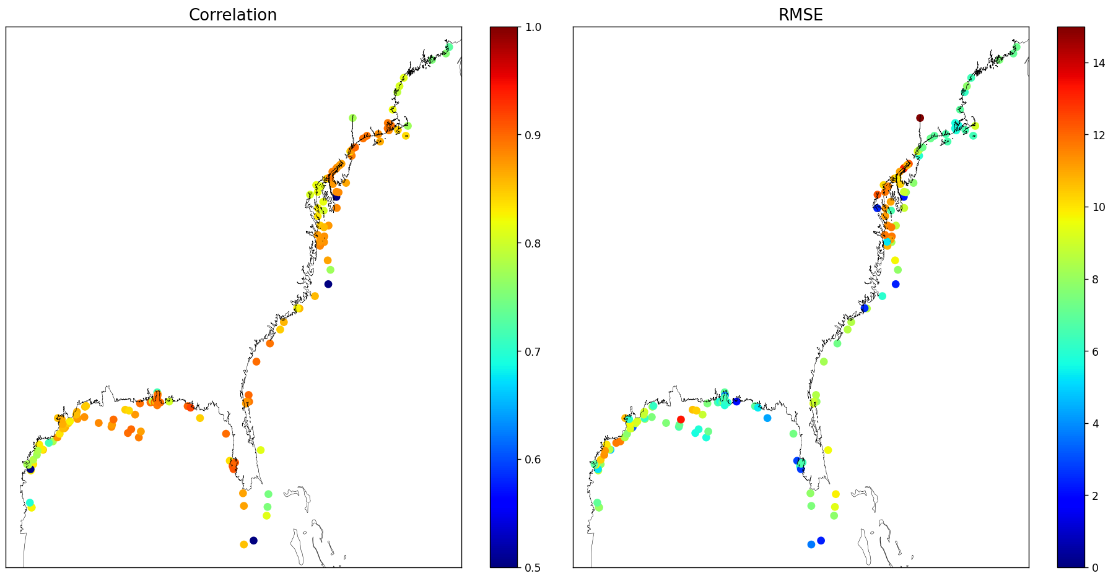
Error Distribution : Sub-tides
Larger RMSE seems to appear around Chesapeake Bay region
CM
Correlation Coefficient (R)
between STOFS3D and ML
RMSE(ML, STOFS3D)

Slide 15
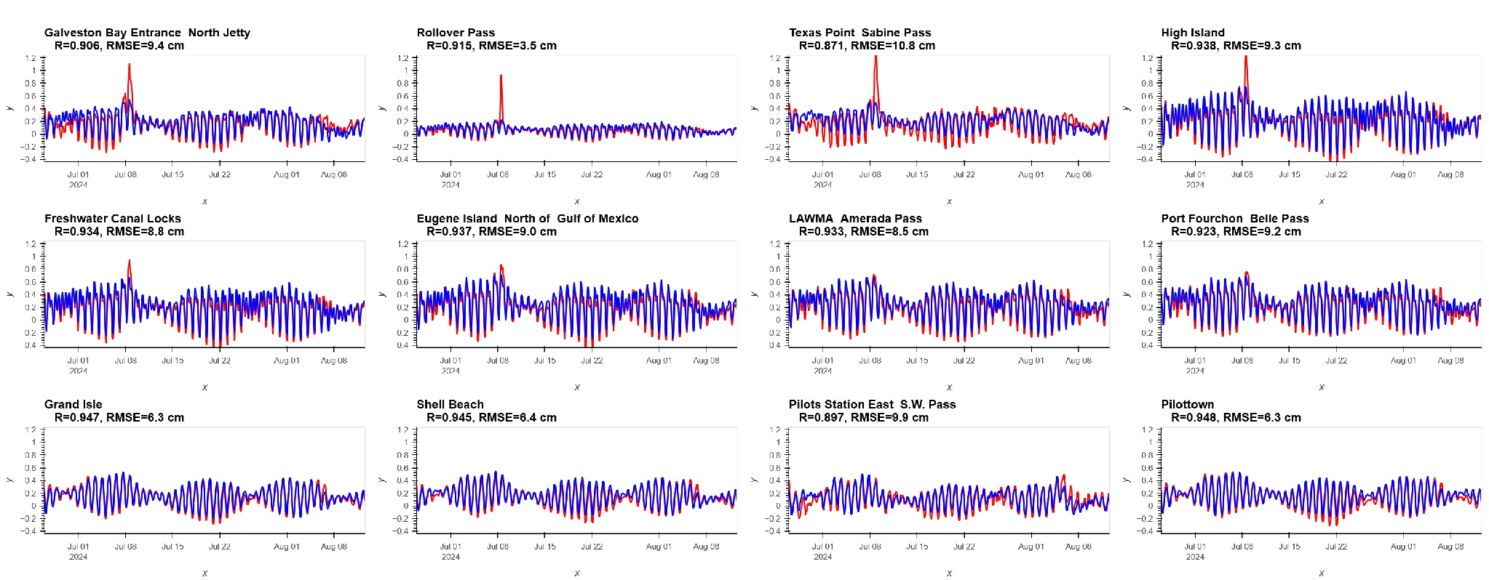
Comparison : total water level
STOFS3D
ML Forecast
ML model is able to generally capture the TWL variation, but underestimate along the hurricane track.

Slide 16
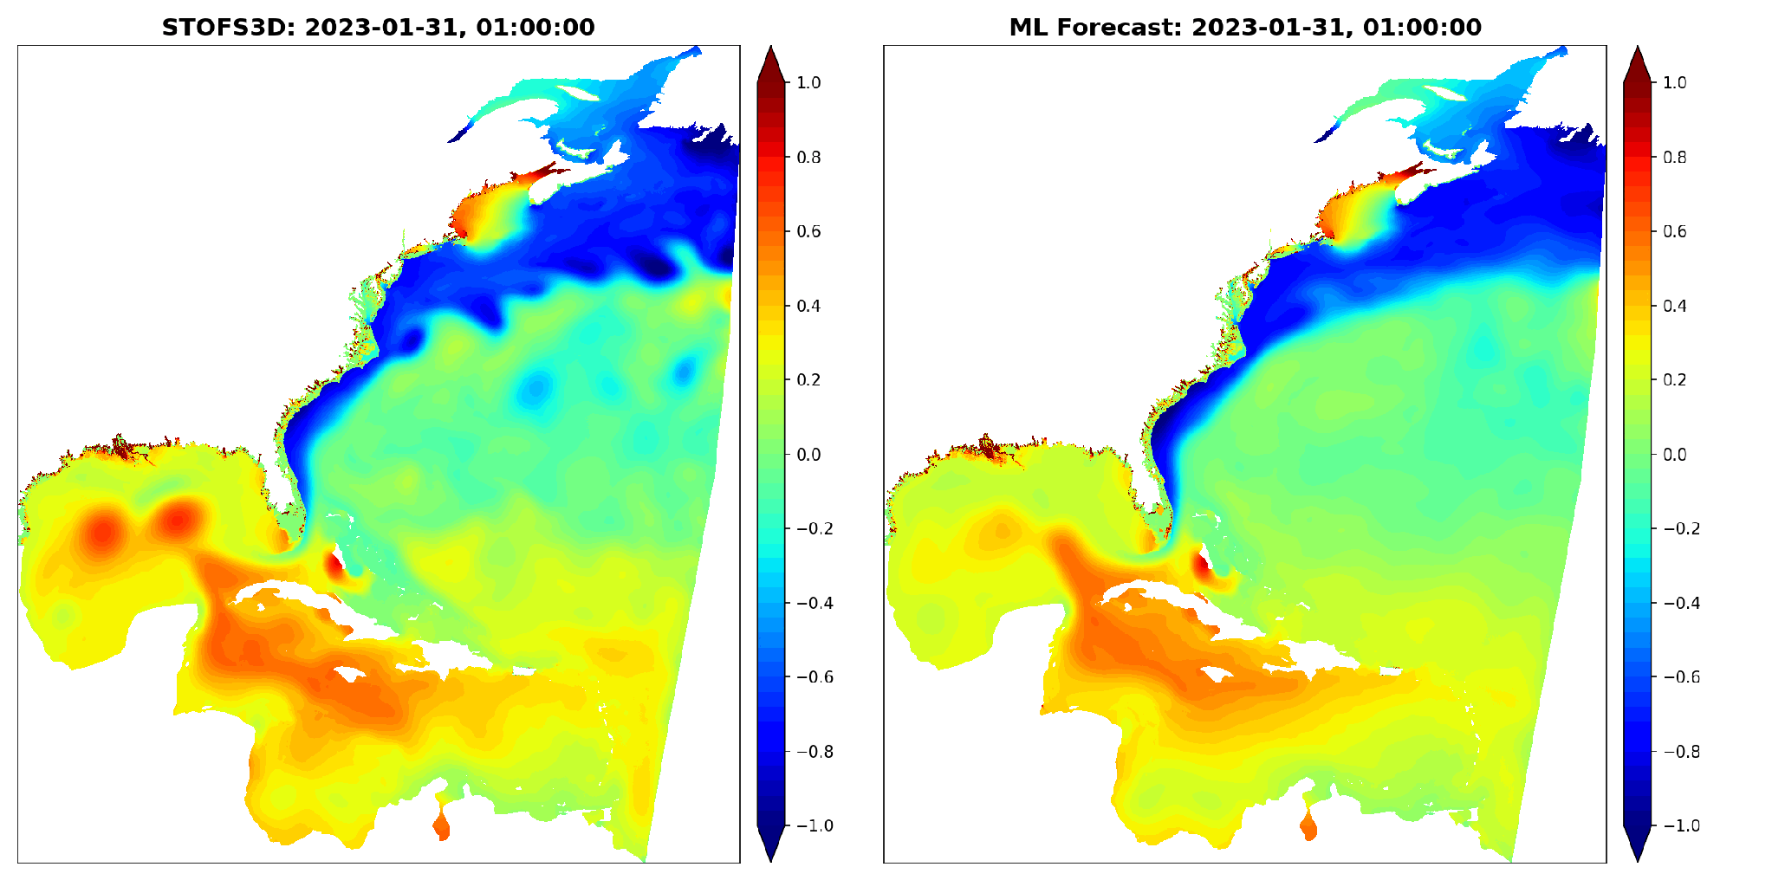
Animation for TWL prediction

Slide 17
Summary
  We proposed a MLEOF method, capable of efficiently extracting the EOF modes from STOFS3D-Atlantic model results.
  We developed a ML-based forecast model (CNN-LSTM) grounded on MLEOF, which well captures the amplitudes of the leading EOF modes.
  Tide is well simulated in ML forecast. Subtide is also well simulated, but tends to have larger error along hurricane track.
  Next: We will combine data simulation and ensemble forecast with ML model to improve the model performance.

