Slide 1
Accelerating UFS Model Development Cycles Through a Process-Oriented, Machine Learning–Based Framework
Augustin Vintzileos⁽¹⁾⁽²⁾
Benjamin A. Cash⁽²⁾, and Jim Kinter⁽²⁾
⁽¹⁾University of Maryland – ESSIC
⁽²⁾George Mason University - COLA

Slide 2
From Traditional Global Tuning to Process-Consistent Model Development
The problem
Parameterization calibration is slow and inefficient: improving one performance metric often degrades others.
Proposed framework: PROMETHEUS
(PROcess-oriented Model dEvelopment Through dEcision tRee HeUristic System)
PROMETHEUS replaces the traditional cycle of iterative parameterization tuning and global model evaluation by:
Grouping atmospheric columns, guided by the statistically distinct behavior of a target variable (e.g., OLR tendency), into Column States (physics regimes) associated with distinct combinations of dominant physical processes.
Optimizing physical parameterizations within each physics regime.
Evaluating the impact of process-oriented improvements on simulations and forecasts.
In this presentation, we:
Demonstrate how interpretable machine learning objectively identifies Column States.
Illustrate the framework using process studies based on OLR tendency.
Discuss how the same framework naturally extends to forecast-error diagnosis and weather model improvement.

Slide 3
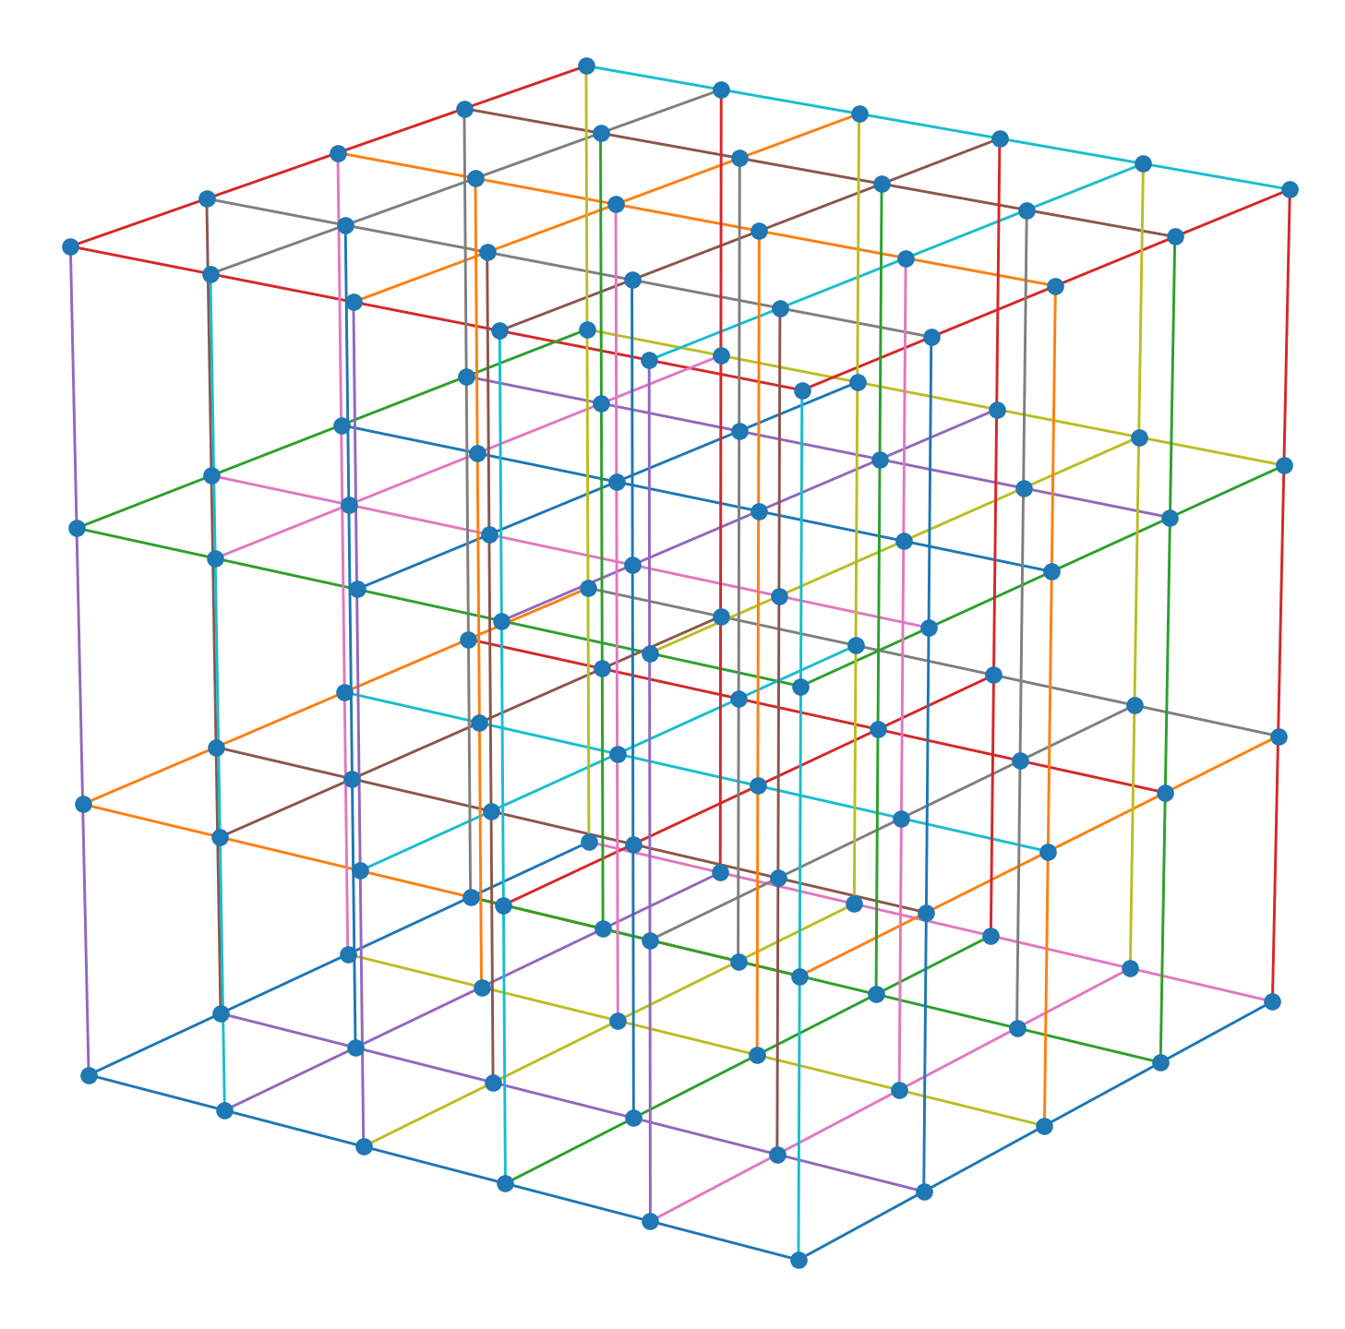
General Circulation Models: Dynamics and Physics
Physics: Parameterizations of unresolved physical processes on each vertical column of the model (one-dimensional)
Dynamics: Numerical solution of the governing atmospheric equations
Strongly Coupled
Most simulation and forecast errors originate in the representation of unresolved physical processes and their coupling to the resolved flow.
One way to improve the Physics is to use Single-column models to isolate the physical parameterizations by prescribing the large-scale dynamics.

Slide 4

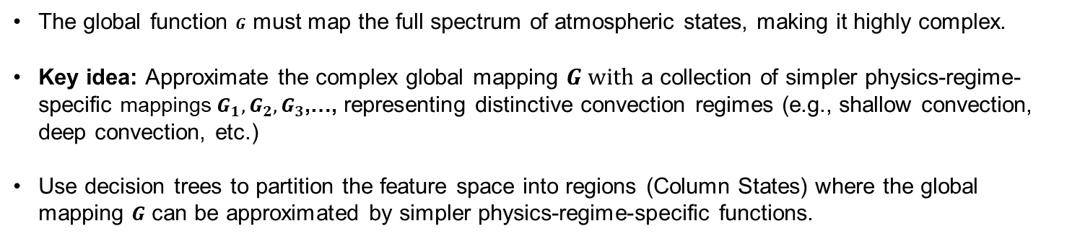
Methodology: From Single Column Models to Decision Trees
Following the Single Column Model paradigm, the tendency of a target variable (e.g., OLR, a proxy for tropical convection) can be represented as a function of the atmospheric state and large-scale forcing.
$$\frac{∂OLR}{∂t} = G\left(OLR, Turb. Flux., Rad. Flux.,T, Q,…,∇\vec{u}q, w, …\right)$$
Target variable
Physics Features
Dynamics Features (forcing)
Feature space S
The global function $G$ must map the full spectrum of atmospheric states, making it highly complex.
Key idea: Approximate the complex global mapping $G with$ a collection of simpler physics-regime-specific mappings $G_{1},G_{2},G_{3}$,…, representing distinctive convection regimes (e.g., shallow convection, deep convection, etc.)
Use decision trees to partition the feature space into regions (Column States) where the global mapping $G$ can be approximated by simpler physics-regime-specific functions.

Slide 5







From Prescribed to Data-Driven Physics Regimes
Example of a prescribed physics partition
Unconditional set of all possible convective states
$$G_{2}\left(s\right) for s∈ S_{2}$$
$$G\left(s\right) for s∈S$$
$$G_{1+2}\left(s\right) for s∈ S_{1}∪ S_{2}$$
$$S_{1}∪ S_{2}≡S\left(T_{surf.}>28°C\right)$$
$$G_{1}\left(s\right) for s∈ S_{1}$$
e.g., Gadgil et al., 1984
At any location and time, a tropical atmospheric column occupies one of many convective states, ranging from suppressed conditions to deep convection.
$$S_{3}≡S\left(T_{surf.}≤28°C\right)$$
The goal is to discover, rather than prescribe, the partitions where atmospheric physics is most simply represented (Column States).
$$G_{3}\left(s\right) for s∈ S_{3}$$

Slide 6

Methodology: Decision Trees Define Column States
A decision tree is constructed by recursively partitioning the data space using splits that maximize a chosen criterion
Root node: Unconditional distribution of the target variable
Candidate features
$$\frac{∂OLR}{∂t}$$
T
Splitting criterion
Q
W
Variance reduction (this presentation)
OLR
BLH
At each node, all candidate splits are evaluated, and the one maximizing the selected criterion is chosen.
MSE
G₁
G₂
G₃
Leaves (Column States): Regions of the feature space with distinct conditional distributions of the target variable.

Slide 7
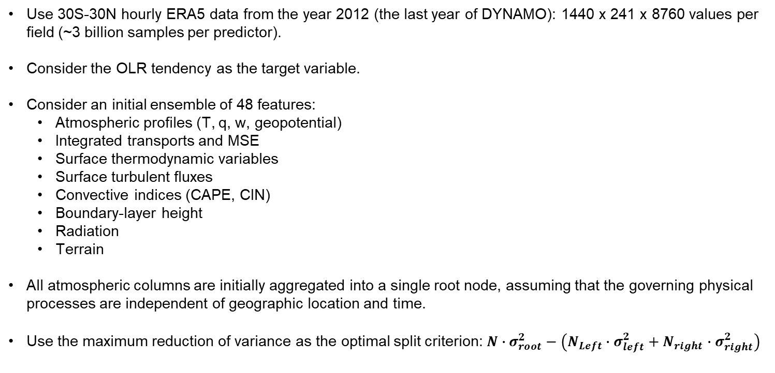
Objective Identification of Column States
Use 30S-30N hourly ERA5 data from the year 2012 (the last year of DYNAMO): 1440 x 241 x 8760 values per field (~3 billion samples per predictor).
Consider the OLR tendency as the target variable.
Consider an initial ensemble of 48 features:
  Atmospheric profiles (T, q, w, geopotential)
  Integrated transports and MSE
  Surface thermodynamic variables
  Surface turbulent fluxes
  Convective indices (CAPE, CIN)
  Boundary-layer height
  Radiation
  Terrain
All atmospheric columns are initially aggregated into a single root node, assuming that the governing physical processes are independent of geographic location and time.
Use the maximum reduction of variance as the optimal split criterion: $N∙σ_{root}^{2}−\left(N_{Left}∙σ_{left}^{2}+N_{right}∙σ_{right}^{2}\right)$

Slide 8


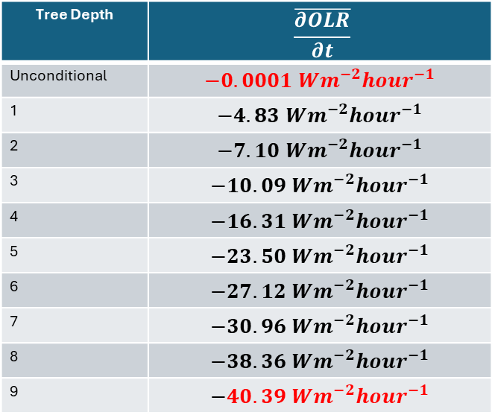

Process Study 1: Investigation of the role of skin temperature in fast convective development
Objective: Determine the atmospheric conditions under which skin temperature becomes the dominant control on rapid convective development over the ocean.
Strategy: Tree traversal; at each node, follow the branch with the minimum OLR tendency until a skin-temperature split is encountered.
Tree Depth | $$\overline{\frac{∂OLR}{∂t}}$$
Unconditional | $$−0.0001 Wm^{−2}{hour}^{−1}$$
1 | $$−4.83 Wm^{−2}{hour}^{−1}$$
2 | $$−7.10 Wm^{−2}{hour}^{−1}$$
3 | $$−10.09 Wm^{−2}{hour}^{−1}$$
4 | $$−16.31 Wm^{−2}{hour}^{−1}$$
5 | $$−23.50 Wm^{−2}{hour}^{−1}$$
6 | $$−27.12 Wm^{−2}{hour}^{−1}$$
7 | $$−30.96 Wm^{−2}{hour}^{−1}$$
8 | $$−38.36 Wm^{−2}{hour}^{−1}$$
9 | $$−40.39 Wm^{−2}{hour}^{−1}$$
$$\frac{∂OLR}{∂t}$$
Root node
$$min\left(\overline{\frac{∂OLR}{∂t}}\right)$$
$$min\left(\overline{\frac{∂OLR}{∂t}}\right)$$

Slide 9
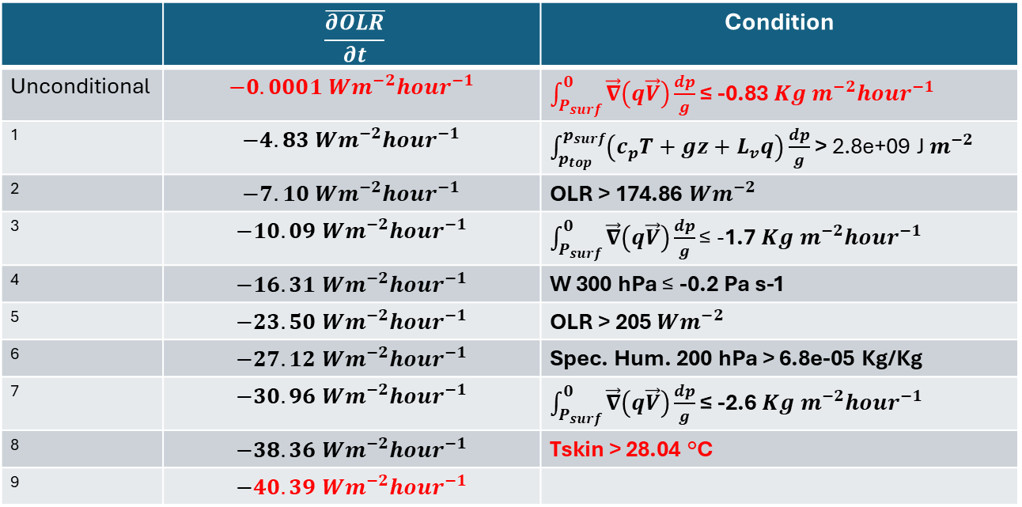
Investigation of the role of skin temperature in fast convective development
 | $$\overline{\frac{∂OLR}{∂t}}$$ | Condition
Unconditional | $$−0.0001 Wm^{−2}{hour}^{−1}$$ | $\int_{P_{surf}}^{0}{\vec{∇}\left(q\vec{V}\right)\frac{dp}{g}}$ ≤ -0.83 $Kg m^{−2}{hour}^{−1}$
1 | $$−4.83 Wm^{−2}{hour}^{−1}$$ | $\int_{p_{top}}^{p_{surf}}{\left(c_{p}T+gz+L_{v}q\right)}\frac{dp}{g}$> 2.8e+09 J $m^{−2}$
2 | $$−7.10 Wm^{−2}{hour}^{−1}$$ | OLR > 174.86 $Wm^{−2}$
3 | $$−10.09 Wm^{−2}{hour}^{−1}$$ | $\int_{P_{surf}}^{0}{\vec{∇}\left(q\vec{V}\right)\frac{dp}{g}}\text{≤ }$-1.7 $Kg m^{−2}{hour}^{−1}$
4 | $$−16.31 Wm^{−2}{hour}^{−1}$$ | W 300 hPa $\text{≤}$ -0.2 Pa s-1
5 | $$−23.50 Wm^{−2}{hour}^{−1}$$ | OLR > 205 $Wm^{−2}$
6 | $$−27.12 Wm^{−2}{hour}^{−1}$$ | Spec. Hum. 200 hPa > 6.8e-05 Kg/Kg
7 | $$−30.96 Wm^{−2}{hour}^{−1}$$ | $\int_{P_{surf}}^{0}{\vec{∇}\left(q\vec{V}\right)\frac{dp}{g}}$ ≤ -2.6 $Kg m^{−2}{hour}^{−1}$
8 | $$−38.36 Wm^{−2}{hour}^{−1}$$ | Tskin > 28.04 °C
9 | $$−40.39 Wm^{−2}{hour}^{−1}$$

Slide 10
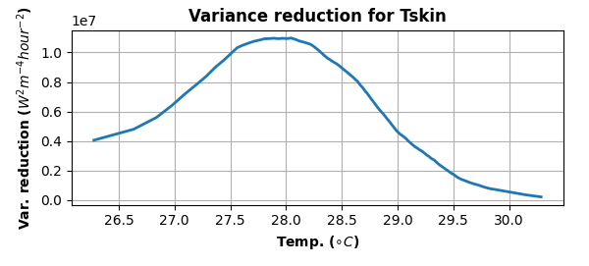


The First Skin-Temperature Node
Variance reduction of OLR tendency is maximized for a split at 28°C
Tskin < 28°C
Tskin ≥ 28°C
28°C
$$\overline{\frac{∂OLR}{∂t}=}−31.53 Wm^{−2}{hour}^{−1}$$
$$\overline{\frac{∂OLR}{∂t}=}−40.39 Wm^{−2}{hour}^{−1}$$
The decision tree objectively identifies the classical ~28°C threshold for enhanced tropical convection, but only after favorable moisture convergence, MSE, and upper-level humidity and ascent conditions have been satisfied.

Slide 11
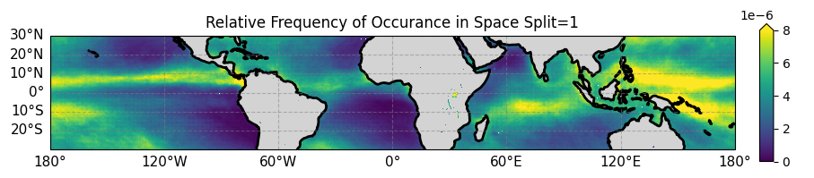
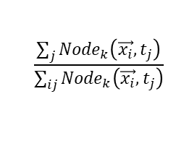
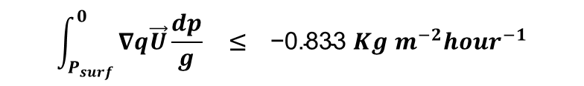
The First Split Objectively Identifies Deep Tropical Convection
Diagnostic: Relative frequency of occurrence of a node
$$\frac{\sum_{j}{{Node}_{k}\left(\vec{x_{i}},t_{j}\right)}}{\sum_{ij}{{Node}_{k}\left(\vec{x_{i}},t_{j}\right)}}$$
$$\int_{P_{surf}}^{0}{∇q\vec{U}\frac{dp}{g}} \text{≤} \text{ −0.833 }Kg m^{−2}{hour}^{−1}$$
First Condition:
Without any geographic information, the first split “discovers” the ITCZ/SPCZ

Slide 12
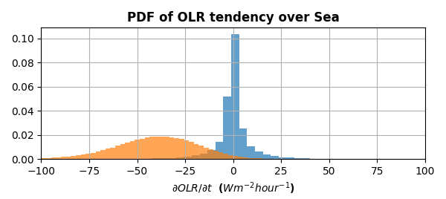
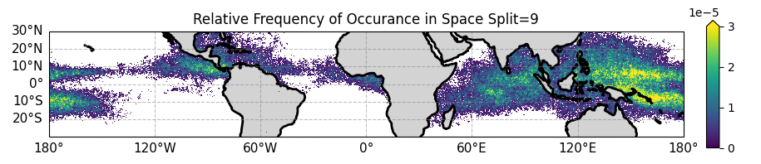

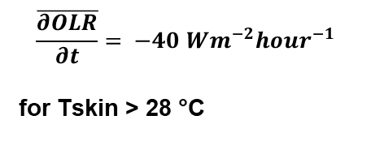
The First Skin-Temperature Split Identifies the Most Rapid Convective Development
$$\overline{\frac{∂OLR}{∂t}}= −40 Wm^{−2}{hour}^{−1}$$
for Tskin > 28 °C
$$\overline{\frac{∂OLR}{∂t}}=−0.0 Wm^{−2}{hour}^{−1}$$
Initial (unconditional) distribution

Slide 13
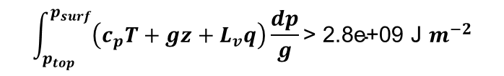
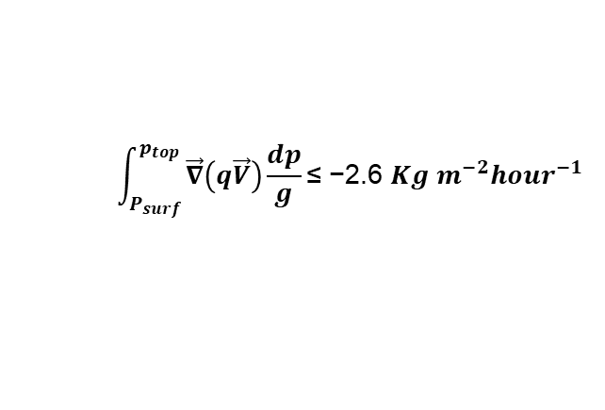

Recapitulating: Physical Environment of the First Tskin Split
$$\int_{p_{top}}^{p_{surf}}{\left(c_{p}T+gz+L_{v}q\right)}\frac{dp}{g}\text{> 2.8}\text{e}\text{+09 }\text{J} m^{−2}$$
Upper levels (200 hPa) Specific Humidity > 6.9e-05 Kg/Kg
Q
W
Vertical velocity < -0.2 Pa s-1 at 300 hPa (upward)
OLR
$$\int_{P_{surf}}^{p_{top}}{\vec{∇}\left(q\vec{V}\right)\frac{dp}{g}}\text{≤} \text{−2.}\text{6} Kg m^{−2}{hour}^{−1}$$
OLR > 205 $Wm^{−2}$ i.e., deep convection still developing
T_{SKIN}
The decision tree shows that T_{SKIN} becomes a dominant discriminator only after the atmosphere has already evolved into a highly favorable convective state.

Slide 14
Summary and Conclusions
PROMETHEUS objectively identifies physically meaningful Column States from large reanalysis datasets.
The framework not only rediscovers established physical relationships (e.g., the ITCZ/SPCZ and the ~28°C SST threshold), but also reveals the sequence of physical processes that lead to them.
The framework is general and can be applied to other phenomena (e.g., coupled ocean–atmosphere interactions, extreme heat) by changing the target variable and predictor set.
PROMETHEUS provides an objective pathway for process-oriented diagnosis of UFS physics, allowing targeted SCM development before expensive global testing.
The next phase is to extend PROMETHEUS by using the UFS Single Column Model to optimize parameterizations within each objectively identified Column State and evaluate the resulting forecast improvements.
PROMETHEUS shifts the question from "Which parameter values work globally?" to "Which parameter values work within each objectively identified Column State?“
PROMETHEUS provides a practical pathway from process-oriented diagnostics to process-consistent model development.
PROMETHEUS has the potential to reduce reliance on global trial-and-error parameter tuning by using an objective, process-consistent model development strategy.

Slide 15
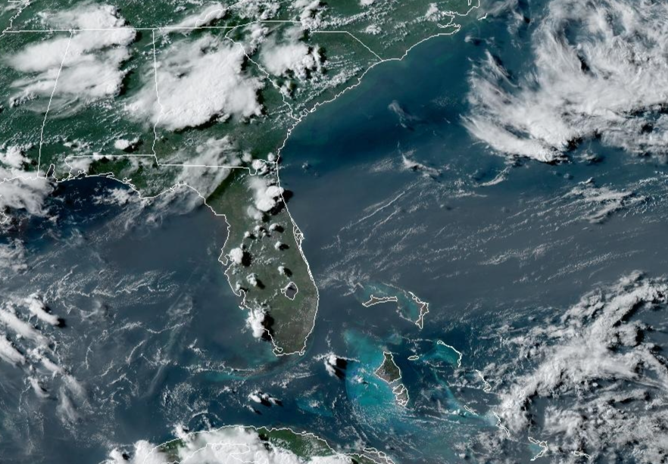
Backup Slides: Convection over Land vs. Sea
GOES-East: July 9, 2026, 6:00 p.m. EDT
The Saharan Air Layer generally suppresses deep convection through dry-air entrainment and increased atmospheric stability.
This example illustrates how neighboring atmospheric columns over land and sea can exhibit markedly different convective behavior despite experiencing a similar large-scale environment.
Tropical convection exhibits systematic differences over land and ocean.
Saharan Air Layer
Strong afternoon convection
PROMETHEUS seeks to identify the physical processes responsible for these contrasting convective regimes objectively from observations.

Slide 16
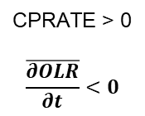
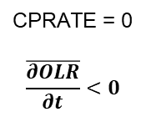
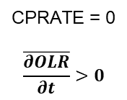
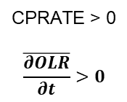
Process Study 2: Intensity of convective activity over land and ocean
A 256-Column State decision tree was induced after imposing the first two splits as Land/Ocean and Convective Precipitation (CPRATE = 0 or > 0). Combined with OLR tendency, convective precipitation distinguishes the development and decay of convection.
This also illustrates how prior physical knowledge can be incorporated into PROMETHEUS by constraining selected tree splits while allowing all subsequent splits to be determined objectively.
Initiation
Growth
Decay
Suppression
CPRATE = 0
$$\overline{\frac{∂OLR}{∂t}}<0$$
CPRATE > 0
$$\overline{\frac{∂OLR}{∂t}}<0$$
CPRATE > 0
$$\overline{\frac{∂OLR}{∂t}}>0$$
CPRATE = 0
$$\overline{\frac{∂OLR}{∂t}}>0$$

Slide 17
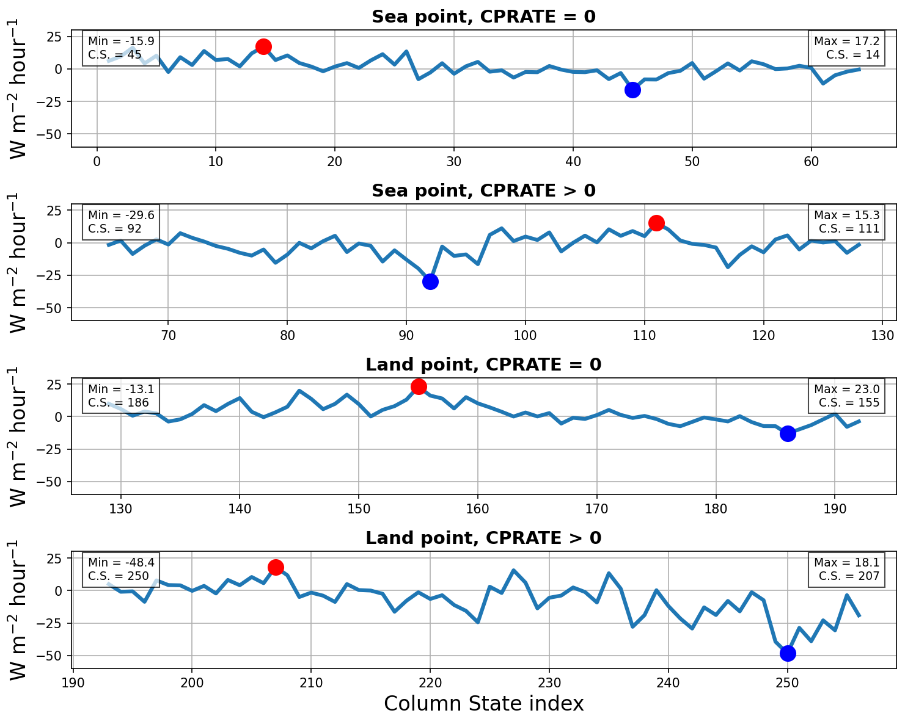
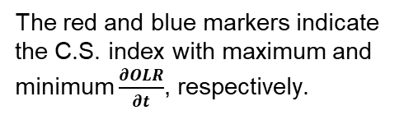
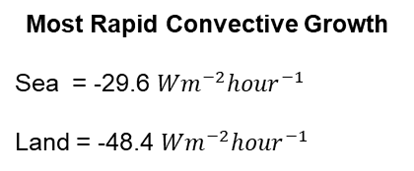
Process Study 2: Intensity of convective activity over land and ocean
The red and blue markers indicate the C.S. index with maximum and minimum $\frac{∂OLR}{∂t}$, respectively.
Mean OLR tendency for each Column State within the four imposed branches (256 Column States)
Most Rapid Convective Growth
Sea = -29.6 $Wm^{−2}{hour}^{−1}$
Land = -48.4 $Wm^{−2}{hour}^{−1}$
This indicates that convective activity on land is stronger than over the ocean, as discussed in, e.g.,
Abbott, T. H., et al. (2025)
"The Land–Ocean Contrast in Deep Convective Intensity in a Changing Climate." Journal of Advances in Modeling Earth Systems (JAMES)

Slide 18
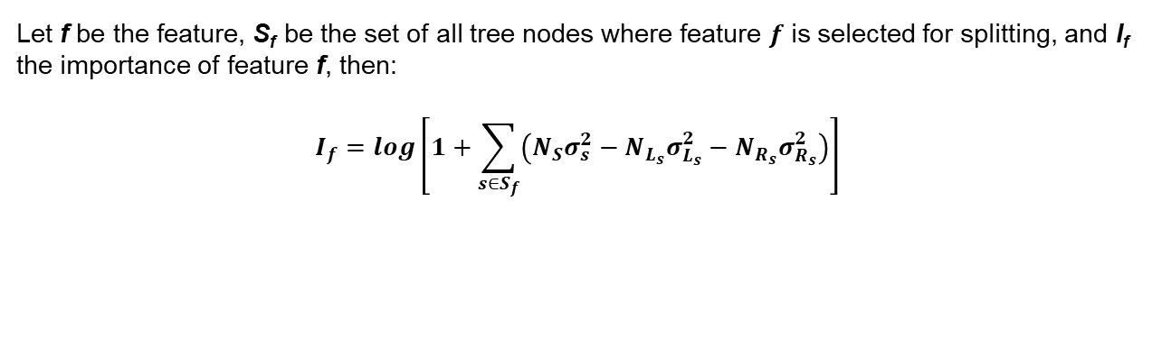
Diagnostic: Importance of Each Feature
We define the importance of each feature as the logarithm of the sum of the reduction in variance whenever this feature is selected for defining a split
Let f be the feature, S_{f}​ be the set of all tree nodes where feature $f$ is selected for splitting, and I_{f} the importance of feature f, then:
$$I_{f}=log\left[1+\sum_{s∈S_{f}}{\left(N_{S}σ_{s}^{2}−N_{L_{s}}σ_{L_{s}}^{2}−N_{R_{s}}σ_{R_{s}}^{2}\right)}\right]$$
Glossary of Features
VIDGeopot_flux = Vertical integral of the divergence of the geopotential flux. This parameter indicates whether atmospheric motions act to decrease (for divergence) or increase (for convergence) the vertical integral of geopotential.
VIDThermal_flux = Vertical Integral of the divergence of the thermal flux. The thermal energy is equal to enthalpy, which is the sum of the internal energy and the energy associated with the pressure of the air on its surroundings.
VI_MOIST_DIV = Vertical integral of moist divergence
TOA_SOLAR = Direct solar radiation at the top of the atmosphere (indicates the time of day)

Slide 19
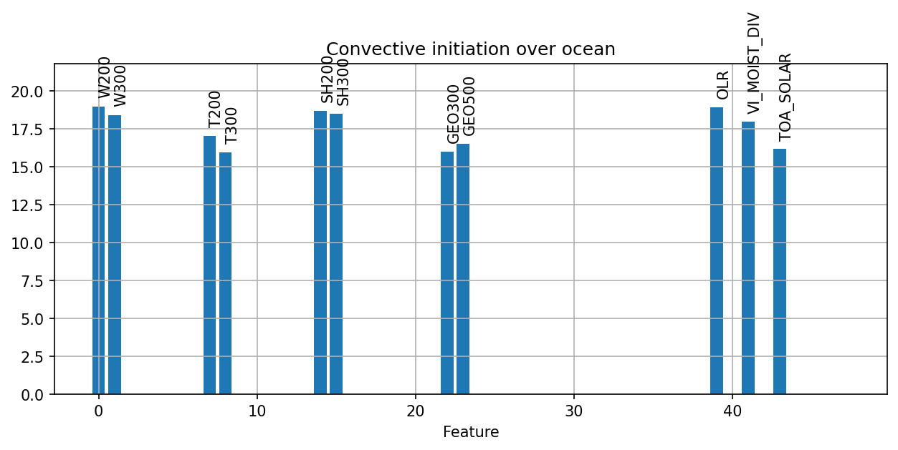
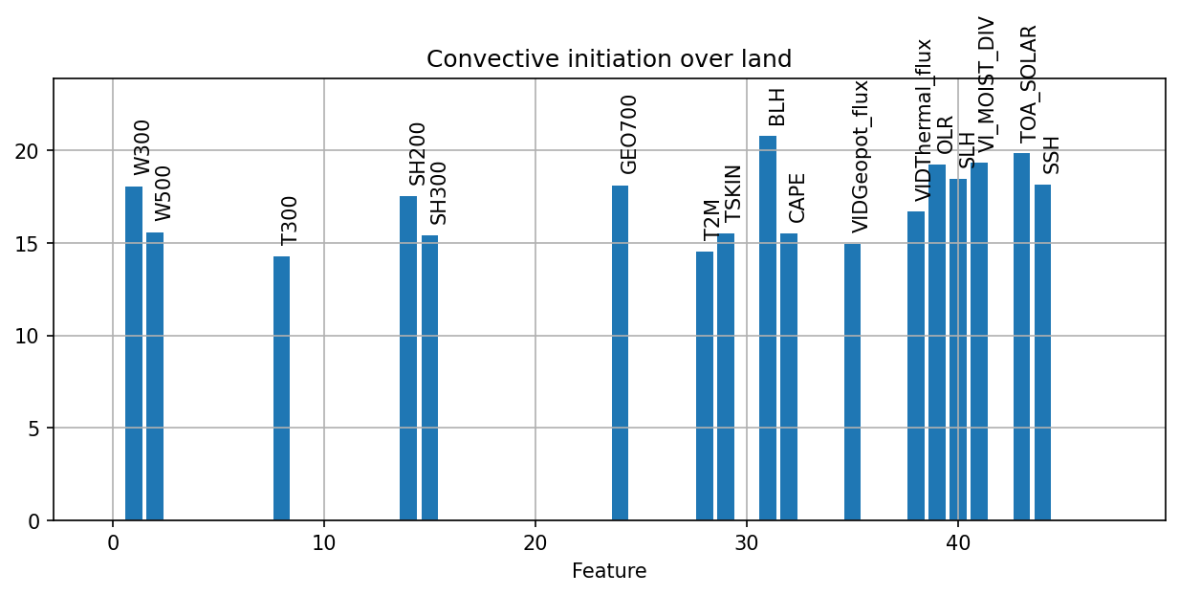
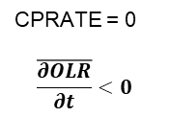
Importance of each feature during the convection initiation stage
Ocean initiation is most strongly associated with the diurnal cycle, vertically integrated moisture convergence, and upper-level thermodynamic and dynamical conditions.
Initiation
Land initiation involves the same large-scale controls with the addition of geopotential and thermal integrated fluxes, but also depends strongly on surface thermodynamics, boundary-layer structure, CAPE, and turbulent surface fluxes.
CPRATE = 0
$$\overline{\frac{∂OLR}{∂t}}<0$$

Slide 20
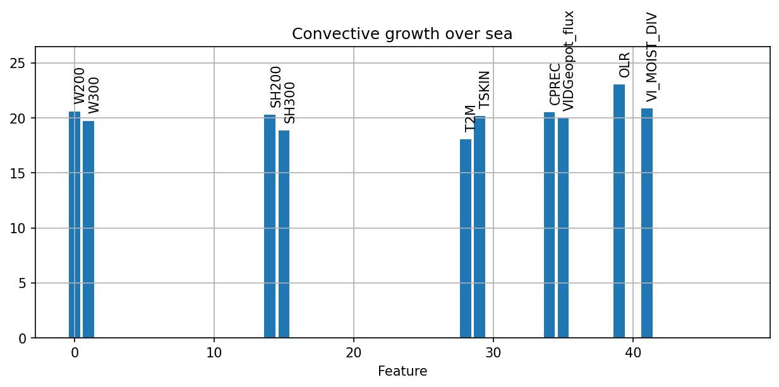
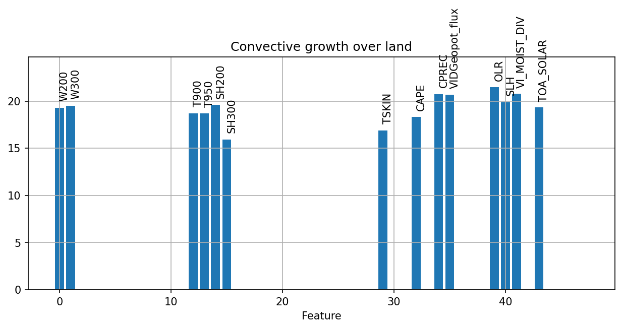
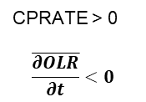
Importance of each feature during the convection growth stage
Ocean convective growth is dominated by upper-level humidity and ascent, as well as by surface temperature, vertically integrated moisture convergence, and geopotential energy transport.
Growth
Over land, convective growth depends on the same large-scale controls but is additionally sustained by lower-tropospheric temperature structure, CAPE, moisture convergence, surface latent heat fluxes, and the diurnal cycle.
CPRATE > 0
$$\overline{\frac{∂OLR}{∂t}}<0$$

