Slide 1
An NSST Alternative in UFS: Skinsst
Shan Sun¹ & Rainer Bleck^{1,2}
¹Global Systems Laboratory
²CIRES, Univ. of Colorado at Boulder
Acknowledgements: Ben Green and OMD modeling group
Funded by OSTI, submitted for publication

Slide 2
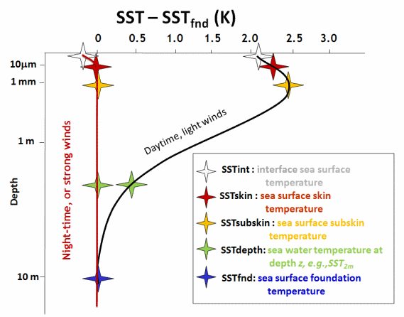
Background
From GHRSST

Slide 3
Three physical processes affect the skin temperature
Solar shortwave radiation
Downward heat diffusion
Cool-skin effect

Slide 4

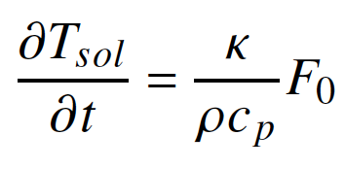
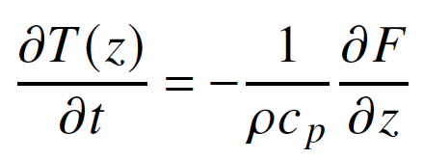
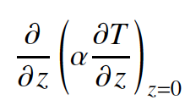
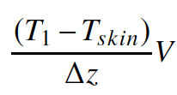
Solar Heating
Vertical Diffusion
skin
Only a function of solar radiation & water turbidity
Independent of top layer thickness in the ocean model
No reference to externally prescribed foundation temperature
Must integrate heating tendency over entire F₀ > 0 episode
Decoupling from bulk SST avoided by vertical diffusion term
F: solar radiation flux
K: absorption coefficient
T: temperature
V: piston velocity
T₁: top layer temp

Slide 5
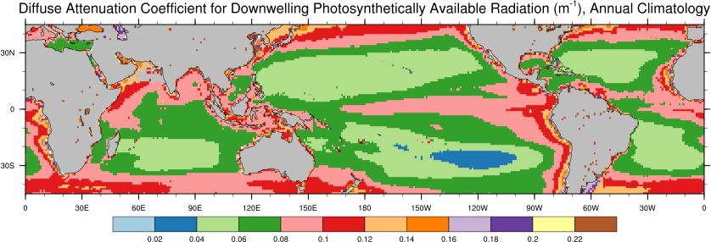
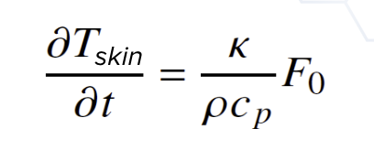
Water Turbidity from SeaWiFS
Son & Wang (2015)

Slide 6
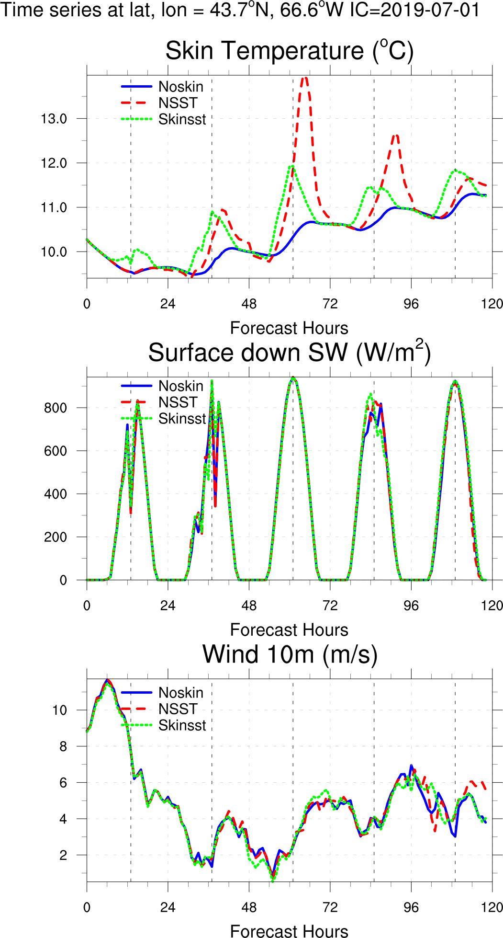
Simulating Tskin in UFS
Exps | Description | Cool Skin | Warm Layer
Noskin | Top layer ocean temperature | N/A | N/A
NSST | NSST Parameterization | Fairall et al. (1996) | Li et al. (2018)
Skinsst | Skinsst Parameterization | Fairall et al. (1996) | Bleck and Sun (2026)
– SFS beta 1.1 code base
– 25 km horizontal resolution for atmosphere, ocean and sea ice models
– Replay initial conditions

Slide 7
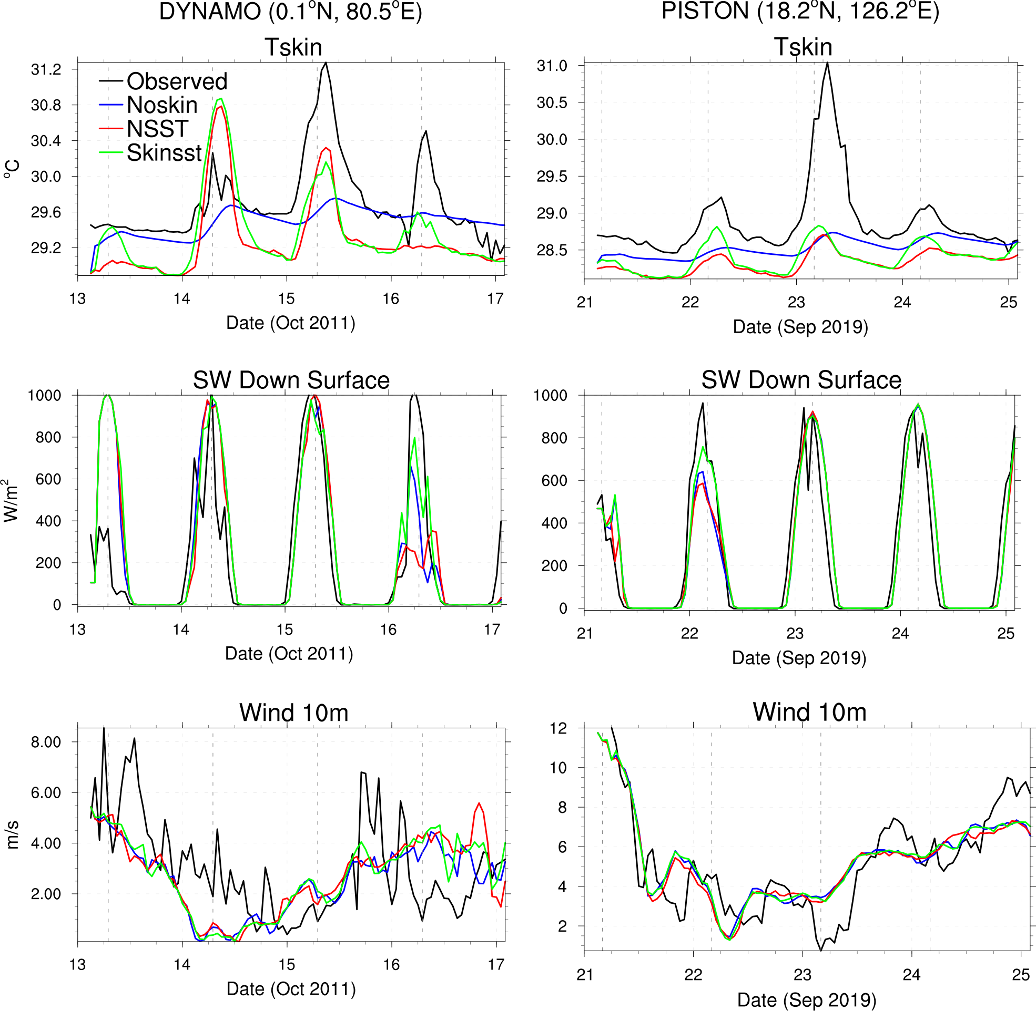
Comparison with DYNAMO and PISTON field campaigns
Tskin
SW
Wind
Low SW => low Tskin
Low wind => high Tskin

Slide 8
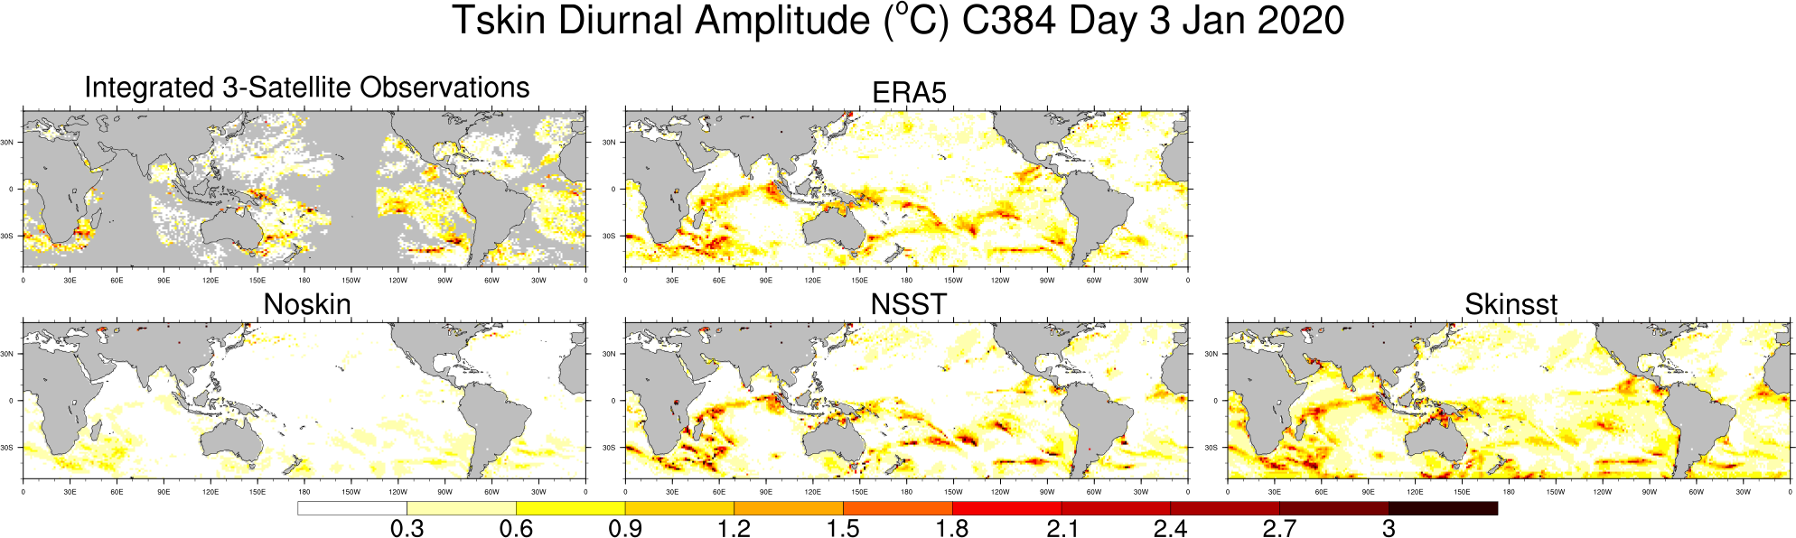
Tskin Diurnal Amplitude Day 3 IC=2020-01-01
Obs ERA5
Noskin NSST Skinsst

Slide 9
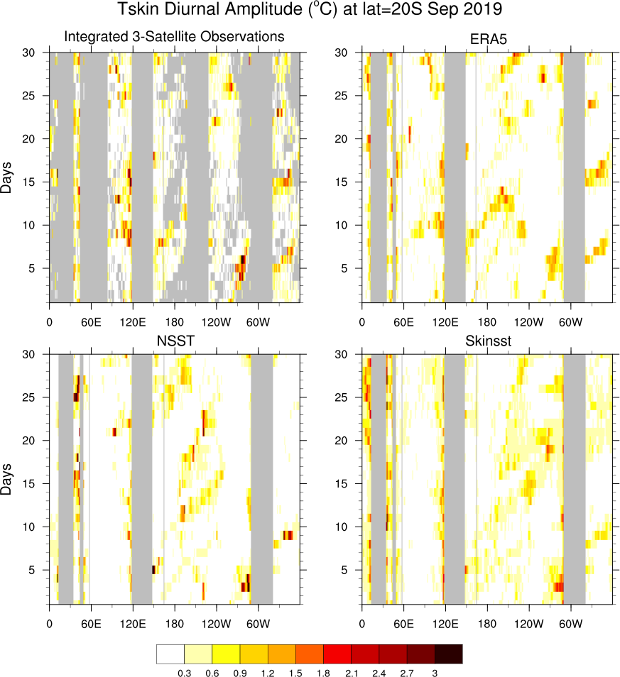
Tskin Diurnal Amplitude lat=20ºS IC=2019-09-01
Obs ERA5
NSST Skinsst

Slide 10
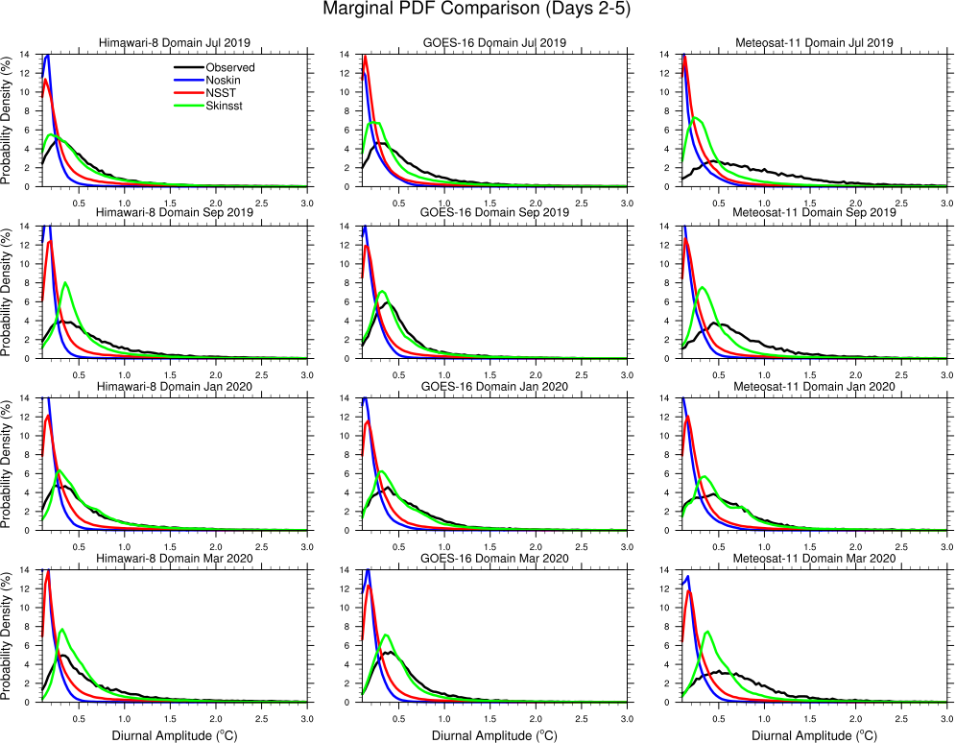
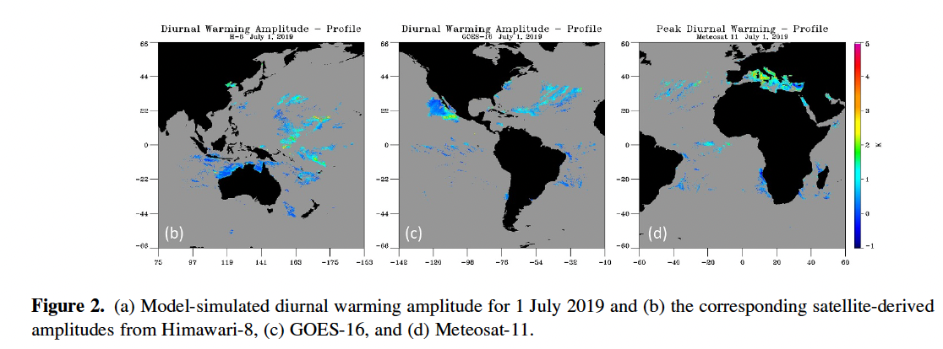
Tskin Comparison with satellite observations (Wick et al. 2024):
Noskin & NSST: peak near 0º amplitude
Skinsst succeeds in shifting PDF toward observed larger amplitudes
Caveat:
all model ocean points are used
only clearsky points are used in the observations
Himawari-8
GOES-16
Meteosat-11

Slide 11
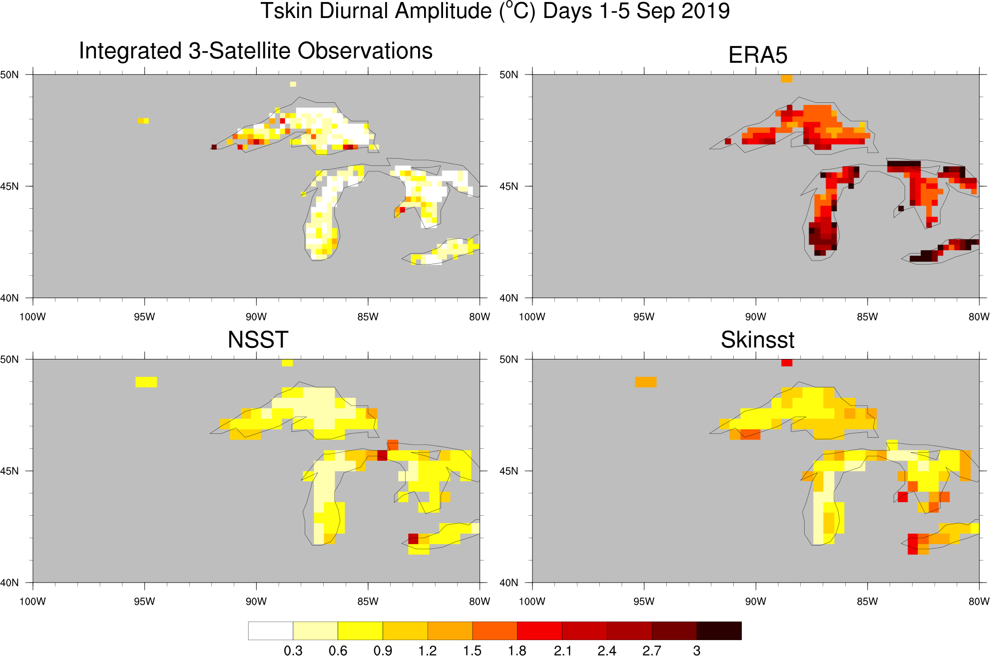
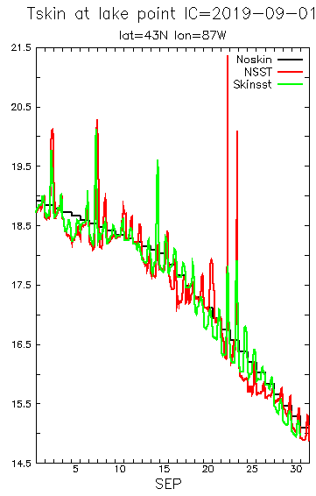
Skinsst in uncoupled Application: over Lakes

Slide 12
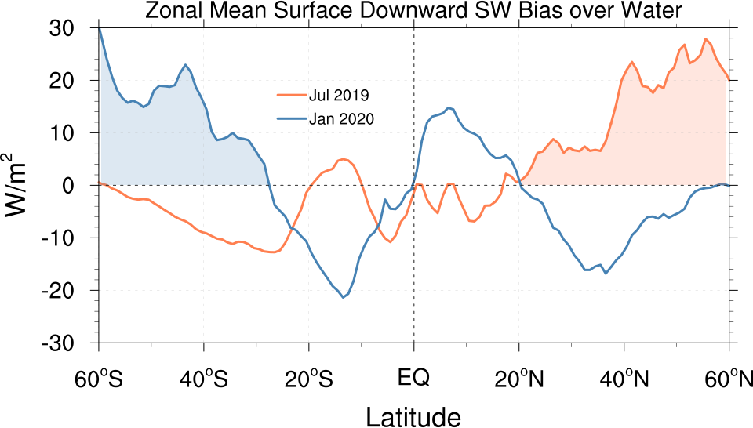
Zonal Mean Shortwave Bias over Water
Relative to CERES/EBAF: positive bias in the summer hemisphere, negative in the winter hemisphere at mid-to-high latitudes

Slide 13
Summary
A simple alternative scheme for Tskin calculation in the UFS, both coupled and uncoupled, has undergone extensive testing. Results encourage adoption.
Requires only “bulk” SST as input, independent of vertical temperature profile and vertical grid spacing.
Independent of climatological data (except turbidity) and “foundation” temp.
Few tunable parameters (mainly in vertical mixing).
Future work: Skinsst in DA applications (adding daytime warming to lower b.c.).

