Slide 1



An Overview of Verification and Evaluation Activities at the Office of Modeling and Development
Jason Levit
Chief, Evaluation and Verification Unit
NOAA/NWS/Office of Modeling and Development
U.S. Department of Commerce
National Oceanic and Atmospheric Administration
National Weather Service

Slide 2
Acknowledgements
Federal Team: Andrew Benjamin, Alicia Bentley, L. Gwen Chen, Tamarah Curtis, Jun Du, Tom Hultquist, Young-Jun (YJ) Kim, Steve Levine, Gordana Rancic, Lydia Stefanova, John Wagner
Lynker Team: Samira Ardani, Saeideh Banihashemi, Marcel Caron, Ho-Chun Huang, Mallory Row, Qi Shi, Shannon Shields
Arch Systems Team: Herbert Atkinson, Daniel Eipper, Gavin Harrison, Michael Levine, Samantha Walley

Slide 3
Office of Modeling and Development Organization Chart
Programming and Planning Unit
Chief: Kevin Garrett
Office of Modeling and Development
Director: Richard Bandy
Deputy Director: Daryl Kleist
Computing & Advanced Technologies Unit
Chief: Jacob Carley
Evaluation & Verification Unit
Chief: Jason Levit
Data Assimilation Division
Chief: Daniel Holdaway
Modeling Division
Chief: Fanglin Yang
Weather Guidance & Products Division
Chief: Geoffrey Manikin
Marine & Decision Support Division
Chief: Mark Willis

Slide 4


Evaluation and Verification Unit Overview
Consolidate the verification components of EMC, MDL, and AFS-11 into a new Unit as part of the merger into OMD
Support becoming the World Leader in Numerical Weather Prediction through advancements in modeling, data assimilation, and the infusion of Artificial Intelligence (NWS Ken’s 10)
Innovate new evaluation and verification methods, metrics, and visualization tools to inform the enterprise on OMD guidance product performance

Slide 5
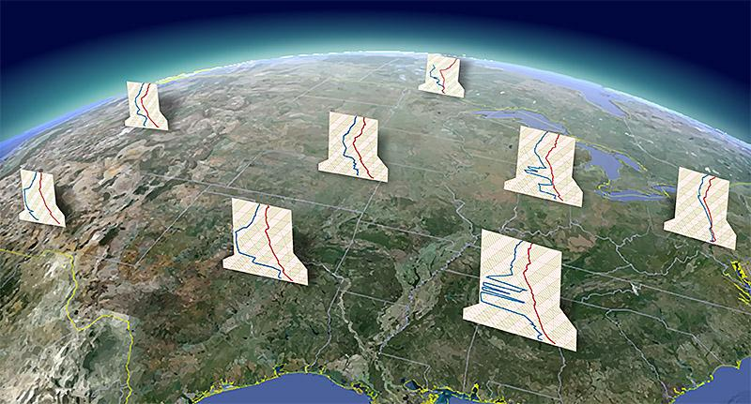
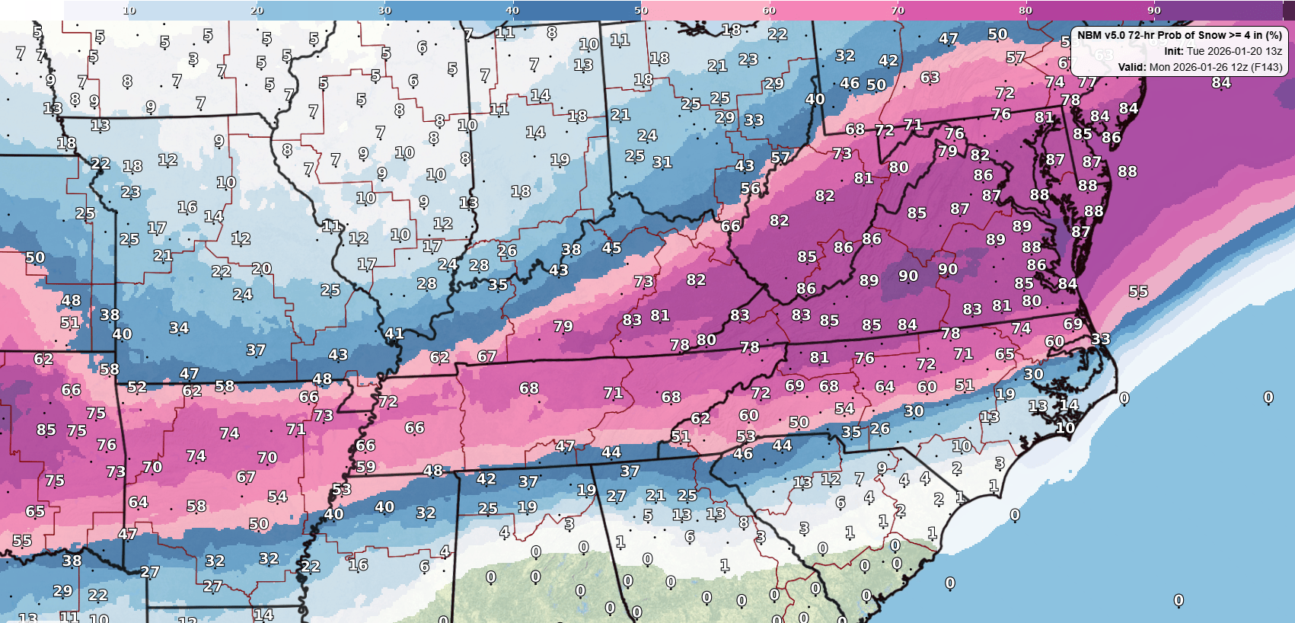
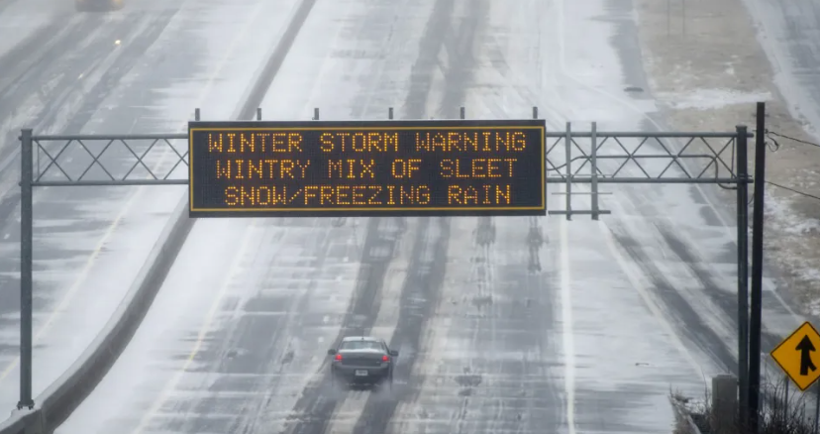
Office of Modeling and Development: Alignment to Deliver the Full Value Chain
Leading NWS Modeling & Application Development Strategic Planning and Execution
Obs Processing
& Data Assimilation
NWP
Probabilistic Guidance
Verification & Evaluation
Forecast & IDSS Application Development
Societal
Response
Upper air observations from a few of the more than 90 observations sites in the United States
Example of NBMv5.0 72 Hour Prob Snow Accum > 4, 6 and 12”
A Georgia DOT sign warns drivers of winter weather as they travel
(AP Photo/John Amis)

Slide 6





Verification Overview
Verification is a in-depth scientific process that compares guidance products with actual observations to evaluate product accuracy and ensure quality control
Systematic, objective verification establishes baselines of guidance performance, and establishes trust in OMD’s products and services
Long-term metrics isolate persistent, systematic errors from noise that assist with driving future product upgrades
Users are more empowered when uncertainty is quantified, and boosts operational decision making and confidence

Slide 7

EVU Areas of Focus
Model Evaluation Group (MEG) and Verification Team: The MEG and broader verification team monitor real-time operational performance alongside newly developed models.
Blend Assessment and Evaluation Team (BEAT): BEAT brings developers and evaluators together to dissect weather case studies and refine National Blend of Models (NBM) performance.
MEG and BEAT collaborations: Teams will collaborate and use user feedback to show performance in entire product value chain.
Development and Research: Define, refine, and develop new metrics, especially for emerging data-driven (ML) models.
Notes:
Early AI modeling efforts have demonstrated significant efficiencies and increased model skill.
AI still requires a strong training data set based on physics-based models. It is not seen as a replacement for traditional NWP, but as a compliment to it.
AI emulator components of our global model ensemble suite will allow expanded ensemble size with significant compute savings. It can be tailored to improve the ensemble distributions for increased identification of the potential for high impact events and to improve the calibrated probabilistic guidance (Next generation NBM) that will serve as the future NWS forecast and foundation of decision support services and public warnings.
AI driven model output can also be tailored to address high resolution microscale forecasts tailored for specific sector demands.

Slide 8
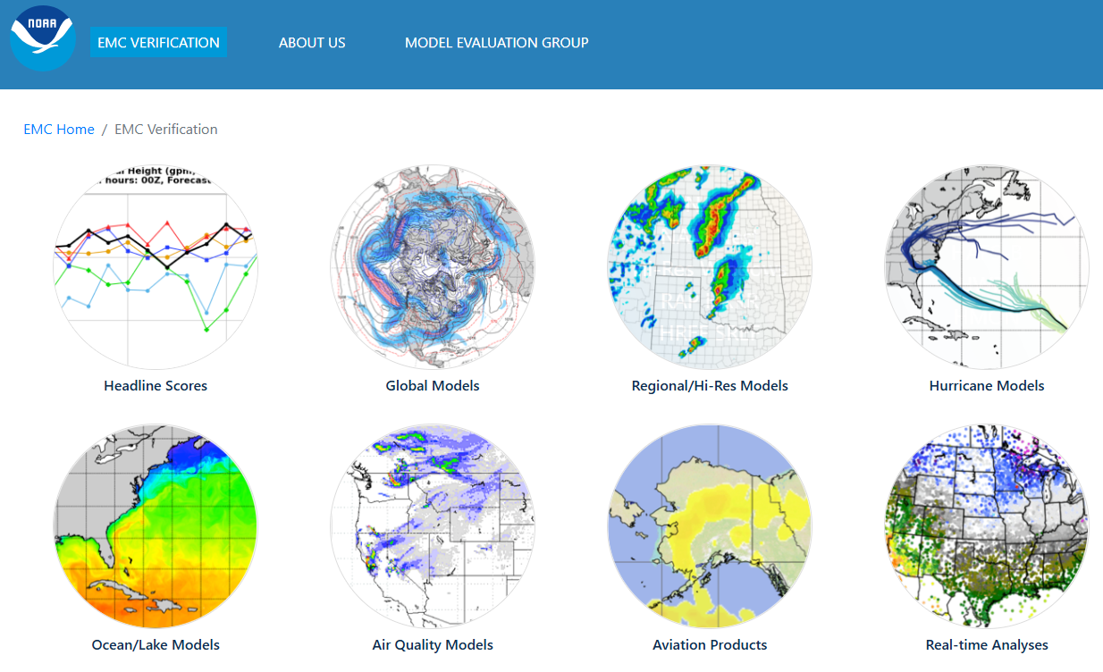
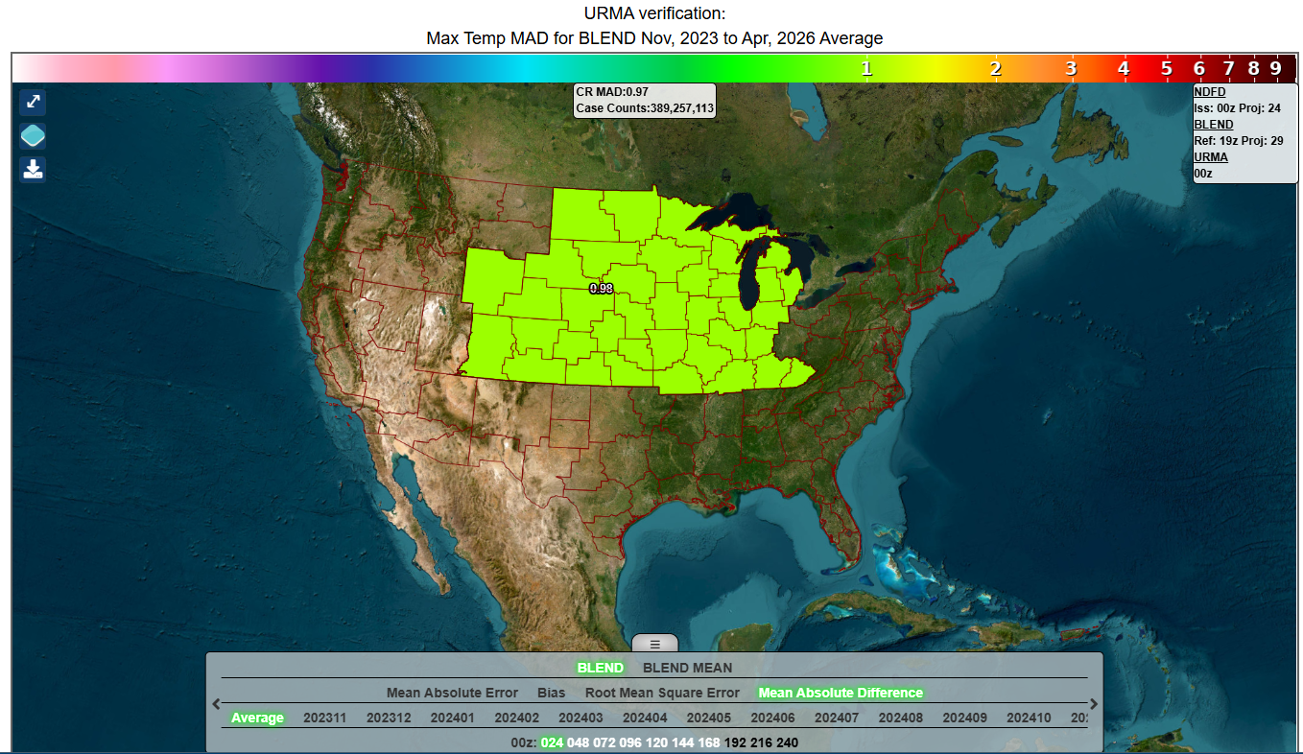
Visualization Tools for Verification
Evaluation and Verification System (EVS)
Veritas
Real-time verification of model guidance via web-based images
Provides information on model performance
Publically accessible
https://www.emc.ncep.noaa.gov/users/verification/
Provides information on NBM and NDFD performance
Accessible to CAC card login only
https://veritas.mdl.nws.noaa.gov

Slide 9
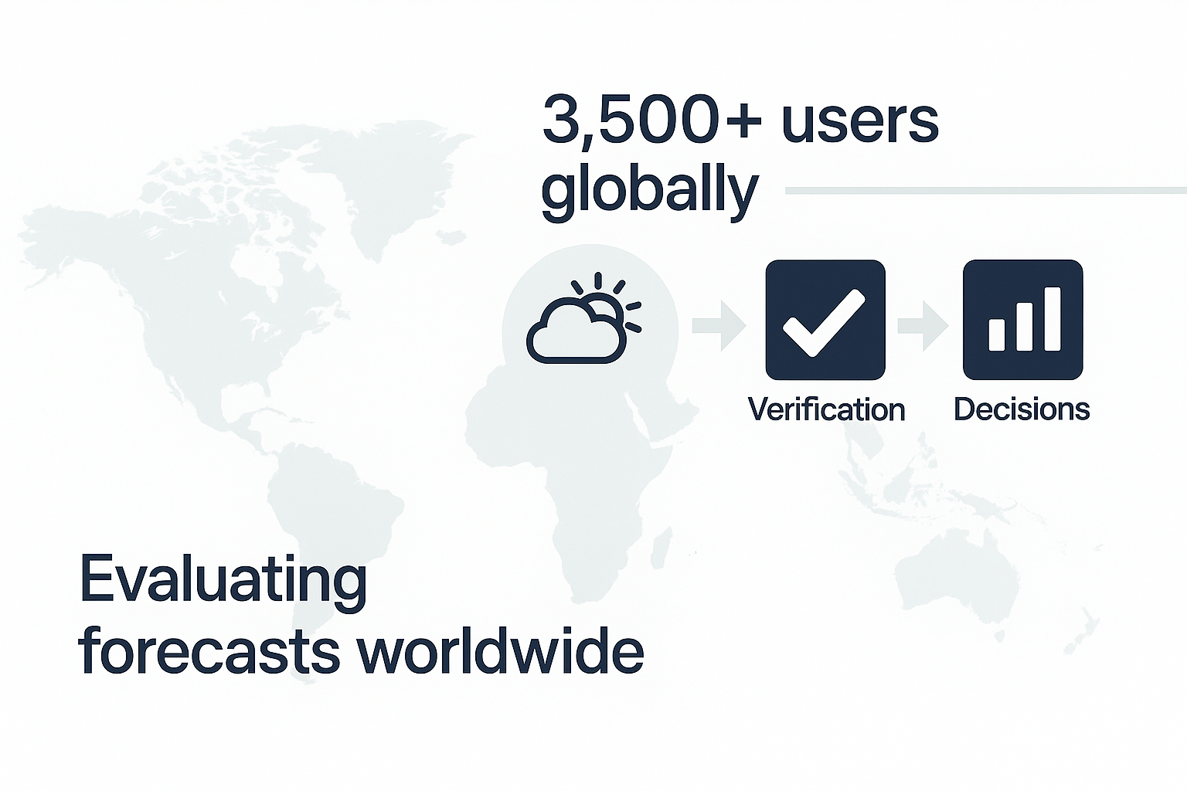

Software: Model Evaluation Toolkit (METplus)
A verification framework that spans a range of temporal and spatial scales
Intended to be extensible through additional capabilities developed by sponsors and the community
Operational in the NWS, UKMO, Air Force
METplus is…
Over 150 traditional statistics and diagnostics for point and gridded datasets
Been developed to allow for easy sharing of configuration files for reproducible results
METplus has…
METplus is open source and community driven with active partnerships in:
National and international operational centers
Universities
Research community
Private sector
User support via GitHub Discussions
Use cases for easy spin-up
Accessible installation via conda build
METplus provides…

Slide 10
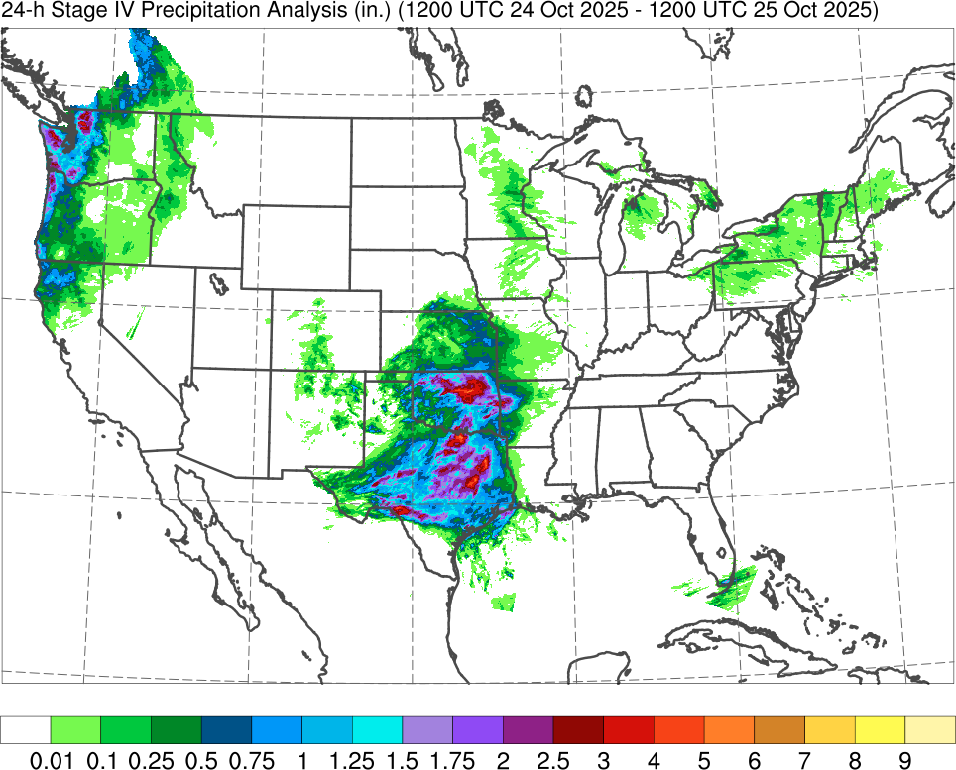
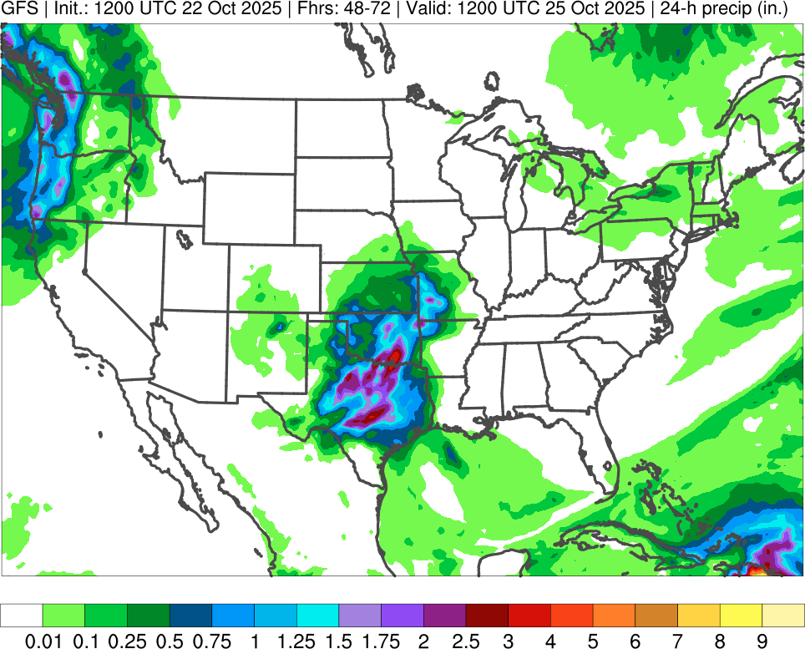
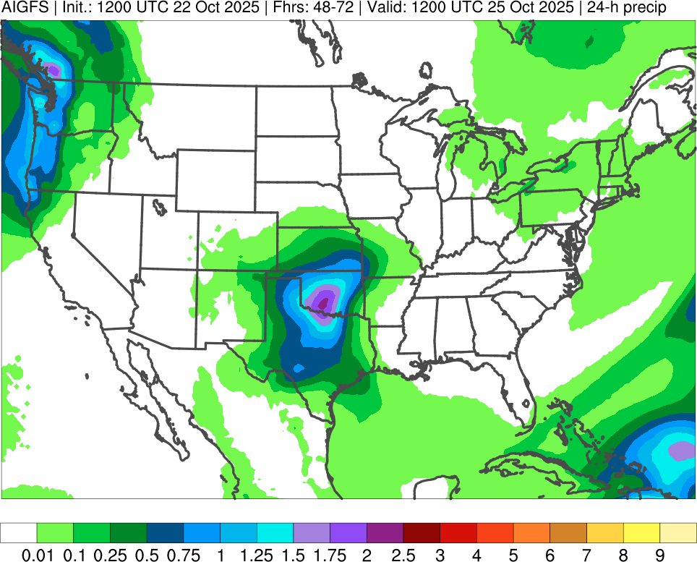
Recent Guidance Evaluation Examples: AIGFS
Initialized: 1200 UTC 22 October 2025 | Valid: 1200 UTC 25 October 2025 (F048–F072)
Stage IV
GFS
AIGFS
in.
in.
in.
AIGFS precipitation plots show too much light precipitation over CONUS and are generally too smooth
AIGFS precipitation plots highlight areas of higher precip. totals, but do not capture largest QPF amounts
Notes:
From 10/30/25 MEG webinar

Slide 11
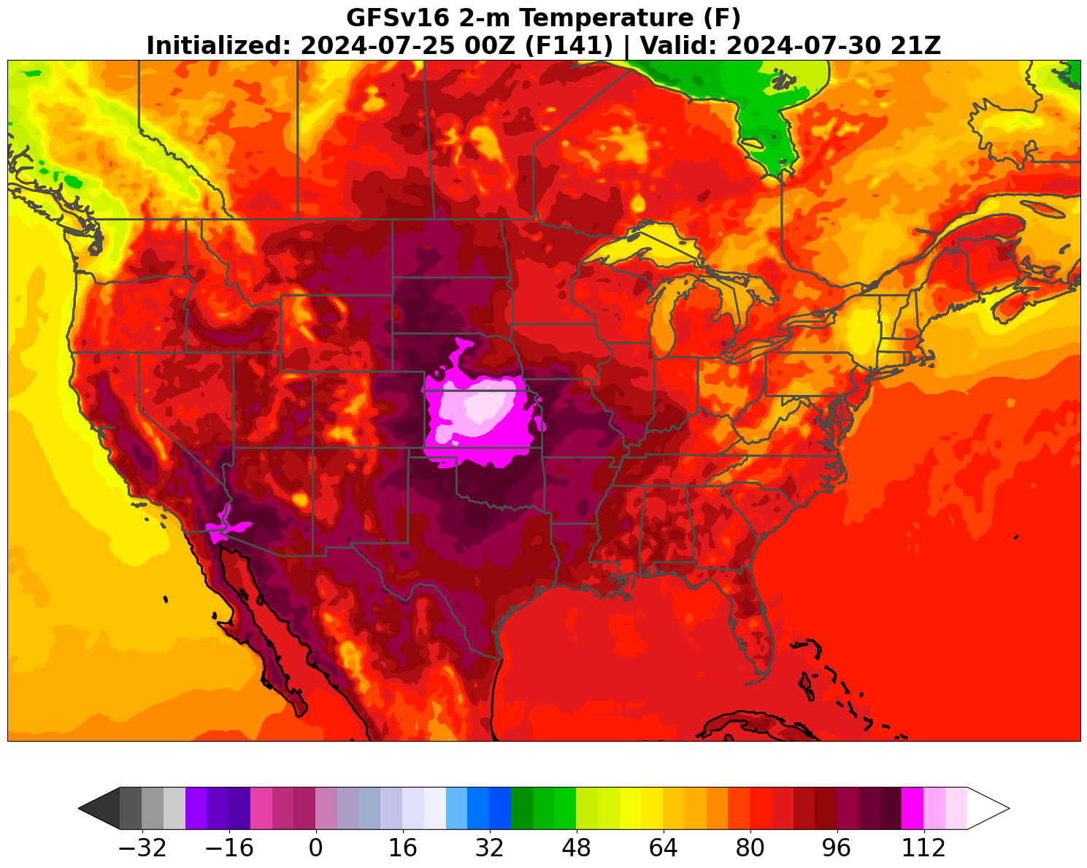
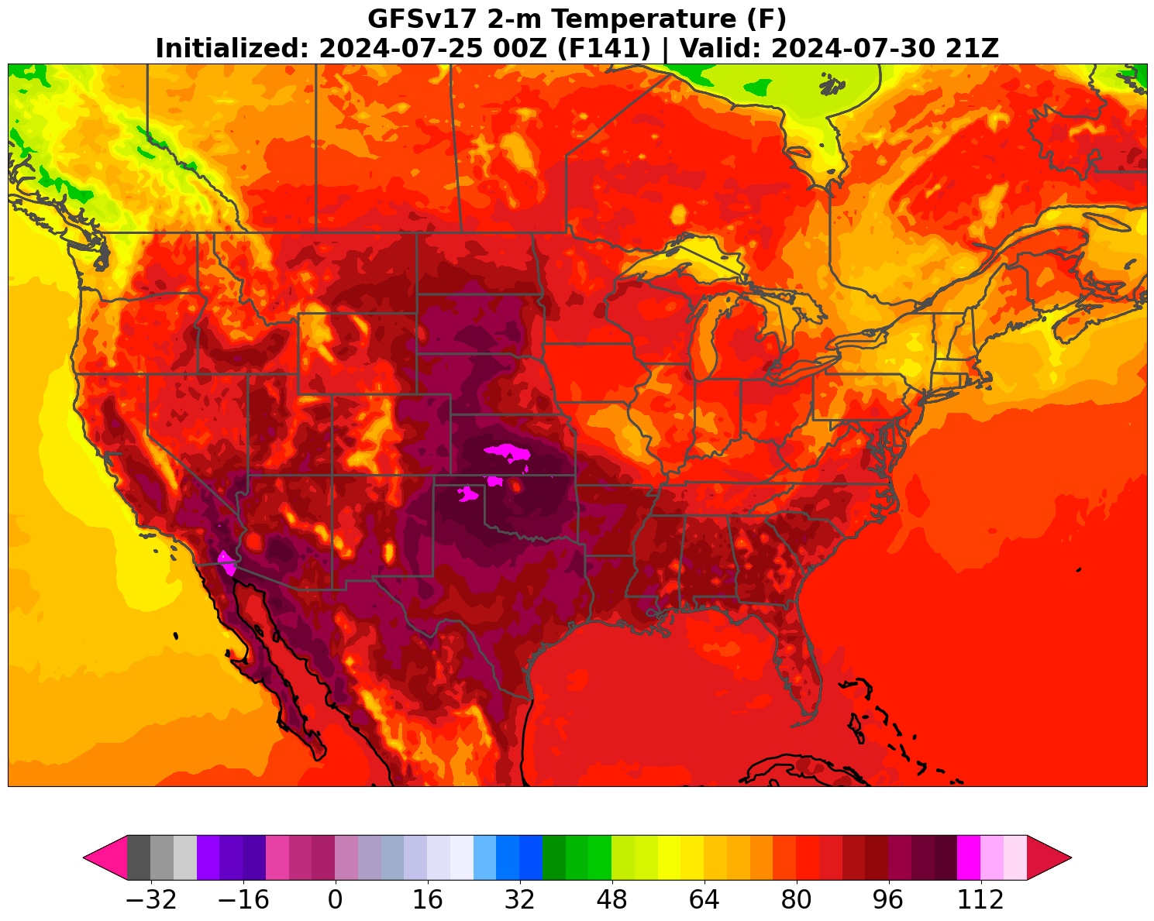
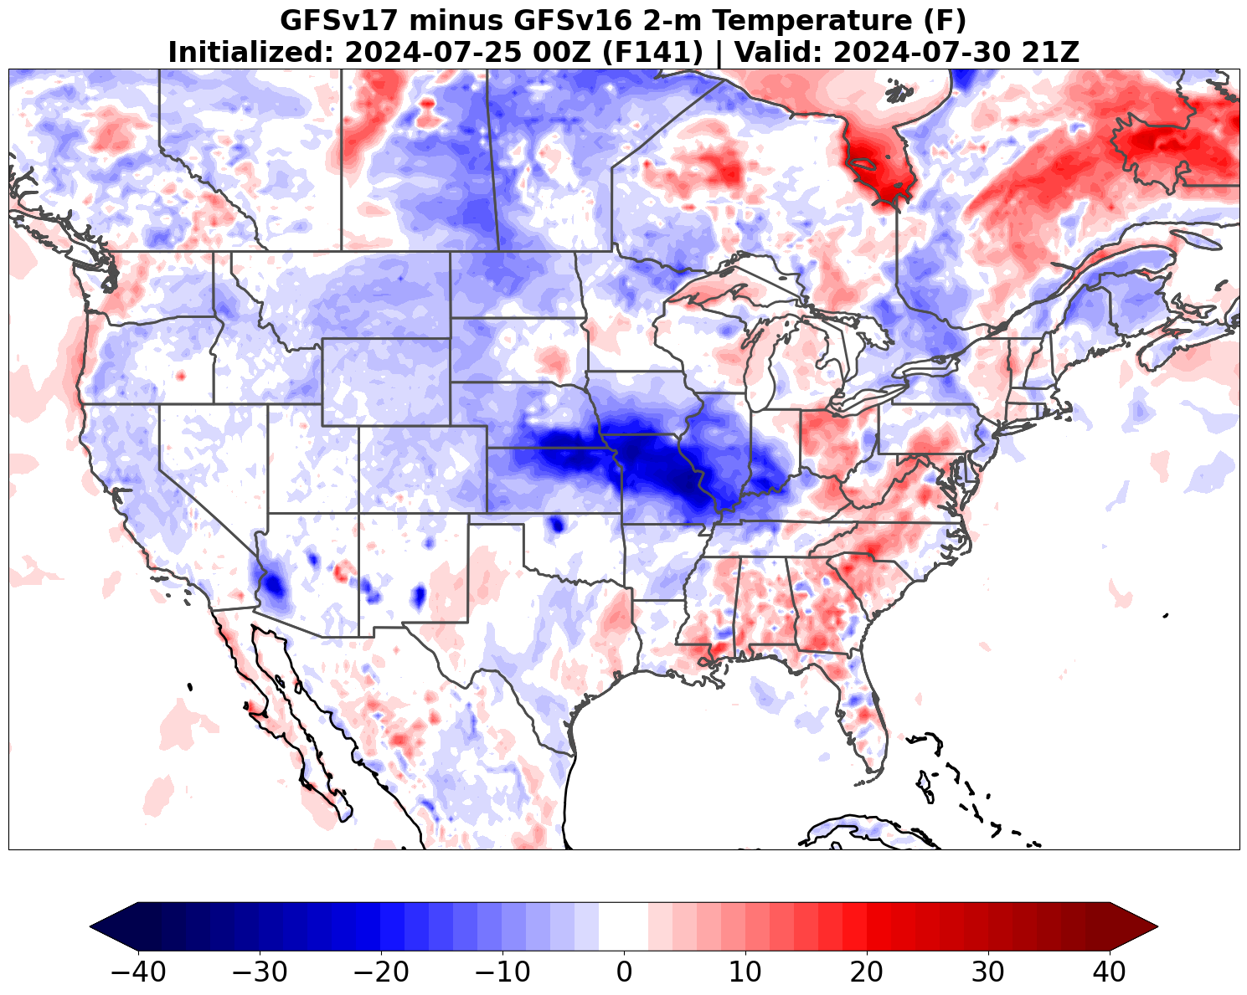
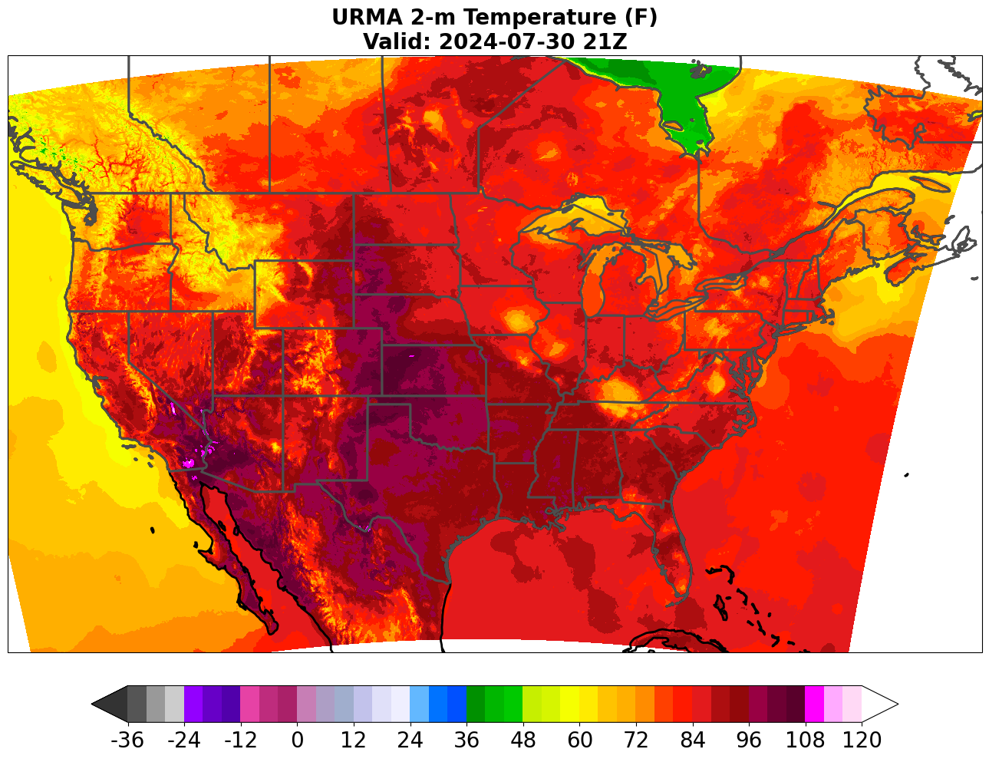
Recent Guidance Evaluation Examples: GFS 2m Temp
Initialized:
00Z 7/25/24 (F141)
Valid:
21Z 7/30/24
This representative example highlights
the GFSv16 warm bias over the Central Plains
that grows with lead time
GFS v17 was cooler than GFS v16 over the central/ western CONUS at F141, with 2-m temperatures closer to URMA over the Central/Northern Plains
GFSv16
GFSv17
v17−v16
URMA
Notes:
From GFSv17 warm-season evaluation MEG webinar

Slide 12
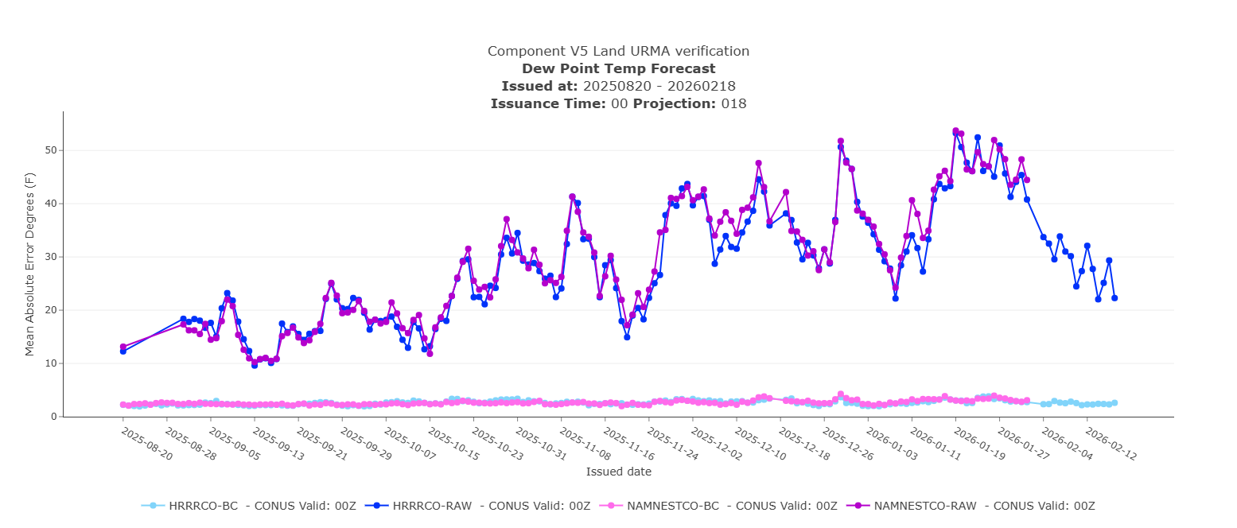
Recent Guidance Evaluation Examples: National Blend
National Blend of Models data is evaluated and verified using the veritas website, informs on NBM performance and quality control
Bias corrected vs non-bias corrected data, serves as QC check

Slide 13
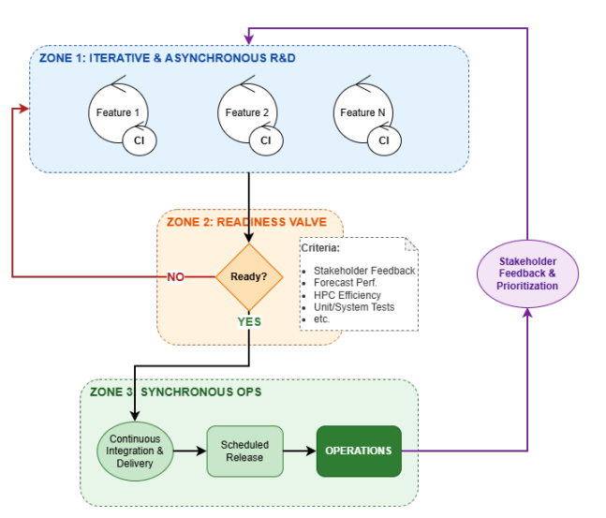
Accelerating Decisions: DevOps for Model Upgrades
New DevOps Model: Faster, smaller system upgrades. When new science is ready, it’s tested and implemented
Zone 2: The Readiness Valve: EVU engages here the most. Collects feedback from internal and external users, assists with evaluations and implementation decisions
Continuous Feedback: Feedback on product performance is continual, and helps inform upgrade priorities
System Evaluation: Users and developers work together to evaluate initial system performance, rather than risky evaluations at end of process

Slide 14
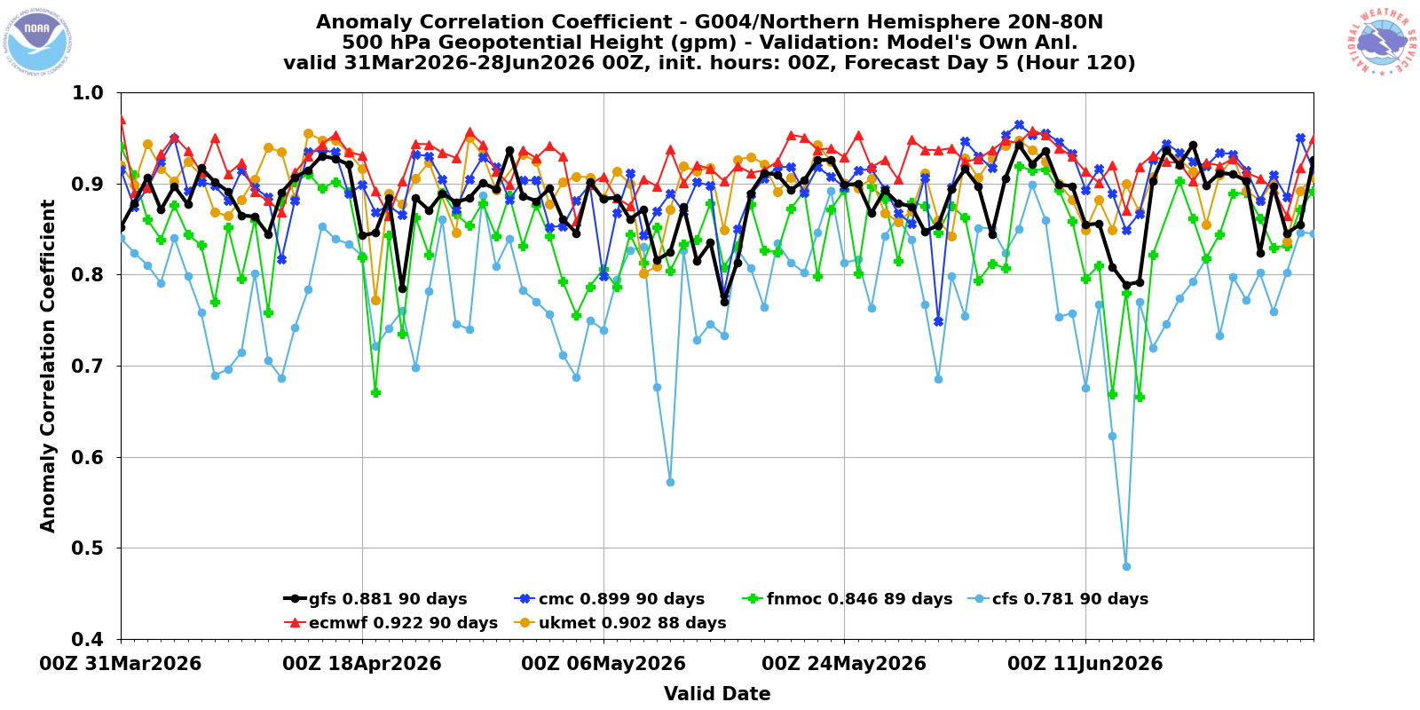
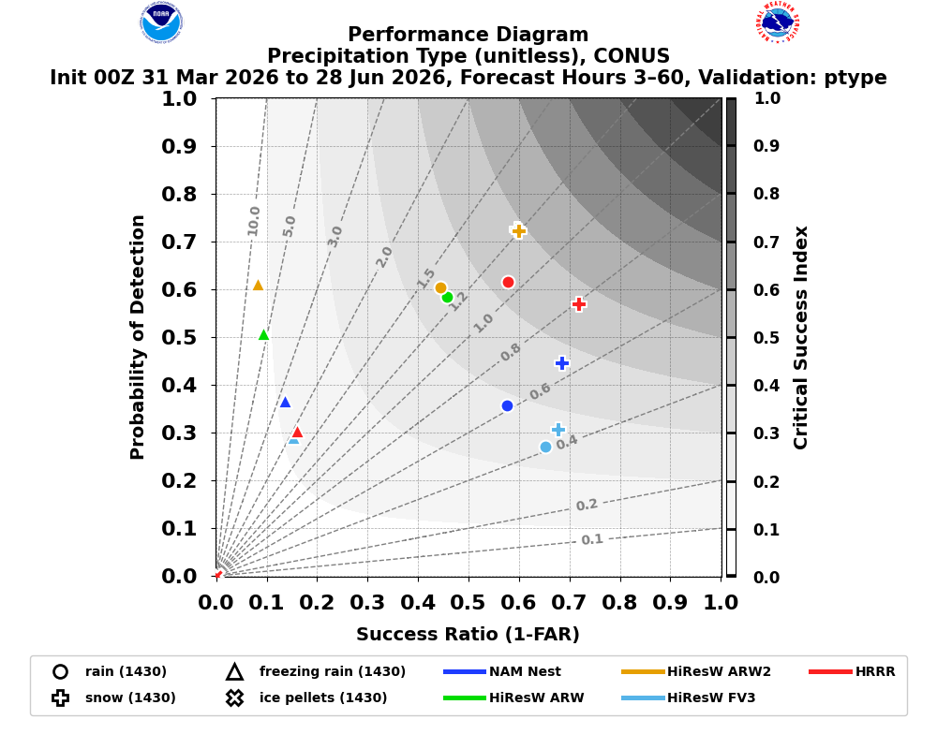
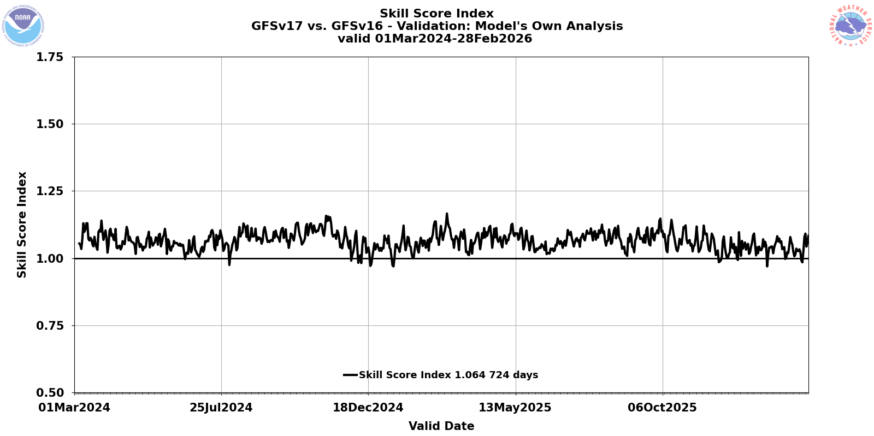
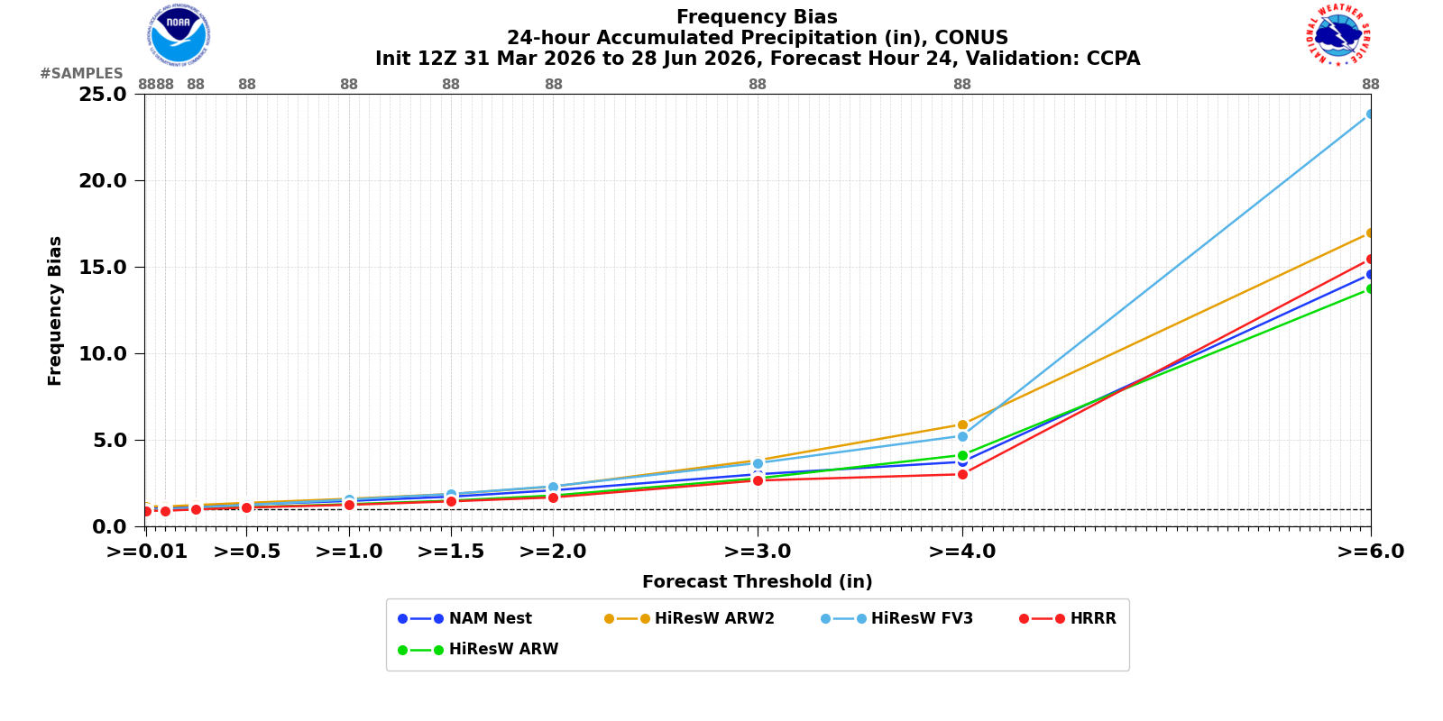
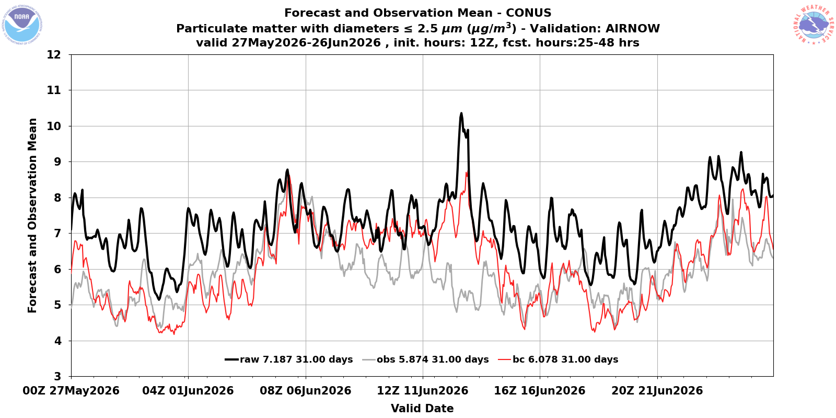
Accelerating Decisions: Summary Assessment Metrics
Individual metrics/statistics can be weighted temporally and spatially into a Summary Assessment Metric (SAM)
Using SAMs could assist with faster model implementation decisions, and provide overviews of broad skill measures
Skill Score Index
Combined Retrospective Streams
Skill Score Index greater than 1.0 means that GFSv17 outperformed GFSv16

Slide 15
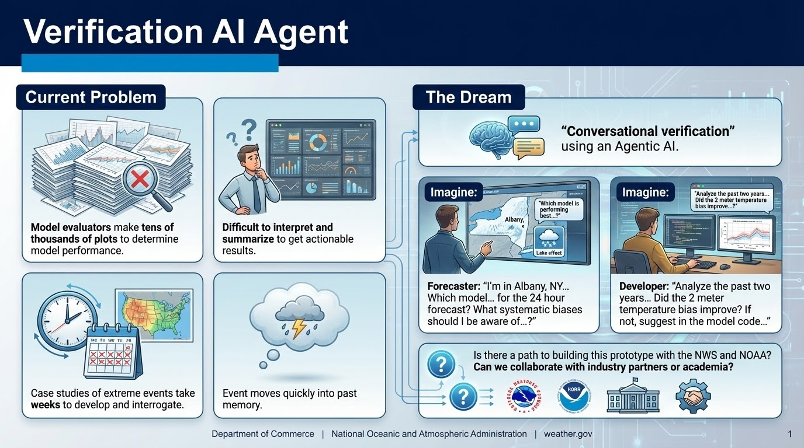
The Future (?): Agentic AI for Verification

Slide 16

Questions?
Jason.Levit@noaa.gov
Websites:
EVS: https://emc.ncep.noaa.gov/users/verification
Veritas: https://veritas.mdl.nws.noaa.gov
EVS Github: https://github.com/NOAA-EMC/EVS
Note: Some of the images in this presentation were generated using Gemini AI. All content has been reviewed for accuracy.

