Slide 1
A Summary of HAFS Data Assimilation Activities at AOML
Jason Sippel, Sarah Ditchek, Altug Aksoy, Kathryn Sellwood, Brittany Dahl, Dan Wu, Trey Alvey, Bachir Annane

Slide 2
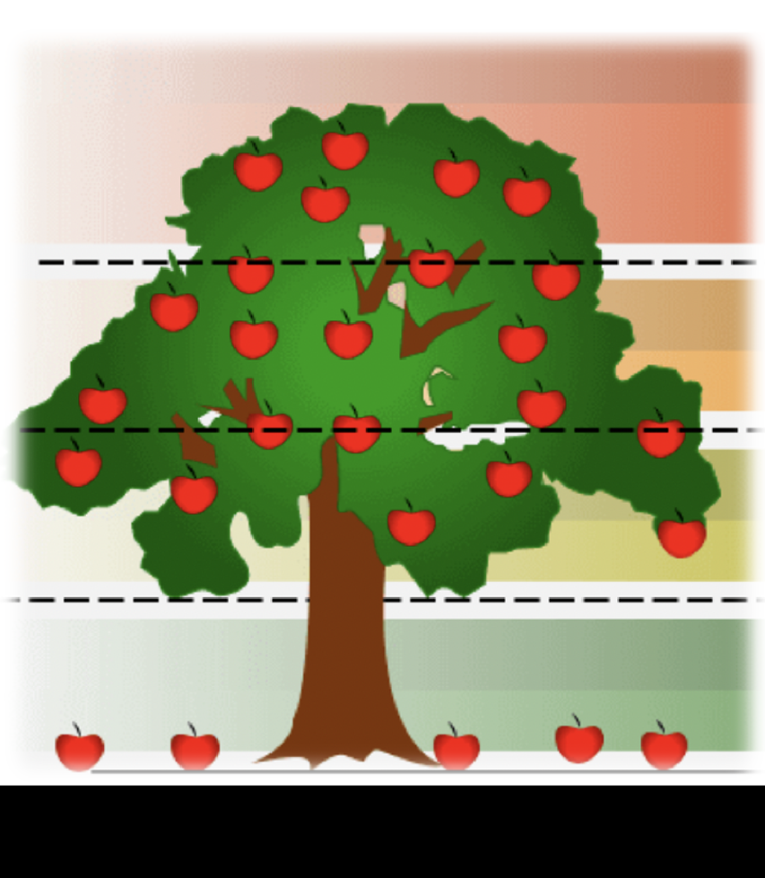
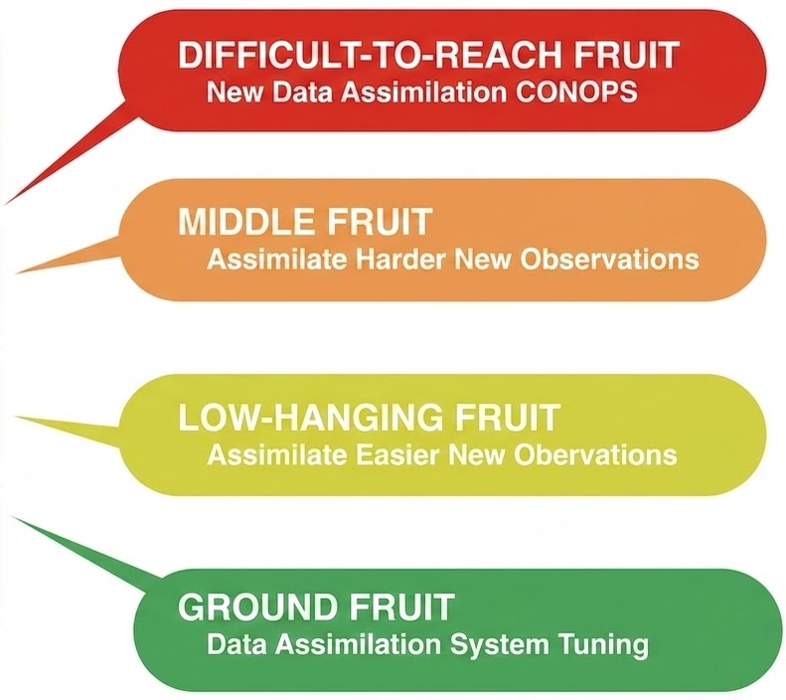




Talk Outline
Hurricane DA Tree

Slide 3
Talk Outline
Ground: Namelist-controlled optimization/tuning
Low-hanging: Using high-RL obs. currently sent to NCEP
Middle: Exploring lower-RL obs. not sent to NCEP
Difficult: Significant new framework developments
Hurricane DA Tree

Slide 4
Ground Fruit: DA System Tuning
BLUF: Low-cost gains still possible
Example 1: ASCAT Optimization
Example 2: Scale-Dependent Localization (SDL)

Slide 5
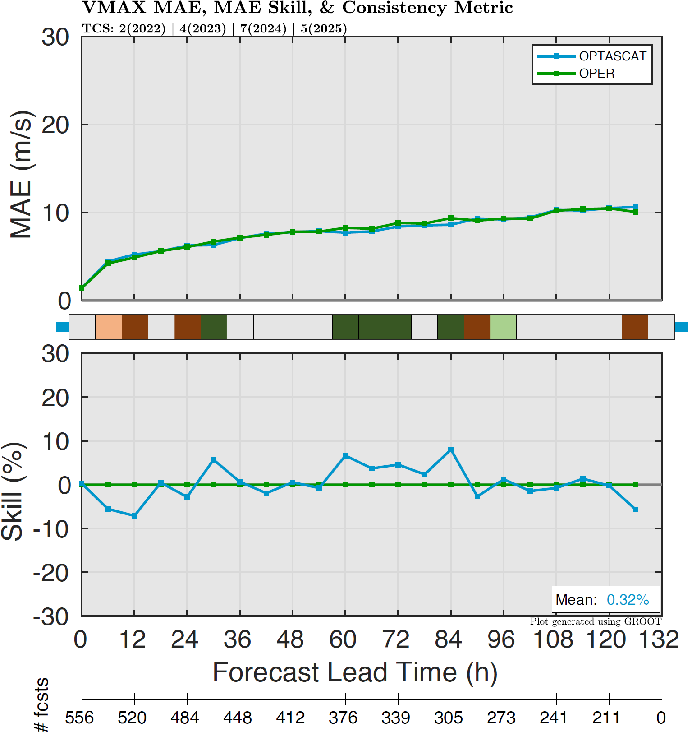
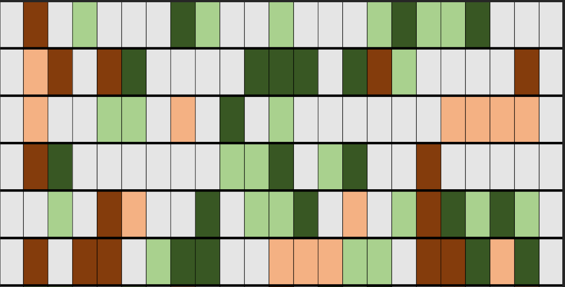

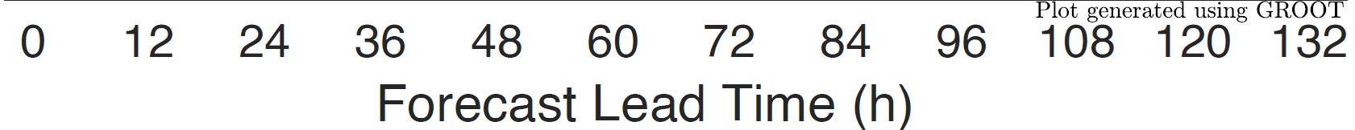
ASCAT Optimization
Increase Obserr from 1.5 → 2.0 m/s
Impact on Intensity (VMAX)
Impact Scorecard for TC Metrics
TRACK
VMAX
PMIN
R34
R50
R64

Slide 6
Scale-Dependent Localization
More Tuning Needed
Hurricane evolution requires interaction between multiple scales.
Scale-dependent localization (SDL) decomposes the background ensemble into different scales and assigns a distinct radius of influence for each scale.
It can provide a superior analysis, but it requires careful tuning.

Slide 7
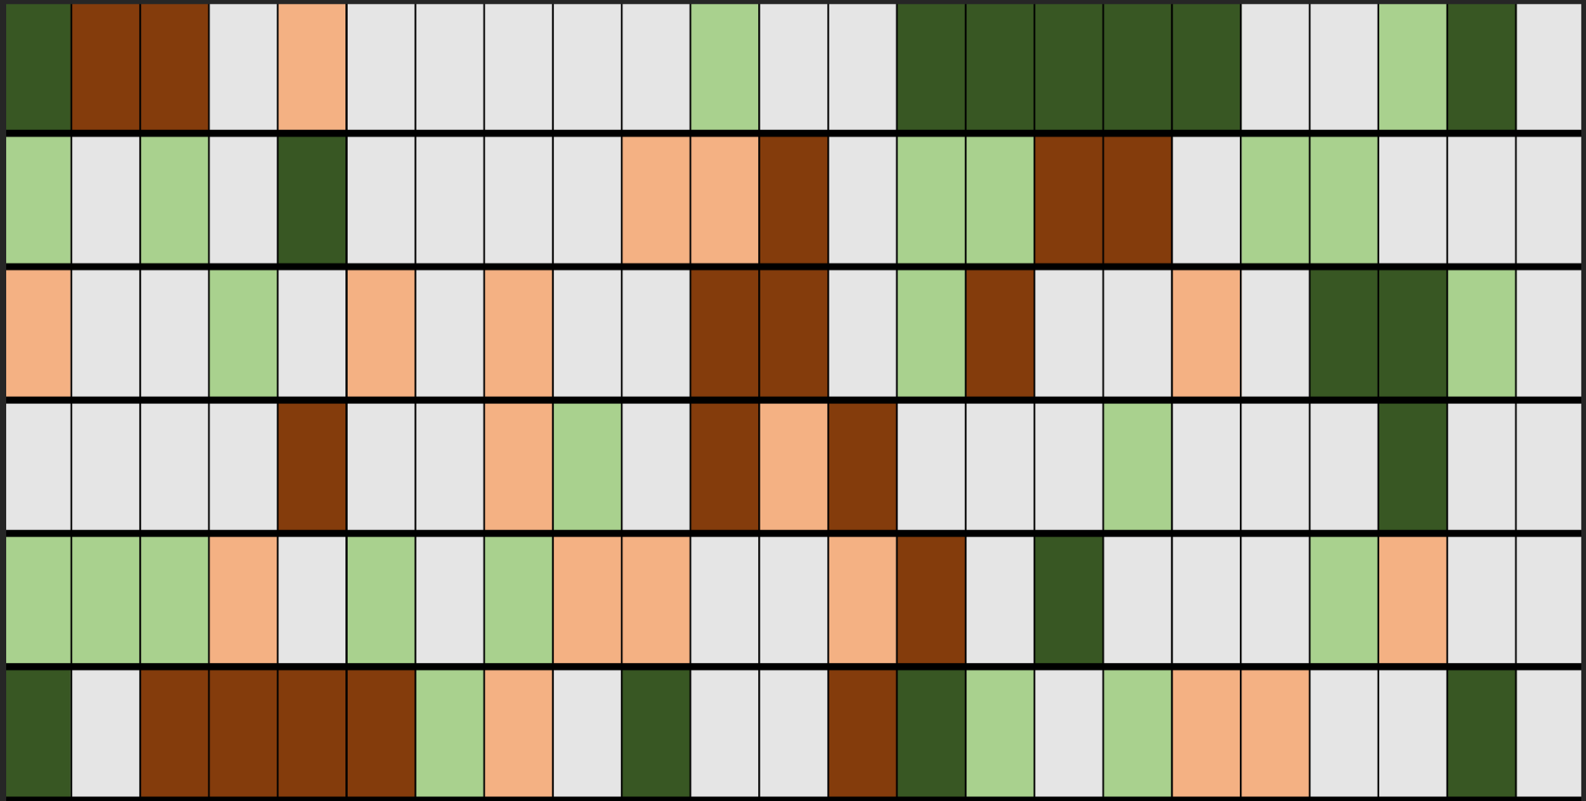
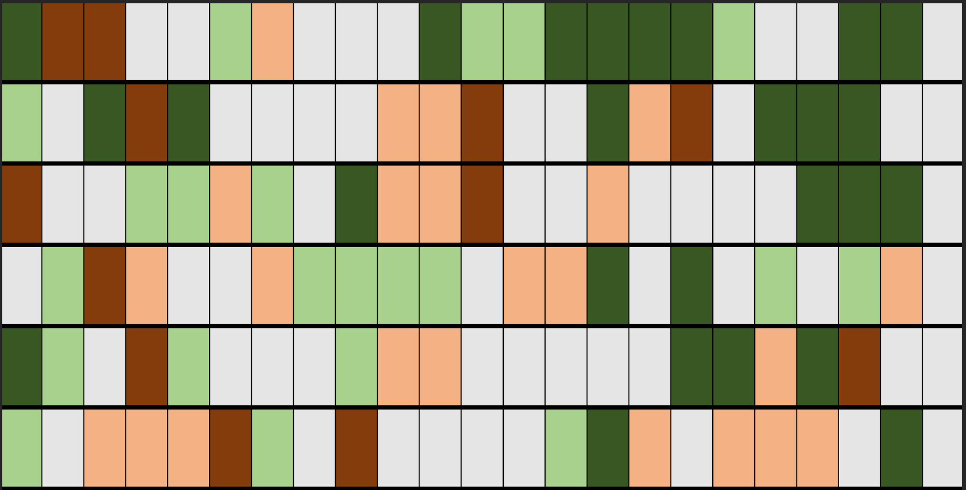
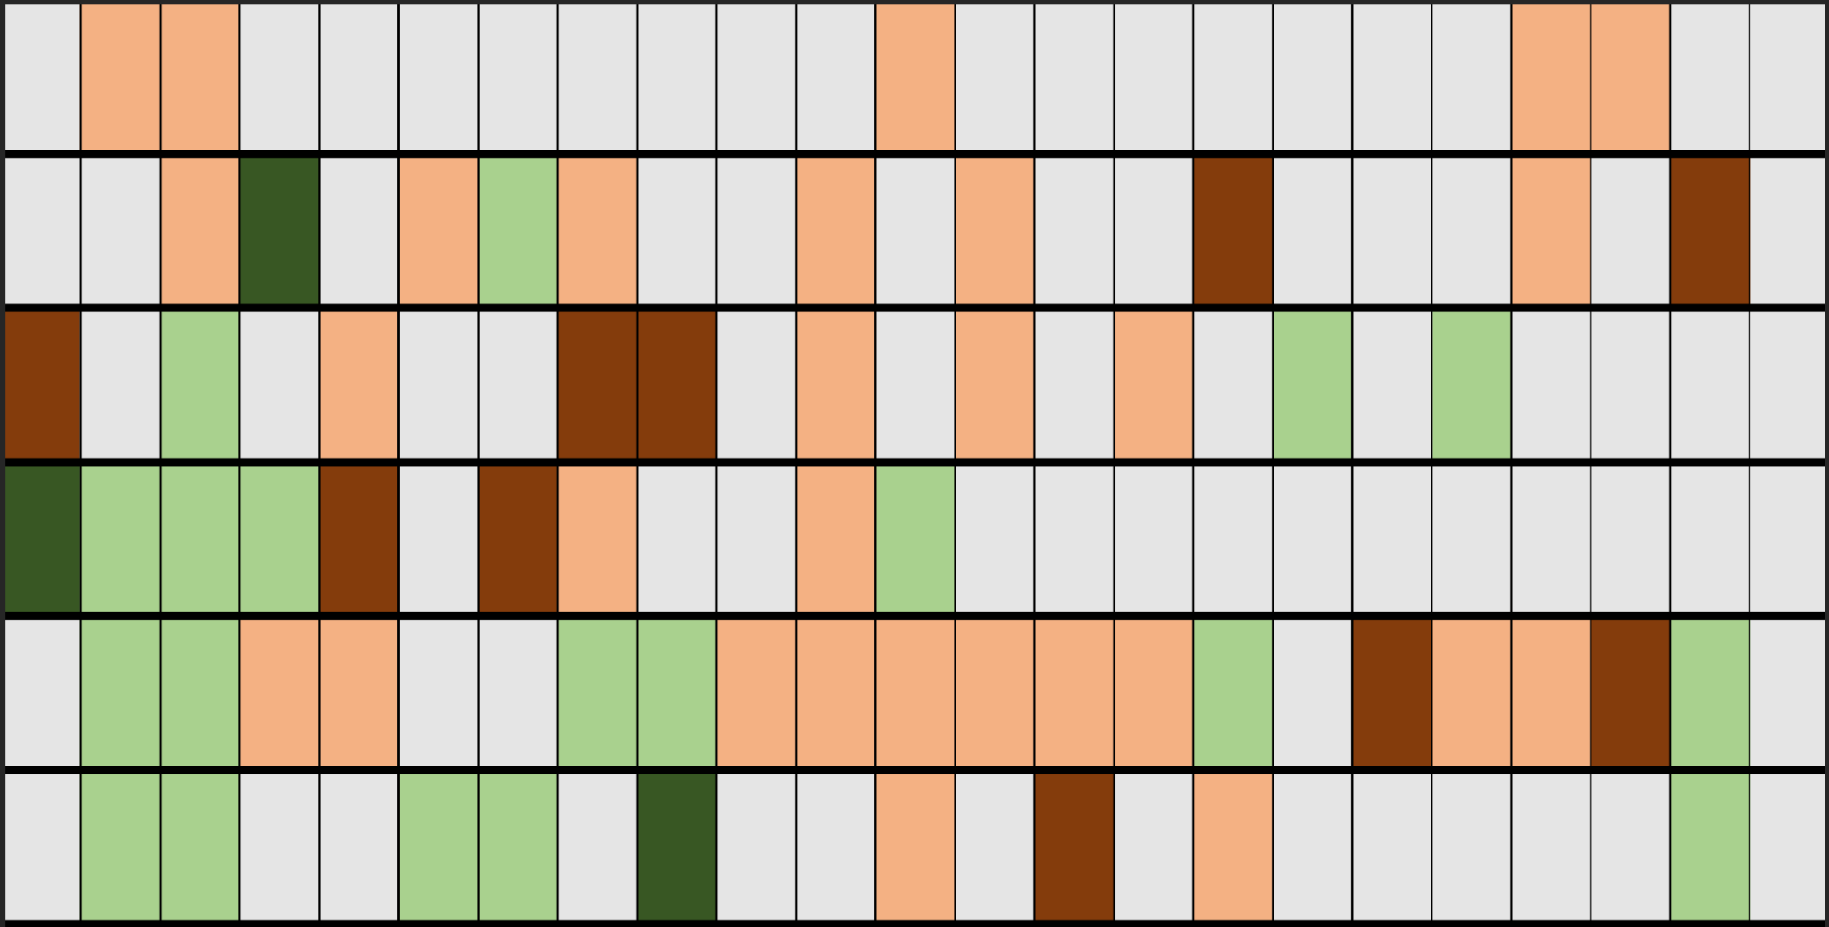
Scale-Dependent Localization
More Tuning Needed
Impacts on ALL Cycles
Impacts on NOTDR Cycles
Impacts on TDR Cycles
TRACK
VMAX
PMIN
R34
R50
R64
Post-hoc assessment reveals that impacts of SDL strongly depend on Tail-Doppler Radar (TDR) availability. This was not known during the HAFSV2 implementation!

Slide 8
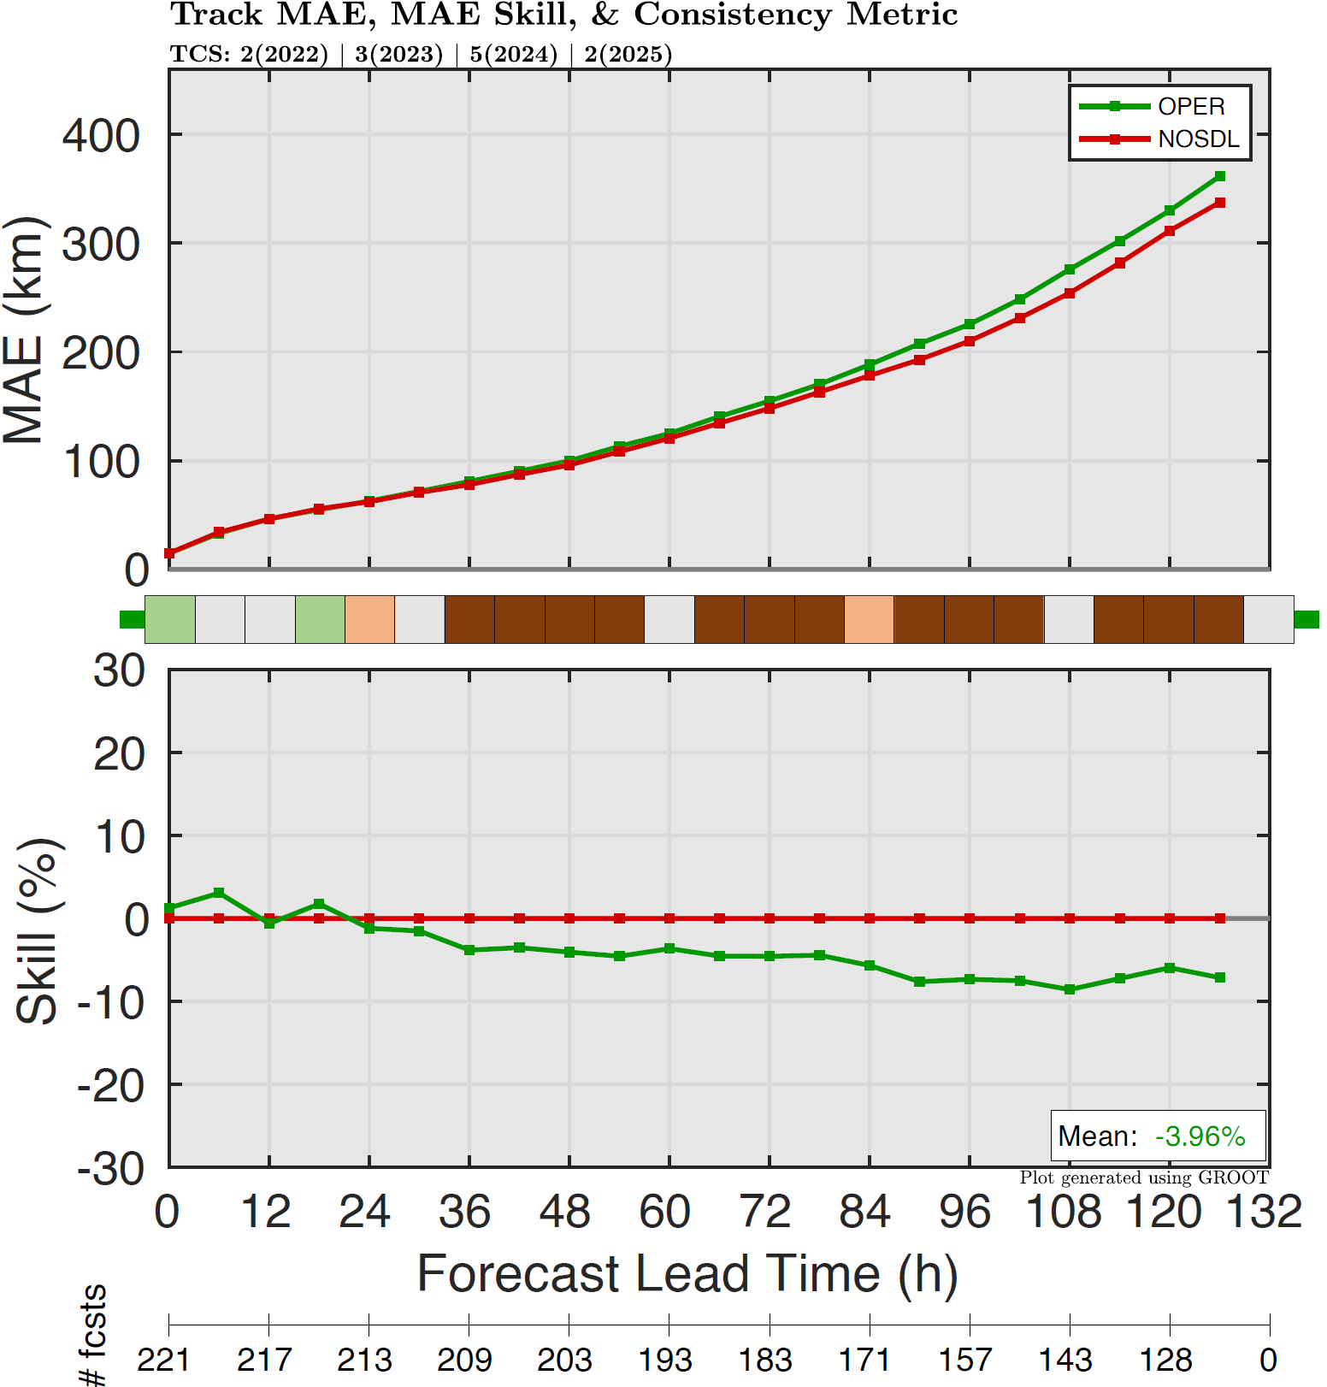
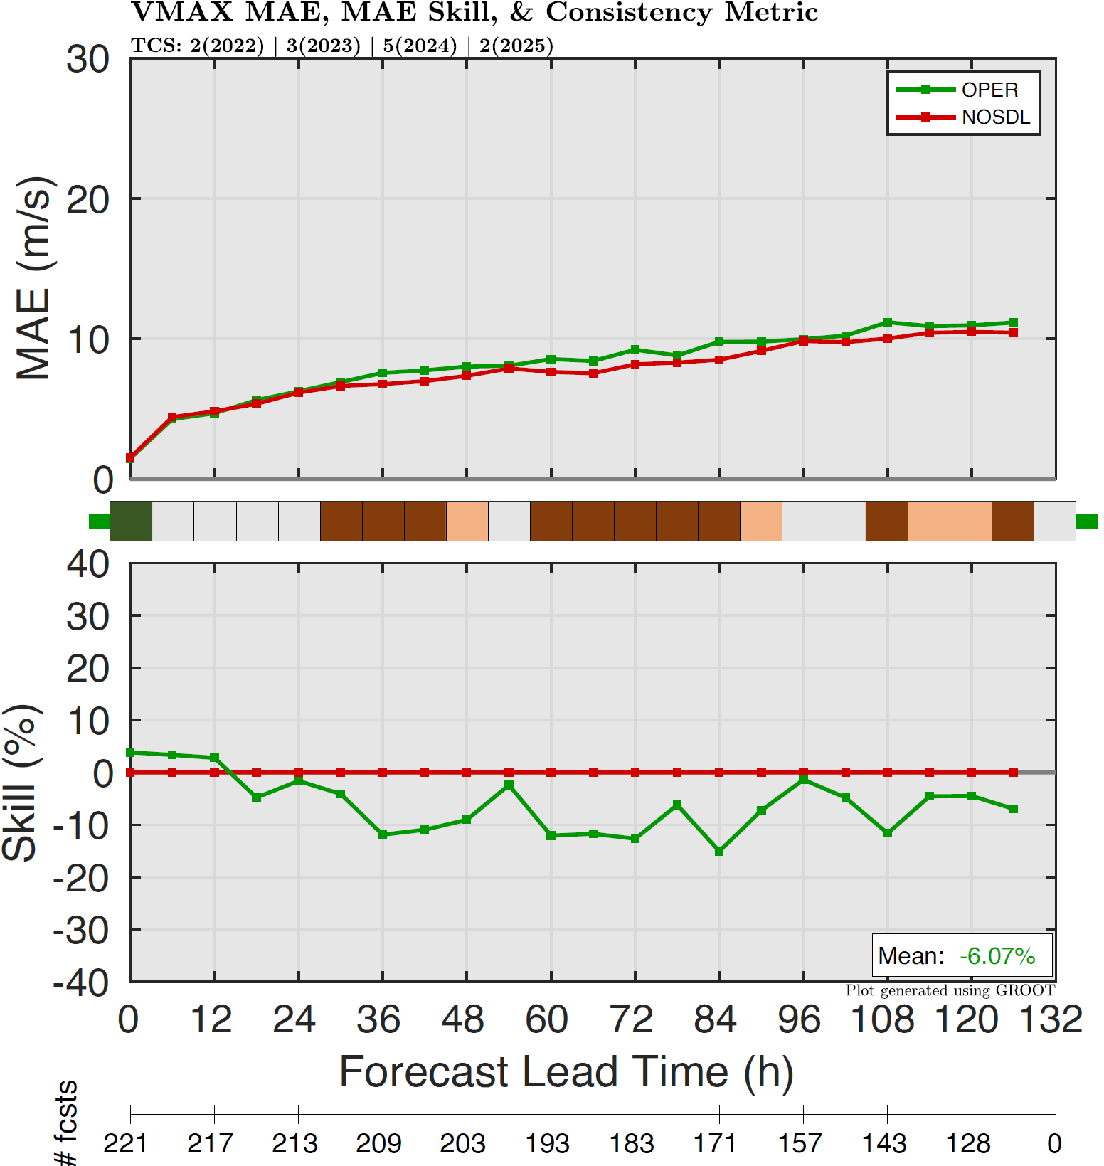
Scale-Dependent Localization
More Tuning Needed
Scope
Impact on TRACK
Impact on VMAX
Yr | NATL TCs | Cycles | Incl. Cycles
2022 | 07L (Fiona) | 39 | 12
 | 09L (Ian) | 31 | 9
2023 | 08L (Franklin) | 49 | 13
 | 10L (Idalia) | 20 | 13
 | 13L (Lee) | 43 | 43
2024 | 02L (Beryl) | 43 | 43
 | 04L (Debby) | 24 | 3
 | 05L (Ernesto) | 32 | 25
 | 14L (Milton) | 21 | 13
 | 18L (Rafael) | 24 | 12
2025 | 08L (Humberto) | 28 | 13
 | 13L (Melissa) | 42 | 22
4 Years | 12 TCs | 396 Cycles | 221 Cycles
-4% on average; up to -10%!
-6% on average; up to 15%!
SDL can SERIOUSLY DEGRADE HAFS-B forecasts
when inner-core data is available

Slide 9
Low-Hanging Fruit: New (High-RL) Obs
BLUF: Much can be still be gained from high-RL obs!
Example 1: Uncrewed Systems (UAS & UMS)
Example 2: Tail-Doppler Radar Superobs

Slide 10
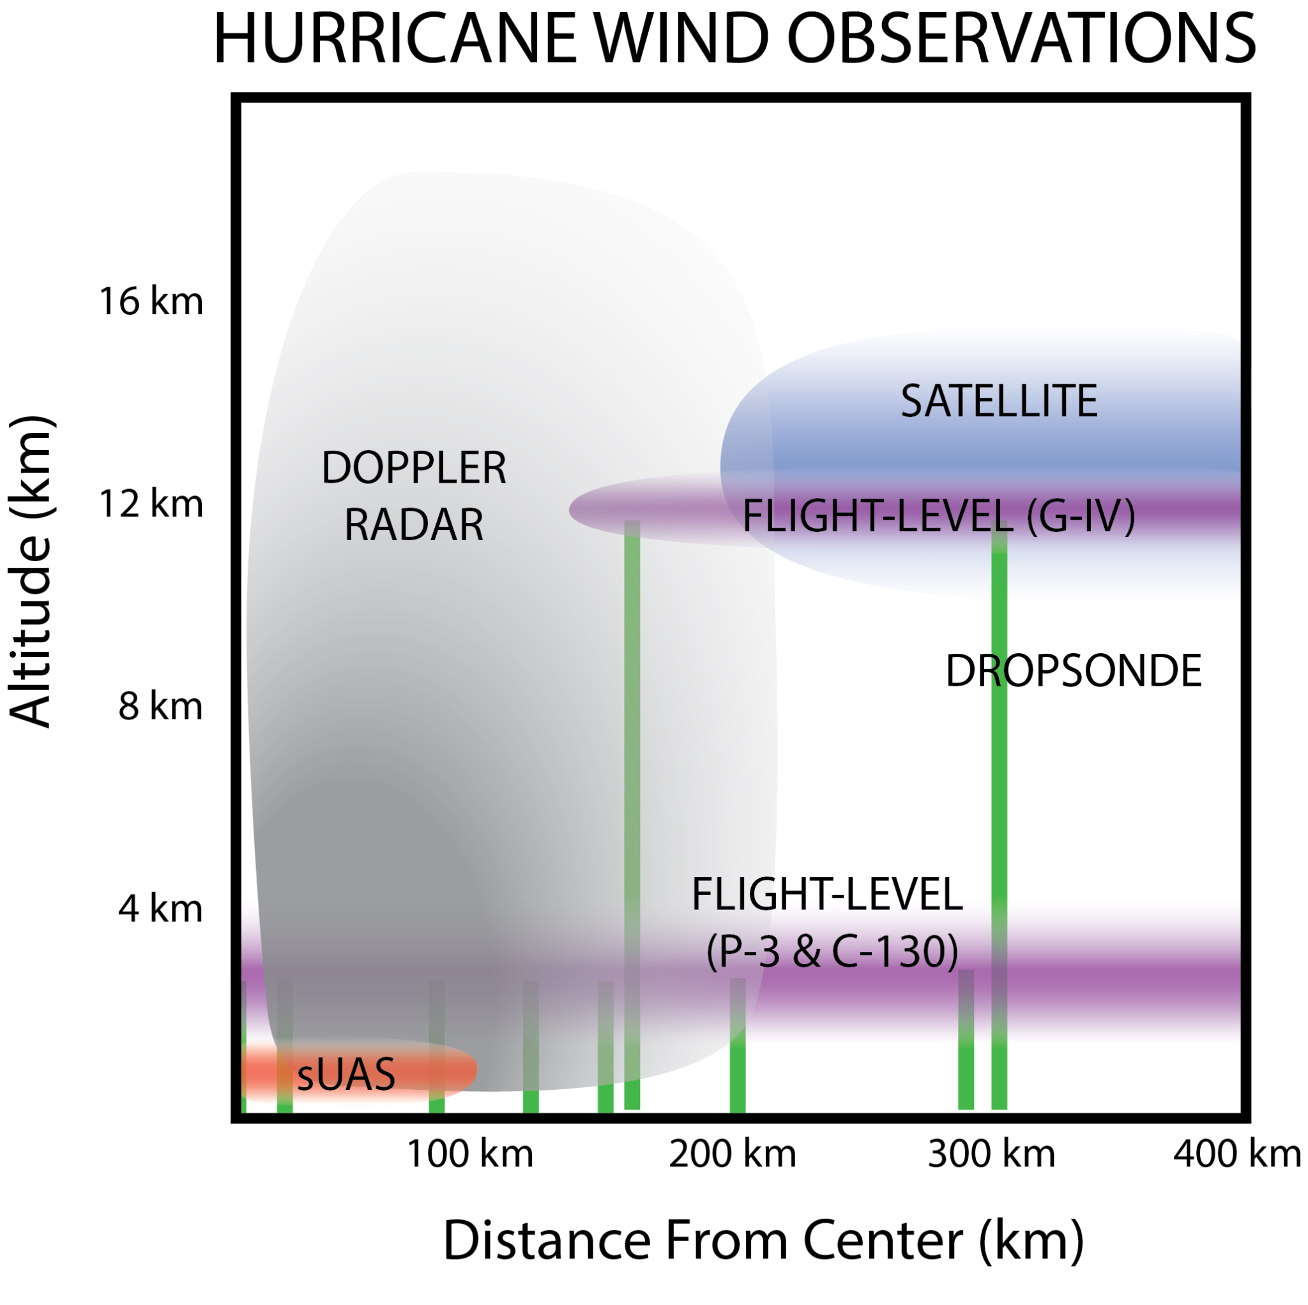
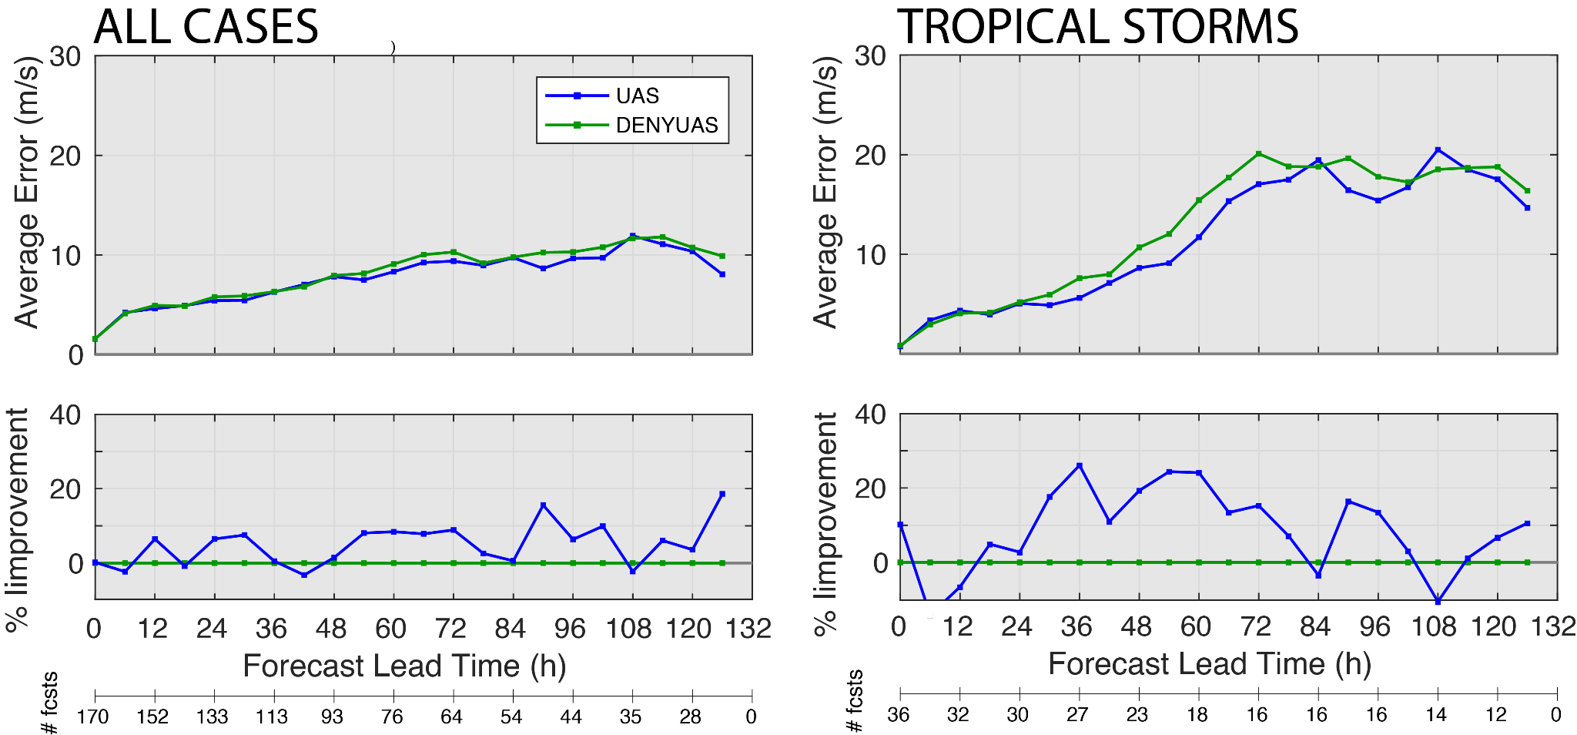
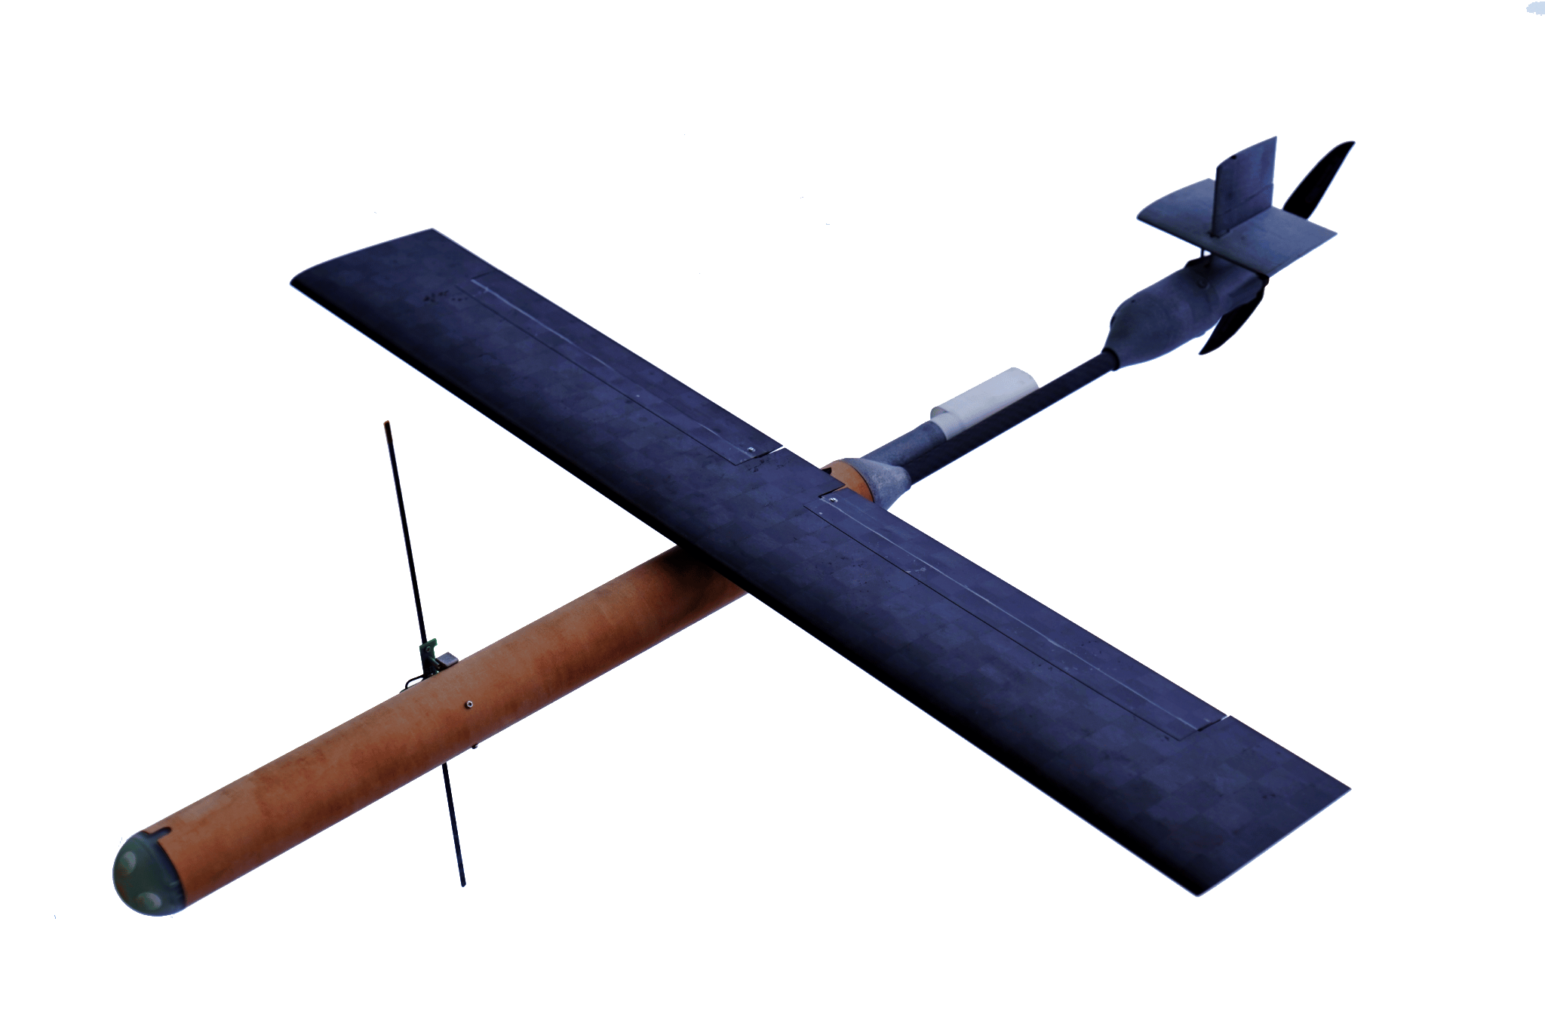
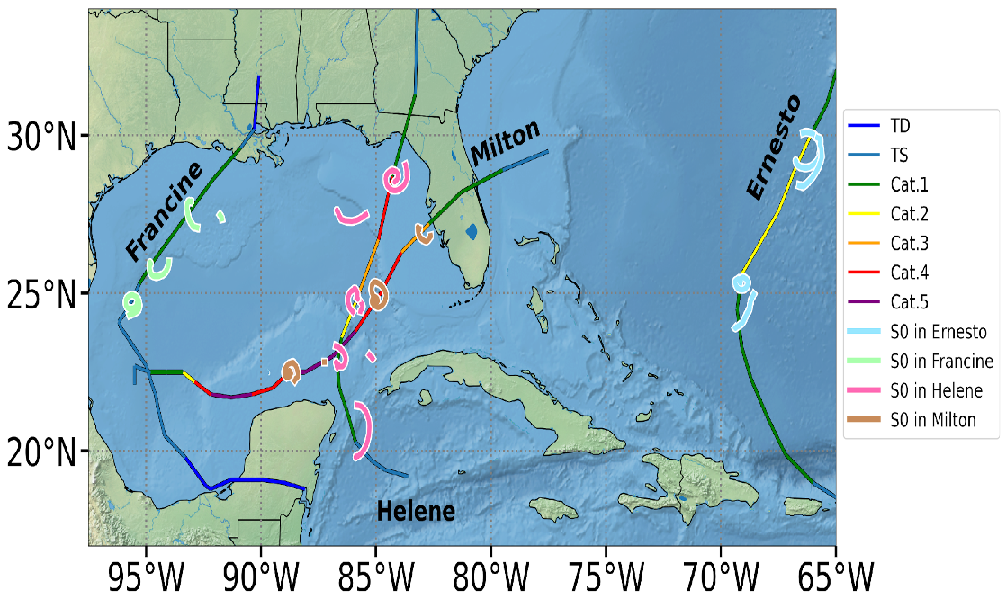
Uncrewed Aerial Systems
Transitioned in 2026
Hurricane Wind Observations
Impact of UAS HDOB on HAFSv2.2B VMAX Errors
All Cases
Tropical Storms
Black Swift Deployments in 2024

Slide 11
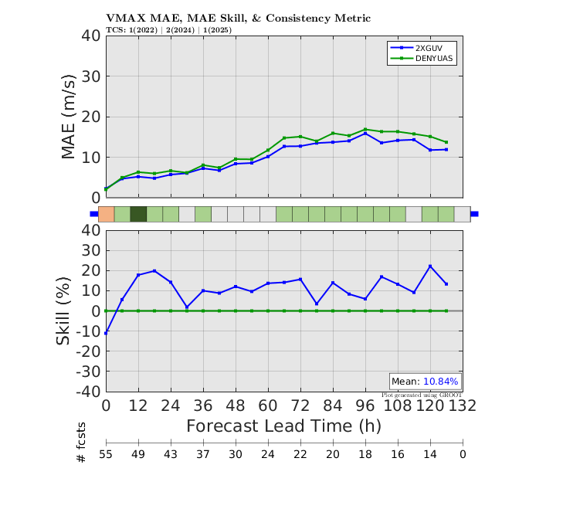
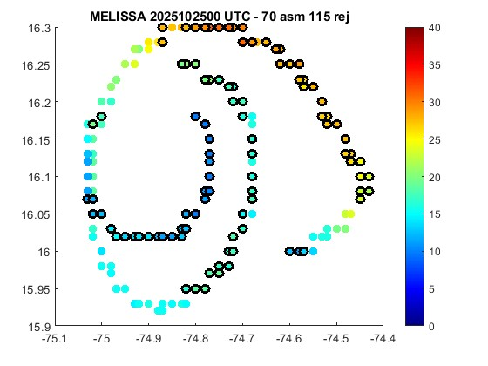
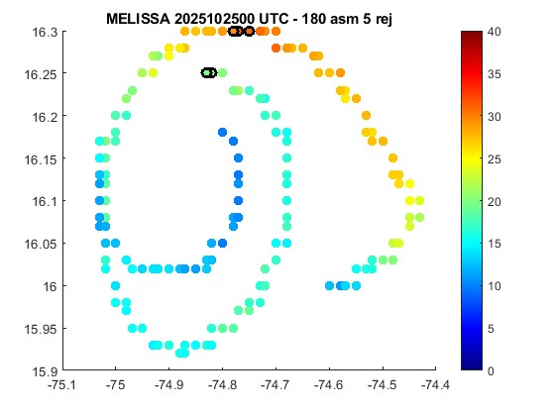

Uncrewed Aerial Systems
Rejecting Fewer Wind Observations
Standard QC
Impact on VMAX
Double UV Gross Error Ratio
Rejected UV Obs

Slide 12
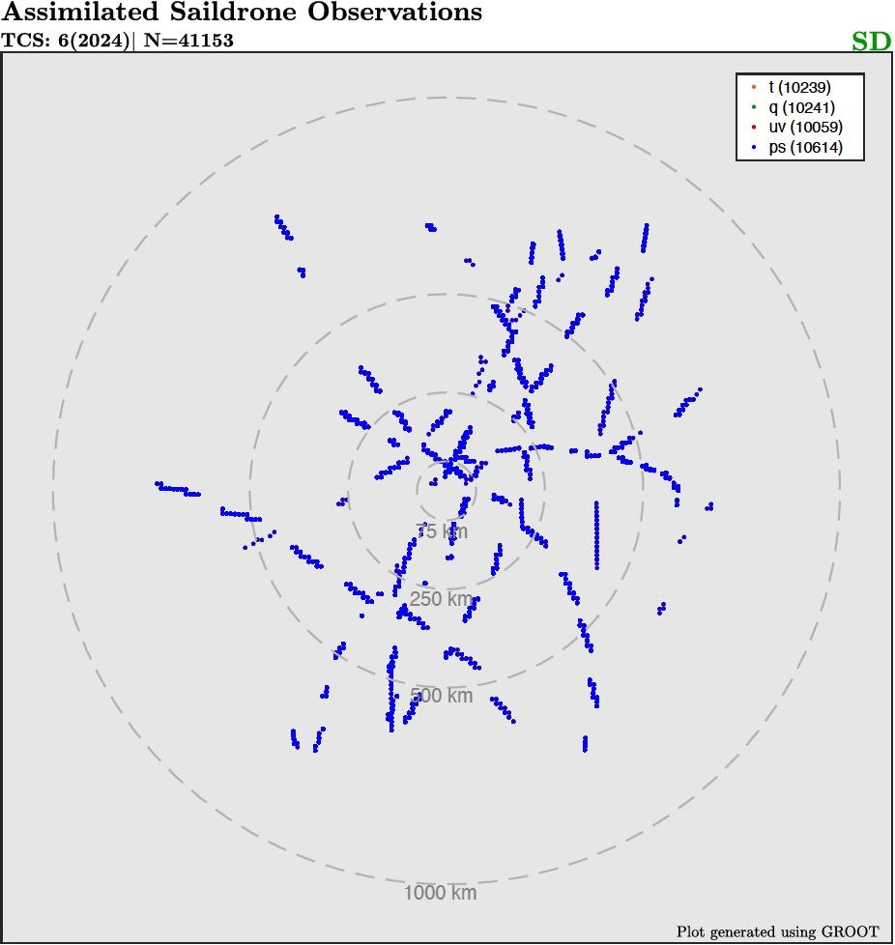
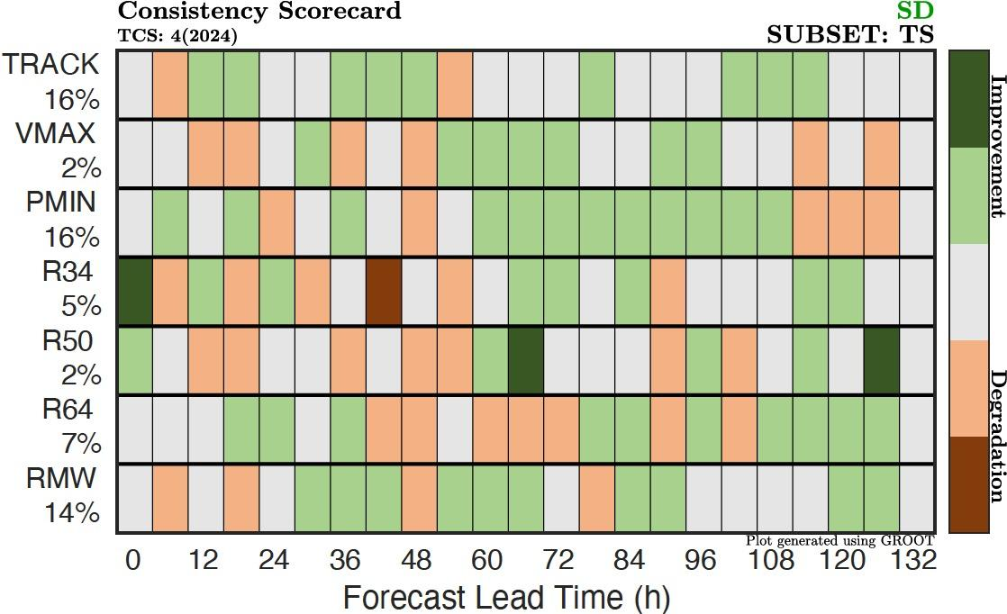
Uncrewed Marine Systems (UMS)
Assimilated Observations
UMS Impact on Tropical Storms
TRACK
VMAX
PMIN
R34
R50
R64
RMW

Slide 13
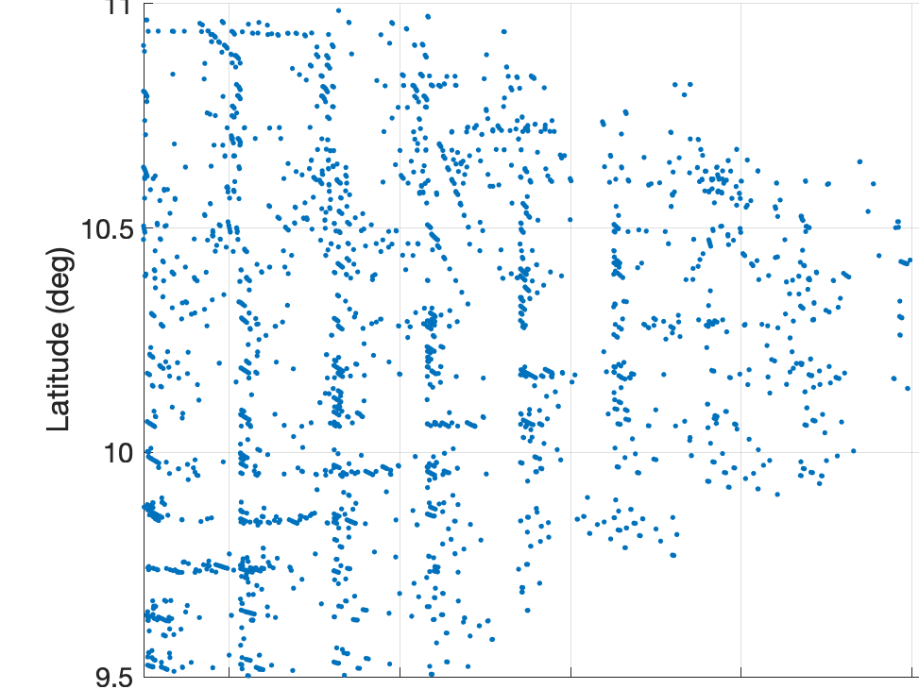
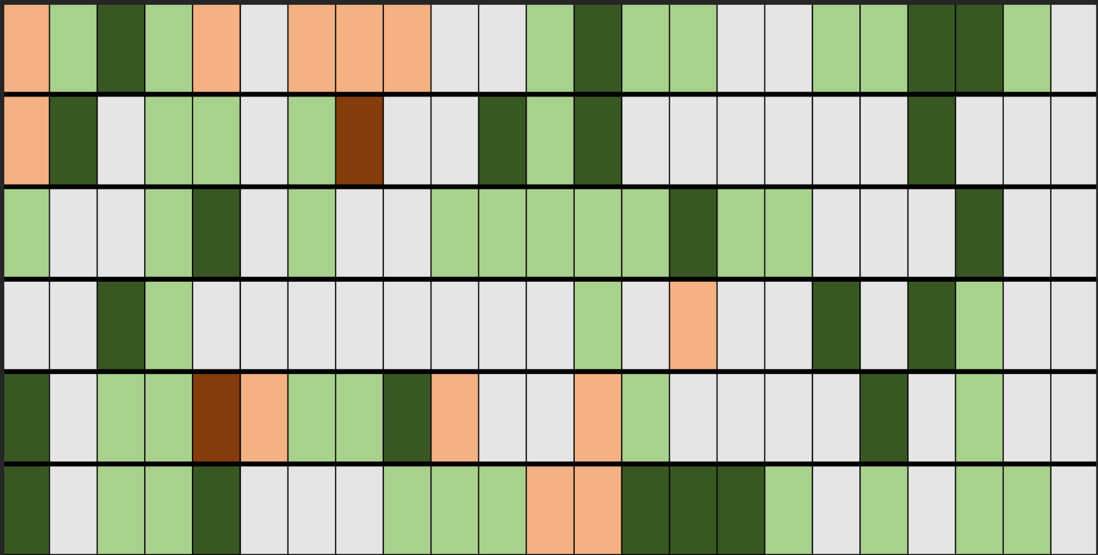
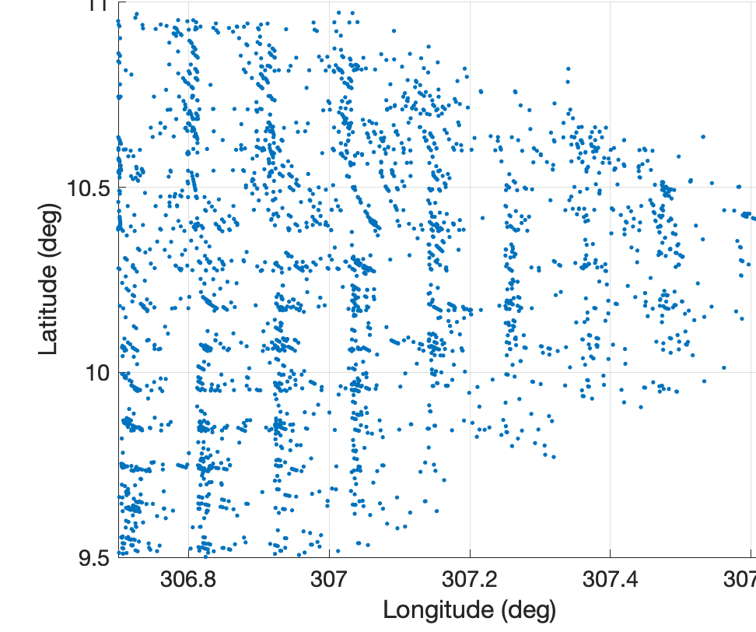
Tail-Doppler Radar Superobs
Operational Recon Data | Transitioned in 2026
Thinned
Impact on Cycles with TDR Data
TRACK
VMAX
PMIN
R34
R50
Superobbed
R64
TDR superobs fill in spatial gaps, remove outliers, and improve forecasts!

Slide 14
Middle Fruit: New (Low-RL) Obs
BLUF: We have plenty of low-RL obs left to use!
Example 1: Dropsonde Superobs
Example 2: Other experimental observations

Slide 15
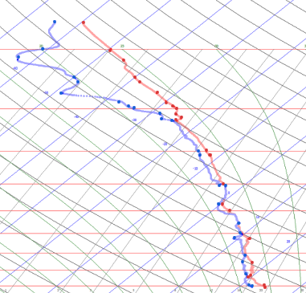
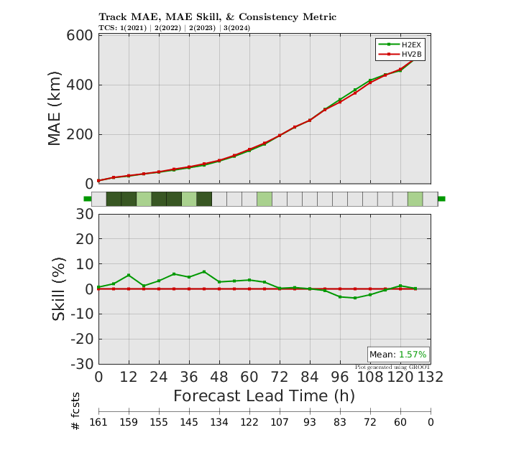
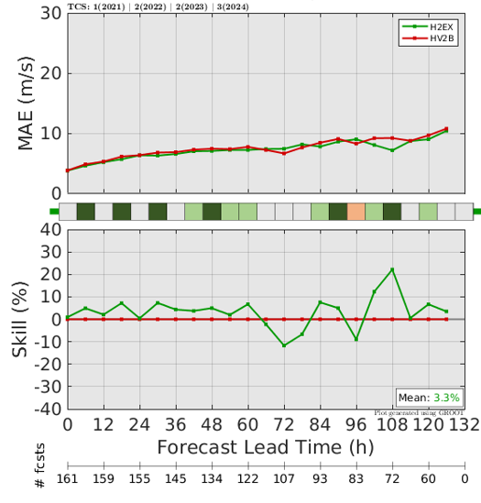
Dropsonde Superobs
Operational Recon Data
TEMPDROP vs. Actual Data
Impact on TRACK
Impact on VMAX
TEMPDROP data point
Full-resolution data
Dropsonde superobs fill in spatial gaps, remove outliers, and improve forecasts!

Slide 16
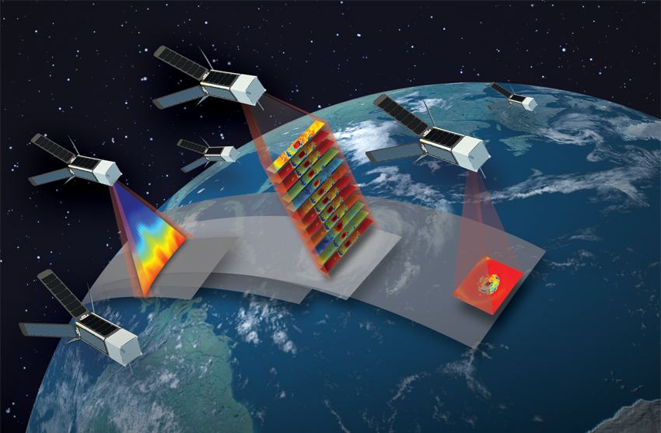
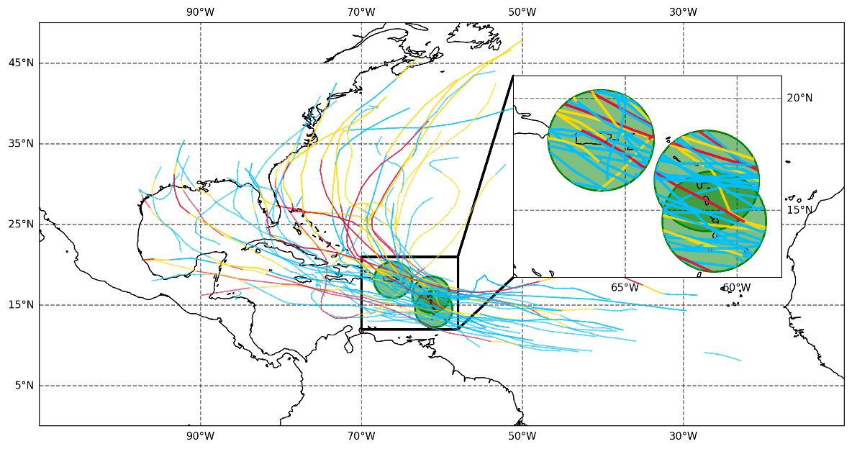
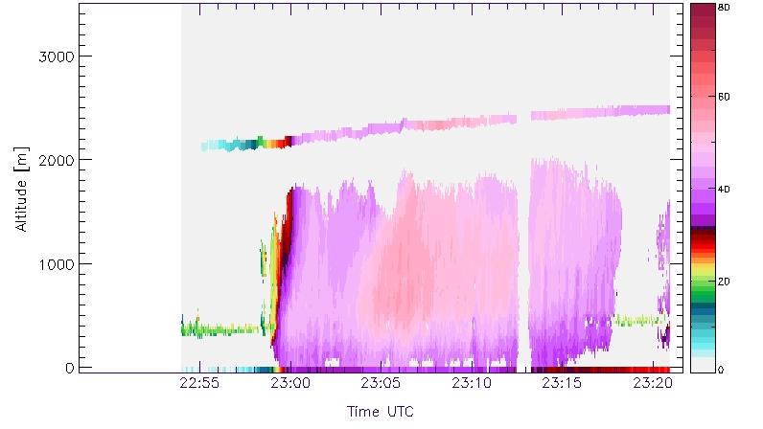
Other Experimental Observations
Recon, Ground, & Satellite
Radiances from
NASA TROPICS
Doppler Velocity from
International Ground-based Radars
Retrieved U/V from
experimental NESDIS airborne radars
Preliminary tests with other gap-filling experimental data
have also shown substantial benefits!

Slide 17
Difficult-to-Reach Fruit: New CONOPS
BLUF: High cost, high benefit developments
Example 1: JEDI Transition
Example 2: New HAFS DA Framework

Slide 18
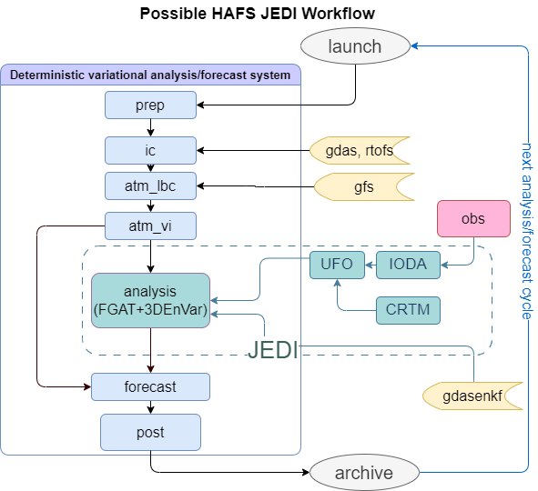
HAFS/JEDI Transition
Big-Picture Overview
Solvers & Functions Tested with HAFS:
BUMP
3D/4D EnVar
GETKF
FGAT
Observation Operator Validation:
~95-98% complete

Slide 19
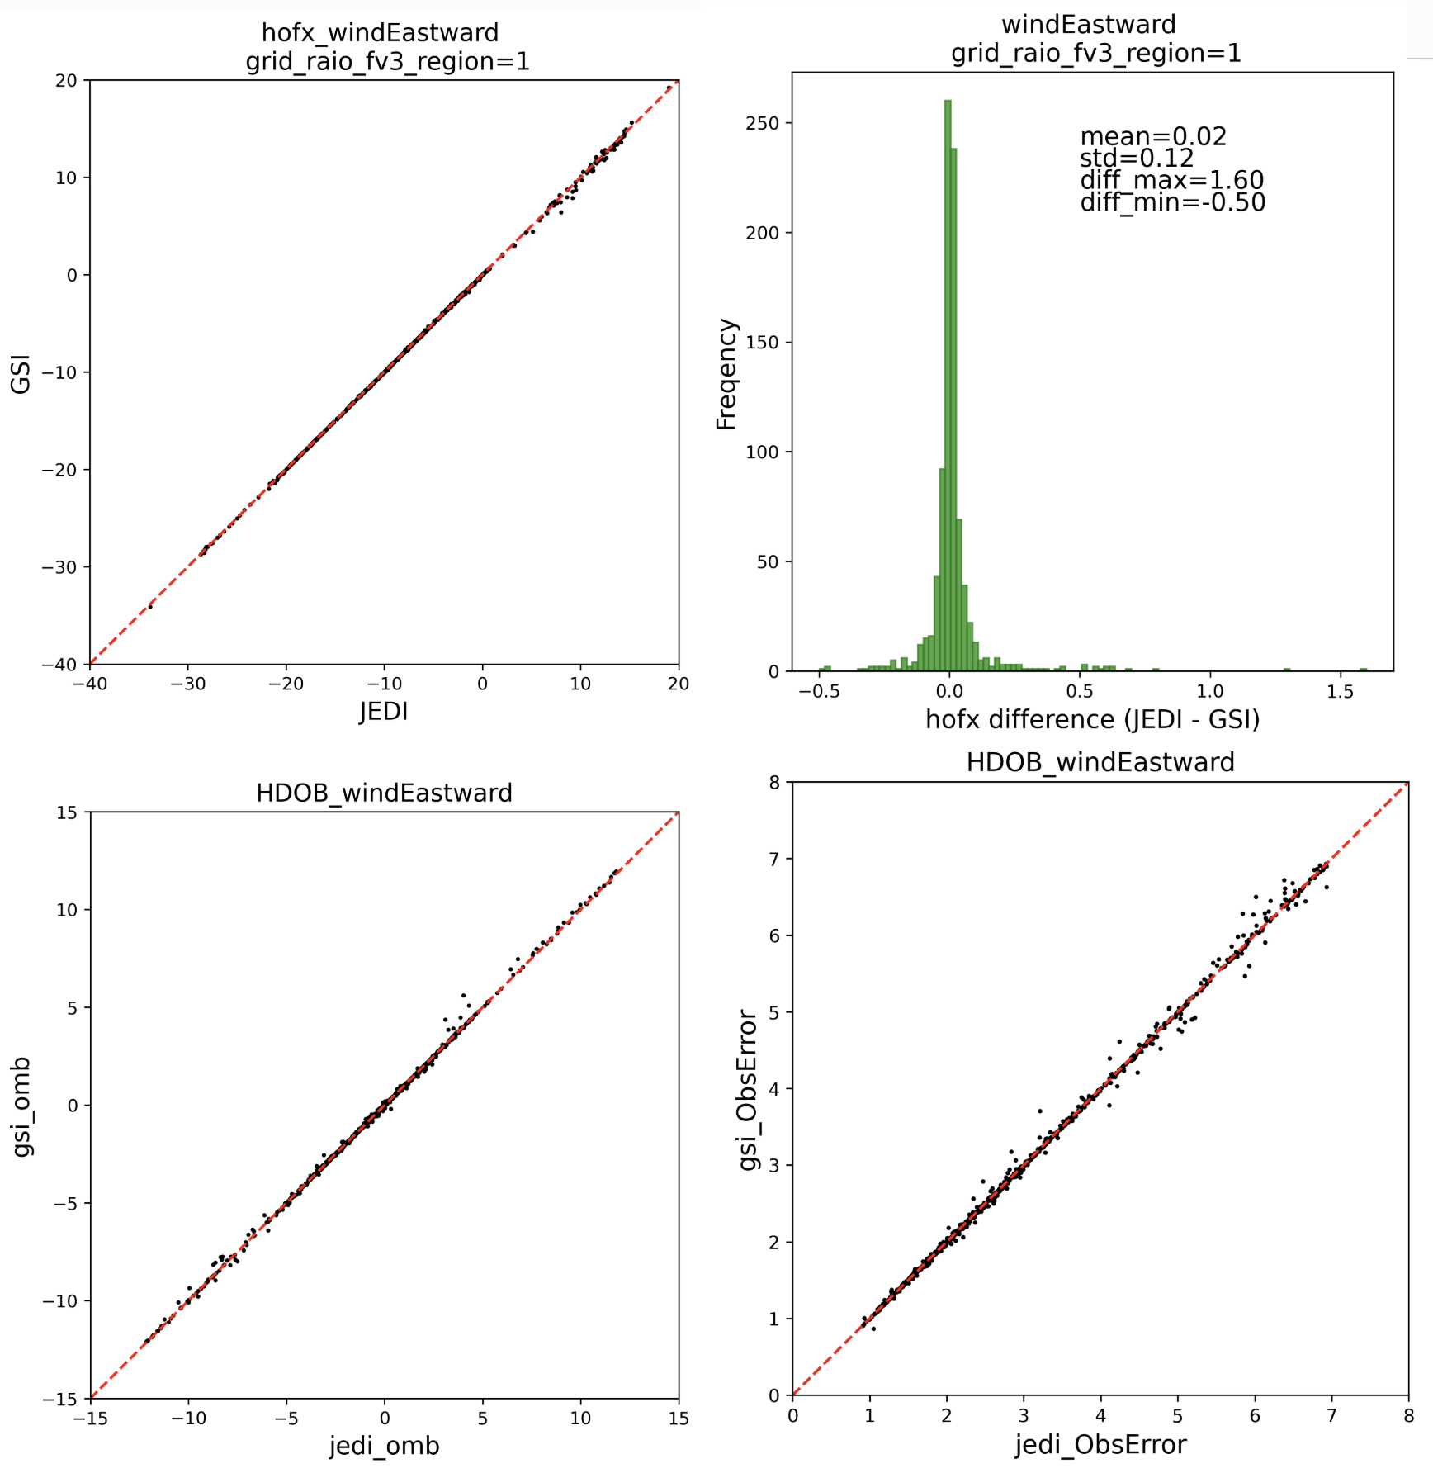
HAFS/JEDI Transition
AOML/HRD Contributions
Flight-level (HDOB) forward operators incorporated into JEDI by imitating GSI, work ongoing for SailDrone USV
Comparable performance between GSI and JEDI
HFIP real-time experiments will use JEDI

Slide 20
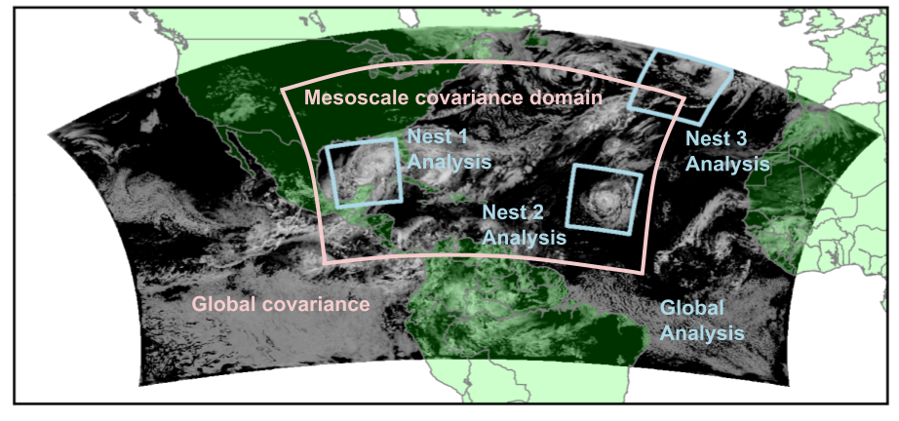
New HAFS DA Framework
Proposed Framework: Future Vision
Single-storm, global covariance ⇨ Multi-storm, mesoscale covariance

Slide 21
New HAFS DA Framework
Proposed Framework: Future Vision
New framework allows for significant advances:
  Improved inner-core background error covariance
  Online observation error assignments
  Online observation quality control
  Improved assimilation of satellite radiances

Slide 22
Summary
AOML/HRD is gathering fruit from the bottom to the top
of the hurricane DA tree
to improve TC prediction
Hurricane DA Tree

Slide 23
BONUS
Hurricane DA Tree

Slide 24
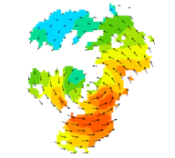
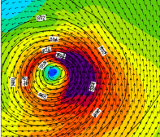
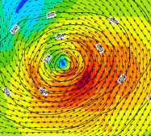
Basin-Scale JEDI-based HAFS
Proposed Framework: Improving Covariance
Observed Winds
Analysis Using
Global Covariance
Analysis Using “Hurricane” covariance

Slide 25
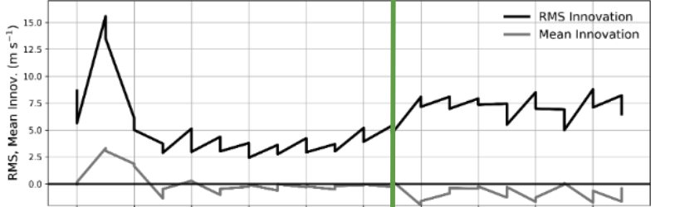
Basin-Scale JEDI-based HAFS
Proposed Framework: Automated Tuning
HDOB Wind Innovations in H. Ian
15
10
05
00
For optimal DA, the ratio:
(spread + obserr)/ innovation ~ 1
RI begins
9/24
9/25
9/26
9/27
9/28

Slide 26
Basin-Scale JEDI-based HAFS
Proposed Framework: Automated Tuning
HDOB Wind Innovations in H. Ian
15
10
05
00
Innovations (obs-minus-background) are much larger once RI begins
RI begins
9/24
9/24
9/25
9/25
9/26
9/26
9/27
9/27
9/28
9/28

Slide 27
Basin-Scale JEDI-based HAFS
Proposed Framework: Automated Tuning
HDOB Wind Innovations in H. Ian
15
10
05
00
Optimality can only be maintained by doubling observation error during & after RI
RI begins
Actual/Optimal Spread
2
1
0
9/24
9/25
9/26
9/27
9/28

Slide 28
HAFS/JEDI Transition
Big-Picture Overview
Tested JEDI functions with HAFS model interface:
  BUMP, 3DEnVar, 4DEnVar, FGAT, GETKF
Observation Operator Validation:
  SATWND, SFCSHP, SURFACE, SONDE, MSONET, Dropsonde, VADWND, HDOB, GPSRO;
  ATMS, MHS, AMSUA, CRIS, IASI, SSMIS, ABI;
  NEXRAD, TDR
Background Covariance options:
  40 members HAFS cold-started ensemble
  80 members GDAS ensemble
  40 members self-cycled HAFS ensemble
Localization options:
  Scale-dependent Localization

