Slide 1
Application targeted configuration of the ocean component in the UFS framework towards seamless predictions.
Presented by:
Santha Akella from the Modeling Division (MD), Office of Modeling and Development.
With acknowledgments to:
[Guidance] Fanglin Yang, Vijay Tallapragada
[Tech/science support] Jiande Wang, Denise Worthen
[Discussions] Neil Barton, Phil Pegion

Slide 2

What’s this Talk about? (Background Info)
The Office of Modeling and Development (OMD) modeling suite includes following coupled models* with ocean and sea ice:
Coupled Model
Implementation Target
Global Forecast System (GFS)
v17 implementation in FY2027.
Seasonal Forecast System (SFS)
v1 implementation in FY27- 28.
Hurricane Analysis and Forecast System (HAFS)
v2.2 implementation FY26.
Global Ensemble Forecast System (GEFS)
v13 implementation in TBD.
Here, I will focus on the GFS and SFS only.
*Physics based models, excluding ML models.

Slide 3
What’s this Talk about? (Topics covered)
1. Component Configuration
Ocean (MOM6)
MOM_input
Mediator (CMEPS)
Ufs.configure
Both GFS and SFS - use the same configuration of MOM6, i.e., resolution (¼-deg) based.
2. Model Initialization
Coupling "shock": Manifested from data assimilation for different components and/or choices of sources for initial conditions.
Ocean surface variables: Investigate behavior in the first few days of a forecast.
*Deliberately excluding sub-surface.
*Limiting to SST and surface currents/speed in the North Atlantic/Gulf Stream.

Slide 4
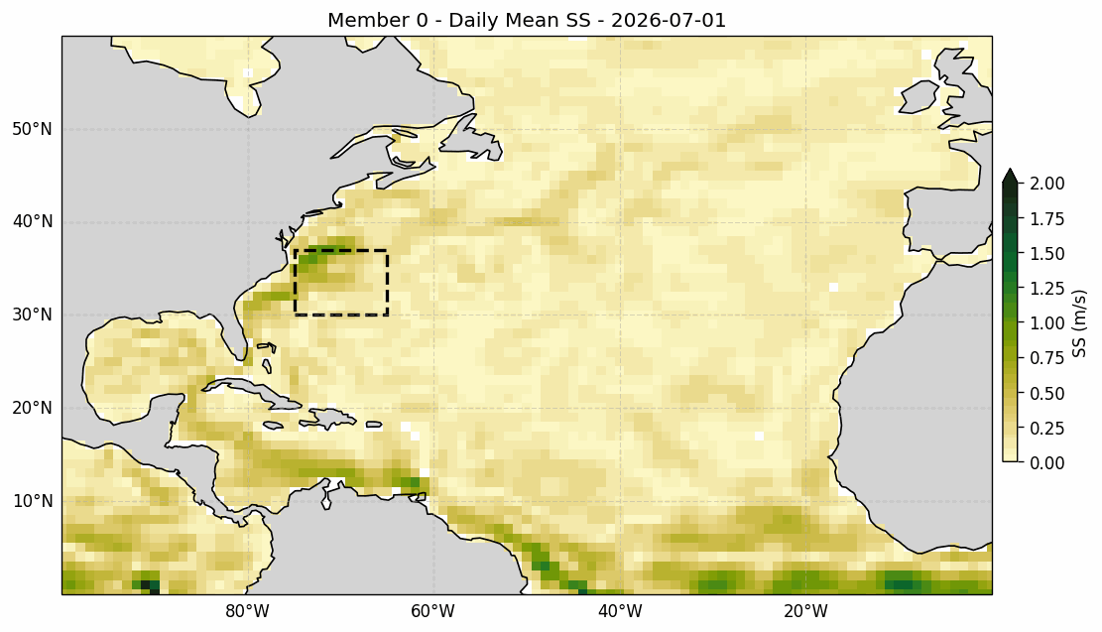
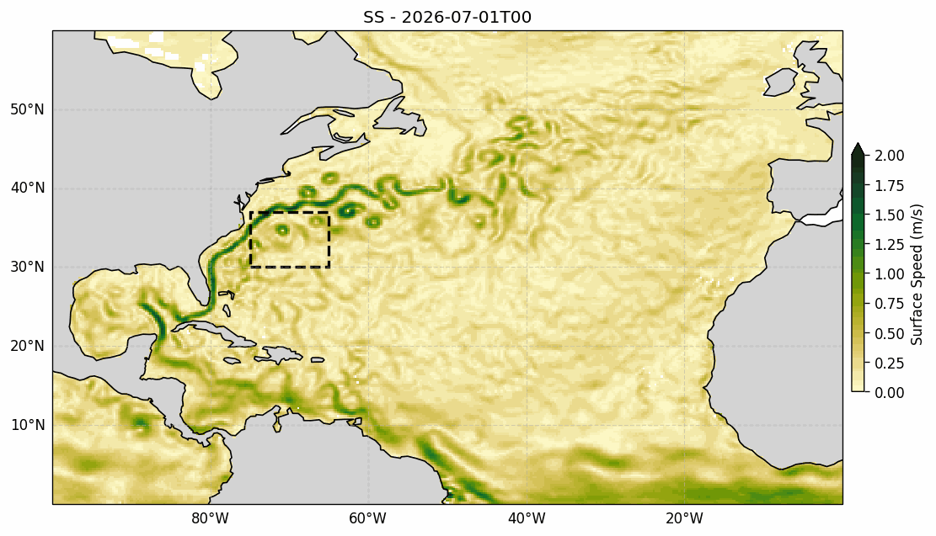
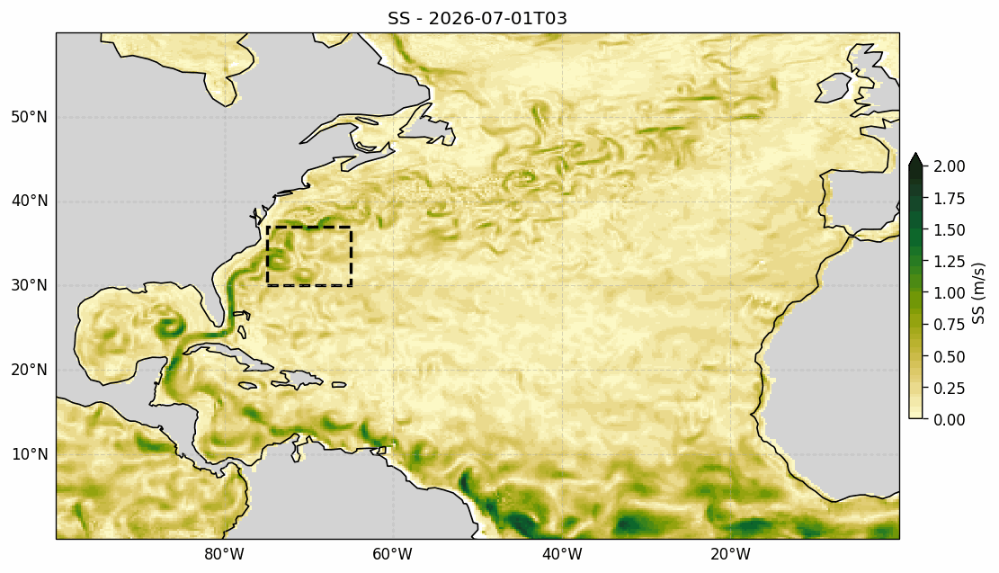
Data Analysis
Use the most recent (Jul 1, 2026) SFS forecast and compare it to that from GFS v17.
Include level-4 satellite data products (OSTIA SST and GlobCurrent from the Copernicus Marine Service) for reference.
Surface current/speed in the North Atlantic; Gulf Stream detachment region in “box”.
SFS v1
GlobCurrent
GFS v17
The SFS forecast:
  Initialized using GLORe (1-deg resolution) ocean and sea ice.
  Spin-up: >= 30-days.
  Operational version will be initialized from ¼-deg model run.
The GFS forecast, can be improved:
    Gulf Stream detachment.
    Loop Current.
Why should we care to have an accurate representation of the Gulf Stream? Impacts weather at different time- and length-scales.
Notes:
Atm: CORe, land: offline forced with CORe

Slide 5
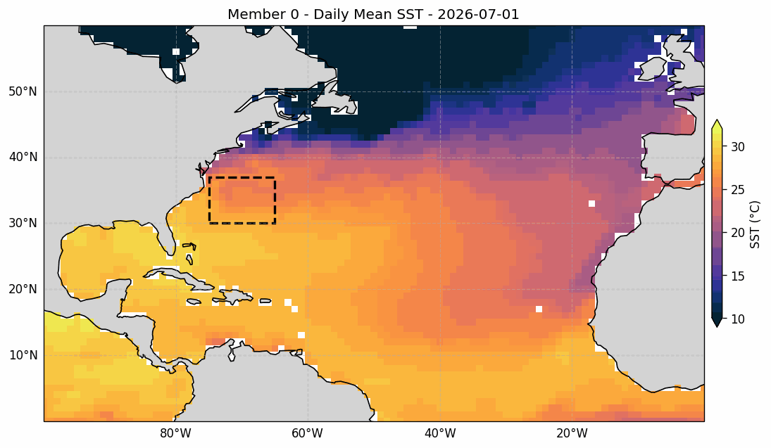
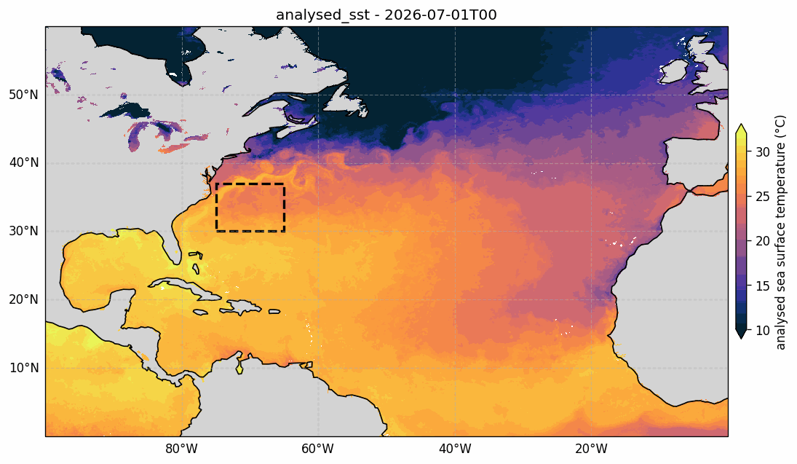
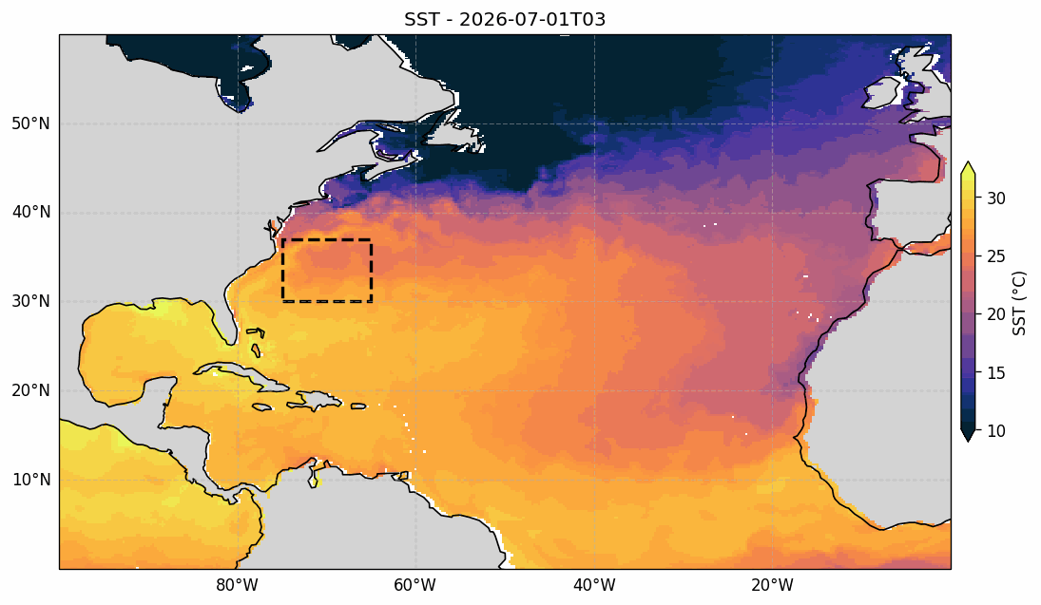
Data Analysis
(Same as before, but for the SST)
SFS v1
OSTIA SST
GFS v17
SST dynamics is tightly controlled by air-sea fluxes:
  (Suggest) Bulk flux calculation in the mediator.
Application specific configuration and tuning:
  Of the MOM6 parameterizations for mixing, viscosities, etc.
  Is a possibly pathway for improvements.
  Of the bulk flux formulae (e.g., drag coefficients).
Notes:
Atm: CORe, land: offline forced with CORe

Slide 6
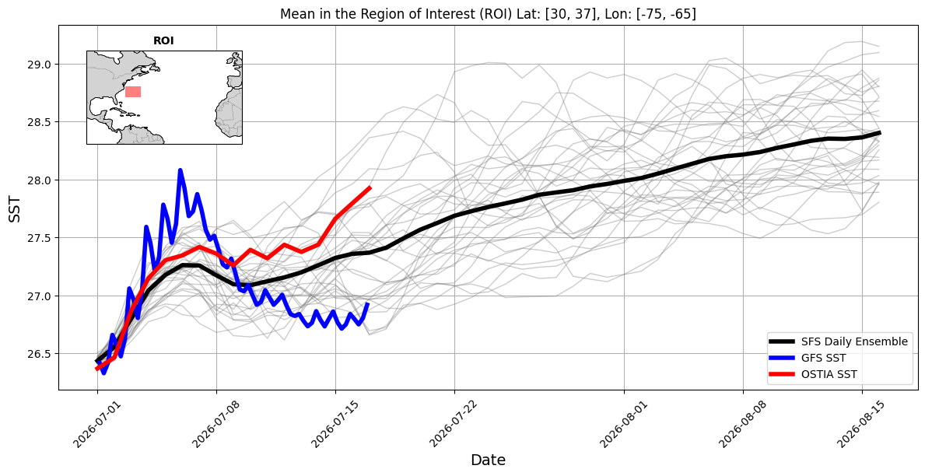
Data Analysis - Gulf Stream detachment
Shows:
Model bias.
Spread of the ensemble: too much?

Slide 7
Summary and suggested path forward
Two OMD coupled forecast applications: GFSv17 and SFSv1 can be further improved.
  By an application specific tuning of components.
  Instead of resolution specific configuration of components.
Investigate initialization and spin-up with the operational version of the SFS (based on ¼-deg ocean). Conduct a comparative analysis of:
  Relaxation/Nudging of ocean fields.
  Replay to an ocean (re-)analysis.
Questions?

Slide 8
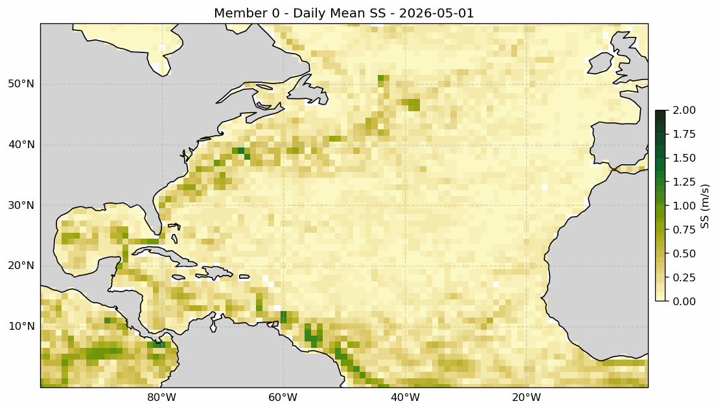
SFS v1
Phil: Initialized from replay toGFSv17
Same as in slide 4

